Slide 1
Chapter 15 Dynamic Memory Allocation
ASHWIN ASHOK
CSC 3320 SYSTEM LEVEL PROGRAMMING
SPRING 2021
Notes:
http://www.cs.utoronto.ca/~krueger/csc209h/lectures/

Slide 2
Dynamic Storage Allocation
C’s data structures, including arrays, are normally fixed in size.
Fixed-size data structures can be a problem, since we’re forced to choose their sizes when writing a program.
Fortunately, C supports dynamic storage allocation: the ability to allocate storage during program execution.
Using dynamic storage allocation, we can design data structures that grow (and shrink) as needed.

Slide 3
Memory Allocation Functions
Dynamic storage allocation is used most often for strings, arrays, and structures.
The <stdlib.h> header declares three memory allocation functions:
malloc—Allocates a block of memory but doesn’t initialize it.
calloc—Allocates a block of memory and clears it.
realloc—Resizes a previously allocated block of memory.
These functions return a value of type void * (a “generic” pointer).

Slide 4
Null Pointers
An example of testing malloc’s return value:
p = malloc(10000);
if (p == NULL) {
/* allocation failed; take appropriate action */
}
NULL is a macro (defined in various library headers) that represents the null pointer.
Some programmers combine the call of malloc with the NULL test:
if ((p = malloc(10000)) == NULL) {
/* allocation failed; take appropriate action */
}

Slide 5
Using malloc to Allocate Memory for a String
Prototype for the malloc function:
void *malloc(size_t size);
malloc allocates a block of size bytes and returns a pointer to it.
size_t is an unsigned integer type defined in the library.

Slide 6
Using malloc to Allocate Memory for a String
A call of malloc that allocates memory for a string of n characters:
p = malloc(n + 1);
p is a char * variable.
Each character requires one byte of memory; adding 1 to n leaves room for the null character.
Some programmers prefer to cast malloc’s return value, although the cast is not required:
p = (char *) malloc(n + 1);

Slide 7
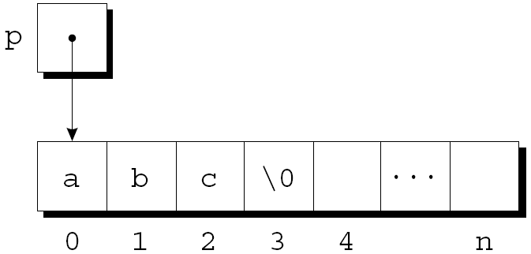
Using malloc to Allocate Memory for a String
Calling strcpy is one way to initialize this array:
strcpy(p, "abc");
The first four characters in the array will now be a, b, c, and \0:

Slide 8
Using malloc to Allocate Storage for an Array
Suppose a program needs an array of n integers, where n is computed during program execution.
We’ll first declare a pointer variable:
int *a;
Once the value of n is known, the program can call malloc to allocate space for the array:
a = malloc(n * sizeof(int));
Always use the sizeof operator to calculate the amount of space required for each element.

Slide 9
Example
struct rec
{
int a;
char LastName[41];
char FirstName[41];
};
struct rec *r;
r = (struct rec *) malloc(sizeof(struct rec));

Slide 10
Deallocating Storage
malloc and the other memory allocation functions obtain memory blocks from a storage pool known as the heap.
Calling these functions too often—or asking them for large blocks of memory—can exhaust the heap, causing the functions to return a null pointer.
To make matters worse, a program may allocate blocks of memory and then lose track of them, thereby wasting space.

Slide 11
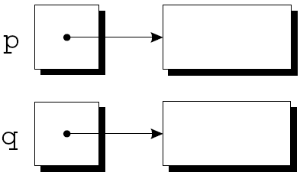
Deallocating Storage
Example:
p = malloc(…);
q = malloc(…);
p = q;
A snapshot after the first two statements have been executed:

Slide 12
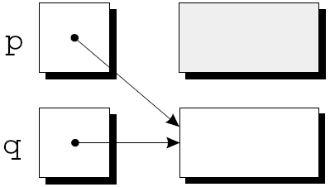
Deallocating Storage
After q is assigned to p, both variables now point to the second memory block:
There are no pointers to the first block, so we’ll never be able to use it again.

Slide 13
Deallocating Storage
A block of memory that’s no longer accessible to a program is said to be garbage.
A program that leaves garbage behind has a memory leak.
Some languages provide a garbage collector that automatically locates and recycles garbage, but C doesn’t.
Instead, each C program is responsible for recycling its own garbage by calling the free function to release unneeded memory.

Slide 14
Deallocating Storage
Memory allocated with malloc must be released after you are done with them.
this memory is released by calling the function free().
free expects as an argument the pointer returned by malloc.
free( r );

Slide 15
Example
char *p = malloc(4);
…
free(p);
…
strcpy(p, “abc”); // WRONG

Slide 16
Practice
Write a C program named as getMostFreq.c
Takes input text file as arguments
Outputs the most frequent letter (ignoring cases) and displays how many times that letter appears.
If the text file does not exist, print out an error message to the terminal.
$cat test.txt
This is a list of courses.
CSC 1010 - COMPUTERS & APPLICATIONS
$./getMostFreq test.txt
Most frequent letter is 's', it appeared 8 times
$./getMostFreq NotExist.txt
Error: file not exist.

Slide 17
Practice
How to manage a file?
How to get arguments from command line?
Count the frequency of each letter(ignoring the cases)?

Slide 18
Practice
How to manage a file?
Open -> Read or Write -> Close
E.g.
open a text file for reading
FILE *fp;
fp = fopen("test.txt", ”r");
read up to n-1 characters from the input stream referenced by file pointer
char buff[255];//n=255
fgets(buff, 255, (FILE*)fp);
printf("%s\n", buff );
Notes:
If a read has been successful, fgets returns the pointer to the buffer that you passed to it (i.e. string in your example). If the End-of-File is encountered and no characters have been read, fgets returns NULL.

Slide 19
Practice
Write the stream to the output stream referenced by file pointer
fputs("test.txt", fp);
Close a file
fclose(fp);

Slide 20
Practice
How to obtain the arguments from command line?
E.g.
#include <stdio.h>
int main( int argc, char *argv[] ) {
printf("Program name %s\n", argv[0]);
if( argc == 2 ) {
printf("The argument supplied is %s\n", argv[1]);
}
else if( argc > 2 ) {
printf("Too many arguments supplied.\n");
}
}

Slide 21
Practice
How to count the frequency of each letter while ignoring cases?
int count[26]={0};
…
c=buff[i];
if(c<=‘z’&& c>=‘a’)
count[c-’a’]++;
else if(c<=‘Z’&& c>=‘A’)
count[c-’A’]++;
…

Slide 22
Practice
void GetMemory(char *p , int nlen)
{
p = (char*)malloc(nlen);
}
void main()
{
char* str=NULL;
GetMemory(str , 11);
strcpy(str, "hello world");
printf(str);
}

Slide 23
Practice
void GetMemory(char **p , int nlen)
{
*p = (char*)malloc(nlen);
}
void main()
{
char* str=NULL;
GetMemory(&str , 11);
strcpy(str, "hello world");
printf("%s \n",str);
free(str);
}

Slide 24
Practice
char *GetMemory( void )
{
char p[] = "hello world";
return p;
}
void main( void )
{
char *str = NULL;
str = GetMemory();
printf( str );
}

