Slide 1
Strings
Char arrays and Command Line Arguments
ASHWIN ASHOK
CSC 3320 SYSTEM LEVEL PROGRAMMING
SPRING 2021
Notes:
http://www.cs.utoronto.ca/~krueger/csc209h/lectures/

Slide 2
Chapter 13
Strings
‹#›
Copyright © 2008 W. W. Norton & Company.
All rights reserved.

Slide 3
Introduction
This chapter covers both string constants (or literals, as they’re called in the C standard) and string variables.
Strings are arrays of characters in which a special character—the null character—marks the end.
The C library provides a collection of functions for working with strings.
‹#›
Copyright © 2008 W. W. Norton & Company.
All rights reserved.

Slide 4
String Literals
A string literal is a sequence of characters enclosed within double quotes:
"When you come to a fork in the road, take it."
String literals may contain escape sequences.
Character escapes often appear in printf and scanf format strings.
For example, each \n character in the string
"Candy\nIs dandy\nBut liquor\nIs quicker.\n --Ogden Nash\n"
causes the cursor to advance to the next line:
Candy
Is dandy
But liquor
Is quicker.
--Ogden Nash
‹#›
Copyright © 2008 W. W. Norton & Company.
All rights reserved.

Slide 5
Continuing a String Literal
The backslash character (\) can be used to continue a string literal from one line to the next:
printf("When you come to a fork in the road, take it. \
--Yogi Berra");
In general, the \ character can be used to join two or more lines of a program into a single line.
‹#›
Copyright © 2008 W. W. Norton & Company.
All rights reserved.

Slide 6
Continuing a String Literal
There’s a better way to deal with long string literals.
When two or more string literals are adjacent, the compiler will join them into a single string.
This rule allows us to split a string literal over two or more lines:
printf("When you come to a fork in the road, take it. "
"--Yogi Berra");
‹#›
Copyright © 2008 W. W. Norton & Company.
All rights reserved.

Slide 7
How String Literals Are Stored
When a C compiler encounters a string literal of length n in a program, it sets aside n + 1 bytes of memory for the string.
This memory will contain the characters in the string, plus one extra character—the null character—to mark the end of the string.
The null character is a byte whose bits are all zero, so it’s represented by the \0 escape sequence.
‹#›
Copyright © 2008 W. W. Norton & Company.
All rights reserved.

Slide 8
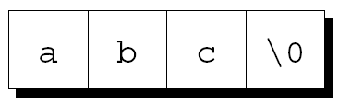

How String Literals Are Stored
The string literal "abc" is stored as an array of four characters:
The string "" is stored as a single null character:
‹#›
Copyright © 2008 W. W. Norton & Company.
All rights reserved.

Slide 9
How String Literals Are Stored
Since a string literal is stored as an array, the compiler treats it as a pointer of type char *.
Both printf and scanf expect a value of type char * as their first argument.
The following call of printf passes the address of "abc" (a pointer to where the letter a is stored in memory):
printf("abc");
‹#›
Copyright © 2008 W. W. Norton & Company.
All rights reserved.

Slide 10
Operations on String Literals
We can use a string literal wherever C allows a char * pointer:
char *p;
p = "abc";
This assignment makes p point to the first character of the string.
‹#›
Copyright © 2008 W. W. Norton & Company.
All rights reserved.

Slide 11
Operations on String Literals
String literals can be subscripted:
char ch;
ch = "abc"[1];
The new value of ch will be the letter b.
A function that converts a number between 0 and 15 into the equivalent hex digit:
char digit_to_hex_char(int digit)
{
return "0123456789ABCDEF"[digit];
}
‹#›
Copyright © 2008 W. W. Norton & Company.
All rights reserved.

Slide 12
Operations on String Literals
Attempting to modify a string literal causes undefined behavior:
char *p = "abc";
*p = 'd'; /*** WRONG ***/
A program that tries to change a string literal may crash or behave erratically.
‹#›
Copyright © 2008 W. W. Norton & Company.
All rights reserved.

Slide 13
String Literals versus Character Constants
A string literal containing a single character isn’t the same as a character constant.
"a" is represented by a pointer.
'a' is represented by an integer.
A legal call of printf:
printf("\n");
An illegal call:
printf('\n'); /*** WRONG ***/
‹#›
Copyright © 2008 W. W. Norton & Company.
All rights reserved.

Slide 14
String Variables
Any one-dimensional array of characters can be used to store a string.
A string must be terminated by a null character.
Difficulties with this approach:
It can be hard to tell whether an array of characters is being used as a string.
String-handling functions must be careful to deal properly with the null character.
Finding the length of a string requires searching for the null character.
‹#›
Copyright © 2008 W. W. Norton & Company.
All rights reserved.

Slide 15
String Variables
If a string variable needs to hold 80 characters, it must be declared to have length 81:
#define STR_LEN 80
…
char str[STR_LEN+1];
Adding 1 to the desired length allows room for the null character at the end of the string.
Defining a macro that represents 80 and then adding 1 separately is a common practice.
‹#›
Copyright © 2008 W. W. Norton & Company.
All rights reserved.

Slide 16
String Variables
Be sure to leave room for the null character when declaring a string variable.
Failing to do so may cause unpredictable results when the program is executed.
The actual length of a string depends on the position of the terminating null character.
An array of STR_LEN + 1 characters can hold strings with lengths between 0 and STR_LEN.
‹#›
Copyright © 2008 W. W. Norton & Company.
All rights reserved.

Slide 17
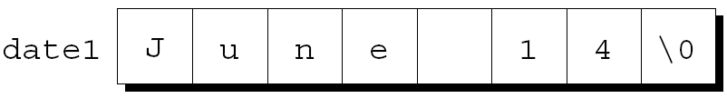
Initializing a String Variable
A string variable can be initialized at the same time it’s declared:
char date1[8] = "June 14";
The compiler will automatically add a null character so that date1 can be used as a string:
"June 14" is not a string literal in this context.
Instead, C views it as an abbreviation for an array initializer.
‹#›
Copyright © 2008 W. W. Norton & Company.
All rights reserved.

Slide 18
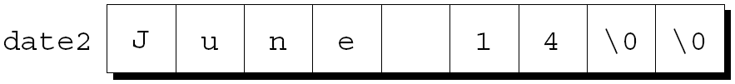
Initializing a String Variable
If the initializer is too short to fill the string variable, the compiler adds extra null characters:
char date2[9] = "June 14";
Appearance of date2:
‹#›
Copyright © 2008 W. W. Norton & Company.
All rights reserved.

Slide 19
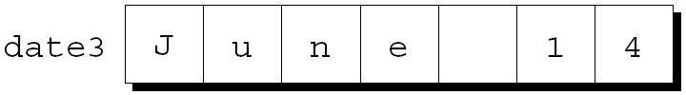
Initializing a String Variable
An initializer for a string variable can’t be longer than the variable, but it can be the same length:
char date3[7] = "June 14";
There’s no room for the null character, so the compiler makes no attempt to store one:
‹#›
Copyright © 2008 W. W. Norton & Company.
All rights reserved.

Slide 20
Initializing a String Variable
The declaration of a string variable may omit its length, in which case the compiler computes it:
char date4[] = "June 14";
The compiler sets aside eight characters for date4, enough to store the characters in "June 14" plus a null character.
Omitting the length of a string variable is especially useful if the initializer is long, since computing the length by hand is error-prone.
‹#›
Copyright © 2008 W. W. Norton & Company.
All rights reserved.

Slide 21
Character Arrays versus Character Pointers
The declaration
char date[] = "June 14";
declares date to be an array,
The similar-looking
char *date = "June 14";
declares date to be a pointer.
Thanks to the close relationship between arrays and pointers, either version can be used as a string.
‹#›
Copyright © 2008 W. W. Norton & Company.
All rights reserved.

Slide 22
Character Arrays versus Character Pointers
However, there are significant differences between the two versions of date.
In the array version, the characters stored in date can be modified. In the pointer version, date points to a string literal that shouldn’t be modified.
In the array version, date is an array name. In the pointer version, date is a variable that can point to other strings.
‹#›
Copyright © 2008 W. W. Norton & Company.
All rights reserved.

Slide 23
Character Arrays versus Character Pointers
The declaration
char *p;
does not allocate space for a string.
Before we can use p as a string, it must point to an array of characters.
One possibility is to make p point to a string variable:
char str[STR_LEN+1], *p;
p = str;
Another possibility is to make p point to a dynamically allocated string.
‹#›
Copyright © 2008 W. W. Norton & Company.
All rights reserved.

Slide 24
Character Arrays versus Character Pointers
Using an uninitialized pointer variable as a string is a serious error.
An attempt at building the string "abc":
char *p;
p[0] = 'a'; /*** WRONG ***/
p[1] = 'b'; /*** WRONG ***/
p[2] = 'c'; /*** WRONG ***/
p[3] = '\0'; /*** WRONG ***/
Since p hasn’t been initialized, this causes undefined behavior.
‹#›
Copyright © 2008 W. W. Norton & Company.
All rights reserved.

Slide 25
Reading and Writing Strings
Writing a string is easy using either printf or puts.
Reading a string is a bit harder, because the input may be longer than the string variable into which it’s being stored.
To read a string in a single step, we can use either scanf or gets.
As an alternative, we can read strings one character at a time.
‹#›
Copyright © 2008 W. W. Norton & Company.
All rights reserved.

Slide 26
Writing Strings Using printf and puts
The %s conversion specification allows printf to write a string:
char str[] = "Are we having fun yet?";
printf("%s\n", str);
The output will be
Are we having fun yet?
printf writes the characters in a string one by one until it encounters a null character.
‹#›
Copyright © 2008 W. W. Norton & Company.
All rights reserved.

Slide 27
Writing Strings Using printf and puts
To print part of a string, use the conversion specification %.ps.
p is the number of characters to be displayed.
The statement
printf("%.6s\n", str);
will print
Are we
‹#›
Copyright © 2008 W. W. Norton & Company.
All rights reserved.

Slide 28
Writing Strings Using printf and puts
The %ms conversion will display a string in a field of size m.
If the string has fewer than m characters, it will be right-justified within the field.
To force left justification instead, we can put a minus sign in front of m.
The m and p values can be used in combination.
A conversion specification of the form %m.ps causes the first p characters of a string to be displayed in a field of size m.
‹#›
Copyright © 2008 W. W. Norton & Company.
All rights reserved.

Slide 29
Writing Strings Using printf and puts
printf isn’t the only function that can write strings.
The C library also provides puts:
puts(str);
After writing a string, puts always writes an additional new-line character.
‹#›
Copyright © 2008 W. W. Norton & Company.
All rights reserved.

Slide 30
Reading Strings Using scanf and gets
The %s conversion specification allows scanf to read a string into a character array:
scanf("%s", str);
str is treated as a pointer, so there’s no need to put the & operator in front of str.
When scanf is called, it skips white space, then reads characters and stores them in str until it encounters a white-space character.
scanf always stores a null character at the end of the string.
‹#›
Copyright © 2008 W. W. Norton & Company.
All rights reserved.

Slide 31
Reading Strings Using scanf and gets
scanf won’t usually read a full line of input.
A new-line character will cause scanf to stop reading, but so will a space or tab character.
To read an entire line of input, we can use gets.
Properties of gets:
Doesn’t skip white space before starting to read input.
Reads until it finds a new-line character.
Discards the new-line character instead of storing it; the null character takes its place.
‹#›
Copyright © 2008 W. W. Norton & Company.
All rights reserved.

Slide 32
Reading Strings Using scanf and gets
Consider the following program fragment:
char sentence[SENT_LEN+1];
printf("Enter a sentence:\n");
scanf("%s", sentence);
Suppose that after the prompt
Enter a sentence:
the user enters the line
To C, or not to C: that is the question.
scanf will store the string "To" in sentence.
‹#›
Copyright © 2008 W. W. Norton & Company.
All rights reserved.

Slide 33
Reading Strings Using scanf and gets
Suppose that we replace scanf by gets:
gets(sentence);
When the user enters the same input as before, gets will store the string
" To C, or not to C: that is the question."
in sentence.
‹#›
Copyright © 2008 W. W. Norton & Company.
All rights reserved.

Slide 34
Reading Strings Using scanf and gets
As they read characters into an array, scanf and gets have no way to detect when it’s full.
Consequently, they may store characters past the end of the array, causing undefined behavior.
scanf can be made safer by using the conversion specification %ns instead of %s.
n is an integer indicating the maximum number of characters to be stored.
gets is inherently unsafe; fgets is a much better alternative.
‹#›
Copyright © 2008 W. W. Norton & Company.
All rights reserved.

Slide 35
Reading Strings Character by Character
Programmers often write their own input functions.
Issues to consider:
Should the function skip white space before beginning to store the string?
What character causes the function to stop reading: a new-line character, any white-space character, or some other character? Is this character stored in the string or discarded?
What should the function do if the input string is too long to store: discard the extra characters or leave them for the next input operation?
‹#›
Copyright © 2008 W. W. Norton & Company.
All rights reserved.

Slide 36
Reading Strings Character by Character
Suppose we need a function that (1) doesn’t skip white-space characters, (2) stops reading at the first new-line character (which isn’t stored in the string), and (3) discards extra characters.
A prototype for the function:
int read_line(char str[], int n);
If the input line contains more than n characters, read_line will discard the additional characters.
read_line will return the number of characters it stores in str.
‹#›
Copyright © 2008 W. W. Norton & Company.
All rights reserved.

Slide 37
Reading Strings Character by Character
read_line consists primarily of a loop that calls getchar to read a character and then stores the character in str, provided that there’s room left:
int read_line(char str[], int n)
{
int ch, i = 0;
while ((ch = getchar()) != '\n')
if (i < n)
str[i++] = ch;
str[i] = '\0'; /* terminates string */
return i; /* number of characters stored */
}
ch has int type rather than char type because getchar returns an int value.
‹#›
Copyright © 2008 W. W. Norton & Company.
All rights reserved.

Slide 38
Reading Strings Character by Character
Before returning, read_line puts a null character at the end of the string.
Standard functions such as scanf and gets automatically put a null character at the end of an input string.
If we’re writing our own input function, we must take on that responsibility.
‹#›
Copyright © 2008 W. W. Norton & Company.
All rights reserved.

Slide 39
Accessing the Characters in a String
Since strings are stored as arrays, we can use subscripting to access the characters in a string.
To process every character in a string s, we can set up a loop that increments a counter i and selects characters via the expression s[i].
‹#›
Copyright © 2008 W. W. Norton & Company.
All rights reserved.

Slide 40
Accessing the Characters in a String
A function that counts the number of spaces in a string:
int count_spaces(const char s[])
{
int count = 0, i;
for (i = 0; s[i] != '\0'; i++)
if (s[i] == ' ')
count++;
return count;
}
‹#›
Copyright © 2008 W. W. Norton & Company.
All rights reserved.

Slide 41
Accessing the Characters in a String
A version that uses pointer arithmetic instead of array subscripting :
int count_spaces(const char *s)
{
int count = 0;
for (; *s != '\0'; s++)
if (*s == ' ')
count++;
return count;
}
‹#›
Copyright © 2008 W. W. Norton & Company.
All rights reserved.

Slide 42
Accessing the Characters in a String
Questions raised by the count_spaces example:
Is it better to use array operations or pointer operations to access the characters in a string? We can use either or both. Traditionally, C programmers lean toward using pointer operations.
Should a string parameter be declared as an array or as a pointer? There’s no difference between the two.
Does the form of the parameter (s[] or *s) affect what can be supplied as an argument? No.
‹#›
Copyright © 2008 W. W. Norton & Company.
All rights reserved.

Slide 43
Using the C String Library
Some programming languages provide operators that can copy strings, compare strings, concatenate strings, select substrings, and the like.
C’s operators, in contrast, are essentially useless for working with strings.
Strings are treated as arrays in C, so they’re restricted in the same ways as arrays.
In particular, they can’t be copied or compared using operators.
‹#›
Copyright © 2008 W. W. Norton & Company.
All rights reserved.

Slide 44
Using the C String Library
Direct attempts to copy or compare strings will fail.
Copying a string into a character array using the = operator is not possible:
char str1[10], str2[10];
…
str1 = "abc"; /*** WRONG ***/
str2 = str1; /*** WRONG ***/
Using an array name as the left operand of = is illegal.
Initializing a character array using = is legal, though:
char str1[10] = "abc";
In this context, = is not the assignment operator.
‹#›
Copyright © 2008 W. W. Norton & Company.
All rights reserved.

Slide 45
Using the C String Library
Attempting to compare strings using a relational or equality operator is legal but won’t produce the desired result:
if (str1 == str2) … /*** WRONG ***/
This statement compares str1 and str2 as pointers.
Since str1 and str2 have different addresses, the expression str1 == str2 must have the value 0.
‹#›
Copyright © 2008 W. W. Norton & Company.
All rights reserved.

Slide 46
Using the C String Library
The C library provides a rich set of functions for performing operations on strings.
Programs that need string operations should contain the following line:
#include <string.h>
In subsequent examples, assume that str1 and str2 are character arrays used as strings.
‹#›
Copyright © 2008 W. W. Norton & Company.
All rights reserved.

Slide 47
The strcpy (String Copy) Function
Prototype for the strcpy function:
char *strcpy(char *s1, const char *s2);
strcpy copies the string s2 into the string s1.
To be precise, we should say “strcpy copies the string pointed to by s2 into the array pointed to by s1.”
strcpy returns s1 (a pointer to the destination string).
‹#›
Copyright © 2008 W. W. Norton & Company.
All rights reserved.

Slide 48
The strcpy (String Copy) Function
A call of strcpy that stores the string "abcd" in str2:
strcpy(str2, "abcd");
/* str2 now contains "abcd" */
A call that copies the contents of str2 into str1:
strcpy(str1, str2);
/* str1 now contains "abcd" */
‹#›
Copyright © 2008 W. W. Norton & Company.
All rights reserved.

Slide 49
The strcpy (String Copy) Function
In the call strcpy(str1, str2), strcpy has no way to check that the str2 string will fit in the array pointed to by str1.
If it doesn’t, undefined behavior occurs.
‹#›
Copyright © 2008 W. W. Norton & Company.
All rights reserved.

Slide 50
The strcpy (String Copy) Function
Calling the strncpy function is a safer, albeit slower, way to copy a string.
strncpy has a third argument that limits the number of characters that will be copied.
A call of strncpy that copies str2 into str1:
strncpy(str1, str2, sizeof(str1));
‹#›
Copyright © 2008 W. W. Norton & Company.
All rights reserved.

Slide 51
The strcpy (String Copy) Function
strncpy will leave str1 without a terminating null character if the length of str2 is greater than or equal to the size of the str1 array.
A safer way to use strncpy:
strncpy(str1, str2, sizeof(str1) - 1);
str1[sizeof(str1)-1] = '\0';
The second statement guarantees that str1 is always null-terminated.
‹#›
Copyright © 2008 W. W. Norton & Company.
All rights reserved.

Slide 52
The strlen (String Length) Function
Prototype for the strlen function:
size_t strlen(const char *s);
size_t is a typedef name that represents one of C’s unsigned integer types.
‹#›
Copyright © 2008 W. W. Norton & Company.
All rights reserved.

Slide 53
The strlen (String Length) Function
strlen returns the length of a string s, not including the null character.
Examples:
int len;
len = strlen("abc"); /* len is now 3 */
len = strlen(""); /* len is now 0 */
strcpy(str1, "abc");
len = strlen(str1); /* len is now 3 */
‹#›
Copyright © 2008 W. W. Norton & Company.
All rights reserved.

Slide 54
The strcat (String Concatenation) Function
Prototype for the strcat function:
char *strcat(char *s1, const char *s2);
strcat appends the contents of the string s2 to the end of the string s1.
It returns s1 (a pointer to the resulting string).
strcat examples:
strcpy(str1, "abc");
strcat(str1, "def");
/* str1 now contains "abcdef" */
strcpy(str1, "abc");
strcpy(str2, "def");
strcat(str1, str2);
/* str1 now contains "abcdef" */
‹#›
Copyright © 2008 W. W. Norton & Company.
All rights reserved.

Slide 55
The strcat (String Concatenation) Function
As with strcpy, the value returned by strcat is normally discarded.
The following example shows how the return value might be used:
strcpy(str1, "abc");
strcpy(str2, "def");
strcat(str1, strcat(str2, "ghi"));
/* str1 now contains "abcdefghi";
str2 contains "defghi" */
‹#›
Copyright © 2008 W. W. Norton & Company.
All rights reserved.

Slide 56
The strcat (String Concatenation) Function
strcat(str1, str2) causes undefined behavior if the str1 array isn’t long enough to accommodate the characters from str2.
Example:
char str1[6] = "abc";
strcat(str1, "def"); /*** WRONG ***/
str1 is limited to six characters, causing strcat to write past the end of the array.
‹#›
Copyright © 2008 W. W. Norton & Company.
All rights reserved.

Slide 57
The strcat (String Concatenation) Function
The strncat function is a safer but slower version of strcat.
Like strncpy, it has a third argument that limits the number of characters it will copy.
A call of strncat:
strncat(str1, str2, sizeof(str1) - strlen(str1) - 1);
strncat will terminate str1 with a null character, which isn’t included in the third argument.
‹#›
Copyright © 2008 W. W. Norton & Company.
All rights reserved.

Slide 58
The strcmp (String Comparison) Function
Prototype for the strcmp function:
int strcmp(const char *s1, const char *s2);
strcmp compares the strings s1 and s2, returning a value less than, equal to, or greater than 0, depending on whether s1 is less than, equal to, or greater than s2.
‹#›
Copyright © 2008 W. W. Norton & Company.
All rights reserved.

Slide 59
The strcmp (String Comparison) Function
Testing whether str1 is less than str2:
if (strcmp(str1, str2) < 0) /* is str1 < str2? */
…
Testing whether str1 is less than or equal to str2:
if (strcmp(str1, str2) <= 0) /* is str1 <= str2? */
…
By choosing the proper operator (<, <=, >, >=, ==, !=), we can test any possible relationship between str1 and str2.
‹#›
Copyright © 2008 W. W. Norton & Company.
All rights reserved.

Slide 60
The strcmp (String Comparison) Function
strcmp considers s1 to be less than s2 if either one of the following conditions is satisfied:
The first i characters of s1 and s2 match, but the (i+1)st character of s1 is less than the (i+1)st character of s2.
All characters of s1 match s2, but s1 is shorter than s2.
‹#›
Copyright © 2008 W. W. Norton & Company.
All rights reserved.

Slide 61
The strcmp (String Comparison) Function
As it compares two strings, strcmp looks at the numerical codes for the characters in the strings.
Some knowledge of the underlying character set is helpful to predict what strcmp will do.
Important properties of ASCII:
A–Z, a–z, and 0–9 have consecutive codes.
All upper-case letters are less than all lower-case letters.
Digits are less than letters.
Spaces are less than all printing characters.
‹#›
Copyright © 2008 W. W. Norton & Company.
All rights reserved.

Slide 62
Program: Printing a One-Month Reminder List
The remind.c program prints a one-month list of daily reminders.
The user will enter a series of reminders, with each prefixed by a day of the month.
When the user enters 0 instead of a valid day, the program will print a list of all reminders entered, sorted by day.
The next slide shows a session with the program.
‹#›
Copyright © 2008 W. W. Norton & Company.
All rights reserved.

Slide 63
Program: Printing a One-Month Reminder List
Enter day and reminder: 24 Susan's birthday
Enter day and reminder: 5 6:00 - Dinner with Marge and Russ
Enter day and reminder: 26 Movie - "Chinatown"
Enter day and reminder: 7 10:30 - Dental appointment
Enter day and reminder: 12 Movie - "Dazed and Confused"
Enter day and reminder: 5 Saturday class
Enter day and reminder: 12 Saturday class
Enter day and reminder: 0
Day Reminder
5 Saturday class
5 6:00 - Dinner with Marge and Russ
7 10:30 - Dental appointment
12 Saturday class
12 Movie - "Dazed and Confused“
24 Susan's birthday
26 Movie - "Chinatown"
‹#›
Copyright © 2008 W. W. Norton & Company.
All rights reserved.

Slide 64
Program: Printing a One-Month Reminder List
Overall strategy:
Read a series of day-and-reminder combinations.
Store them in order (sorted by day).
Display them.
scanf will be used to read the days.
read_line will be used to read the reminders.
‹#›
Copyright © 2008 W. W. Norton & Company.
All rights reserved.

Slide 65
Program: Printing a One-Month Reminder List
The strings will be stored in a two-dimensional array of characters.
Each row of the array contains one string.
Actions taken after the program reads a day and its associated reminder:
Search the array to determine where the day belongs, using strcmp to do comparisons.
Use strcpy to move all strings below that point down one position.
Copy the day into the array and call strcat to append the reminder to the day.
‹#›
Copyright © 2008 W. W. Norton & Company.
All rights reserved.

Slide 66
Program: Printing a One-Month Reminder List
One complication: how to right-justify the days in a two-character field.
A solution: use scanf to read the day into an integer variable, than call sprintf to convert the day back into string form.
sprintf is similar to printf, except that it writes output into a string.
The call
sprintf(day_str, "%2d", day);
writes the value of day into day_str.
‹#›
Copyright © 2008 W. W. Norton & Company.
All rights reserved.

Slide 67
Program: Printing a One-Month Reminder List
The following call of scanf ensures that the user doesn’t enter more than two digits:
scanf("%2d", &day);
‹#›
Copyright © 2008 W. W. Norton & Company.
All rights reserved.

Slide 68
remind.c
/* Prints a one-month reminder list */
#include <stdio.h>
#include <string.h>
#define MAX_REMIND 50 /* maximum number of reminders */
#define MSG_LEN 60 /* max length of reminder message */
int read_line(char str[], int n);
int main(void)
{
char reminders[MAX_REMIND][MSG_LEN+3];
char day_str[3], msg_str[MSG_LEN+1];
int day, i, j, num_remind = 0;
for (;;) {
if (num_remind == MAX_REMIND) {
printf("-- No space left --\n");
break;
}
‹#›
Copyright © 2008 W. W. Norton & Company.
All rights reserved.

Slide 69
printf("Enter day and reminder: ");
scanf("%2d", &day);
if (day == 0)
break;
sprintf(day_str, "%2d", day);
read_line(msg_str, MSG_LEN);
for (i = 0; i < num_remind; i++)
if (strcmp(day_str, reminders[i]) < 0)
break;
for (j = num_remind; j > i; j--)
strcpy(reminders[j], reminders[j-1]);
strcpy(reminders[i], day_str);
strcat(reminders[i], msg_str);
num_remind++;
}
printf("\nDay Reminder\n");
for (i = 0; i < num_remind; i++)
printf(" %s\n", reminders[i]);
return 0;
}
‹#›
Copyright © 2008 W. W. Norton & Company.
All rights reserved.

Slide 70
int read_line(char str[], int n)
{
int ch, i = 0;
while ((ch = getchar()) != '\n')
if (i < n)
str[i++] = ch;
str[i] = '\0';
return i;
}
‹#›
Copyright © 2008 W. W. Norton & Company.
All rights reserved.

Slide 71
String Idioms
Functions that manipulate strings are a rich source of idioms.
We’ll explore some of the most famous idioms by using them to write the strlen and strcat functions.
‹#›
Copyright © 2008 W. W. Norton & Company.
All rights reserved.

Slide 72
Searching for the End of a String
A version of strlen that searches for the end of a string, using a variable to keep track of the string’s length:
size_t strlen(const char *s)
{
size_t n;
for (n = 0; *s != '\0'; s++)
n++;
return n;
}
‹#›
Copyright © 2008 W. W. Norton & Company.
All rights reserved.

Slide 73
Searching for the End of a String
To condense the function, we can move the initialization of n to its declaration:
size_t strlen(const char *s)
{
size_t n = 0;
for (; *s != '\0'; s++)
n++;
return n;
}
‹#›
Copyright © 2008 W. W. Norton & Company.
All rights reserved.

Slide 74
Searching for the End of a String
The condition *s != '\0' is the same as *s != 0, which in turn is the same as *s.
A version of strlen that uses these observations:
size_t strlen(const char *s)
{
size_t n = 0;
for (; *s; s++)
n++;
return n;
}
‹#›
Copyright © 2008 W. W. Norton & Company.
All rights reserved.

Slide 75
Searching for the End of a String
The next version increments s and tests *s in the same expression:
size_t strlen(const char *s)
{
size_t n = 0;
for (; *s++;)
n++;
return n;
}
‹#›
Copyright © 2008 W. W. Norton & Company.
All rights reserved.

Slide 76
Searching for the End of a String
Replacing the for statement with a while statement gives the following version of strlen:
size_t strlen(const char *s)
{
size_t n = 0;
while (*s++)
n++;
return n;
}
‹#›
Copyright © 2008 W. W. Norton & Company.
All rights reserved.

Slide 77
Searching for the End of a String
Although we’ve condensed strlen quite a bit, it’s likely that we haven’t increased its speed.
A version that does run faster, at least with some compilers:
size_t strlen(const char *s)
{
const char *p = s;
while (*s)
s++;
return s - p;
}
‹#›
Copyright © 2008 W. W. Norton & Company.
All rights reserved.

Slide 78
Searching for the End of a String
Idioms for “search for the null character at the end of a string”:
while (*s) while (*s++)
s++; ;
The first version leaves s pointing to the null character.
The second version is more concise, but leaves s pointing just past the null character.
‹#›
Copyright © 2008 W. W. Norton & Company.
All rights reserved.

Slide 79
Copying a String
Copying a string is another common operation.
To introduce C’s “string copy” idiom, we’ll develop two versions of the strcat function.
The first version of strcat (next slide) uses a two-step algorithm:
Locate the null character at the end of the string s1 and make p point to it.
Copy characters one by one from s2 to where p is pointing.
‹#›
Copyright © 2008 W. W. Norton & Company.
All rights reserved.

Slide 80
Copying a String
char *strcat(char *s1, const char *s2)
{
char *p = s1;
while (*p != '\0')
p++;
while (*s2 != '\0') {
*p = *s2;
p++;
s2++;
}
*p = '\0';
return s1;
}
‹#›
Copyright © 2008 W. W. Norton & Company.
All rights reserved.

Slide 81
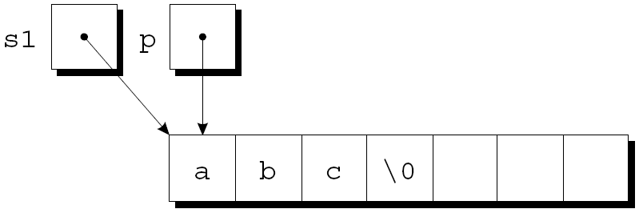
Copying a String
p initially points to the first character in the s1 string:
‹#›
Copyright © 2008 W. W. Norton & Company.
All rights reserved.

Slide 82
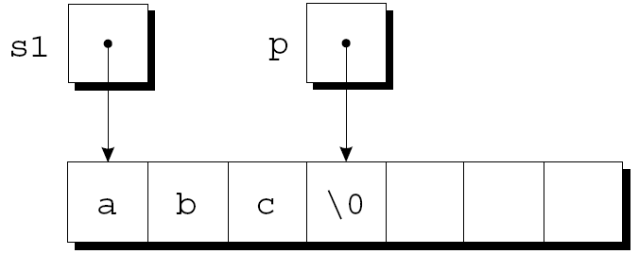
Copying a String
The first while statement locates the null character at the end of s1 and makes p point to it:
‹#›
Copyright © 2008 W. W. Norton & Company.
All rights reserved.

Slide 83
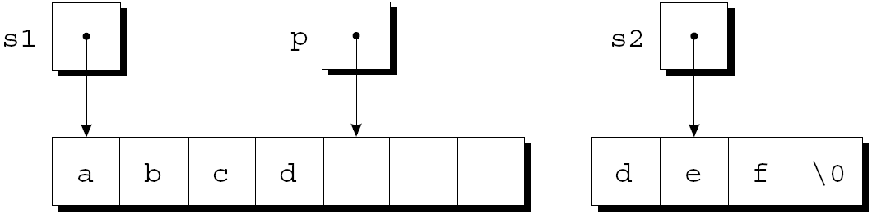
Copying a String
The second while statement repeatedly copies one character from where s2 points to where p points, then increments both p and s2.
Assume that s2 originally points to the string "def".
The strings after the first loop iteration:
‹#›
Copyright © 2008 W. W. Norton & Company.
All rights reserved.

Slide 84
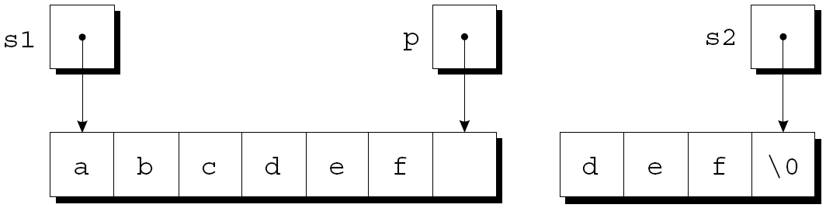
Copying a String
The loop terminates when s2 points to the null character:
After putting a null character where p is pointing, strcat returns.
‹#›
Copyright © 2008 W. W. Norton & Company.
All rights reserved.

Slide 85
Copying a String
Condensed version of strcat:
char *strcat(char *s1, const char *s2)
{
char *p = s1;
while (*p)
p++;
while (*p++ = *s2++)
;
return s1;
}
‹#›
Copyright © 2008 W. W. Norton & Company.
All rights reserved.

Slide 86
Copying a String
The heart of the streamlined strcat function is the “string copy” idiom:
while (*p++ = *s2++)
;
Ignoring the two ++ operators, the expression inside the parentheses is an assignment:
*p = *s2
After the assignment, p and s2 are incremented.
Repeatedly evaluating this expression copies characters from where s2 points to where p points.
‹#›
Copyright © 2008 W. W. Norton & Company.
All rights reserved.

Slide 87
Copying a String
But what causes the loop to terminate?
The while statement tests the character that was copied by the assignment *p = *s2.
All characters except the null character test true.
The loop terminates after the assignment, so the null character will be copied.
‹#›
Copyright © 2008 W. W. Norton & Company.
All rights reserved.

Slide 88
Arrays of Strings
There is more than one way to store an array of strings.
One option is to use a two-dimensional array of characters, with one string per row:
char planets[][8] = {"Mercury", "Venus", "Earth",
"Mars", "Jupiter", "Saturn",
"Uranus", "Neptune", "Pluto"};
The number of rows in the array can be omitted, but we must specify the number of columns.
‹#›
Copyright © 2008 W. W. Norton & Company.
All rights reserved.

Slide 89
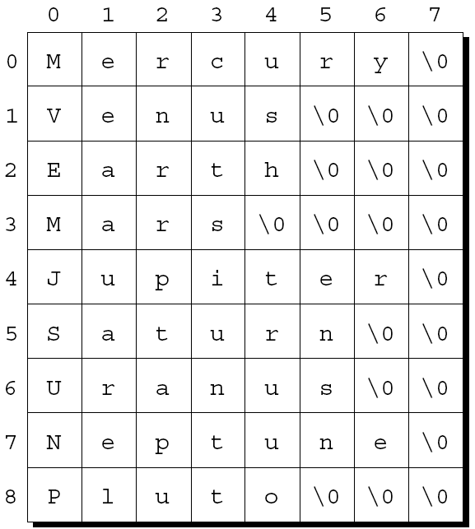
Arrays of Strings
Unfortunately, the planets array contains a fair bit of wasted space (extra null characters):
‹#›
Copyright © 2008 W. W. Norton & Company.
All rights reserved.

Slide 90
Arrays of Strings
Most collections of strings will have a mixture of long strings and short strings.
What we need is a ragged array, whose rows can have different lengths.
We can simulate a ragged array in C by creating an array whose elements are pointers to strings:
char *planets[] = {"Mercury", "Venus", "Earth",
"Mars", "Jupiter", "Saturn",
"Uranus", "Neptune", "Pluto"};
‹#›
Copyright © 2008 W. W. Norton & Company.
All rights reserved.

Slide 91
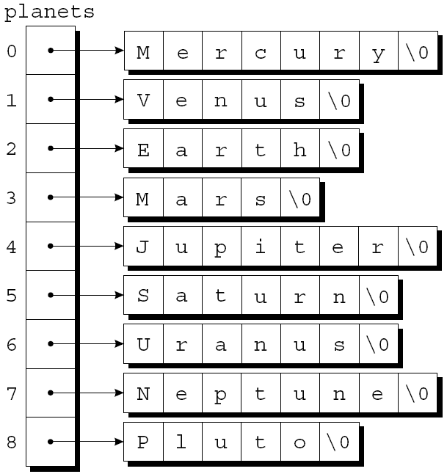
Arrays of Strings
This small change has a dramatic effect on how planets is stored:
‹#›
Copyright © 2008 W. W. Norton & Company.
All rights reserved.

Slide 92
Arrays of Strings
To access one of the planet names, all we need do is subscript the planets array.
Accessing a character in a planet name is done in the same way as accessing an element of a two-dimensional array.
A loop that searches the planets array for strings beginning with the letter M:
for (i = 0; i < 9; i++)
if (planets[i][0] == 'M')
printf("%s begins with M\n", planets[i]);
‹#›
Copyright © 2008 W. W. Norton & Company.
All rights reserved.

Slide 93
Command-Line Arguments
When we run a program, we’ll often need to supply it with information.
This may include a file name or a switch that modifies the program’s behavior.
Examples of the UNIX ls command:
ls
ls –l
ls -l remind.c
‹#›
Copyright © 2008 W. W. Norton & Company.
All rights reserved.

Slide 94
Command-Line Arguments
Command-line information is available to all programs, not just operating system commands.
To obtain access to command-line arguments, main must have two parameters:
int main(int argc, char *argv[])
{
…
}
Command-line arguments are called program parameters in the C standard.
‹#›
Copyright © 2008 W. W. Norton & Company.
All rights reserved.

Slide 95
Command-Line Arguments
argc (“argument count”) is the number of command-line arguments.
argv (“argument vector”) is an array of pointers to the command-line arguments (stored as strings).
argv[0] points to the name of the program, while argv[1] through argv[argc-1] point to the remaining command-line arguments.
argv[argc] is always a null pointer—a special pointer that points to nothing.
The macro NULL represents a null pointer.
‹#›
Copyright © 2008 W. W. Norton & Company.
All rights reserved.

Slide 96
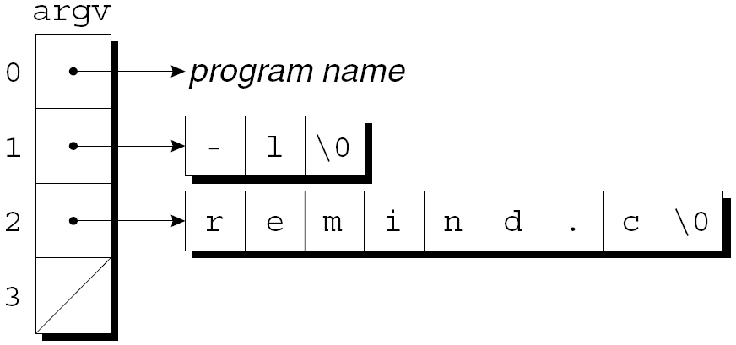
Command-Line Arguments
If the user enters the command line
ls -l remind.c
then argc will be 3, and argv will have the following appearance:
‹#›
Copyright © 2008 W. W. Norton & Company.
All rights reserved.

Slide 97
Command-Line Arguments
Since argv is an array of pointers, accessing command-line arguments is easy.
Typically, a program that expects command-line arguments will set up a loop that examines each argument in turn.
One way to write such a loop is to use an integer variable as an index into the argv array:
int i;
for (i = 1; i < argc; i++)
printf("%s\n", argv[i]);
‹#›
Copyright © 2008 W. W. Norton & Company.
All rights reserved.

Slide 98
Command-Line Arguments
Another technique is to set up a pointer to argv[1], then increment the pointer repeatedly:
char **p;
for (p = &argv[1]; *p != NULL; p++)
printf("%s\n", *p);
‹#›
Copyright © 2008 W. W. Norton & Company.
All rights reserved.

Slide 99
Program: Checking Planet Names
The planet.c program illustrates how to access command-line arguments.
The program is designed to check a series of strings to see which ones are names of planets.
The strings are put on the command line:
planet Jupiter venus Earth fred
The program will indicate whether each string is a planet name and, if it is, display the planet’s number:
Jupiter is planet 5
venus is not a planet
Earth is planet 3
fred is not a planet
‹#›
Copyright © 2008 W. W. Norton & Company.
All rights reserved.

Slide 100
planet.c
/* Checks planet names */
#include <stdio.h>
#include <string.h>
#define NUM_PLANETS 9
int main(int argc, char *argv[])
{
char *planets[] = {"Mercury", "Venus", "Earth",
"Mars", "Jupiter", "Saturn",
"Uranus", "Neptune", "Pluto"};
int i, j;
‹#›
Copyright © 2008 W. W. Norton & Company.
All rights reserved.

Slide 101
for (i = 1; i < argc; i++) {
for (j = 0; j < NUM_PLANETS; j++)
if (strcmp(argv[i], planets[j]) == 0) {
printf("%s is planet %d\n", argv[i], j + 1);
break;
}
if (j == NUM_PLANETS)
printf("%s is not a planet\n", argv[i]);
}
return 0;
}
‹#›
Copyright © 2008 W. W. Norton & Company.
All rights reserved.

