Slide 1

Introduction and Overview
1
CSc 3320: System Level Programming
Spring 2021
Instructor
Dr. Ashwin Ashok
Assistant Professor
Department of Computer Science, GSU
CSC3320 System Level Programming

Slide 2

Administrative
2
 Required Prerequisites
⚪ CSc 1301/2010 Principle of Computer Science I
⚪ Csc 1302/2310 Principle of Computer Science II (Java
Programming)
 Google Classroom for course management
 General Guidelines: https://docs.google.com/document/d/1k8Y0z9_YaAubDmthXb8mRwVAEpLDMRookyK3HxoSWJw/edit?usp=sharing
CSC3320 System Level Programming

Slide 3
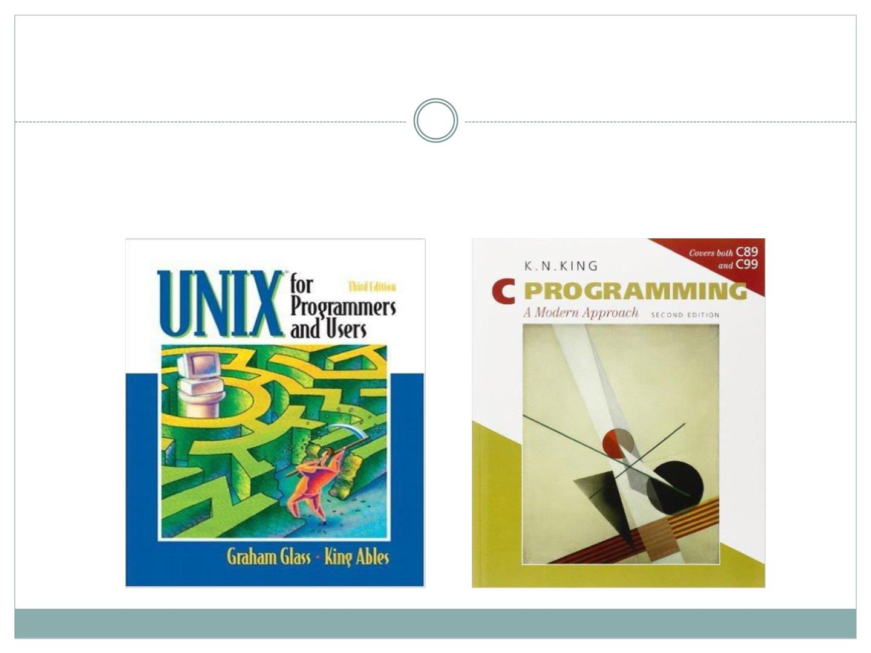
Administrative Issues
3
 Required Textbook
CSC3320 System Level Programming

Slide 4
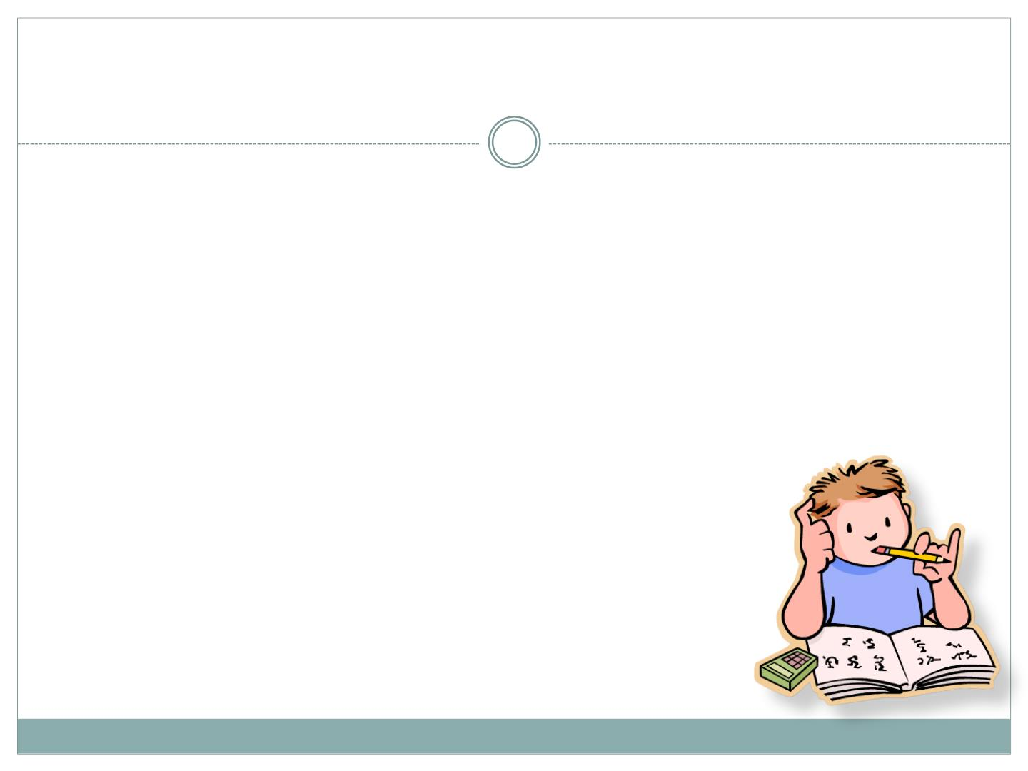
Assignments
4
 About 10 homeworks and 10 lab assignments
 The lowest one will be dropped for both
homework and lab assignment
 Penalty for late submissions is on the syllabus
 Plagiarism/Cheating will strictly lead to F
CSC3320 System Level Programming

Slide 5
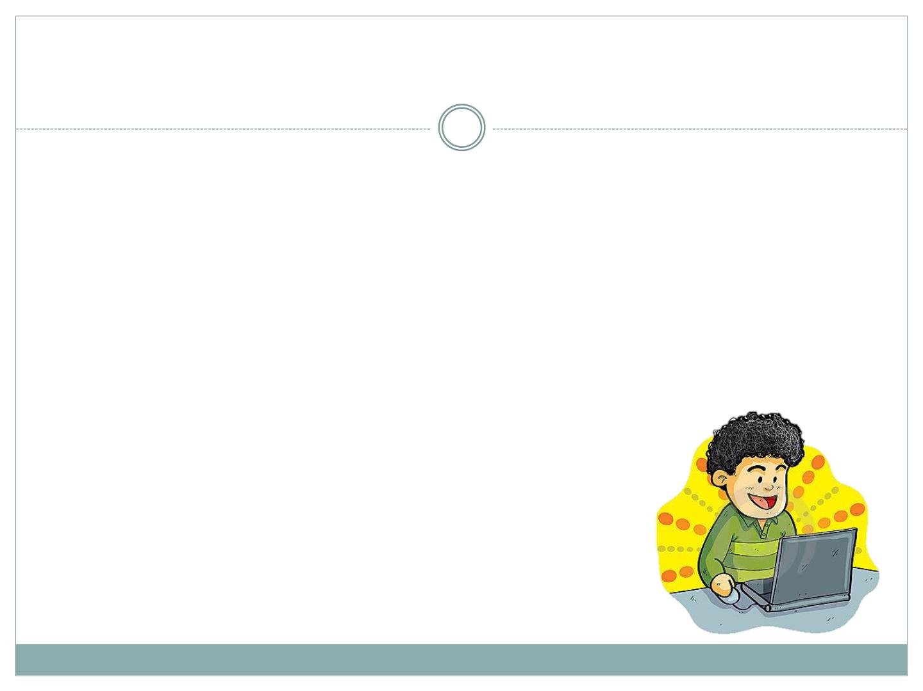
Class Policies
5
 Online SYNCHRONOUS mode via Google Meet.
 MUTE your microphone by default. Unruly and noisy audio feedback will lead to removal of the attendee from that session.
CSC3320 System Level Programming

Slide 6
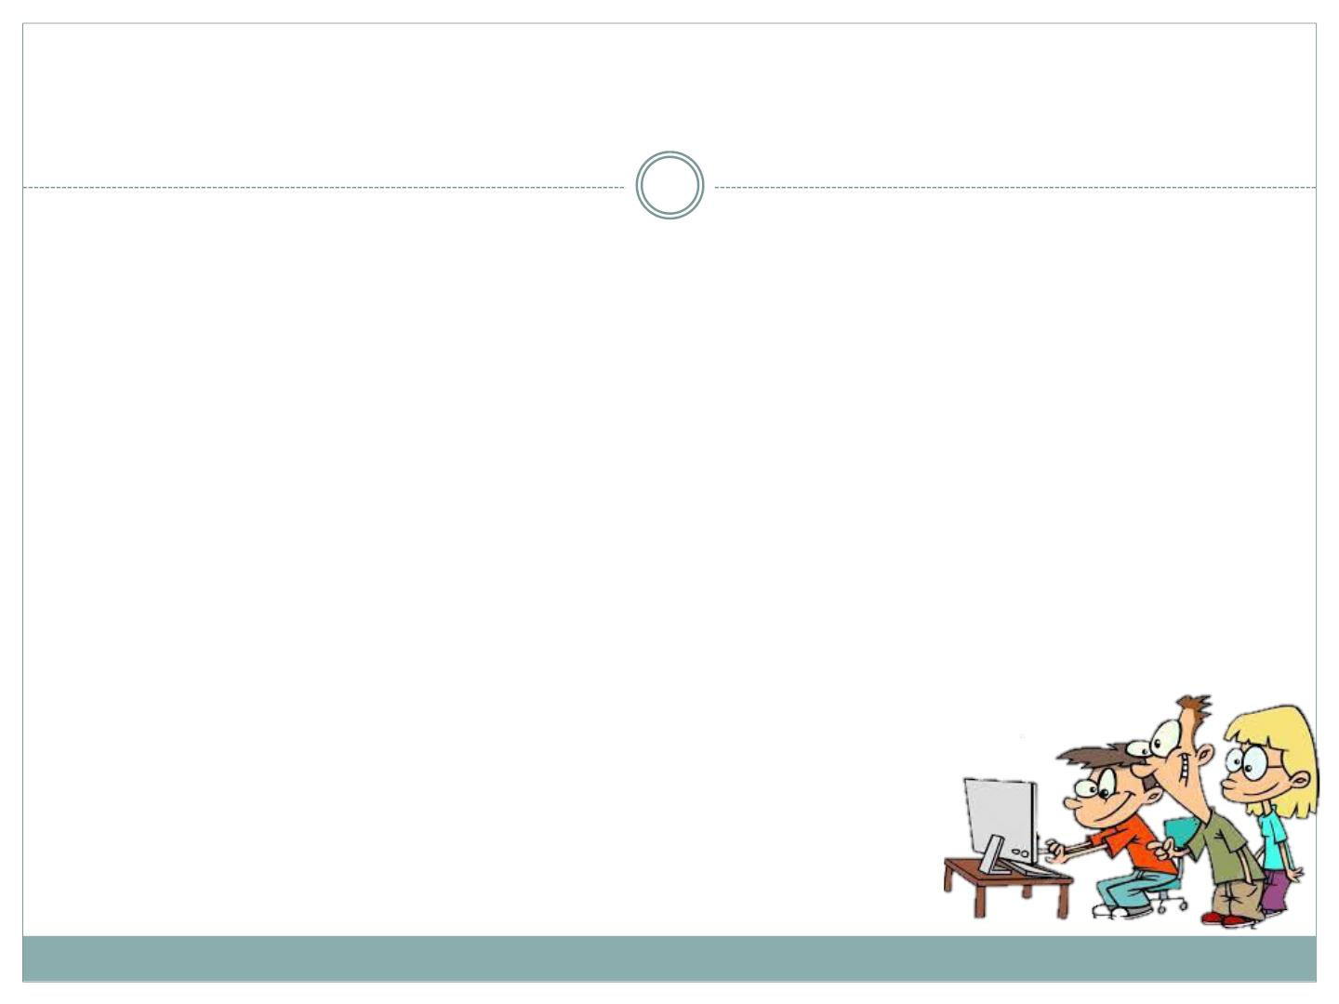
Lab Policies
6
 All the in-lab assignments are due in each lab session
 Remember to submit your AT-HOME lab work on time.
 Remember to ask your lab instructor to grade your
work during the lab session.
 Or ask the lab instructor to grade your work after the
lab session if the lab instructor is not free.
CSC3320 System Level Programming

Slide 7
Lab Policies
7
 Food and Drinks are not allowed at any time in the
computer lab.
 You may have water, but please no glass containers.
 Attendance is required.
 You are expected to develop the debugging and
programming skills over the course of the labs.
 The lab instructor is available to tutor and provide
appropriate support related to lab assi
CSC3320 System Level Programming

Slide 8

Grading policies and Exams
8
 Homework (approx. 10) : 30%
 Two (take-home)MIDTERM exams: 10% each
 Final (take-home) exam: 20%
 Lab assignments(approx. 10): 20%
 Surprise Quizzes: 10%
All re-grading requests must be made within 1 WEEK
from returned work
CSC3320 System Level Programming

Slide 9

Expectations
10
• Knowing how to use Unix utility
• Writing basic shell script
• Writing C program
• File management
• Process management
CSC3320 System Level Programming

Slide 10
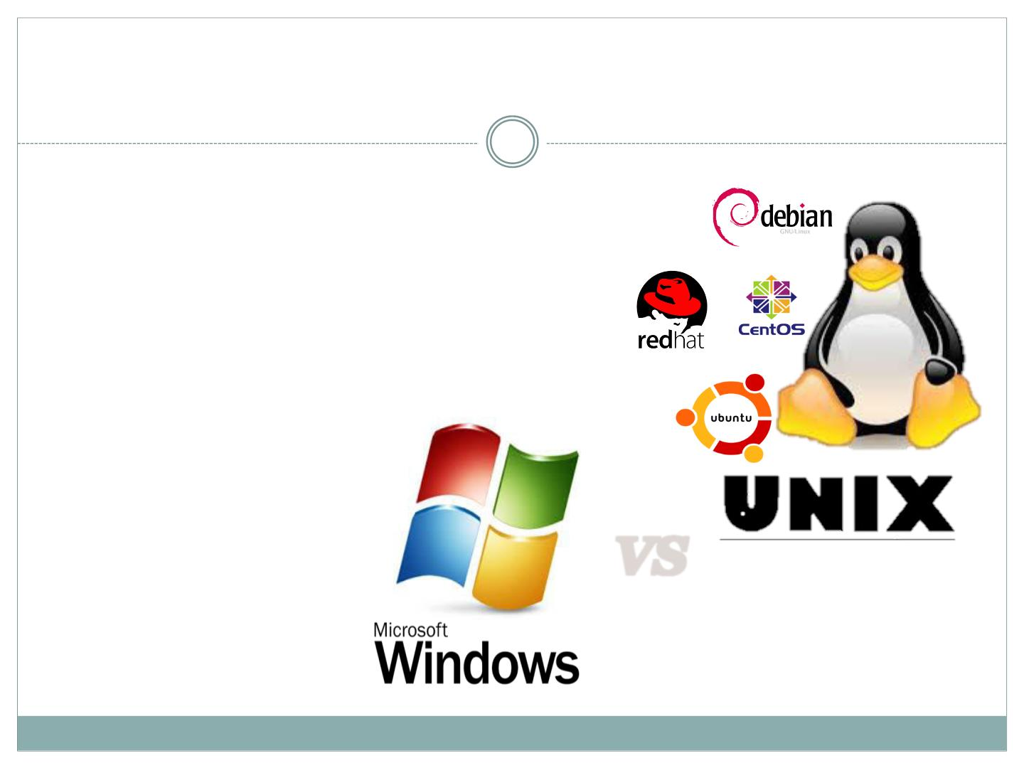
Why learn Unix?
11
 Free
 Open-source
 Secure
 Well-specified
VS
CSC3320 System Level Programming

Slide 11
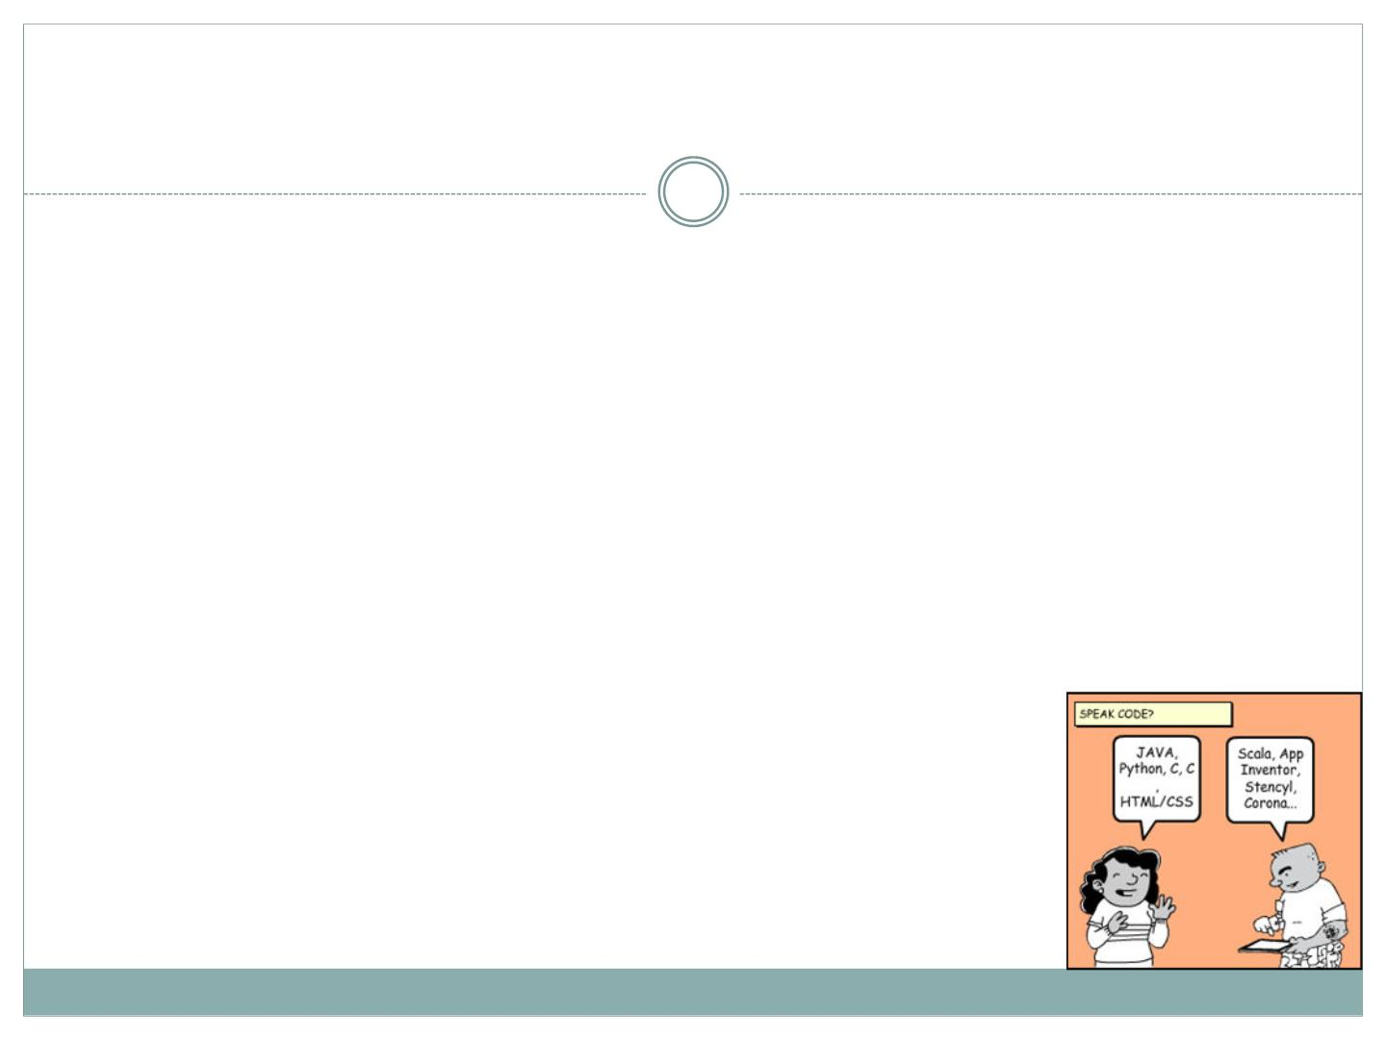
Why learn C?
12
 A low-level language
⚪ Better control of memory allocation and addresses
⚪ Interface to driver of kernel
⚪ Close to machine language --- Fast
 Used to create other languages and Operating
Systems
⚪ Most of Sun’s Java implementation (JVM)
⚪ Unix
⚪ Windows
⚪ Most embedded systems (e.g. iOS & Android)
Make Beliefs Comix
CSC3320 System Level Programming

Slide 12
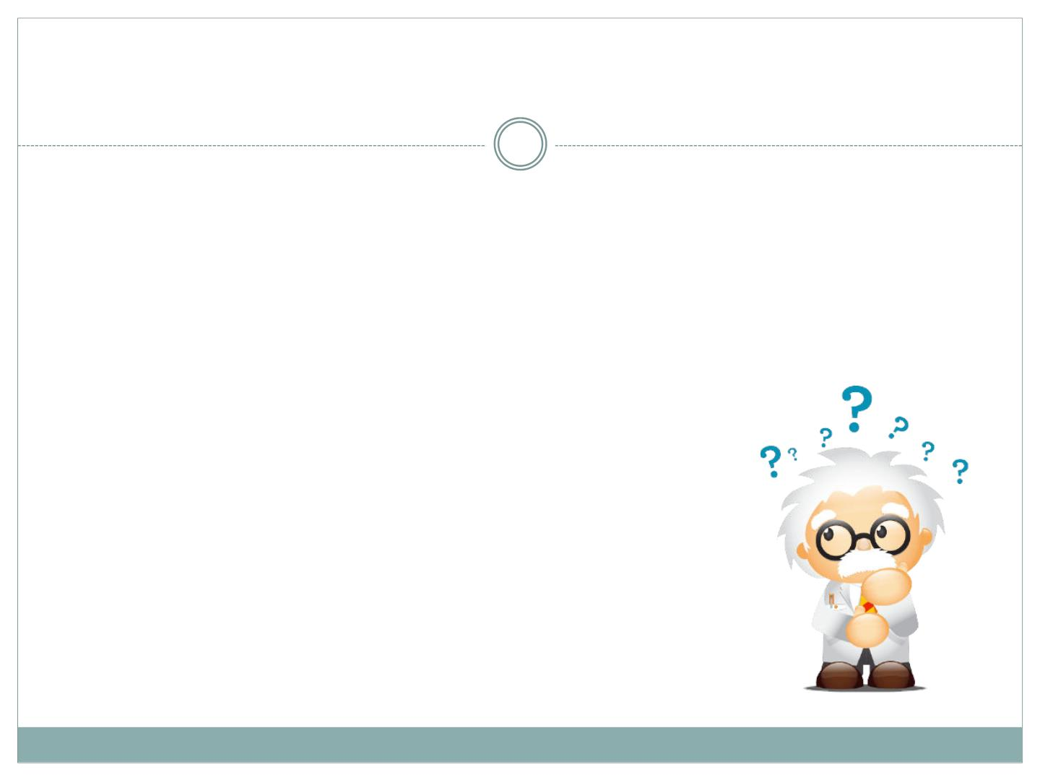
13
Any questions before we start…..
CSC3320 System Level Programming

