Slide 1
Chapter 1
What is UNIX?
ACKNOWLEDGEMENT: Thanks to Drs.Raj Sunderraman and Michael Weeks for the original notes on this chapter

Slide 2
Computer Systems
• Computer System : Hardware + Software
• Hardware: CPU, Memory (RAM/ROM), Disk drives,
Keyboard, Mouse, Printer, Tape drive, Modem, Ethernet
interface, CD-ROM drives, Monitor, Graphics card, Other peripherals.
• Software: Operating System, Application Programs
• UNIX is the name of a popular operating system.
cs3320
2

Slide 3
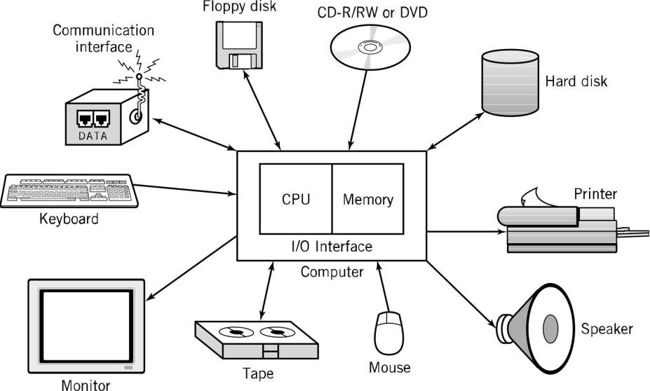
Typical Personal Computer System
cs3320
3

Slide 4
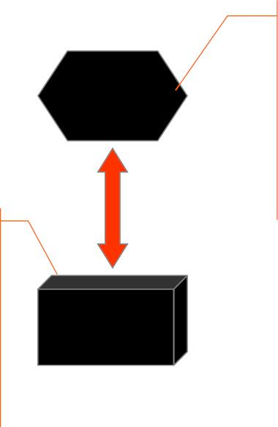
Hardware Key Components (1) :
CPU and Main Memory
Chip that executes
program
commands
Central
Processing
Unit
Intel Pentium 4 or
Sun ultraSPARC
III Processor
Primary storage
area for programs
and data that are in
active use
Main
Memory
Synonymous with
RAM
cs3320
4

Slide 5







Hardware Key Components (2) :
Secondary Memory Devices
Secondary memory
devices provide
long-term storage
Central
Processing
Unit
Information is moved
between main memory
and secondary memory
as needed
Hard disks
Floppy disks
ZIP disks
Writable
CDs
Hard Disk
Main
Memory
Floppy Disk
Tapes
cs3320
5

Slide 6
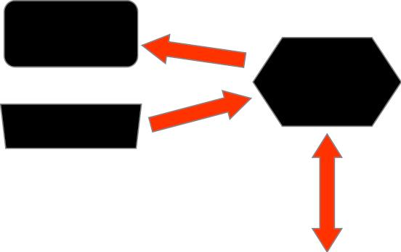







Hardware Key Components (3) :
Input / Output Devices
Monitor
Central
Processing
Unit
I/O devices facilitate user
interaction
Keyboard
Monitor screen
Keyboard
Mouse
Hard Disk
Main
Joystick
Memory
Bar code scanner
Touch screen
Floppy Disk
cs3320
6

Slide 7
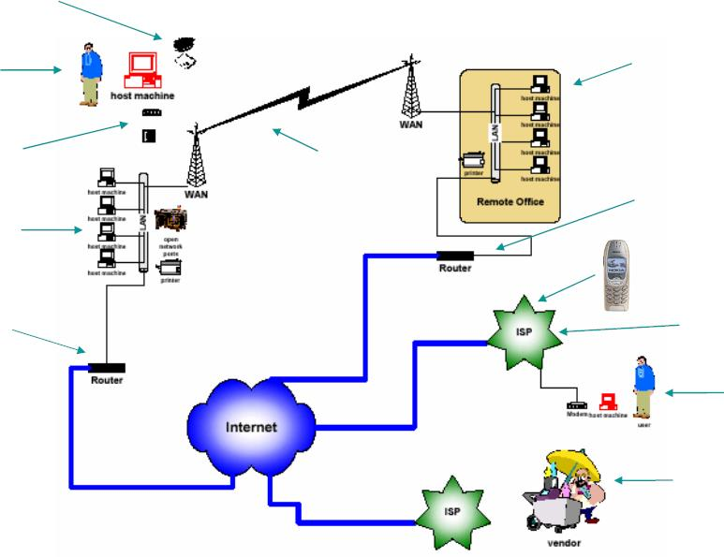
Computer Network
REMOVABLE
MEDIA
REMOTE
LOCATION
USER
MODEM +
TELEPHONE
RADIO
EMISSIONS
RADIO
EMISSIONS
“BACKDOOR”
INTERNET
CONNECTION
LOCAL AREA
NETWORK
WIRELESS
USER
INTERNET
CONNECTION
ISP
REMOTE
USER
VENDORS AND
SUBCONTRACTORS
cs3320
7

Slide 8
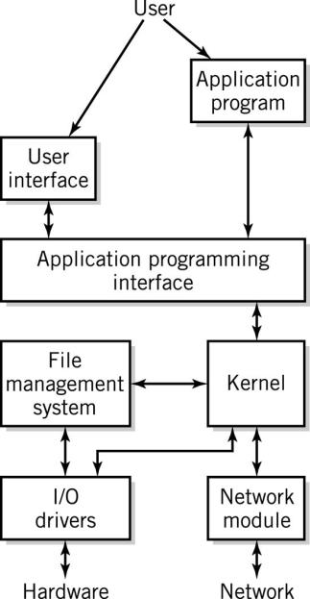
Software Component
• Applications
• Operating System
– API: application program
interface
– File management
– I/O
– Kernel
• Memory management
• Resource scheduling
• Program communication
• Security
– Network Module
cs3320
8

Slide 9
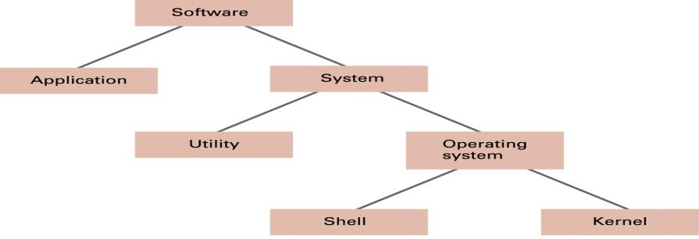
Software Categories
• Operating System
– controls all machine activities
– Oversee operation of computer - Store and retrieve files
– Schedule programs for execution - Coordinate the execution of
programs - Provides the user interface to the computer
– manages resources such as the CPU and memory
• Application program
– generic term for any other kind of software
– word processors, missile control systems, games
• Most operating systems and application programs have a graphical
user interface (GUI)
cs3320
9

Slide 10
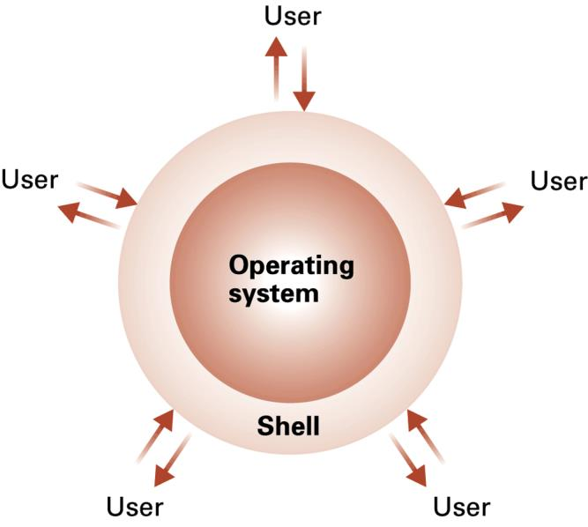
The shell as an interface between users and
the operating system
cs3320
10

Slide 11
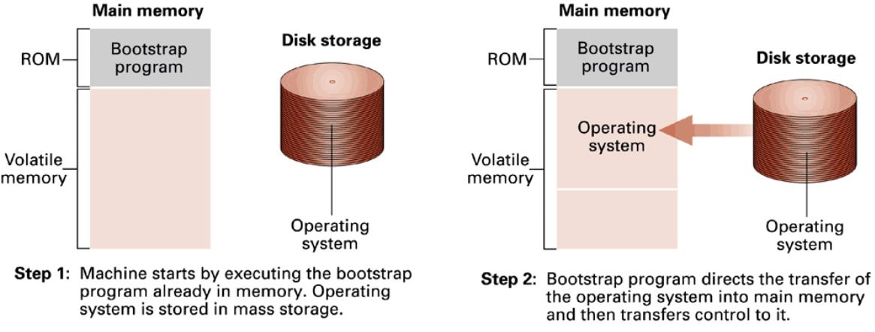
Figure 3.5 The booting
process
cs3320
11

Slide 12

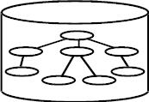
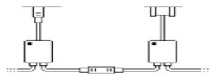
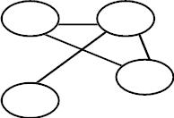

! " #$ %&'%() %*+ ,-(.&) /%'0'.,1
3 4 56
!"#$%&'()$
.$'/ ()0&%$'12
* )(+),- &
Provides a framework for executing programs and storing
files
●
File: collection of data normally stored on disk.
●
Program: collection of instructions/data that is stored
●
in a file.
cs3320
12

Slide 13
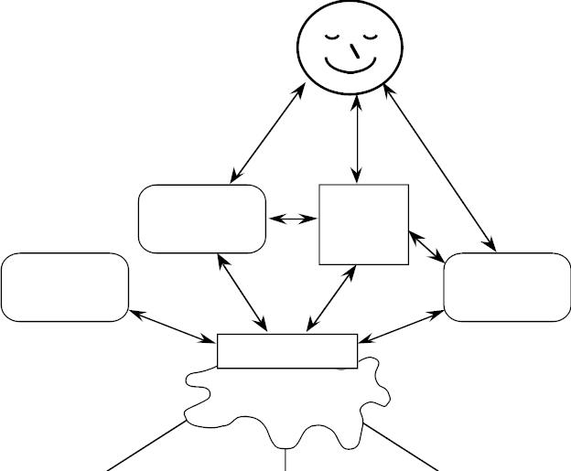
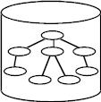
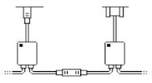
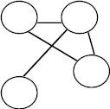
UNIX API – the system calls
ultimately everything works through system calls
:!#*
-++$&2-(&)/!
X
!8!(#.
9-#.)/!
!"#$$
API
4567
%&$#'!()*#
/#(0)*1!'#(23
+*),*-.!
cs3320
13

Slide 14
Process
●
When a program is executed, it is loaded into memory. It is
called a process when it is executing.
●
●
●
●
Most processes read/write data from/to files
Processes and files have an owner
UNIX supports hierarchical directory structure
Files and processes have a location within the directory
structure
UNIX provides the capabilities to create, modify and
destroy files, programs, and processes.
●
cs3320
14

Slide 15
Unix Attributes
●
Sharing of resources: CPU (time slices), memory (pages),
disk (blocks)
Communication: process-device controller, process-
process, etc. (pipes 1-way, sockets 2-way)
●
Utilities: Unix comes with a large collection of utilities; we
will study many of these.
●
●
Programmer support: All kinds of compilers available;
Access to parallel processing, file handling and interprocess
communication via System calls in C
cs3320
15

Slide 16
Advantages of UNIX
• It is multitasking, therefore, multiple programs can
run at one time.
• It is multiuser, allowing more than a single user to
work at any given time. This is accomplished by
sharing processing time between each user and
utilizing distributed computing systems.
• It is safe, preventing one program from accessing
memory or storage space allocated to another, and
enables protection, requiring users to have
permission to perform certain functions, i.e. accessing
a directory, file, or disk drive
cs3320
16

Slide 17
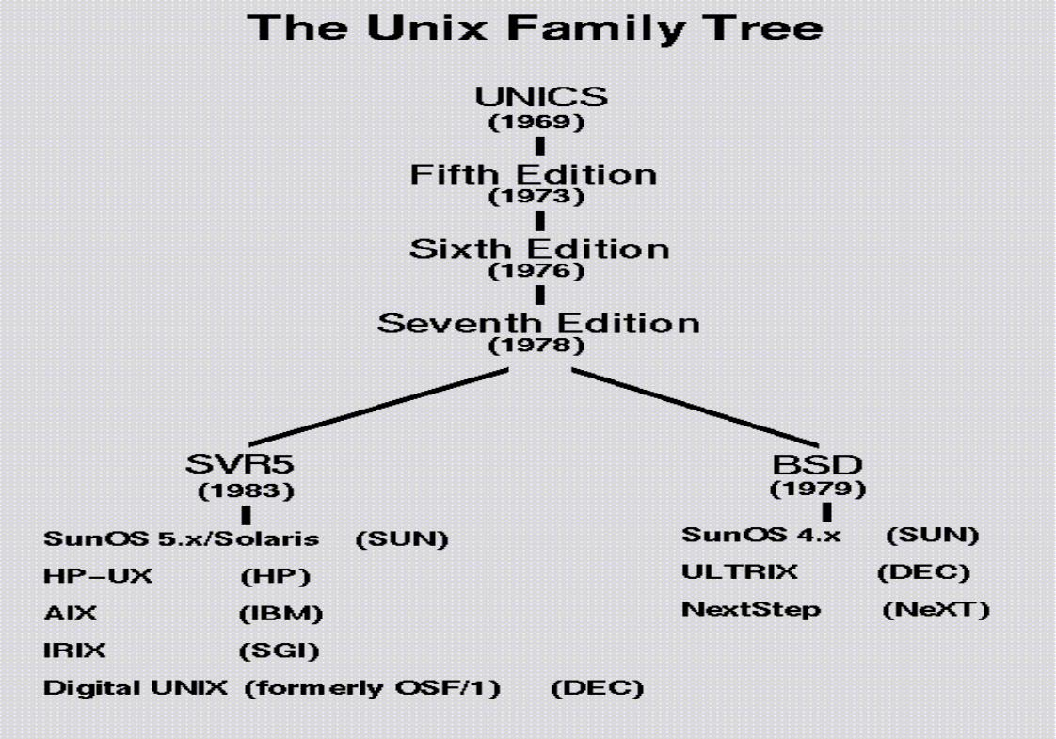
cs3320
17

Slide 18
Two Main Varieties of Unix
•System V (AT&T) and
•BSD (Berkeley Standard Distribution)
• Both are merged now. SunOS, IRIX, AIX, HP-
UX have features from both varieties although
most are System V Unix.
•Other Unix versions you may have heard of:
●
●
●
Linux (Fedora, Red Hat, Ubuntu, SUSE, etc.)
Sun Java Desktop OS, Solaris
Apple OS/X
cs3320
18

Slide 19
Sub-Varieties of Unix
•Linux (Runs on PC architecture)
●
●
●
●
Fedora
Red Hat
Ubuntu
Sun Java Desktop OS, etc.
•Sun Solaris (Runs on SPARC architecture)
•Apple OS/X (Runs on PowerPC and Intel
platforms)
cs3320
19

Slide 20
Philosophies of Unix
• Pipe mechanism
●
Output of one process can be used as input
for another process. e.g.
• $ who | sort
●
Using the pipe mechanism, complex tasks
can be broken down into simpler ones and
combined using pipes etc.
• Super user
●
user who has complete control over the
system resources. Typically the System's
Administrator.
cs3320
20

Slide 21
Review
• Computer Systems
• Unix as an operating system
• Processes
• Unix Attributes
• Unix Varieties
• Unix Philosophies
cs3320
21

