Slide 1
Chapter 2: Unix Utilities for non-programmers
Ashwin Ashok
CSC 3320 SYSTEM LEVEL PROGRAMMING
Spring 2021
Updated based on original notes from Raj Sunderraman and Michael Weeks

Slide 2
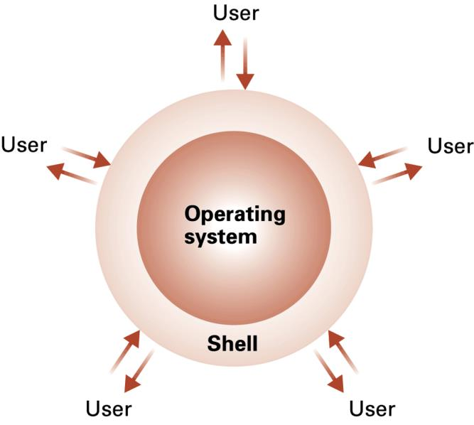
Unix
An operating system is computer software that manages hardware and other software.
Shell is a command interpreter that takes commands from the keyboard and gives them to the operating system to perform
Notes:
Case sensitive……

Slide 3
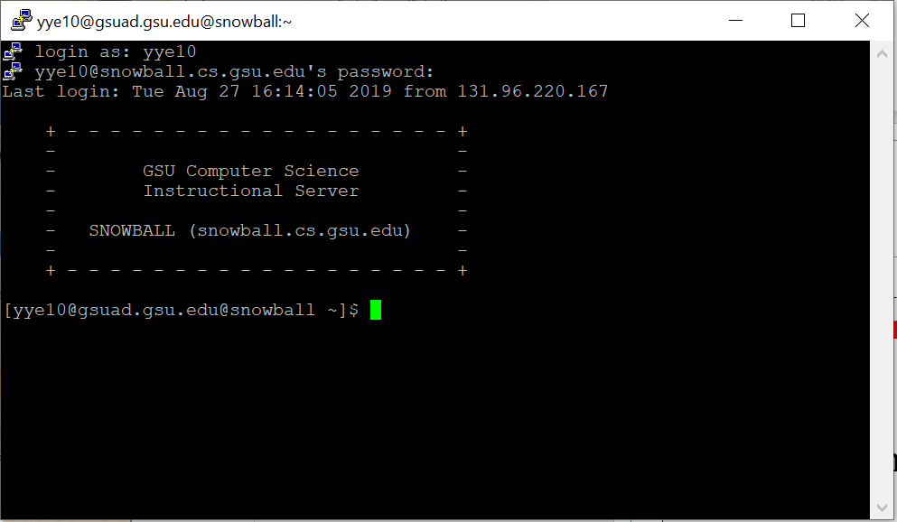
Unix
In the old days, shell was the only user interface available on a Unix-like system such as Linux. Nowadays, we have graphical user interfaces (GUIs) in addition to command line interfaces (CLIs) such as the shell.
Notes:
Case sensitive……

Slide 4
Review
How to use Linux system
Shells and Special Characters
Common Utilities
Working with Directories
Removing Files
File Attributes/Types
File permissions, groups, and owner

Slide 5
Getting Started
Obtain an account -OR- install Linux
Logging in
locally: enter username and password
remotely: use the ssh/telnet utility to sign on to
Upon logging on you will see a prompt (usually $ or %) which is displayed by a special kind of program called a SHELL program.
To set your password, use passwd
[GSUAD\ylong4@snowball csc3320]$ ssh ylong4@snowball.cs.gsu.edu
Notes:
Case sensitive……

Slide 6
Shells
Popular shells:
Bourne Shell
Korn Shell
C Shell
Bash (Bourne Again Shell)‏
All have common core functionality; some differences.
Each shell has its own programming language. (Shell programming).
Notes:
A shell execute all the commands you enter.
Why shell language?
Manipulating files and processes in UNIX.

Slide 7
Running Utilities
To run a utility, simply type the name of the utility after the prompt, and press Enter key
Some utilities: date, man, clear, stty, passwd
Utility: date [yymmddhhmm[.ss]]
Utility: clear
Utility: man [-s section] word
man -k keyword
To logout, enter CTRL-D (or exit)‏

Slide 8
Special Characters
list meta characters with stty -a command
[GSUAD\ylong4@snowball csc3320]$ stty -a
speed 38400 baud; rows 37; columns 96; line = 0;
intr = ^C; quit = ^\; erase = ^?; kill = ^U; eof = ^D; eol = <undef>; eol2 = <undef>;
swtch = <undef>; start = ^Q; stop = ^S; susp = ^Z; rprnt = ^R; werase = ^W; lnext = ^V;
flush = ^O; min = 1; time = 0;
-parenb -parodd cs8 -hupcl -cstopb cread -clocal -crtscts -cdtrdsr
-ignbrk -brkint -ignpar -parmrk -inpck -istrip -inlcr -igncr icrnl ixon -ixoff -iuclc -ixany
-imaxbel -iutf8
opost -olcuc -ocrnl onlcr -onocr -onlret -ofill -ofdel nl0 cr0 tab0 bs0 vt0 ff0
isig icanon iexten echo echoe echok -echonl -noflsh -xcase -tostop -echoprt echoctl echoke
^ means Control
^C means hold down control key (CTRL) and press the C key
Notes:
We have some special characters in Unix. They will be interpreted with special meaning at a UNIX terminal.
To check those special characters, we can use utility stty with option a.
So here list the result of stty –a in snowball.
You can find we have many special characters. However, in this class, you just need to know part of them colored red.
Here the carrot ^ means Control key
^ C means hold down…
Then we can learn some important special characters one by one.

Slide 9
Special Characters
intr: CTRL-C interrupt running program
susp: CTRL-Z suspend running program
stop: CTRL-S/CTRL-Q stop printing to screen
eof: CTRL-D give program end of file
To test these:
Try a command like find /
For eof, try cat > testfile then CTRL-D on new line
Notes:
And here are some special characters used for dealing with the execution of command or process.
Sometimes, if you want terminate a program before it is finished, you can use CTRL-C.
If you do not want to terminate it ,but pause it, then use ctrl –z to suspend it. After that, if you want to resume it, use fg(susp in foreground) or bg(susp in background) command.
If sometimes, a process has a lot of output and the output scrolls rapidly up the screen, you may need to use CTRL-S to pause the printing of output; After that, to resume generating ouput, you may either type ctrl –s again, or type ctrl-q.
So this pair is like of switch of output.
Many utilities in unix takes the input from file, and many from the keyboard. If the input is from the keyboard, to end the input, you must type ctrl-D at the end of your input (on a line of its own after the last line of output);
Demo….
We use find / to list all the file in my computer.
To terminate the process,...
To pause the process, to resume the process
To pause the output, to resume the ouptput
End of file.
Also we can use ctrl-d to log out of the UnIX system.
Difference between intr and susp: a suspended program can be resumed but a interrupted program cannot .
E.g. vi editor -> ^Z ->date-> vi editor , so I do not need to quit and save in vi editor before checking the date
^S stop; ^Q resume
=======

Slide 10
Some common UNIX utilities
Utilities | Feature
ls | List files
cat ,more, page, head, tail | Show file contents
mkdir, rmdir,cd, pwd | Working with directories
mv, cp, rm | Working with files
wc | Word count
file, groups, chgrp, chmod | About file permission
vi, emacs | Text editor
Notes:
Currently, you have known some special characters in UNIX. The next step is create some files in UNIX system.
If the operating system provides you a graphics, it is not hard to create a file. However, in this chapter, you will need to learn create a file without using graphics, but just some basic UNIX utilities typed in terminal.
Here is a list of those basic utilities.
We can use ls to list files in current directory, which is usually done by a file explorer in GUI.
We can also use cat,more,page,head,tail to display the content in a file. These utilitieshave the similar functionality as in a text editor.
If you want to create a new directory, use mkdir;to remove it, use rmdir
If you want to rename ,copy or remove file, then mv, cp,rm can be used.
Wc is a quite useful utility, which can count the number of words, characters and lines in a file. In future, you may need to implement this utility in C.
To change the access permission of file, chmod is usded.
At last, you will learn the text editor in unix system, such as vi, emacs. However, those text editors are designed without GUI. So they are very different from the text editors you often used in Mac or Windows.

Slide 11
Pathnames
The hierarchy from a starting directory to a target file or directory.
E.g. /home/myFile , ../myFile, ./myFile
Absolute pathname : relative to the root directory
Relative pathname : relative to its current working directory
/ refers to root directory
. refers to current directory (example: ./a.out)‏
.. refers to parent directory (example: ../p2.cpp)‏
Notes:
Before showing the details about those utilities, we first learn how to locate a file using the pathnames.
You should not be strange to the meaning of pathname.
Here are some examples of pathnames, for the mac user, could you tell me what does / mean?
For the windows users, could you tell me the differences from the pathnames in windows?
(1) No disk symbol C:
(2) We use / here, instead of back slash.
We can use two kinds of pathname to locate a file, the absolute and relative pathnames.
The absolute pathname, also called full pathname, is a the pathname relative to the root directory. So the starting directory should be the root direcotry in it. The starting directory is represented by /
The relative pathname, is the pathname relative to the current working directory. Once you log into a UNIX system, your shell starts off in a particular directory, called current working directory. Usually, every user has a different home directory, begins with /home. For example, my home directory is /home/ylong4 in snowball.
The current working directory can be changed using utility cd. However, if you use GUI, you should click the icon of a directory to change the directory displayed in the screen.
To well define the relatvie pathname, we use some special charaters, Single . Refers to current directory, and double dots refers to parent directory.
For example,…..a.out, p2.cpp

Slide 12
Pathnames
root
File | Absolute Path
Test.txt | /home/csc3320/Test.txt
Try.c | /home/Try.c
try | /bin/try
/
home
etc
bin
/etc/Try.c
csc3320
Try.c
try
Test.txt
/ refers to root directory
. refers to current directory (example: ./a.out)‏
.. refers to parent directory (example: ../p2.cpp)‏
Notes:
Now we do some practices.
The left diagrams shows you a hierarchical of directories and files in UNIX system.
This is a tree structre. Under root directory, we can find home, etc and bin directory. Also in this system, there are some file, such as test.txt, try.c and try in different folders.
The absolute path for Test.txt is
The absolute path for Try.c is
The absolute path for try is /bin/try
?? The absolute path for directory csc3320 is

Slide 13
Pathnames
root
File | Relative Path
Test.txt | Test.txt or ./Test.txt
Try.c | ../../etc/Try.c
try | ../../bin/try
/
home
etc
bin
csc3320
Try.c
try
Test.txt
Assume csc3320 as the current working directory.
/ refers to root directory
. refers to current directory (example: ./a.out)‏
.. refers to parent directory (example: ../p2.cpp)‏
Notes:
Then we assume csc3320 as the current working directory.
The relative path for Test.txt is , since the leading ./ is redudant, the second form is rarely used.
For Try.c is
For try is ?
?? For directory bin

Slide 14
Example of pwd
[GSUAD\ylong4@snowball csc3320]$ pwd
/home/local/GSUAD/ylong4/csc3320
[GSUAD\ylong4@snowball csc3320]$ cd ..
[GSUAD\ylong4@snowball ~]$ pwd
/home/local/GSUAD/ylong4
Notes:
To check the pathname for current woking directory, we can use pwd. Current working directory indicates where you are in the file hierarchy
To change current working directory, we can use cd

Slide 15
Example of cat
$ cat > letter
Hi Mom,
Please send me money!
David
^D
$ ls -l letter
-rw-r--r-- 1 raj other 38 May 28 11:20 letter
Special Character
Notes:
Now, you already know how to change the working directory. Then how to create a file.
And here shows you one method to create a file in current working directory by example of using utility cat..
Cat can take input from keyboard or a list of files and output them.
We can send the output of a process to a file instead of the screen by making use of shell facility called output redirection. Here the angle bracket means the redirecion.
To memorize it, you can simply consider the > as the meaning of save as in a file.
So the letter is the file. If letter exists,it will be overwritten, otherwise, it willl be created automatically.
After hiting a enter, you can type the text for file letter. To end the input, please use ctrl-D.
After that, we can use ls to list the files in current directory, and from output we find letter exists in directory, and detailed information about it.
Here is one example of using ls, actually using ls can be more complicated with different options.

Slide 16
List Files ( ls )
$ ls -algFsdR <file-spec-list>
options
a: hidden files
l: long listing
g: group
F: put character after file name indicating executable *, link @, directory /, socket =
s: number of disk blocks
d: dir details not contents
R: recursive listing
The input can be a set of elements, separated by space
File-spec is the pathname for directory or file
Notes:
The synopsis of using ls is listed here.
With no arguments, ls lists all o the files in the current working directory in alphabetical order, excluding the hidden files.
Options are preceded by a hyphen. For most commands, the options can be combined together written like a single string; For most commands, you can also separate the options, preceding each with a hyphen.
Then use –a, hidden files can be listed.
The –l option generates a long listing, including permission flags, the file’s owner, and the last time the file was modified.
The –g option lists a file’s group.
The –F option put …
The –s option include the number of disk blocks that the file occupiees in the listing.
The –d option list the detail of directory, rather than the detail of contents in directory.
Since sometimes a diectory may contain one more directories, we can use option –R to recurceively lists the coentents of a direcoty and its subdirectoriies.
Here the file-spec is the pathname for a direcoty or file.
The list means the input could be a list of files or directories.

Slide 17
Show File Contents (cat, more)
$ cat <file-spec-list>
list contents of file(s) on screen without pause
$ more <file-spec-list>
same as cat; pauses after each screen
space bar takes you to next screen
q quit
enter shows next line
h help key for more commands
Notes:
To list the content in a file, there are several utilities we can use.
Cat can list the content for a list of files, without pause. However, it is good for listing small files, but does not pause between full screens of ouput.
So there are some other utilities designed especially for larger files, and allow user to scroll backward or forward.
The more utilit allow you to scrool through a list of files, one page a time.
To display next page, you can hit space bar.
To show next line, you can hit enter.
To obtain help on the multitude of other commands, press the h key.
To quit more, press q key.

Slide 18
Show File Contents (page, head, tail)
$ page <file-spec-list>
same as more; clears screen before each page
quicker
$ head –n <file-spec-list>
display n lines from front of file
$ tail –n <file-spec-list>
display n lines from end of file
Notes:
Page works similar to more. The difference is that it clears screen before displaying each page.
If you just want to display n lines from front of file, use head utlility. If n is not specified, head defaults to 10.
If you just want to display n lines form end of file, use tail utility. If n is not specified, the default is also 10.

Slide 19
Working with Directories (mkdir, cd, pwd)
$ mkdir <dir-list>
make a new directory
$ cd <dir>
built-in to shell
changes shell to a different directory
$ pwd
print working directory
Notes:
Now if you want to create a new file in a different directory, what utilites we can use ?
Here list some utilities you may need to use in this case?
Use mkdir to create a new directroy in current folder. The argument could be a list of names of direcotries.
Or you can change current working directory by using cd, the argument should be the pathname of the directory you want to go to. Cd is a built-in program in shell, which means it can change the curernt working directory path used by shell.
Pwd is used to print out the current working directory, which is a full pathname.

Slide 20
Rename Files (mv)
Rename files (simply change labels in the file hierarchy)‏
$ mv -i <old> <new>
i for inquire
( prompt if <new> already exists )‏
$ mv -i <file-spec> <dir>
$ mv -i <dir> <dir>
Move file to a new directory
Rename a directory
Notes:
Now, I want to rename the file created I created before, I must use mv utiliy.
The first argument for input is the old pathname , the second argument for input is the new pathname.
The –i option means inquire, it prompts you for confrimation if new files already exists.
The first form of mv renames oldfilename as new filename.
The second form of allows you to move a file to a directory.
The last form allows to you move an entire directory

Slide 21
Copy Files ( cp )
$ cp -i <old> <new>
i for inquire
(prompt if <new> already exists)‏
$ cp -i <file-spec> <dir>
$ cp -ir <dir> <dir>
r for recursive
Notes:
Sometimes, you may need to copy files as backups. Then you can use utility cp.
The first form copies oldfile to newfile in current directoy.
The second form copied oldfile into another directory.
The third form copies entire directory to a new directory. The –r option must be used, if there are some sub-directories.

Slide 22
Removing Files (rm, rmdir)
remove (delete) file
$ rm -fir <file-spec-list>
f: force; inhibits all prompts/messages
i: inquire
r: recursive
Be careful! This is a permanent deletion!
remove (delete) directory
$ rmdir <dir-list>
Notes:
To remove a file, or a list of files, you can use rm.
The I option prompts the confirmation before deleting a file;
The r option must be used, if you want to delete an entire directory including sub-directories.
The f option inhibits all error messages and prompts.
rm *
Rmdir removes all a list of directories, however, those directoreis must be empty before it can removed.
Note: to remove a directory and all its subdirectories, you must use rm –r dir

Slide 23
Word Count ( wc )
word count
$ wc -clw <file-spec>
c counts the bytes
l counts the newline characters
w prints the word counts
Notes:
After you create a file, you may want to find out how many characters, words and lines in the file.
At that time, yu can use wv utility.
If no option is provided, all three counts are dispalyed.
C option requests a character count.
L option request a line count.
W option request a word count.

Slide 24
File Attributes
$ ls -lsF test.java
4 -rw-r--r--. 1 GSUAD\ylong4 GSUAD\domain^users 247 Aug 22 13:36 test.java
4 : number of physical blocks
-rw-r--r-- : file type (first char), permissions
file type (- regular, d dir, b buffered file disk drive, c unbuffered file terminal, l link, p pipe, s socket )
1 : hard link count
GSUAD\ylong4 : file owner
GSUAD\domain^users : file's group
247 : file size in bytes
Aug 22 13:36 : file modification date
test.java : file name
Notes:
Now you have known some file-oriented utilities, it is time to check the file attributes.
You can use ls to obtain a long listing of some file.
For example, we get the a line of output for flie test.java. Each filed in the line is the value of a file attribute.
4 : the number of blocks occupied in physcial storage.
Rw : permission mode of file, indicating who can read, write and execute the file.
1: hard link, dicussed in next chapter.
The username of the owner of the file
The group name of the file
The file size in bytes
The time that the file was last modified

Slide 25
File Type (file)
$ file <file-spec-list>
Ascertains the type of file (ascii/binary etc.)‏
[GSUAD\ylong4@snowball csc3320]$ file testDir
testDir: directory
[GSUAD\ylong4@snowball csc3320]$ file Person.class
Person.class: compiled Java class data, version 50.0 (Java 1.6)
[GSUAD\ylong4@snowball csc3320]$ file *
Person.class: compiled Java class data, version 50.0 (Java 1.6)
test: ELF 64-bit LSB executable, x86-64, version 1 (SYSV), dynamically linked (uses shared libs), for GNU/Linux 2.6.18, not stripped
test.c: ASCII C program text
testDir: directory
test.java: ASCII C++ program text
* matches all files in current directory
Notes:
To check the type of file, you can use file utiliy.
For example, we find testDIr is a directory.
Person.class is a compield jave class file.
Or you can use file * to list the types of all files in current folder.s

Slide 26
Groups (groups,chgrp,newgrp)
list the groups a particular user belongs to
$ groups <userid>
change the group a file belongs to
$ chgrp -R <group-name> <file-spec>
R stands for recursive
create subshell with effective group id = group
$ newgrp <group-name>
Notes:
One of the important utilies in file attributes is the group name.
Unix provides you some utilies to list the groups a particular user belongs to, the defualt is the current user without user id. change the group a file belongs and switch groups for a user. Since one user may user belong to multiple users.

Slide 27
Groups
Example
I belong to two groups: cs and music
Currently, I am acting as an user in cs
$ date > test1
$ newgrp music
$ date > test2
^D
$ ls –lg test1 test2
-rw-rw-r-- 1 cs 29 Aug 23 13:57 test1
-rw-rw-r-- 1 music 29 Aug 23 13:57 test2
“music” group shell
terminate the new shell
Notes:
For creating cs and music groups, please refer to the lecture notes.
Now assume I belong to two diffeent groups, cs and music.
Currently, I am acting as an user in cs.
Then I create a file storing current date, and name it as test1
Then I switch myself to the group music.
And I create another file storing current date, and name it as test 2
After that, I use Ctrl D to quit current shell. Which means, I go back to previous shell, acting as an cs group user.
Then I use ls to obtain the details of test 1 and test2.
And find that they belong to different groups.

Slide 28
Change File Permissions (chmod)
change file mode; u,g,o,a r,w,x,s
user, group, other, all
read, write, execute, (set)‏
plus (+) adds permissions
minus (-) subtracts
Notes:
I created a file, however, I do not want the user in the same groups or other groups to use, what should I do?
At this time, you should use chmod,which means change file mode.
To learn how to use it, you must first know the meanings of some special characters.
U means current user, g means the other user in same group, o means the users in other groups. A means all users.
R means read permission, w means write, e means execute, set means set user ID (it may be confusing to you, so you can ignore it now).
Plus means adding permissions, minus means removing permission.

Slide 29
Change File Permissions
Examples :
Assume the file permission is rw-r--r--
$ chmod g+w <file-spec>
$ chmod u-rw <file-spec>
$ chmod u+w, g-r <file-spec>
Change parameters | Feature | File permission Result
g+w | Add group with write permission | rw-rw-r--
u-rw | Remove user read and write permission | ---r--r--
u+x, g-r | Add execution permission for user, and remove read permission from group | rwxr-----
rwx---r--
Notes:
Then chmod changes the modes of files according to the change parameters defined by those special characters.
Assume currently the file permission is rw-r—r--. The first three characters are for current user, the middle three characters are for the user in same group, the last three characters are for the users in other groups.
In each group, there are three permissions can be set. From left to right are read(r), write(w), execute(x). If the character for th permision is replaced by symbol - , it means the permission is not open.
For example, rw- means a user can read and write the file, but no rights to execute.
R– means the users in same group can just read it.
R– means the users in other group can just read it.
Now if you use change paramters g+w, it means add w permission for the users in the same group.
U-rw….
To define the change the parameters for both user and group, you can use comma to separate the change paramter.

Slide 30
Change File Permissions
Assign permissions absolutely using octal number
Example: Set the file permission of one file as rw-r--r--
$chmod 644 <file-spec>
 | User | Group | Others
setting | rw- | r-- | r--
binary | 110 | 100 | 100
octal | 6 | 4 | 4
Notes:
If you want to specify the permission, you can use octal number.
So what is an octal number?
Binary number system is base 2 number system.
Decimal system is base 10 number sysem.
Octal number system is base 8 number system.
Octal numbers therefore have a range of just “8” digits, (0, 1, 2, 3, 4, 5, 6, 7).
An octal number can be converted from a binary number.
Octal numerals can be made from binary numerals by grouping con’secutive binary digits into groups of three (starting from the right). For eample, the binary representation for decimal 74 is 1001010, then the octal number is 112.

Slide 31
Change File Permissions
Another example with octal numbers
mweeks@carmaux:~$ ls -l example.txt
-rw-r--r-- 1 mweeks mweeks 51 2007-08-23 16:06 example.txt
mweeks@carmaux:~$ chmod 765 example.txt
mweeks@carmaux:~$ ls -l example.txt
-rwxrw-r-x 1 mweeks mweeks 51 2007-08-23 16:06 example.txt
Notice
7 = 111 (binary) r “on”, w “on”, x “on”
6 = 110 (binary) r “on”, w “on”, x “off”
5 = 101 (binary) r “on”, w “off”, x “on”
Notes:
How to use man?
Home directory? ~

Slide 32
Review
Shells and Special Characters
Common Utilities
Working with Directories
Removing Files
File Attributes/Types
File permissions, groups, and owner

