Slide 1
Analysis and Design of Algorithms
An algorithm is a method of solving problem (on a computer)
Problem example:
  given a set of points on the plane
  find the closest pair
Algorithm:
  find distance between all pairs
Can we do it faster?

Slide 2
Combinatorial Problems
Closest pair
  O(n^2) algorithm
TSP
  O(n!) algorithm
  too slow
  difficult problem

Slide 3
Course Overview
General algorithmic methods
  divide and conquer, greedy algorithms, dynamic programming
Data structures
  hashing, priority queues, binary search trees, binomial heaps
Combinatorial problems
  MST, TSP, Vertex/Set Cover, Matrix
Computational Complexity
  NP-completeness, reducibility, approximation
Cormen-Leiserson-Rivest
Introduction to Algorithms

Slide 4
Grades
Homeworks = 20 %
  (bi) weekly ~10, the worst grade is dropped
Tests/Quizzes = 30%
  5 quizzes, the worst grade is dropped
Programming Assignment = 10%
Final 4520 / Project 6520 = 40%
Extra –credits <10%

Slide 5
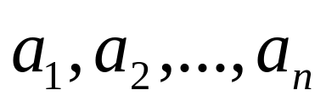
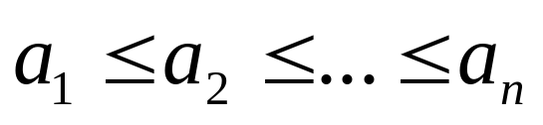
Sorting
Input: sequence of numbers
Output: a sorted sequence
Insertion-Sort
  for j=2 to n do
    current=A[j]
    I = j-1
    while I>0 A[I] & A[I]>current do
      A[I+1]=A[I]
      I=I+1
    A[I+1]=current

Slide 6
How it works
Insertion-Sort
  for J=2 to n do
    current=A[J] next current
    I = j-1 go left
    while I>0 A[I] & A[I]>current do find place for current
      A[I+1]=A[I] shift sorted right
      I=I+1 go left
    A[I+1]=current put current in place

Slide 7
Running Time
Depends on
  input size
  input quality (partially ordered)
Kinds of analysis
  Worst case (standard)
  Average case (sometimes)
  Best case (never)

Slide 8
Asymptotic Analysis
Ignore machine dependent constants
Look at growth of T(n) while n → ∞
O - notation
O(n^3)>O(n^2)

Slide 9
Insertion Sort Analysis
Worst Case O(n^2)
Average Case O(n^2)
Can we do better?
New paradigms

