Slide 1
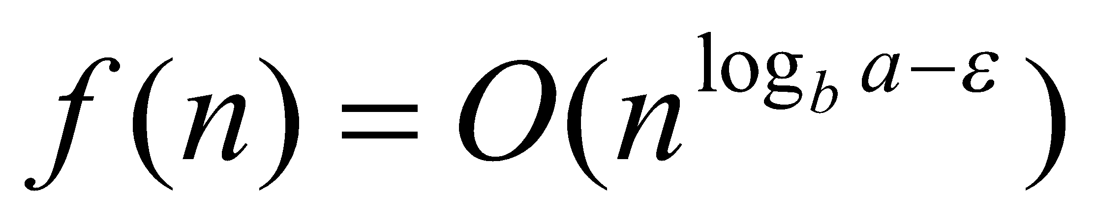
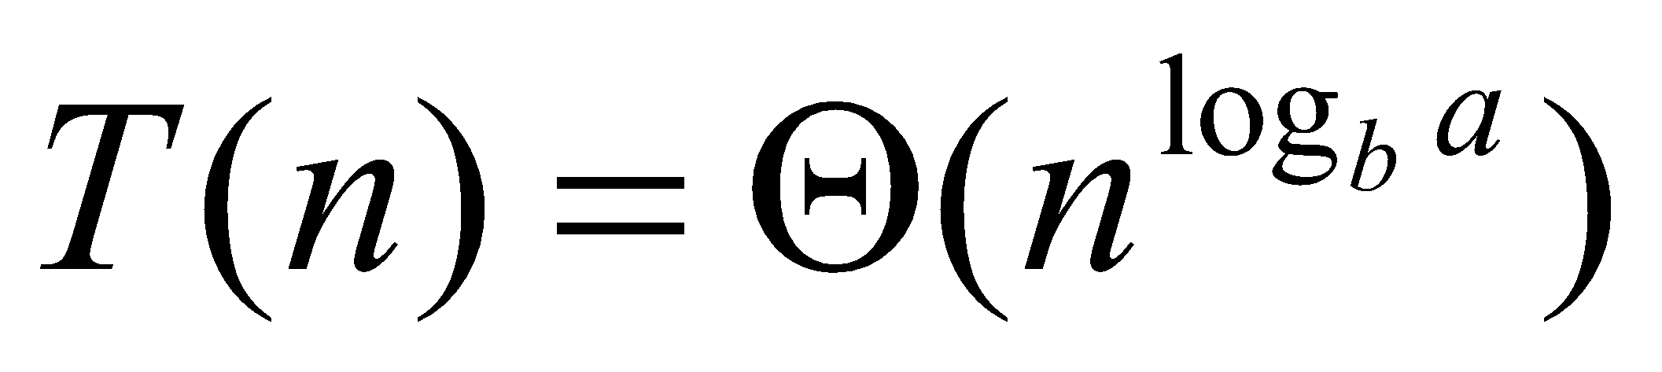
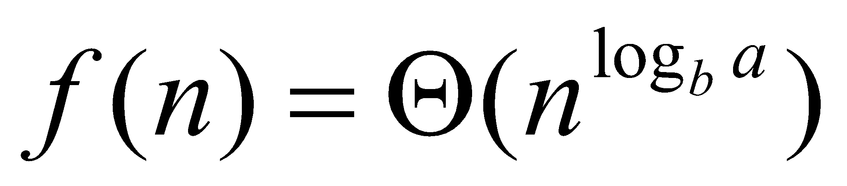
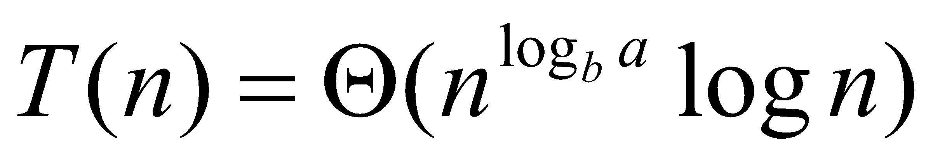
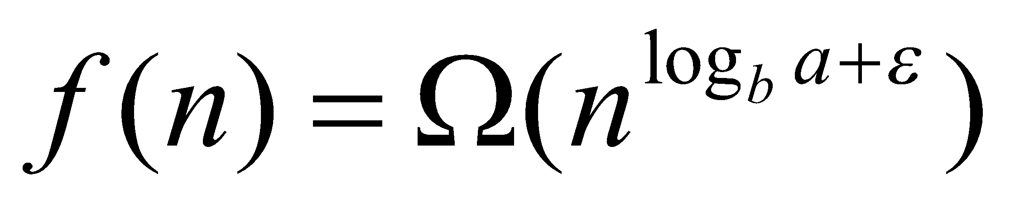
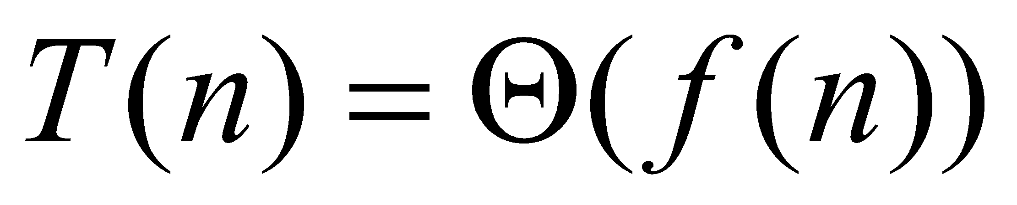
Master Method (4. 3)
Recurrent formula T(n) = a⋅T(n/b) + f(n)
1) if for some ε > 0 then
2) if then
3) if for some ε > 0 and a⋅ f(n/b)≤ c⋅ f(n) for some c < 1 then

Slide 2
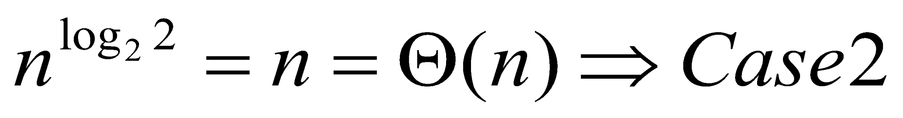
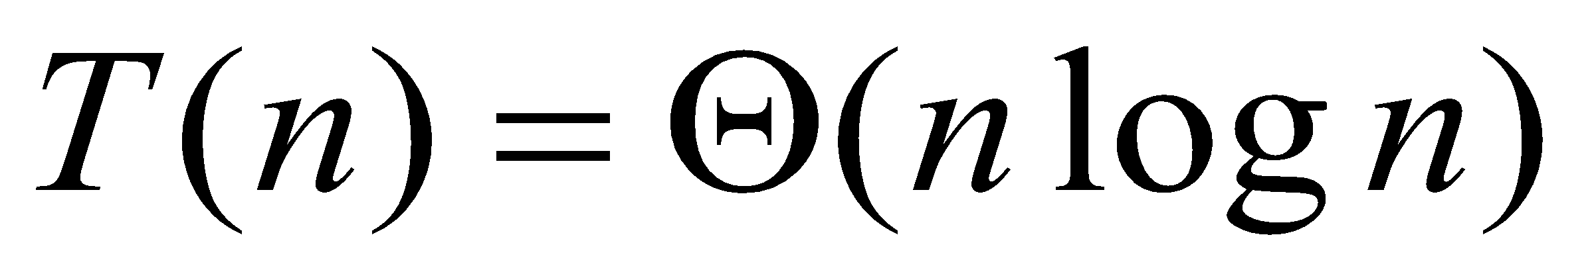
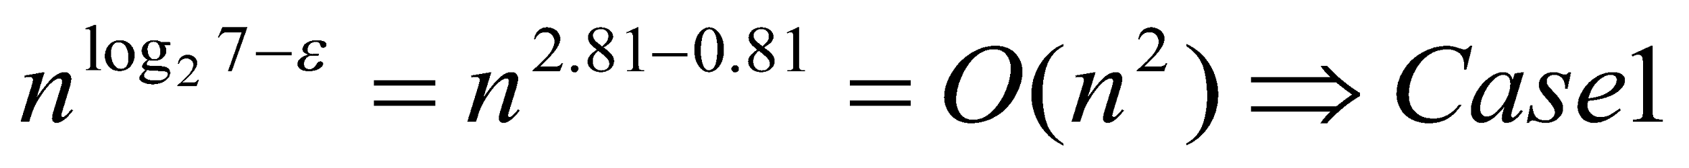
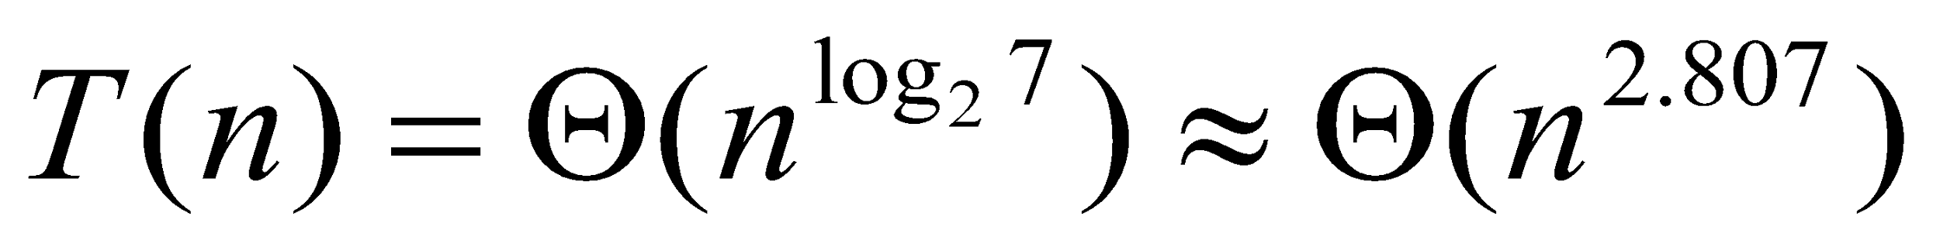
Master Method Examples
Merge sort T(n) = 2T(n/2) + Θ(n)
Strassen T(n) = 7T(n/2) + Θ(n^2)
Home Work: 4-1, p.72 and
4-7, p.75 (find simple solution with n-1 tests)

Slide 3
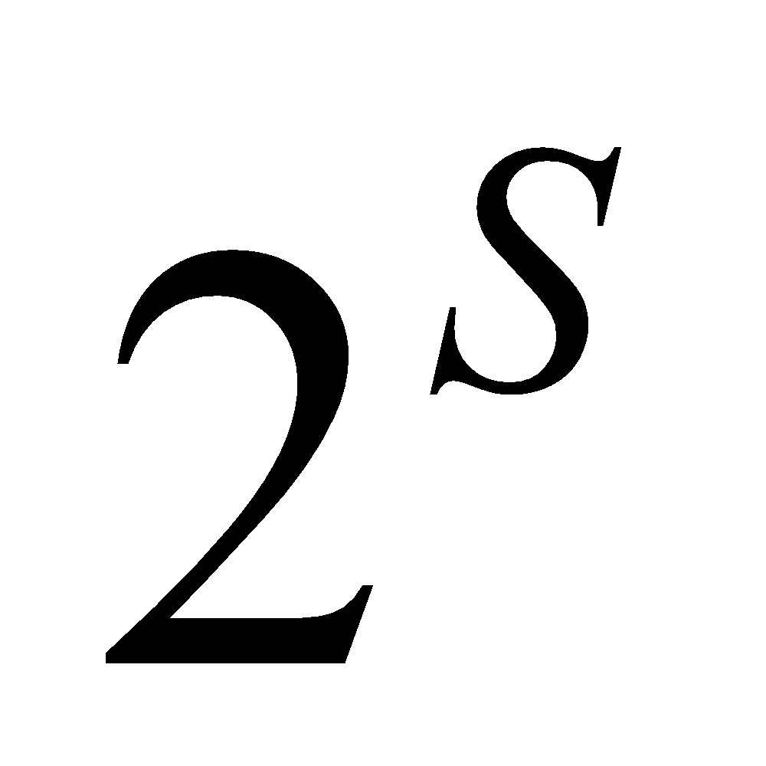
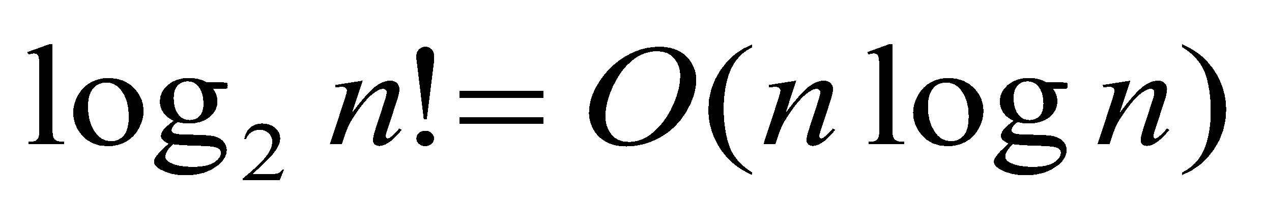
Discrete Probabilities
Sample space (set) S of events
Probability axioms on distribution
Pr{}: → ℜ
Pr{A} ≥ 0;
Pr{S} =1;
Pr{A∪B}=Pr{A}+Pr{B} if A∩B=∅
Home Work
Prove that the number of comparisons for sorting n numbers cannot be less than

Slide 4
Problems
3 boxes with one prize:
you choose one box
showman shows you the empty box from the other two
what is better: keep the same box, switch or toss a coin
3 guys on death row: (Home Work)
only one will be not executed tomorrow morning
the guard told that Pete (among two others) will be executed?
before he got the answer the probability was 1/3,
after he got the answer, he is happy: probability 1/2
should he? what’s wrong?

Slide 5
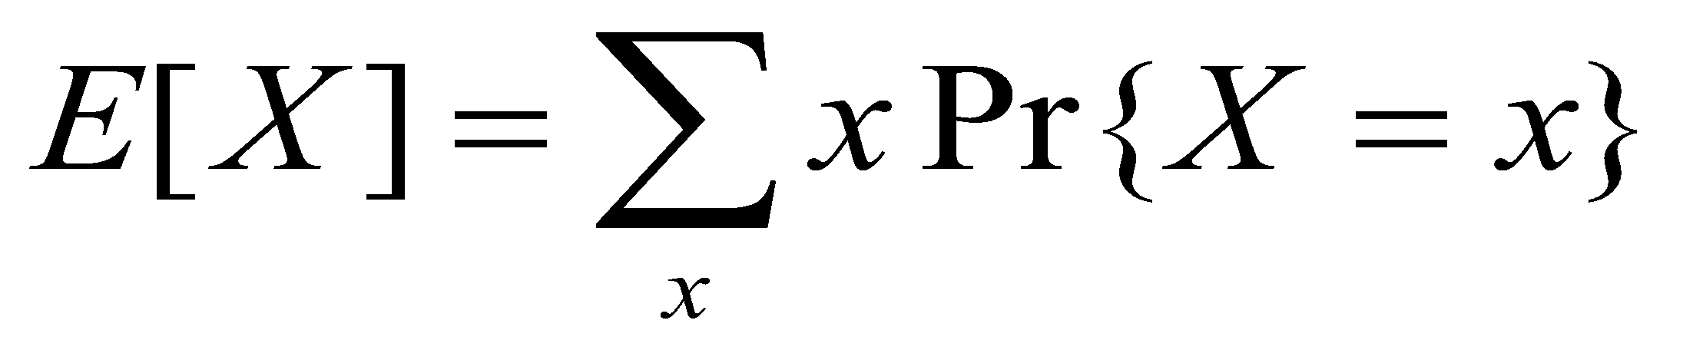
Discrete Probabilities 6.2-6.3
A random variable X ≡ function from set S → ℜ
{X = x} means subset of S s.t. {s ∈ S: X(s) = x}
Uniform distribution ≡ equal probability 1/|S|
Expected value (expectation, minimum, average)
Example: Dice, X = sum of dice
long way: Pr{X=1}=0, Pr{X=2}=1/36,..., Pr{x=5}=4/36,..., Pr{12}=1/36 ⇒ E[X] = 7
short way: E[X1+X2] = E[X1] + E[X2] ⇒
E[X1] = E[X2] = (1 + 2 + ... + 6)/6 = 3.5 ⇒ E[X] = 7

Slide 6
Randomized Quicksort
Randomized algorithms:
includes (pseudo)random-number generator
the behavior depends not only from the input but from random-number generator also
Simple approach: permute randomly the input
same result but more difficult to analyze
Partition around first element: O(n^2) worst-case
Partition around randomly chosen element

