Slide 1
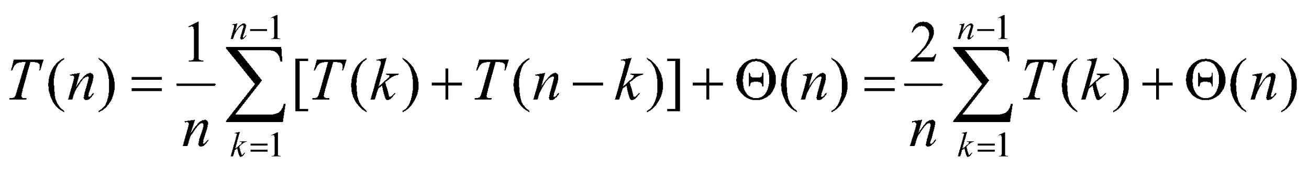
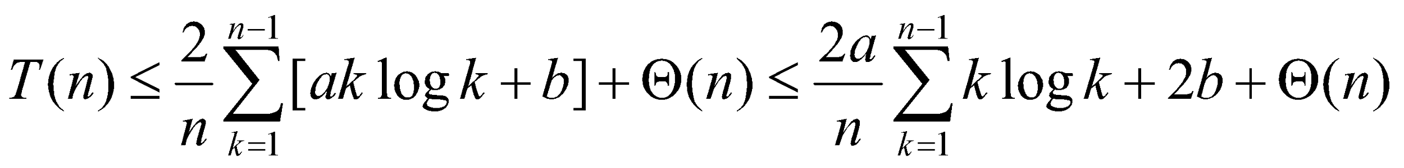
Randomized Quicksort
Randomized Quicksort
i = Random(p, r)
swap A[p] ↔ A[i]
partition A(p, r)
Average analysis = Expected runtime
solving recurrence ≡ T(n) ≤ a⋅ n⋅ log n + b
by induction, it is true for k < n, need to show

Slide 2
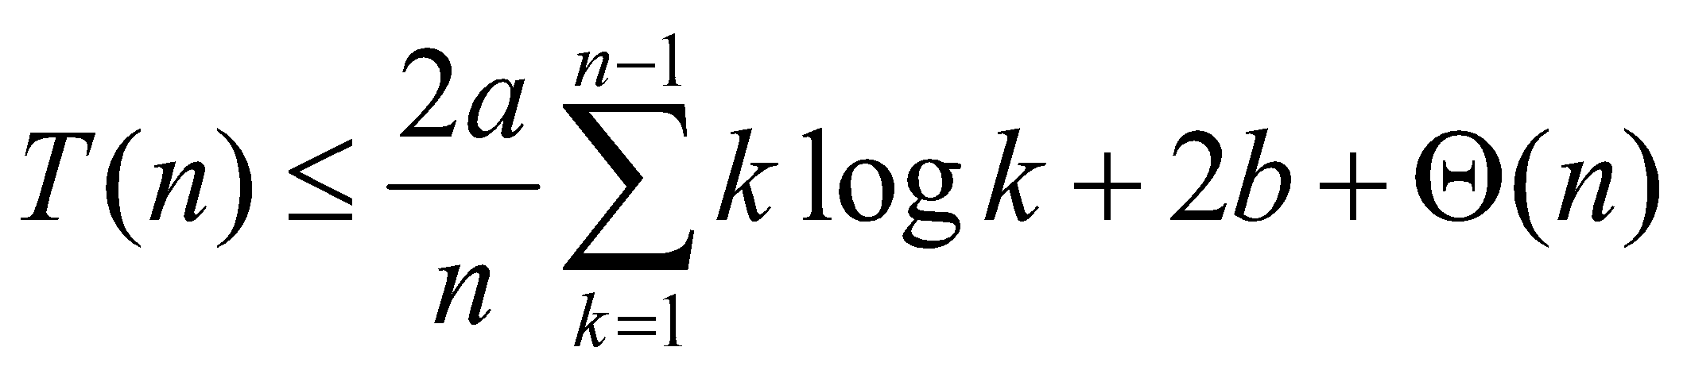
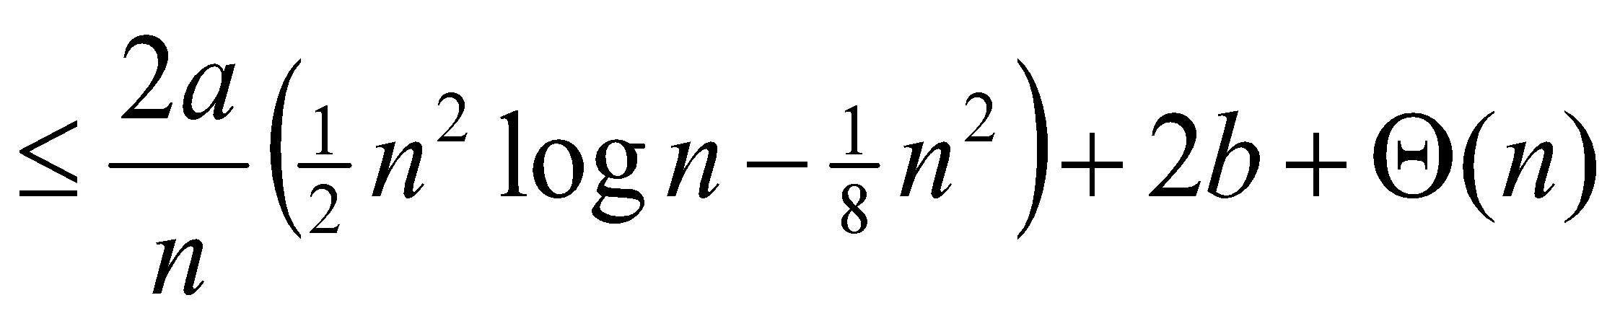
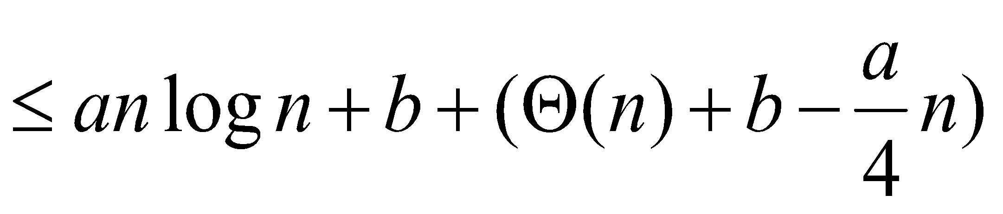
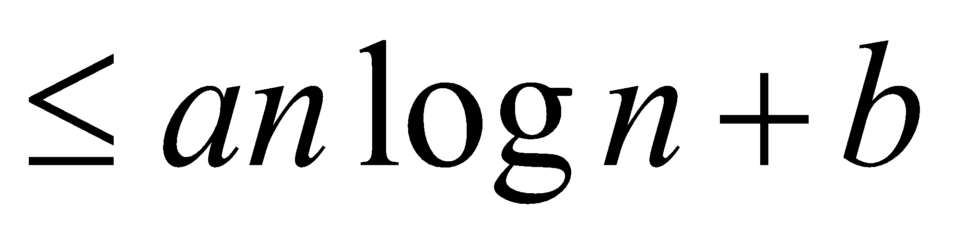
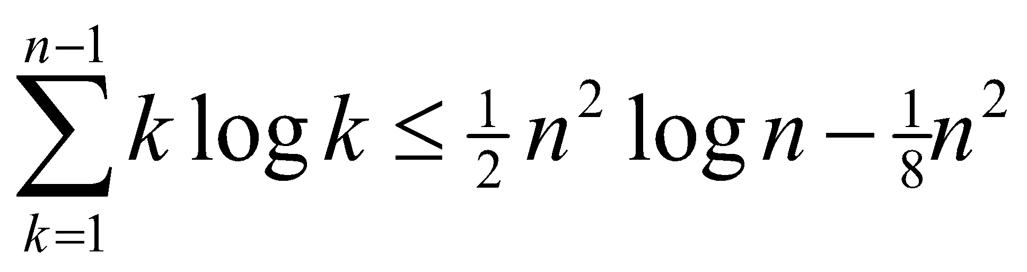
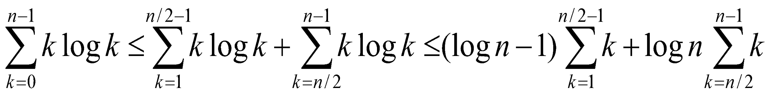
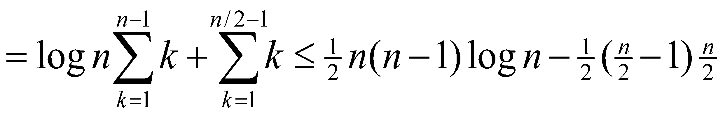
Average Time Analysis

Slide 3
Min & Max
Given n numbers A[1], ..., A[n], find maximum
at least n-1 comparisons - 1 for each entry
Simultaneous max and min
MAX
MIN
3(n/2) comparisons

Slide 4
Selection Problem
Slelection Problem
Given n numbers A[1], ..., A[n],
find i-th element, i.e. which is bigger than i-1
Can be solved by sorting (inefficient)
Randomized algorithm
randomized partition into 2 parts
find where the i-th element (on the left or on the right)
find the new number of the i-th in the corr. part
recursively repeat for the corr.part (only one part!)
Excellent in practice

Slide 5
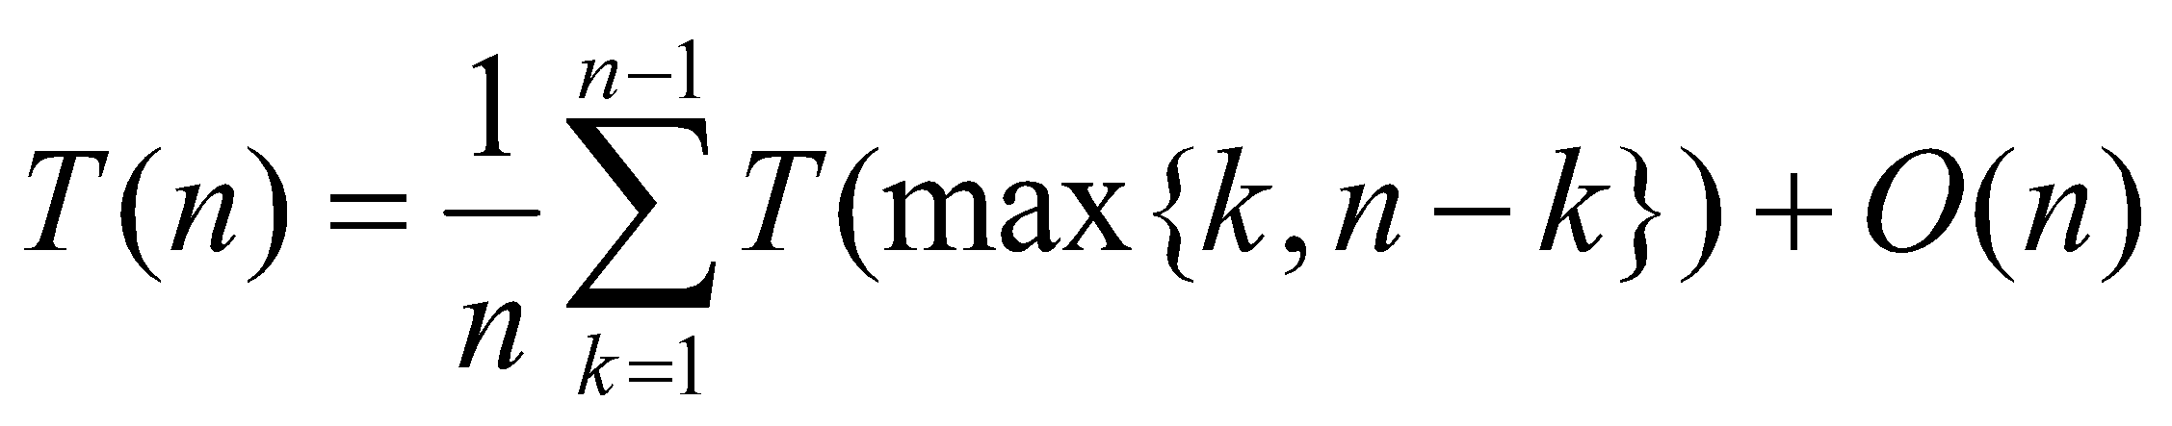
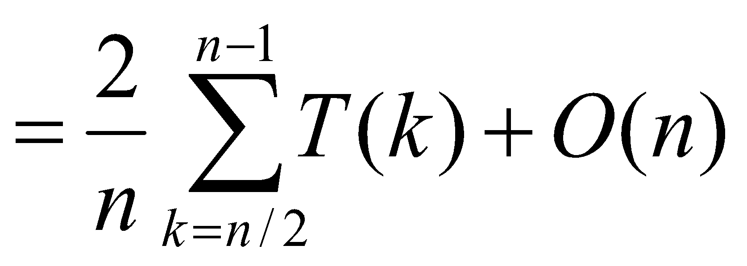
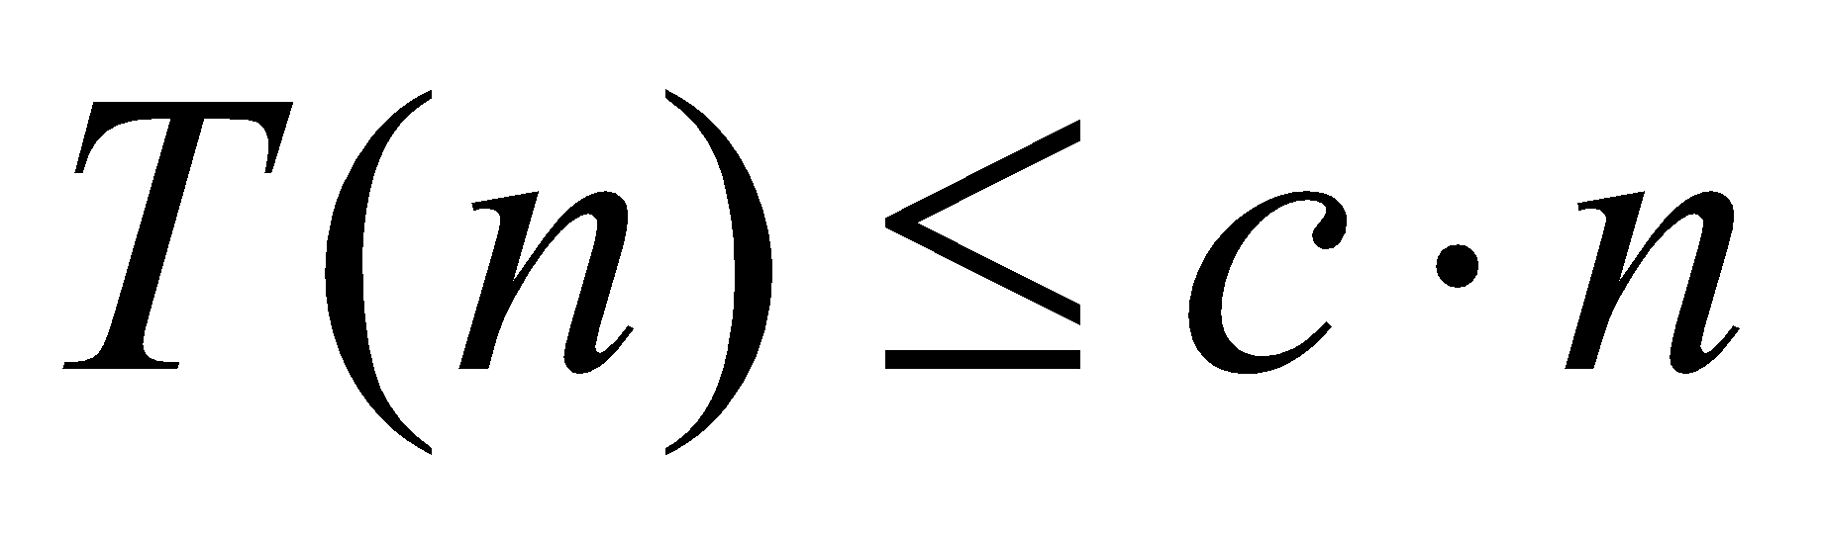
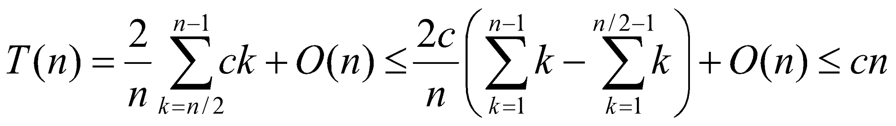
Selection Problem
Average time analysis
Inductive hypothesis:

Slide 6
WC Linear Selection
Theoretical interest only
How to find pseudo-median in linear time:
divide into groups of 5
find the median of each group
find the median x of medians recursively
What do we find? 1 : 3 partition
Recursion: T(n) = T(n/5) +O(n) ⇒ T(n) = O(n)

Slide 7
WC Linear Selection
How to find the i-th:
Partition n elements around pseudo-median
find the part containing the i-th
recursively continue until 5 elements left
Recursion:
T(n) = T(n/(4/3)) +O(n) ⇒ T(n) = O(n)
Master method: still constant

