Slide 1
Dynamic Programming
The 3-d Paradigm
1st = Divide and Conquer
2nd = Greedy Algorithm
Dynamic Programming = metatechnique (not a particular algorithm)
Programming = ``tableau method’’, not writing a code

Slide 2
Longest Common Subsequence
Problem: Given x[1..m] and y[1..n], find LCS
x: A B C B D A B
⇒ B C B A
y: B D C A B A
Brute-force algorithm:
  for every subsequence of x check if it is in y
  O(n2^{m} ) time
    2^{m} subsequences of x (each element either in or out
    O(n) for scanning y with x-subsequence (m ≤ n)

Slide 3
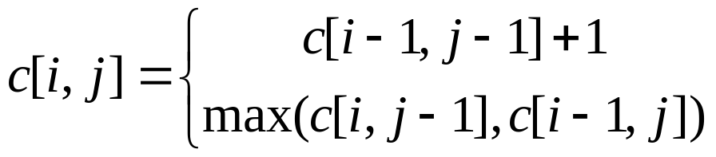
Recurrent Formula for LCS (16.3)
Let c[i,j] = length of LCS of X[i]=x[1..i],Y[j]= y[1..j]
Then c[m,n] = length of LCS of x and y
Theorem:
  if x[i] = y[j]
  otherwise
Proof. x[i] = y[j] ⇒
  LCS([X[i],Y[j]) = LCS(X[i-1],Y[j-1]) + x[i]

Slide 4
DP properties
1st Observation:
any part of the optimal answer is also optimal
  The subsequence of LCS(X,Y) is LCS for some subsequences of X and Y.
2nd Observation:
subproblems overlap
  LCS(X[m],Y[n-1]) and LCS(X[m-1],Y[n]) has common subproblem LCS(X[m-1],Y[n-1])
  There are few problems in total = mn for LCS
  Unlike divide and conquer

Slide 5
DP
After computing solution of a subproblem, store in table
Time = O(mn)
When computing c[i,j] we need O(1) time if we have:
  x[i], y[j]
  c[i,j-1]
  c[i-1,j]
  c[i-1,j-1]

Slide 6
DP Table for LCS
y B D C A B A
x
A
B
C
B
D
A
B

