Slide 1

UCWS SINGAPORE 2026 · SKILLS TRACK
BakerySense
A self-evolving operations harness for bakeries and perishable SMEs.
It turns sales history into tomorrow's bake plan — then learns from its own decisions, evolving a different playbook for every shop, under one-tap human approval.
bakerysense.swmengappdev.workers.dev · github.com/Whyme-Labs/bakerysense

Slide 2
THE PROBLEM
30–40%
The waste isn't ignorance — it's uncertainty. Forecasts are never perfectly calibrated. Every branch behaves differently. No busy owner notices that croissants quietly run 25% high every Wednesday at one shop, and every Sunday at another. That blind spot is pure margin on the floor.
of everything an independent bakery bakes is thrown out.

Slide 3
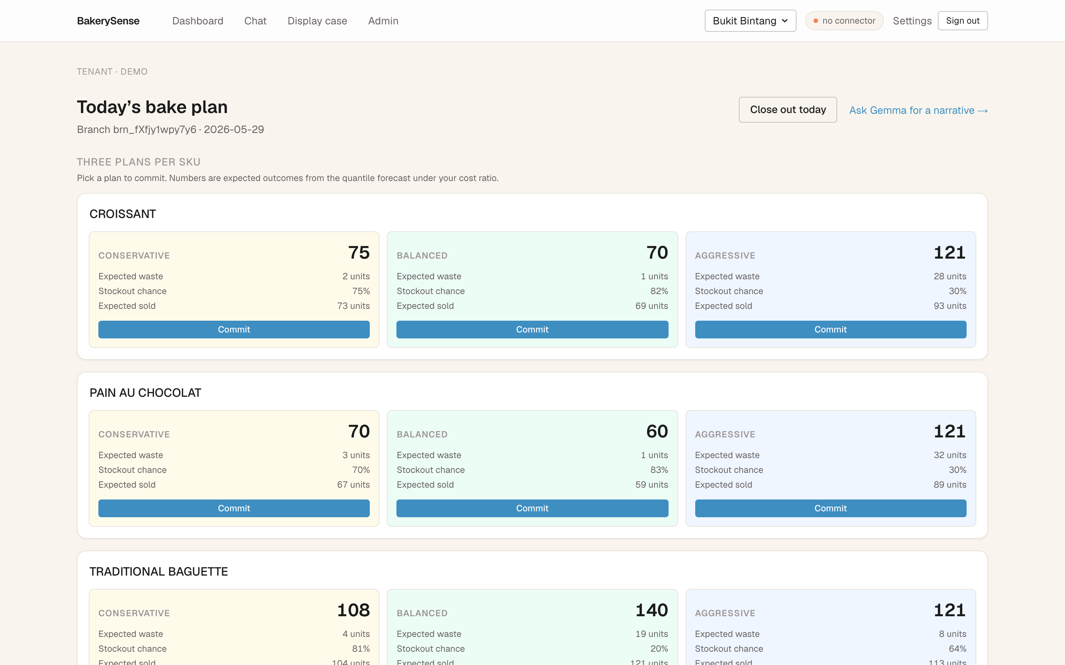
WHAT IT DOES
Tomorrow's bake plan, as a decision — not a chatbot
Three plans per SKU. Conservative · Balanced · Aggressive — each with expected waste, stockout chance, and units sold, picked by newsvendor math from a quantile forecast under the shop's own cost ratio. One tap commits the call.

Slide 4
THE DIFFERENTIATOR · WHY SKILLS TRACK
It learns from its own decisions
1
2
3
4
diagnose
propose
validate
approve
Classify every miss. Stockout-censored, operator override, one-off event, or a genuine skill fault — only the last one is learnable.
Emit a bounded, learning-rate-capped correction to a version-controlled skill artifact (not the model).
Re-score on a strictly held-out window. The edit must measurably cut error before anyone sees it.
The owner approves in one tap. Controlled autonomy — every edit is validated and auditable.
The forecasting model stays frozen. The skills evolve.

Slide 5
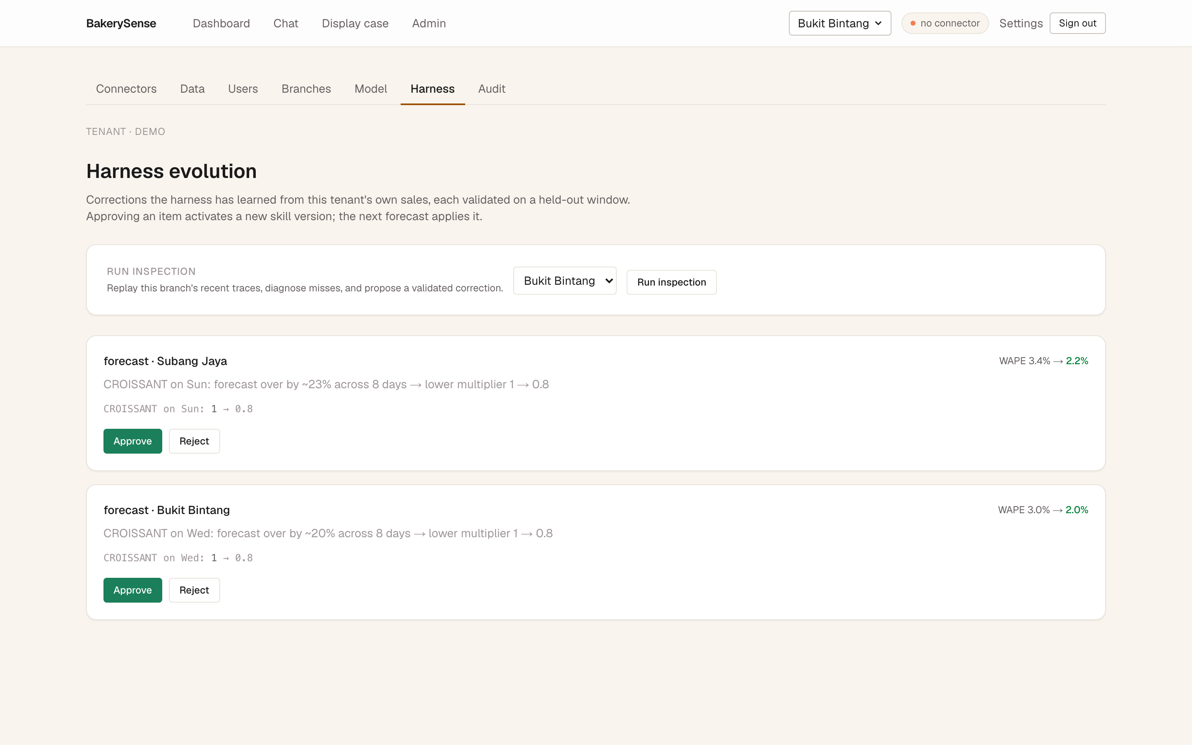
SELF-INSPECTION IN ACTION
Corrections it taught itself, waiting for review
Every night, the harness replays its traces and proposes validated fixes. Bukit Bintang: croissants +25% on Wednesdays. Held-out WAPE 3.0% → 2.0%. CROISSANT · Wed 1.00 → 0.80

Slide 6
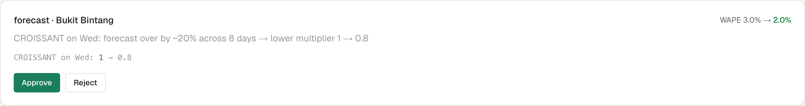

THE WOW · PER-BRANCH EVOLUTION
Same brand, same model — different playbooks
Bukit Bintang
Subang Jaya
CROISSANT · Wed → 0.80
CROISSANT · Sun → 0.80
learned Wednesdays on its own
learned Sundays on its own
Each shop becomes its own agent with its own skill set — branch skills are sparse overrides on brand defaults. A federation of self-evolving shops.

Slide 7
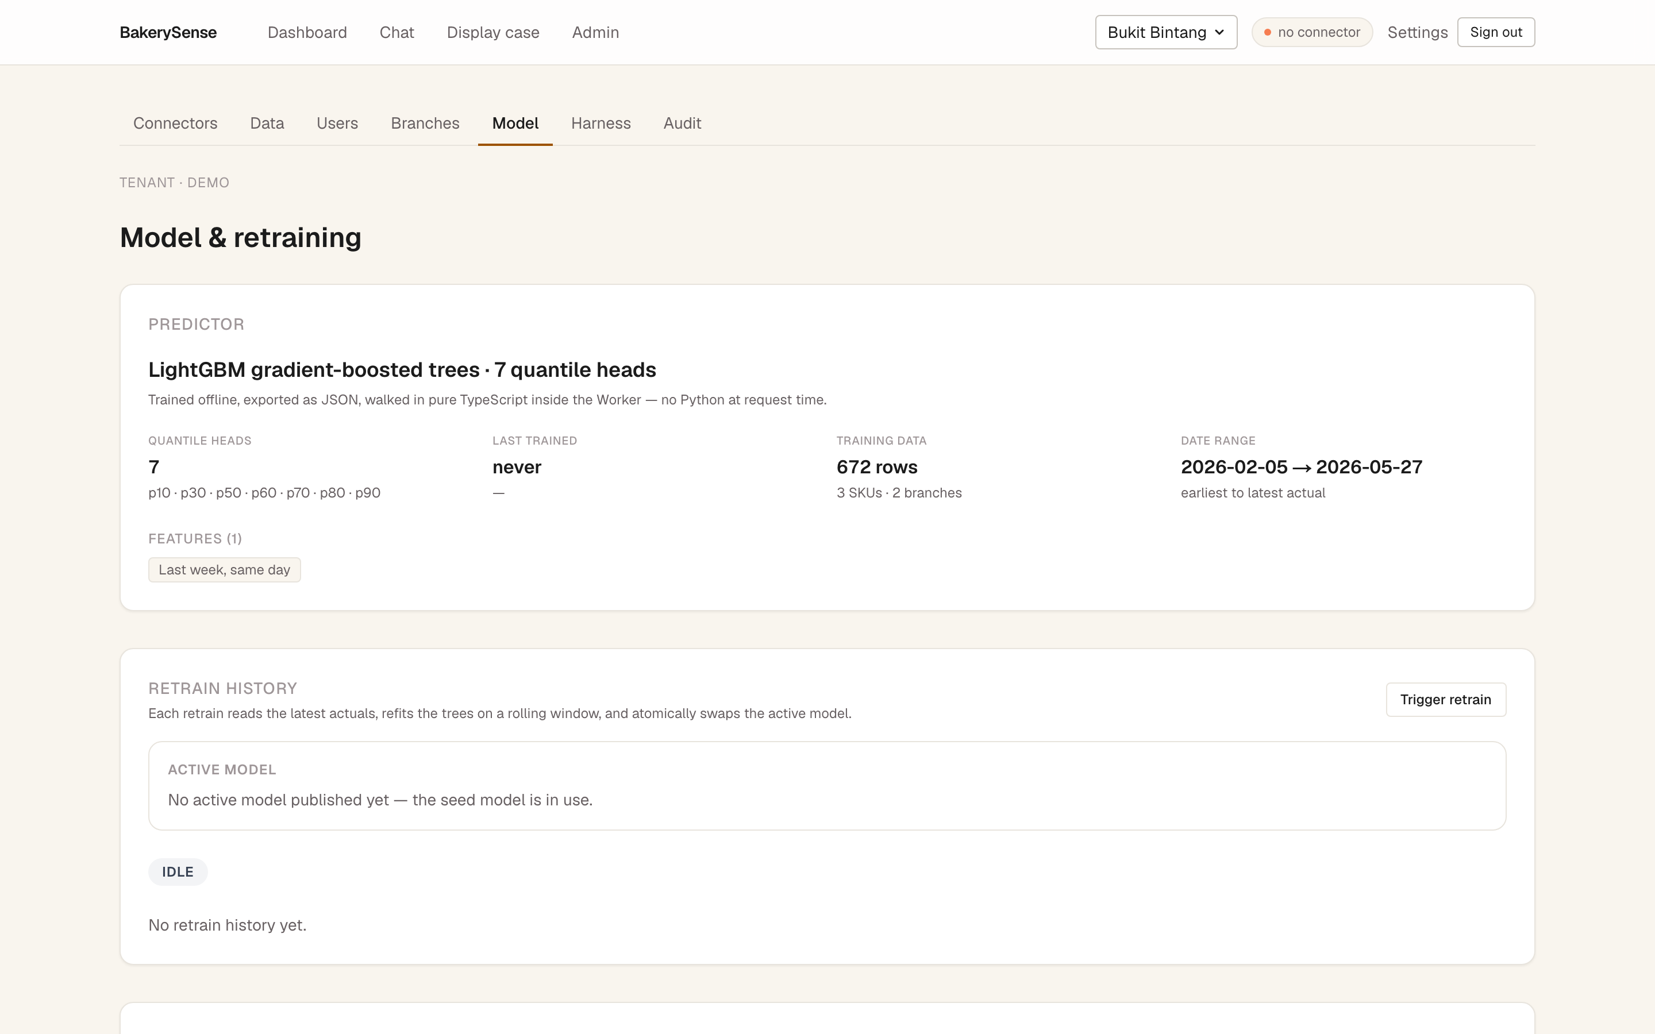
EXECUTION OVER POLISH
A working loop on live infrastructure — not a mockup
285
100%
Live
tests passing
deterministic numbers
on Cloudflare D1
Deterministic numbers, semantic Gemma. Quantities come from a LightGBM quantile forecaster + newsvendor — never hallucinated. Gemma 4 is the narration and explanation layer. That split is what makes recommendations trustworthy to a real operator — and it's what gets the harness's edits past validation instead of vibes.

Slide 8
GLOBAL SCALABILITY
One harness, every perishable business
Bakeries
Cafés
Grocers
Florists
Cloud kitchens
Central kitchens
The brand→branch skill hierarchy scales to chains. Only learned rule diffs propagate — not raw sales — so it preserves each shop's data privacy while sharing what works.
Real product value · execution quality · global scalability.

Slide 9
GET STARTED
Try it in 30 seconds
Live demo bakerysense.swmengappdev.workers.dev
Sign in demo@bs.co / Password2026Password (slug: demo)
Money shot Admin → Harness — two branches, two different learned fixes, awaiting approval.
Repo
github.com/Whyme-Labs/bakerysense
BakerySense · Whyme Labs · UCWS Singapore 2026 · Skills track

