Slide 1
Part Syun

Slide 2
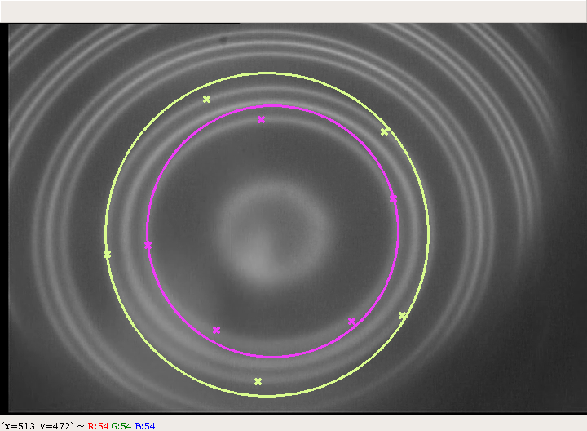
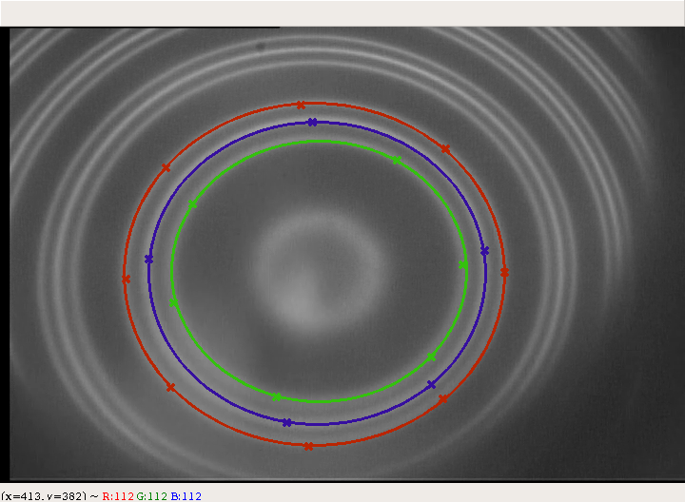
Data Analyse
Use circle to fit data is not enough, we have to write a programme to fit data.

Slide 3
There are two methods to calc \Delta k, one of them is
$\Delta k=\frac{1}{2\mu t}(\frac{r_{p+1,a}^2}{r_{p+1,a}^2-r_{p,a}^2}-\frac{r_{p+1,b}^2}{r_{p+1,b}^2-r_{p,b}^2})$
The another method is
$\Delta k=\frac{1}{2\mu t}\frac{\delta}{\Delta}$
The second method Is better

Slide 4
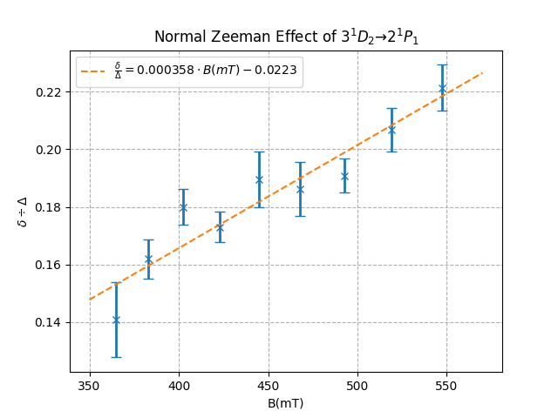
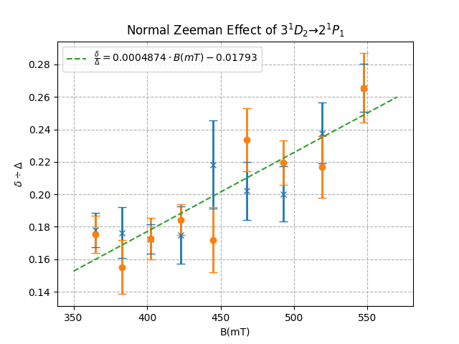
And finally

