Slide 1
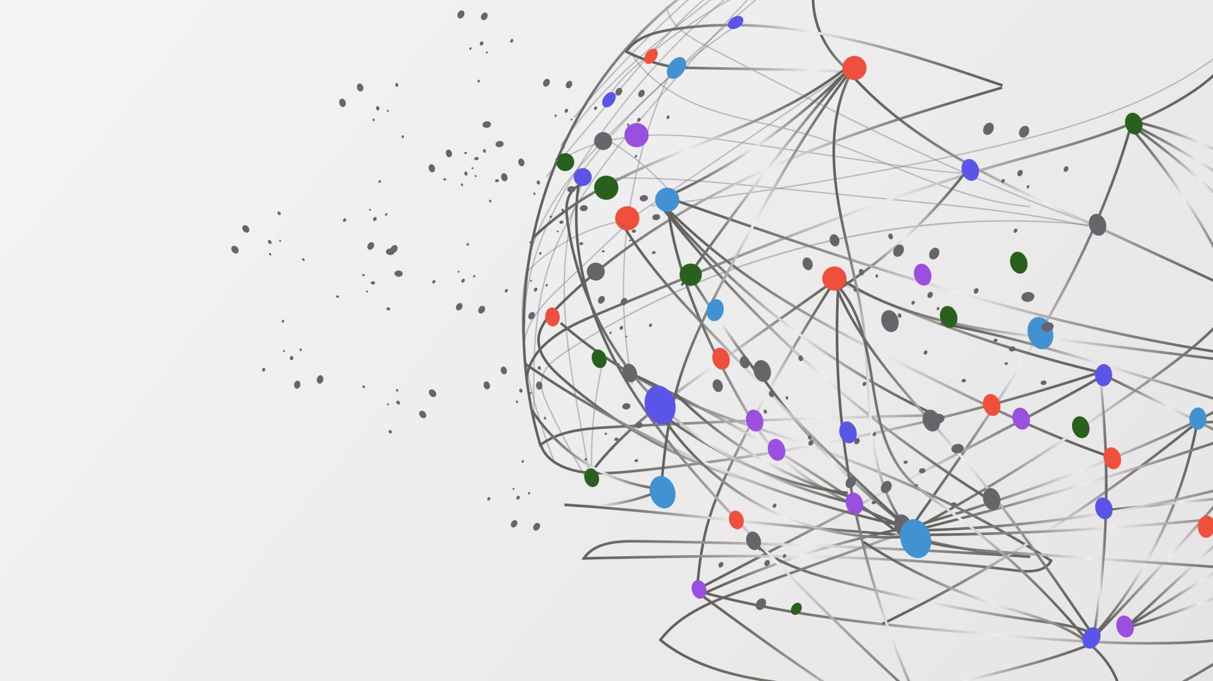
UCLA_WiDS_Team_2

