Slide 1
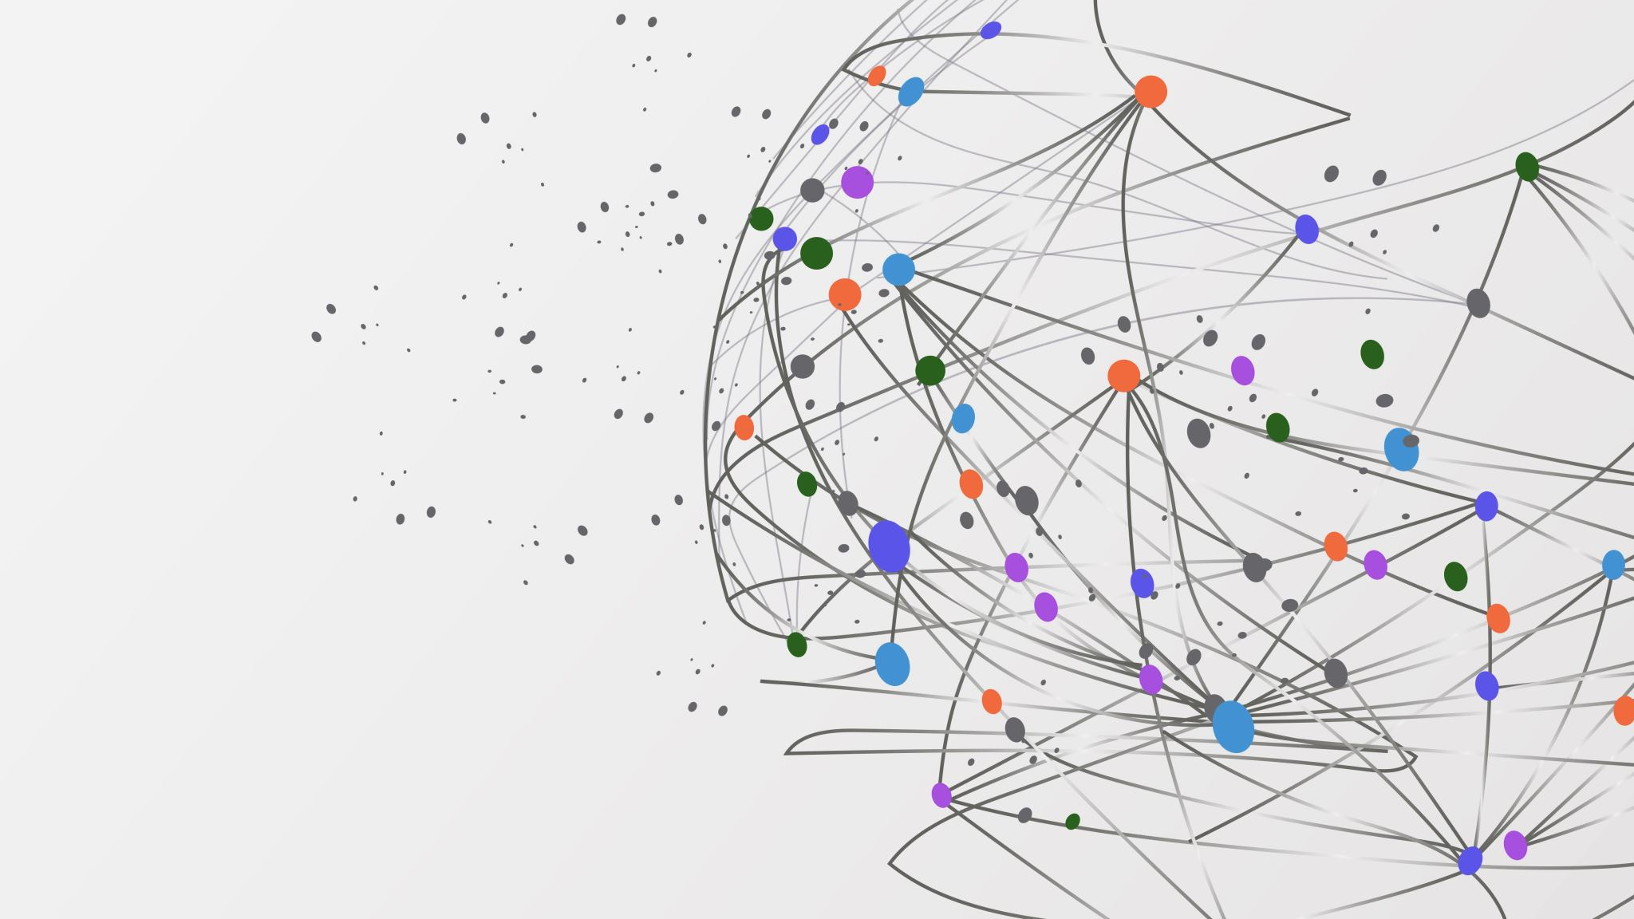
WiDS Datathon 2025
Break Through Tech AI @ UCLA Team 2
Shubhangi Waldiya, Ami Rajesh, Mariia Nikitash, Itzalen Lopez

