Slide 1
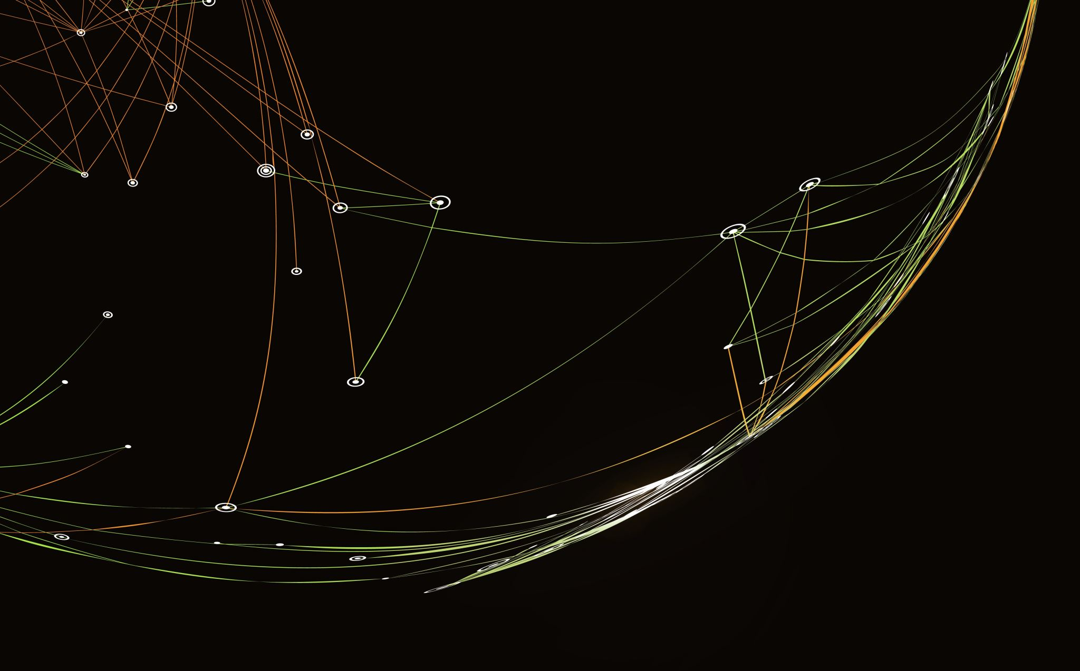
WiDS Datathon 2025
Break Through Tech AI @ UCLA Team 2
Shubhangi Waldiya, Ami Rajesh, Mariia Nikitash, Itzalen Lopez

Slide 2
Introduction to WiDS Datathon
This is a datathon hosted on Kaggle (https://www.kaggle.com/competitions/widsdatathon2025/overview)
We competed as a team through the Break Through Tech AI program at UCLA
Goal: to build a model to predict an individual’s sex and their ADHD diagnosis using functional functional brain imaging data of children and adolescents and their socio-demographic, emotions, and parenting information
Target variables:
ADHD_Outcome: Type of Diagnosis (0=Other/None, 1=ADHD) Sex_F: Sex of participant (0=Male, 1=Female)

Slide 3
Preliminary Planning
We created an initial project plan on Notion (https://www.notion.so/Spring-AI-Studio-Sprint-Planning-1865e0fb585080d8a089e92641db6bd2)
Determined which models to try
Fill in more stuff here
Need to update notes.docx and models to try.docx
CRISP-DM
Business Understanding: we researched different models, focusing on ones that specialize in binary classification
Data Understanding: we looked through the datasets together
Data Preparation: we each completed similar steps but

Slide 4
Data Preparation (steps + results)
Shubhangi_Data_Prep
Fill in steps
Mariia_Data_Prep
Fill in steps

Slide 5
Modeling + Evaluation
Decision Tree
PROCESS +RESULTS
Random Forest
PROCESS +RESULTS

Slide 6
BEST PERFORMING MODEL
Highest Accuracy: 76.031%
COMBINED.ipynb
Best decision tree model predicted the ADHD column
Optimized random forest model predicted the SEX column
Adjustments of parameter values to find the best model
Include a graphic about the model

