Slide 1
All Things Data Science
Notes:
Hey guys, I’m really excited to be here. I hope you re too. Thank you all for coming to the college on a Saturday morning. Calls for an applause!
(Move to Next Slide)

Slide 3
@Kritika_Jalan
I Love Data Science and Spoken Word Poetries
Notes:
To tell you about myself, I am Kritika Jalan, and I like to call myself poetic data nerd because of my obvious love for data science and not-so-obvious love for Poetry. To connect with me, find me on Twitter/Medium/LinkedIn with this name.
Approximately 3 years back, I completed my graduation in Information Technology. Like most of you here, I used to read just enough for me to clear the semester-end examinations. I was the kind of girl who believed ‘College gets you ready for the real world’. I used to belive doing great in whatever institution you are with right now builds the leaders, doing great in your examinations lands great jobs, revising the course twice lands you even better. Dumbass, I know!
As a result of my belief, I learned nothing substantial during my college days
Although, there was this one thing I always wanted. I wanted to stand out from the crowd, always wanted to be the black sheep of my family, always wanted to be relevant.
So in my final year, I started trying out every other thing, like taking a course on parallel programming, registering with HackerEarth, building applications using Java, learning android and creating mobile apps, taking up a project in Natural Language Processing using Support Vector Machines, submitting papers to international journals, participating in hack-a-thons. Phew! Anything and Everything. You guessed it right, I wasn't going anywhere with this
Amidst all this, I got placed in a company that calls itself 'Big data analytics and Decision Sciences firm'. Heavy, I know (Move to next slide)

Slide 4
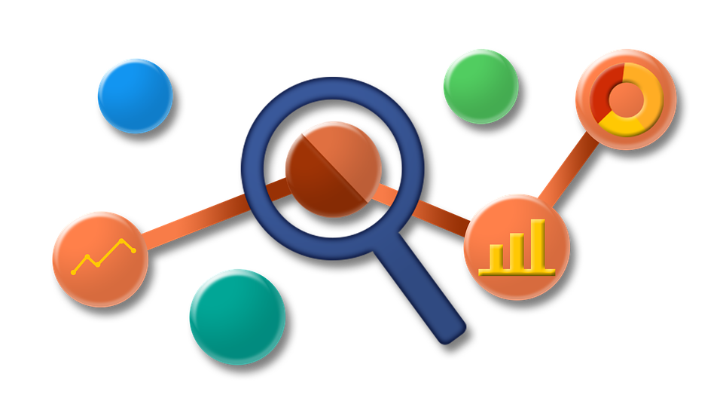
Big Data Analytics and Decision Sciences
Notes:
Let's break this phrase down and look at each of the terms. Big Data. Let me tell you what the hype is all about. Big data, is like any other data but in abundance.
When we start creating data at a speed far more than what we can consume it at, we call it big data. For example look at these numbers.
(Move to next slide)

Slide 5





Why they call it BIG DATA?
~3 Billion Likes Everyday
~8 Years of Video/day
~3.5 Billion Searches/day
~95 Million Posts/day
~0.1 Million Orders/day
~4 Million Transxn/day
~26.5 Million items/day
~0.1 Million Tickets/day
Notes:
This is the amount of data we create on these websites every single day. Not just over the internet, your offline activities become data too. For example your visit to a hotel (google maps capture it), the medical claims that you file with insurance companies, the purchases you make at a supermarket and boy, if you're wearing a fitbit, that little thing is tracking every step of yours (how creepy is that!)
What do these companies do with this kind of data? By building some processes on this data, they create a storytelling machine out of it.
This machine tells them how their company is doing and what can they do to make it work better. Let's take an example of a Telecom company to understand this better.
We all use cellphones, yeah. Suppose I am a telecom company based in India. I capture all sorts of data for each of my customer. When did this customer joined our network, when he made a particular call, how long was the call, what's his internet usage, so on and so forth.
Using this customer level information, I can track every month, how his call usage changes. I can also track if he made a service call to my customer care, I can track if he removed sim card. I can basically track my user behaviour. I can also answer summary questions like, what is my average revenue per user, which geographical areas are doing better than others, which data pack is the most valuable for my customers etc. This is called descriptive analytics. You use the data to describe your business.
Now, when I start answering questions like, how many customer will port out of my network in 2017, which data pack will a particular customer likely subscribe to in next month, how busy will be my network on holi etc. This becomes predictive analytics. When you build models to predict future events based on data, it is called predictive analytics which essentially uses data science techniques.
(Move to next slide)

Slide 6
Big Data Analytics and Decision Sciences
WHAT
WHY
Notes:
Every analysis that you do using this huge data is called big data analytics. Now what do we mean by decision sciences? Yeah, we just put science everywhere to make things sound fancy. But decisions, that is important.
Let's go back to the telecom example. What we have till now is the answer to questions starting with ‘What’. Until I know answers to questions starting with ‘Why’, the information is not good enough. I know from the data that a person’s call usage is going down, but I should be able to dig deeper and say that he bought another sim to make calls from and he is using my sim just for data. From data I know that I am losing my customer base, but I should be able to dig deeper and say that they are leaving because of the network issues. When I start answering the whys, I start enabling the businesses to take decisions. And decisions, are important. Every company is looking for someone who can help them answer their business questions in a way that can help them take data driven decisions
The rate at which data is growing, businesses of all sizes will be using it to help them take decisions and impact their revenues. Whether you go on to work with another company or you build your own, data is going to be crucial. Imagine the kind of things you can build, the kind of questions you can answer, the kind of questions you can ask when you have the capability to find patterns in data. Imagine how relevant you feel with the ability to use data and create models that can predict the future before you make decisions. But you may ask, how do I get started?
(Move to next slide)

Slide 7


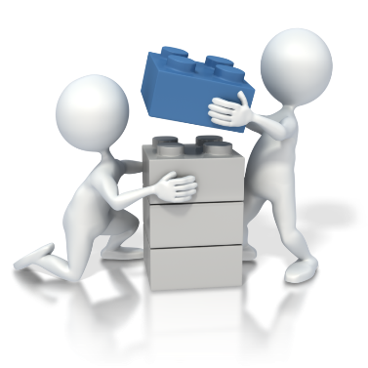
BECOMING DATA SCIENTIST
1
2
3
ACQUIRE
BUILD
SHOWCASE
Notes:
There are three steps to becoming a data scientist-
1. Acquire
2. Build
3. Showcase
You acquire the knowledge of building predictive models, you build models that solve a real world problem and lastly, you showcase it for the world to see. This last step is what most of us forget. If you have built something amazing, unless you talk about it, nobody knows about it.
I can tell you how you can acquire the knowledge. I can also tell you how you can showcase. But solving a real world problem is something completely on you
Let's talk about the first step-
Broadly speaking, there are two possible ways to get into the data science world. One, you take formal education after graduation to become a data scientist. The other is you exploit the internet. Both of these have their pros and cons, let's not get into it. I personally didn't want to enroll into an institute and thus, I moved on to become a self-learned data scientist
For those of you, who want to be on their own, here are some takeaways from my experience of ~a year and a half.
(Move to next slide)

Slide 8
ACQUIRE
Choose any language
First ML Course
Statistics and Algebra
SQL Knowledge is Underestimated
Learning by Doing
Don’t get lost in the web
Notes:
Don't invest too much time in choosing the best language to start with. Choose anything and just get started. In the long run, you will anyway end up learning both R and Python. That said, don’t invest too much time in learning nuances of the language. Learn enough basics that can help you with data cleaning, transforming and visualizing.
There are courses avaialble throughout the web, on edX, coursera, udacity, youtube. Just know if the course emphasizes on theory more or the practical aspect of the algorithms. Depending on whether you learn from theory or practicals, choose your first machine learning course. That said, to become a successful data scientist, you will have to understand the limitations and usability of every algorithm apart from just the knowledge of how to apply them.
Data science is evolving at a really fast pace. There are new papers getting published every single day which highly impacts how we solve problems. You should be equiped with the knowledge of Statitics and Algebra to understand these papers. And oh by the way, almost all of these papers also talk about unsolved real world problems that can be solved using the knowledge from those papers itself.
Having learned SQL helps you get an intuition about data and its structure. It makes it really for you to deal with data cleaning and transformation. But most people don’t acknowledge this fact
We talked about languages, algorithms, statistics, SQL. These are all the things that you will be learning in order to get started. And there a lot of resources available on the web for each of them. Make sure you don’t get lost in the web and do your research before getting started with any of the courses or books. Try to sign up for things that helps you build intuition alongwith giving you a handson experience because learning by doing is the best way of going about anything.

Slide 9
SHOWCASE
Flaunt at GitHub
Write Articles
Join Local Meet-ups
Follow Celebrities on Twitter/LinkedIn
Attend Conferences
Believe you are unstoppable
Notes:
Learning in this field is an endless process and thus, leanring, solving problems and showcasing, all of these happen together. So my advice is, create a github account and have everything that you learn or build be published there. Once you have created a github project, write about it on your blog. Be it a publication or medium or data science centric websites like KDNuggets or AnalyticsVidya. Just talk about whatever you have created. Now that you have an article published, show it to the world by posting it on LinkedIn, Twitter. Oh let me tell you, the DS community is really strong and active on both linkedIn and Twitter. Follow established data scientists here. Meet people with similar interests, join local meet-ups or attend such conferences. Keep pushing yourself and believe you are unstoppable

Slide 10
Becoming Data Scientist
SQL
Statistics
ML Techniques
Algebra
Skill Set
Domain Knowledge
Visualization
Notes:
So to summarise, here are the basic skills you will need to become a successful data scientist. SQL, Statistics, Algebra…. There are debates on whether domain knowledge helps or hinders building data science models, but that’s for another day.
So today, I talked about Why you should care about data and How you can learn to analyse data. Now it's on you to decide What you use this powerful resource for. Thank you and all the very best with your careers :)
(Move to next slide)

Slide 11
Thank You

