Slide 1
Behavioural Data Science
Sahiba Chopra
Data Scientist, Margo Networks

Slide 2


NYC: 8.5M
San Francisco: ?

Slide 3
NYC: 8.5M
San Francisco: 864,816

Slide 4
Behavioural Data Science
User behaviour
Incentives
Externalities
Decision making under risk & uncertainty

Slide 5
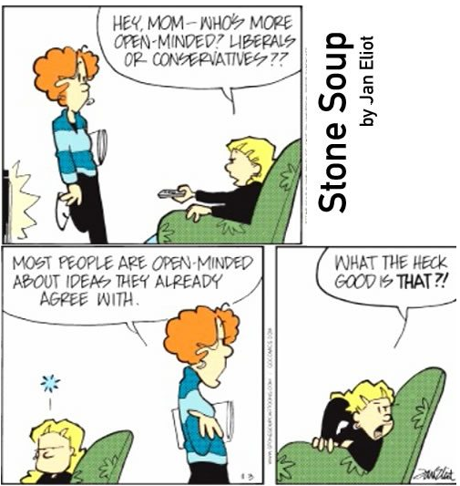

Slide 6
Understand Human Behaviour
Banking: Apps that will notify users of their impulse spending
Wearable fitness devices: Alert users to move based on previous patterns
Marketing: Understanding purchase deferral reasons, cluster visitors according to past behaviour, predict future responses to sales/experience on website

Slide 7
Understand Human Behaviour
Confirmation bias - social media algorithms build a confirmation bias.
Build algorithms that give us a more balanced, accurate view of events?
Do you fact check what your share online?

Slide 8
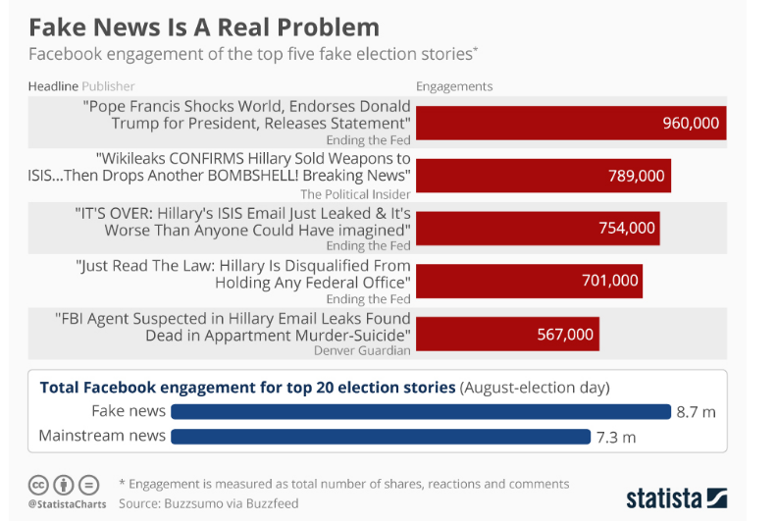

Slide 9
Understand Human Behaviour
Build better policy frameworks that makes it easier for people to ‘opt-in’ to programs
Children eat apples if they are sliced & put in plastic bag

Slide 10
The Last Mile Problem - Oral Rehydration Solution in India
>500,000 infants throughout the developing world die of diarrhea each year
~150,000 of them are in India
>90% of these deaths could be easily averted through the use of a balanced solution of salts
ORS is cheap, easy to find & usage education provided
Why is it not used enough?

Slide 11
The Last Mile Problem - Oral Rehydration Solution in India
A child with diarrhea is constantly leaking fluids
When poor women in India are asked whether to increase or decrease child with diarrhea fluid intake, 35%–50% say that the answer is to decrease it
Keeping the child “dry” is better
Solutions:
Chlorine dispenser at village well
fortifying food that people already eat with extra micro-nutrients, eg routine iodization of salt has vastly reduced problems of iodine deficiency.

Slide 12
You can do it!
You can do it - Kaggle, blogs

Slide 13
Understand Your Behaviour
Learning something new is HARD
You’re not getting stuck: your neural connections are getting stronger
Reframe how you think about your own potential
Negotiate a salary by asking for more than your position; let HR negotiate down
Celebrate the process, not the outcome
Be aware of the sunk cost fallacy

Slide 14
Sunk Cost Fallacy
Assume you have spent INR 1500 on a ticket for a play at NCPA, and then a few days later bought a ticket to watch Padmavat or any movie that you want to watch really badly for INR 600. Now imagine, that by mistake you booked both tickets for the same day and the show timings overlap. The tickets couldn’t be refunded or resold. Which show do you choose?
The thing to remember is this: you can’t get that investment back. It’s gone. Don’t let it cloud your judgement in whatever decision you’re making in this moment—let it remain in the past.

Slide 15
Recognising External Triggers
App notifications keep us coming back for more
impacts our attention & well being
Time inconsistency: our present self behaving in ways that contract our future desires
Moment survey of 200,000 people shows that people regret time spent on social media apps but still spend the most time on them
Big Data on people’s interaction with links: how they feel after interacting with app content

Slide 16
Responsibilities as Data Scientist
“The human understanding when it has once adopted an opinion (either as being the received opinion or as being agreeable to itself) draws all things else to support and agree with it.”
– Francis Bacon
Don’t fall for the “makes sense stopping rule”
Seek evidence to the contrary; are outliers really outliers?
Always look for more data than what’s available
Build products & algorithms that help instead of exploit human behaviour

Slide 17
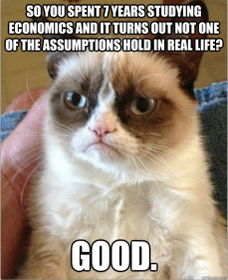

Slide 18
Thank you!
sahiba.chopra@sugarboxnetworks.com

