Slide 1
OVERVIEW OF POLITICAL DATA & INDIAN PARLIAMENTARY RESEARCH
WiDS Mumbai - 2018

Slide 2
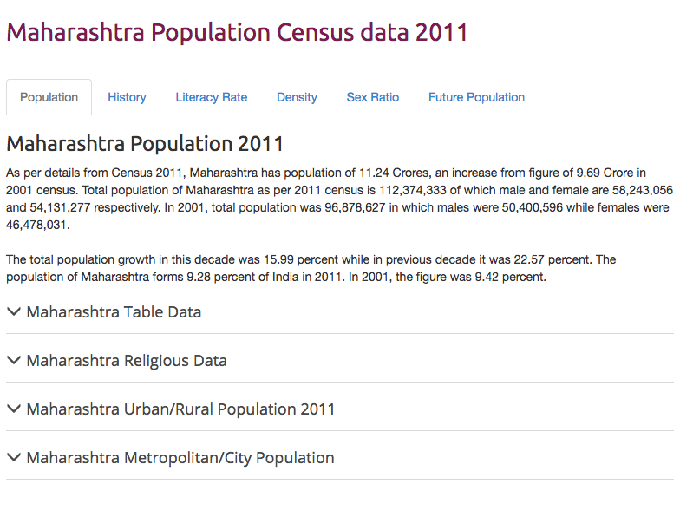
What is Political Data
Experimental Data
Not Feasible
Observed Data
Surveys, Census
Election Results

Slide 3
Formats of Data
Inconsistencies in spellings, logic
Regional Languages
PDFs, PDFs… and more PDFs!
Lack of authoritative sources
Notes:
(Census 2011 – 640, RBI – 644, State Planning Commission – 556)

Slide 4
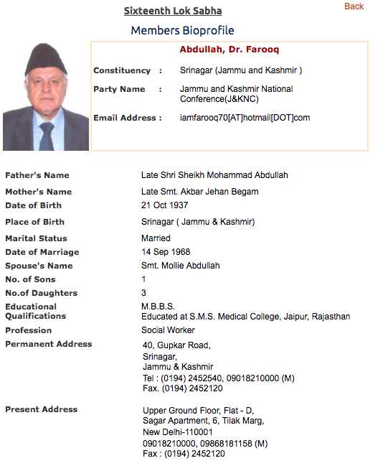
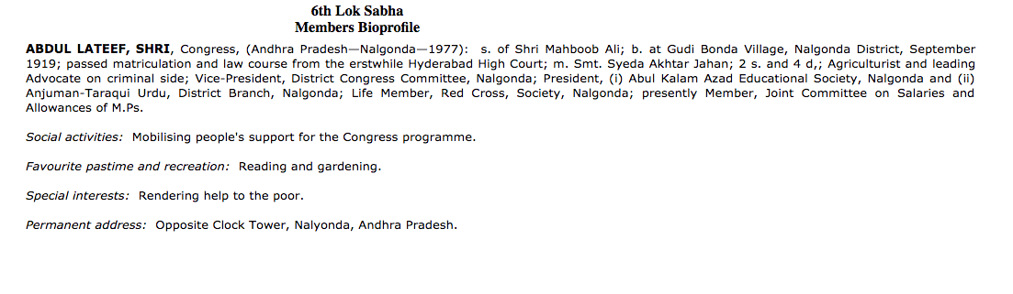

Slide 5
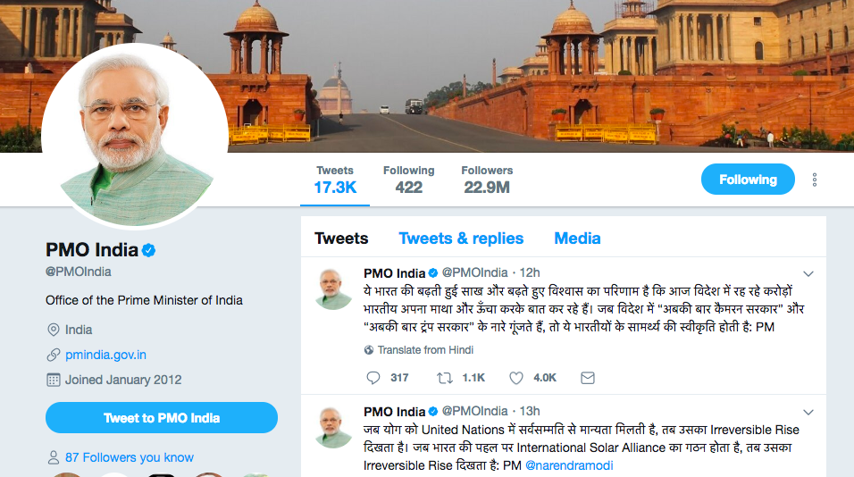
A new kind of data: Political Speech
Social Media
Newspapers – party spokespersons, campaigns
Parliamentary Debates

Slide 6
The Indian Parliament
The President
The Lok Sabha (543 Members + 2 nominated)
The Rajya Sabha (233 Members + 12 nominated)

Slide 7
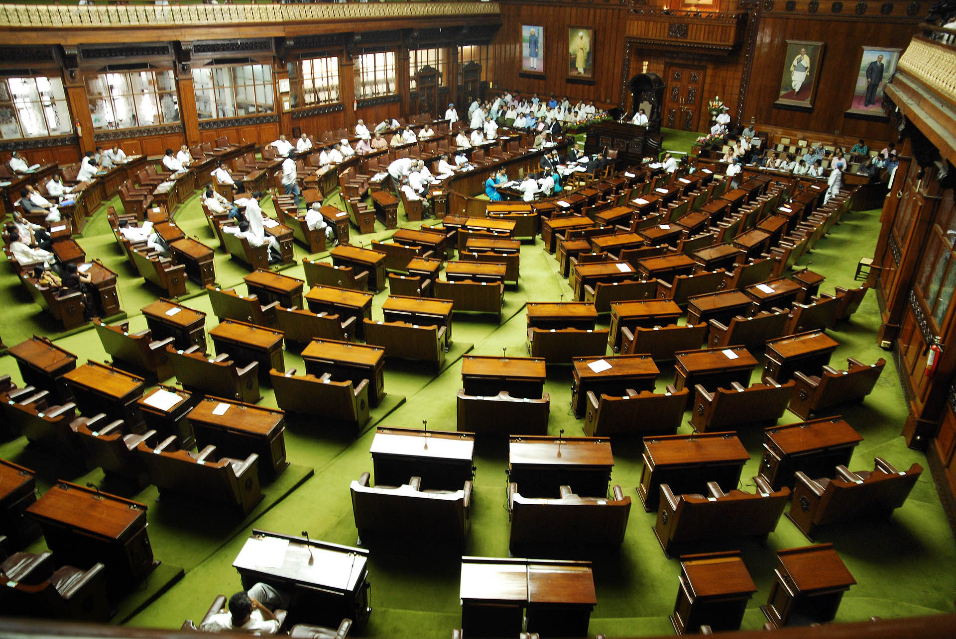
Legislators in the Indian Parliament
Main Job:
Make/ pass laws
represent the views of parliamentary constituencies
oversee budget
To do the job:
attend Parliament
participate in debates & Question Hour
participate in committee meetings

Slide 8
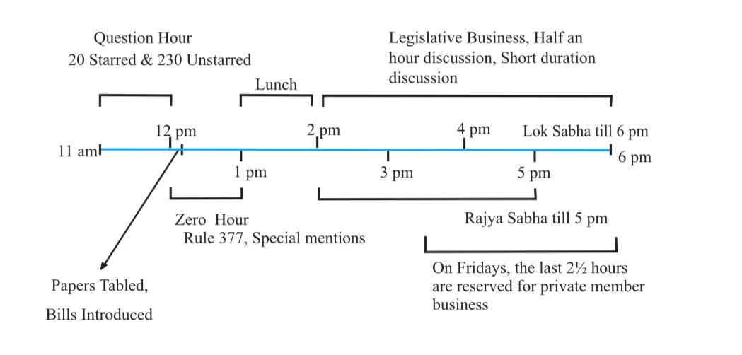
A Day in the Parliament
Source: PRS Legislative Research

Slide 9
Can we understand MP’s interests using data from the Question Hour?
> 60,000 questions raised in each session of the Lok Sabha
> 3 Lakh questions tabled over the last 20 years
Created by using code to create web scrapers to crawl through the Lok Sabha website

Slide 10
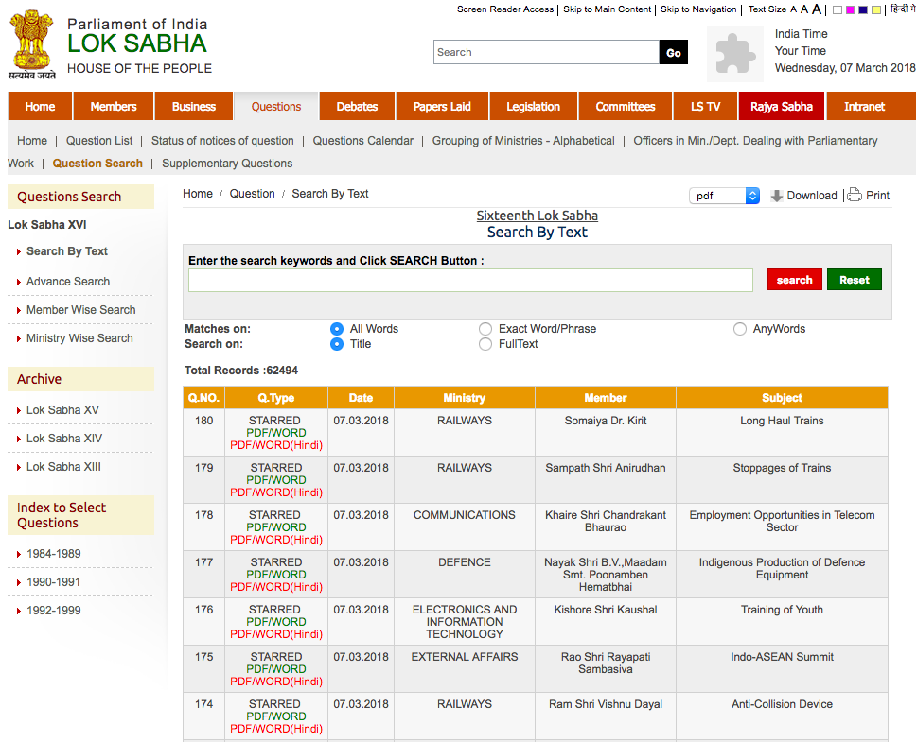
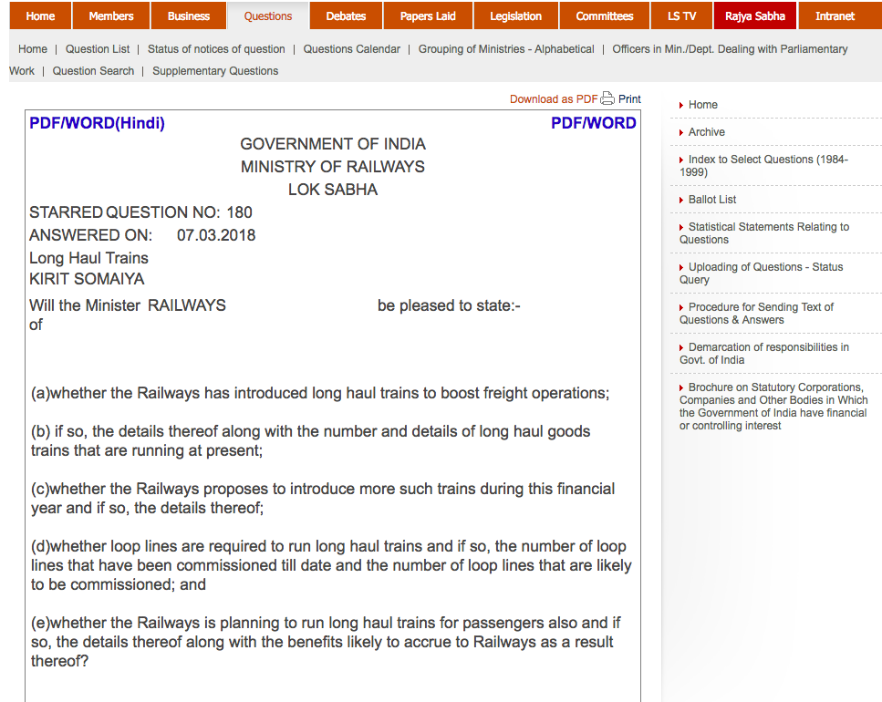
Scraping the Data

Slide 11
Combining with ECI Data
Datasets more powerful once combined with other existing data
Additional variables become available once datasets are merged

Slide 12
Some Insights
Which politicians have asked no questions?
Which politicians have asked the most questions?

Slide 13
An Interesting Paper..
How would one identify women’s issues being represented in the questions asked during Question Hour?
Identify words appearing in question text: woman, mother, girl, balika, gender, mahila, nari, maternal, widow, NCW, maid, dowry, Swadhar, Swayamsidha, surrogacy, devadasi, rape, sati, eve teasing, prostitution
(Suraj Jacob, Gender & Legislative Performance in India)

Slide 14
Approach: Topic Modelling
Statistical model for discovering ‘topics’ from a group of documents
Helps in discovering latent semantic structure within text
Useful in clustering & organizing large blocks of data – from unstructured text to structured text
Method: eliminate stop-words, high frequency words & non-nouns

Slide 15
Rough Topic Assignment
Topic No. | Words | Estimated Topic(s)
0 | competition companies practices commission view terms india service decision operations company penalty manner guidelines names services cci business panel trade | Trade, competition
1 | gas network pipeline project cities authority thereon distribution plan pipelines india gail availability target lines transport priority cng power stations | Oil, gas, pipelines
2 | dairy production increase cattle farmers milk quality fact assistance animals animal agriculture cows income demand livestock fodder fisheries breeds cow | Cattle, dairy farming, agriculture
3 | institutes management technology iits students institutions institute research universities iit institution plan nits engineering seats education information sciences class fee | Higher/Technical Education
4 | railways railway trains train rail safety accidents passengers tracks speed passenger lines network cost coaches route run condition replacement neer | Transport

Slide 16
In Conclusion
Data may not be able to give all the answers, but it can point us to very pertinent questions.

Slide 17
Thank You
saloni.bhogale@yif.ashoka.edu.in

