Slide 1
WiFiMon ASNET-AM Pilot
Nikos Kostopoulos, NTUA, WiFiMon Team Member
Pilot Support: Samuel Petrosyan, ASNET-AM
Exploring Virtualization & Monitoring Opportunities in Networking
Workshop, Yerevan, Armenia
October 5th, 2023

Slide 2


Slide 3
Past WiFiMon Pilots (1/2)
TNC19 (Tallinn, Estonia - June 2019)
Monitored conference Wi-Fi network during TNC19 days
Based on WiFiMon Hardware Probe (WHP) measurements – 5 WHP’s
More than 800 participants
Pilot Outcomes:
WiFiMon detects significant throughput drops and delivers useful insight about Wi-Fi performance
First WiFiMon crash test was considered successful

Slide 4
Past WiFiMon Pilots (2/2)
GÉANT Symposium 2020 (Ljubljana, Slovenia - February 2020)
Monitored eduroam during the conference days
Based on both crowdsourced and probe measurements (7 WHP’s)
Roughly 250 participants
Pilot Outcomes:
WiFiMon detects Wi-Fi performance degradation
Probe measurements verify the trends of crowdsourced measurements
WiFiMon detects drops that are not reported by WLAN NIC measurements

Slide 5
ASNET-AM Pilot Details (1/2)
The 3rd WiFiMon conference pilot
Monitoring eduroam at the Institute for Informatics and Automation Problems (IIAP) - National Academy of Sciences of Armenia
Monitoring since September 21st
Monitoring about 50-100 people (researchers, professors, engineers, students)
Measurements from 1 WHP (Raspberry Pi 4 Model B) – placed on the floor
WAS/WTS installed in a single VM with 4 vCPU’s, 8 GB RAM (WiFiMon v. 2.1.0)
Pilot Goal:
Experiment with newly introduced WiFiMon features
Help ASNET-AM Wi-Fi administrators identify interesting points requiring further inspection

Slide 6
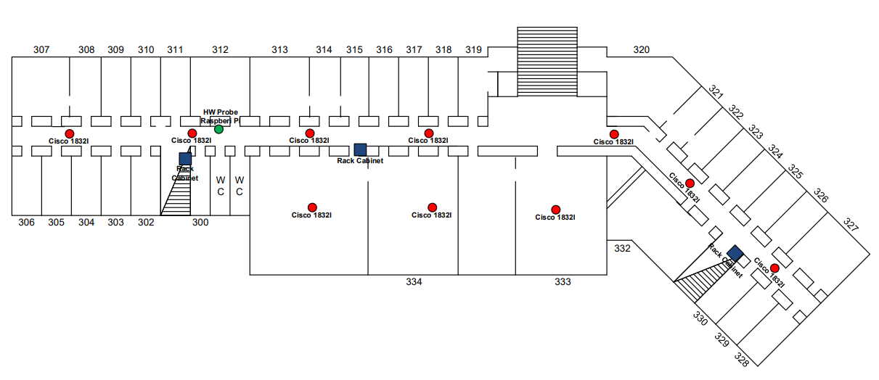
ASNET-AM Pilot Details (2/2)
Monitored area blueprints: WHP is placed at the green bullet

Slide 7
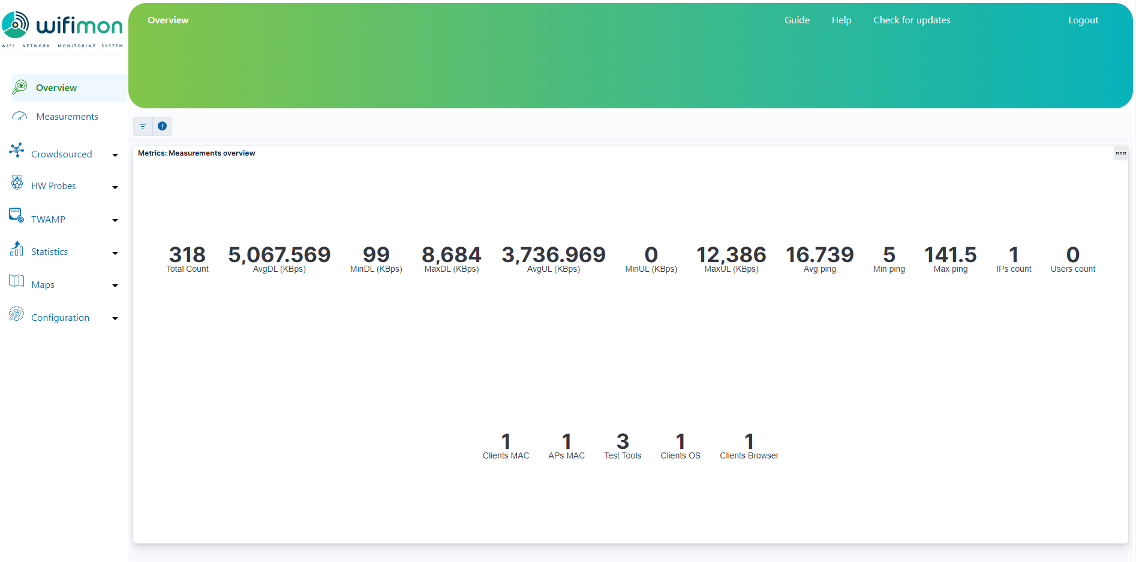
Overview of WiFiMon Measurements (1/8)
The Overview tab summarizes received measurements on a daily basis

Slide 8
Overview of WiFiMon Measurements (2/8)
Total number of received measurements (since midnight)
The Overview tab summarizes received measurements on a daily basis

Slide 9
Overview of WiFiMon Measurements (3/8)
Average download throughput reported
The Overview tab summarizes received measurements on a daily basis

Slide 10
Overview of WiFiMon Measurements (4/8)
Minimum download throughput reported
The Overview tab summarizes received measurements on a daily basis

Slide 11
Overview of WiFiMon Measurements (5/8)
Maximum download throughput reported
The Overview tab summarizes received measurements on a daily basis

Slide 12
Overview of WiFiMon Measurements (6/8)
Metrics for Upload Throughput
The Overview tab summarizes received measurements on a daily basis

Slide 13
Overview of WiFiMon Measurements (7/8)
HTTP ping metrics
The Overview tab summarizes received measurements on a daily basis

Slide 14
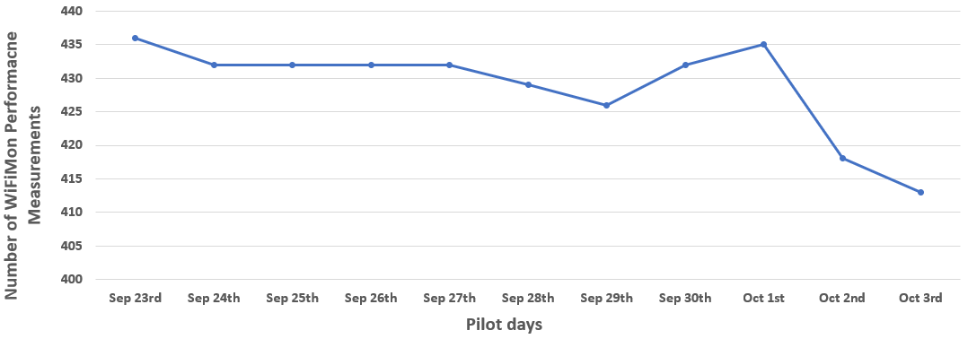
Overview of WiFiMon Measurements (8/8)
Total number of WiFiMon performance measurements received daily between Sep 23rd and Oct 3rd
The WiFiMon Analysis Server (WAS) received 4717 total measurements on 11 days and 429 measurements per day on average
Loss of measurements is evident in various days (e.g. maximum loss on Oct 3rd)

Slide 15
WiFiMon Performance Measurements
WiFiMon may report various types of performance measurements (against the WiFiMon Test Server – WTS)
The most important are:
Download Throughput
Upload Throughput
HTTP Ping Round-Trip Time (RTT)
Jitter

Slide 16
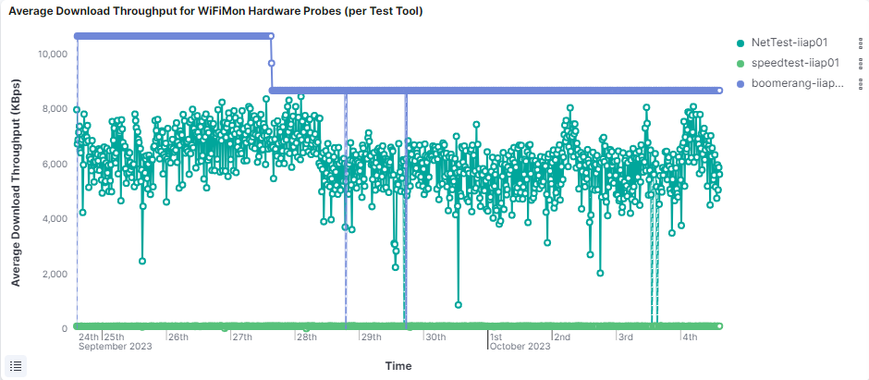
Average Download Throughput – Per Test-Tool
Average download throughput during the last 10 days:
3 different test-tools were used (NetTest, Akamai Boomerang & LibreSpeed Speedtest)
NetTest reports interesting performance drops
LibreSpeed Speedtest reports rather stable performance
Akamai Boomerang detects a very interesting performance drop during the 27th of September; performance suddenly drops and almost stabilizes on a lower value

Slide 17
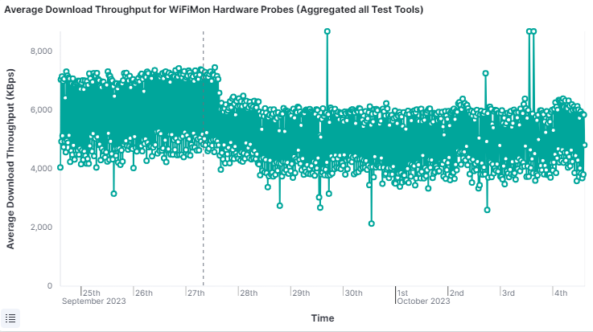
Average Download Throughput – Aggregated
Average download throughput during the last 10 days:
The results of all test-tools are aggregated
Interesting points (blue circles) can be seen in the diagram
Wi-Fi administrators may further inspect what happened at these points

Slide 18
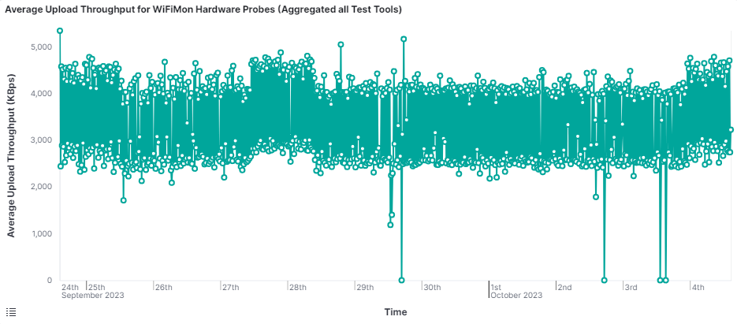
Average Upload Throughput – Aggregated
Average upload throughput during the last 10 days:
The results of all test-tools are aggregated
Significant drops (blue circles) are also visible in the chart

Slide 19
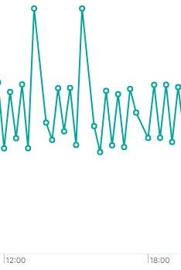
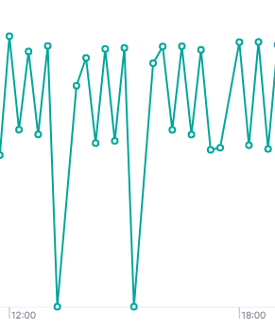
A Closer look on October 3rd Measurements
Average download throughput
Average upload throughput
Download throughput presumably dropped because of data uploads

Slide 20
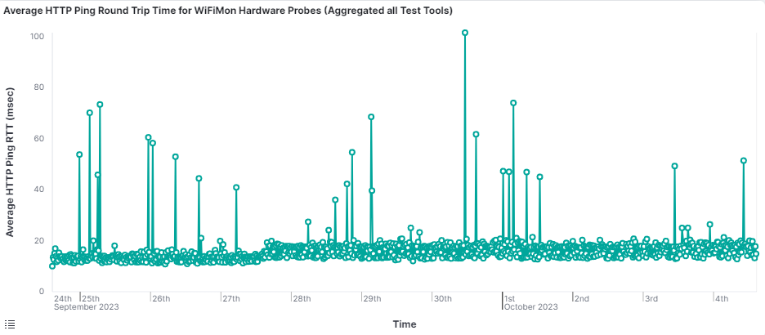
Average HTTP Ping RTT - Aggregated
Average HTTP Ping RTT during the last 10 days:
The results of all test-tools are aggregated
Higher RTT’s are visible (blue circles) in the chart

Slide 21
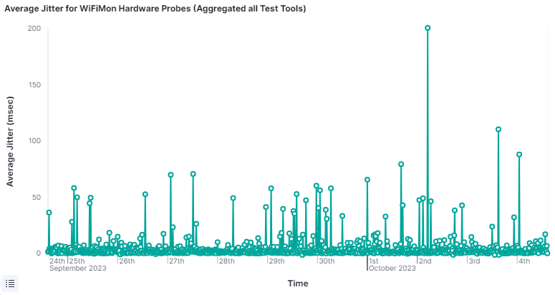
Average Jitter
Average Jitter during the last 10 days:
A very high jitter measurement (blue circle) is visible on October 2nd

Slide 22
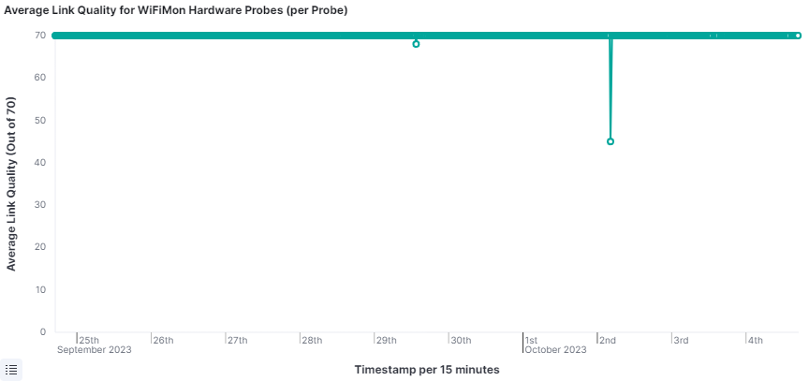
Average Link Quality
Average link quality during the last 10 days reported from the WLAN NIC of the probe:
Link quality (WLAN NIC) does not capture the drops reported by WiFiMon
A major drop on October 2nd matches the jitter increase (previous slide)

Slide 23
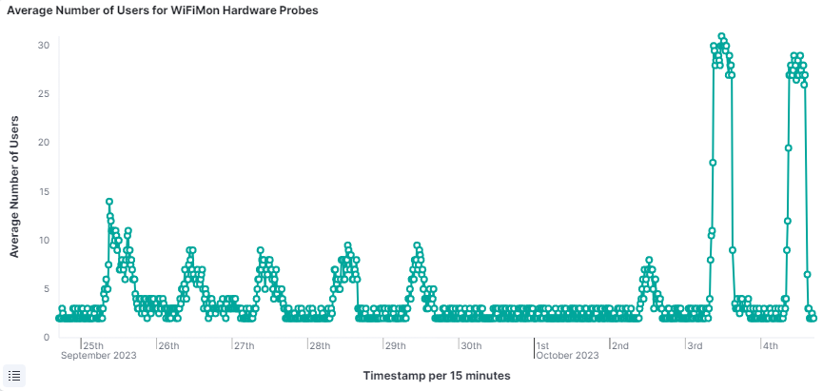
Average Number of Users
Average number of Wi-Fi users during the last 10 days (reported by arp-scan):
Almost no users during the weekend (blue rectangle)
Higher number of users during the conference days (green rectangle)

Slide 24
WiFiMon Performance Measurements
Apart from average measurements, WiFiMon may also report:
Median values
Maximum values
Minimum values
95th percentile values

Slide 25
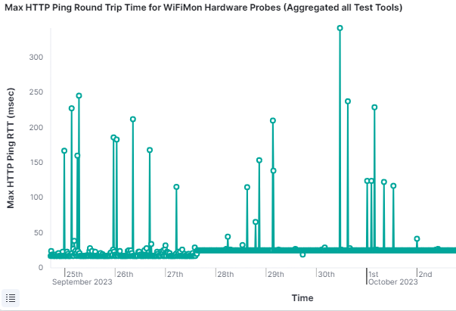
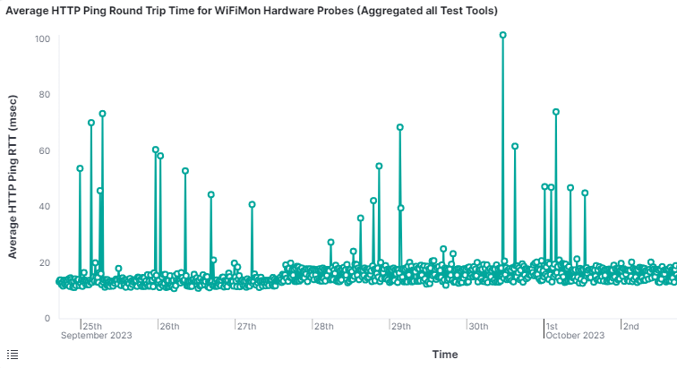
Average vs Max HTTP Ping RTT
Comparison between the average and the maximum HTTP Ping RTT:
Maximum values of RTT are much higher than the reported average

Slide 26
A Glance in the Future of WiFiMon
Version 2.2.0
(expected November 2023)

Slide 27
WiFiMon Anomaly Detection Feature
Currently (version 2.1.1):
WiFiMon administrators are expected to manually inspect measurements
No mechanisms to automatically detect important throughput deviations
WiFiMon v2.2.0 will introduce mechanisms to analyze throughput time series
Anomalies will be detected using the Hampel method
Hampel method assesses deviations from a median value evaluated on specified measurement windows
WiFiMon UI has been enriched to support the new feature
Still under improvement

Slide 28
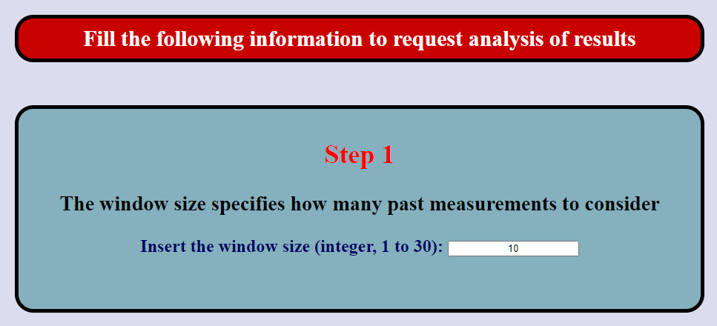
Anomaly Detection UI (1/5)
Step 1: Specification of the window size, i.e. how many previous measurements to use for median value calculation

Slide 29

Anomaly Detection UI (2/5)
Step 2: What deviation from the median is considered an anomaly?

Slide 30

Anomaly Detection UI (3/5)
Step 3: How many days to include in the analysis?

Slide 31
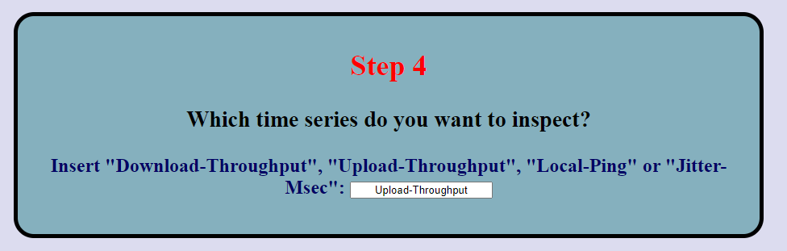
Anomaly Detection UI (4/5)
Step 4: Which time series do we want to inspect?

Slide 32

Anomaly Detection UI (5/5)
Step 5: Symbolic name of the considered test-tool

Slide 33
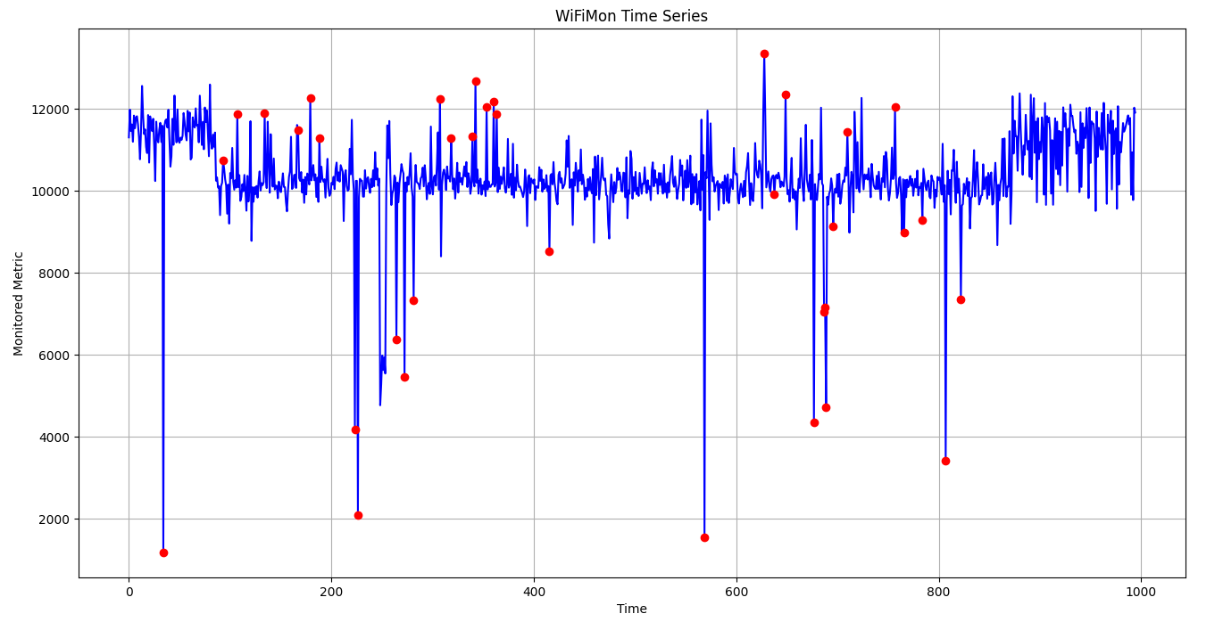
Results for ASNET-AM Pilot (1/2)
Red dots indicate points that should be further inspected

Slide 34
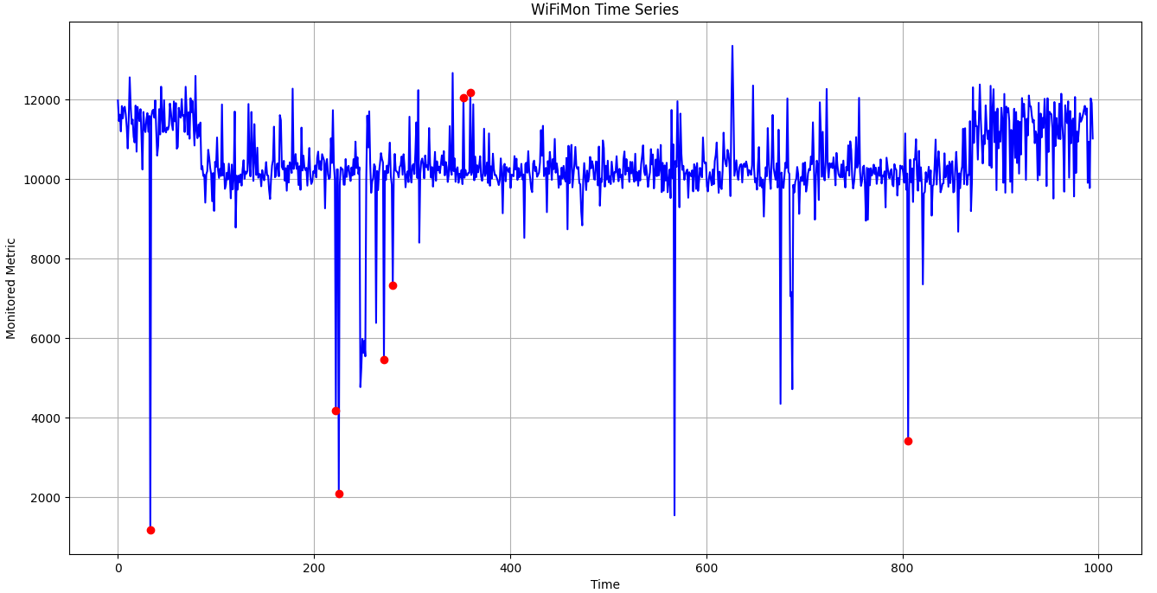
Results for ASNET-AM Pilot (2/2)
Stricter Hampel method parameters (e.g. “10” in step 2) may return less red dots, i.e. anomaly indications that are more serious

Slide 35
Thank You

