Slide 2
WiFiMon: Introduction
Monitoring Wi-Fi network performance as experienced by end users
Combination of crowdsourced and hardware probe measurements
IEEE 802.1X networks (eduroam): Data from RADIUS and DHCP logs strengthen analysis options, e.g. per Access Point (AP)
Contribution:
Detection of Wi-Fi throughput degradation
Determination of underperforming areas within a Wi-Fi network
→ Admins can enhance performance, e.g. by installing more APs
WiFiMon vs other monitoring solutions:
Monitoring from the end user perspective (end user experience)
No requirements for end user intervention or installation of apps
Centralized view of Wi-Fi performance available to the Wi-Fi administrator

Slide 3
Design Features
Combination of crowdsourced and deterministic measurements
Correlation with RADIUS and DHCP logs respecting end user privacy
Independence of Wi-Fi technology and hardware vendor
Lightweight, active monitoring without impact on end user browsing experience

Slide 4
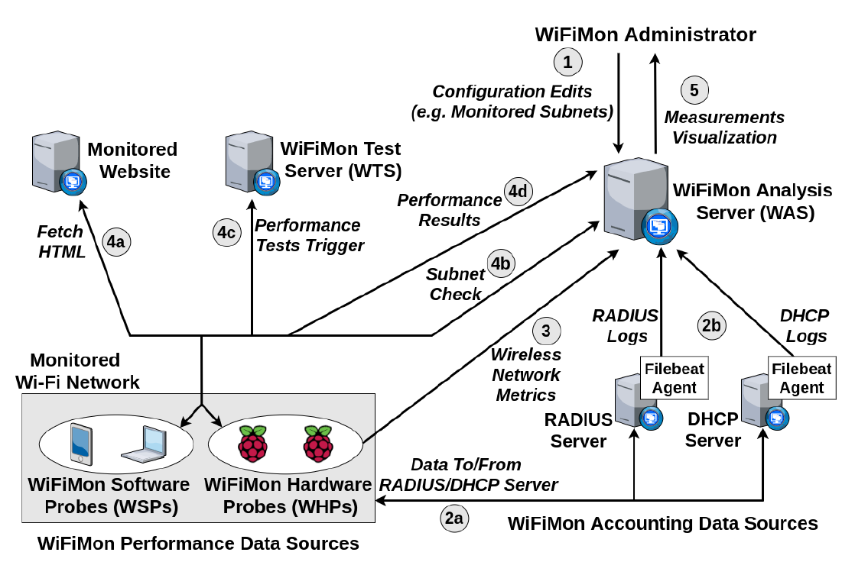
WiFiMon Operation
WiFiMon Components:
WiFiMon Software Probes (WSPs)
WiFiMon Hardware Probes (WHPs)
WiFiMon Test Server (WTS)
WiFiMon Analysis Server (WAS)

Slide 5
WiFiMon Test Server (WTS)
Purpose: Holds code and test data for performance measurements
Based on JavaScript technology
HTML lines pointing to WTS JavaScript-based test tools
These lines are embedded to frequently visited sites
Measurements of the HTTP service (Majority of Internet traffic)
3 available test tools:
NetTest (https://code.google.com/archive/p/nettest/)
Akamai Boomerang (https://github.com/akamai/boomerang)
LibreSpeed Speedtest (https://github.com/librespeed/speedtest)
WTS Placement: Close to the monitored networks for small RTTs between end devices and WTS
→ If not possible: WiFiMon captures relative changes in Wi-Fi performance

Slide 6
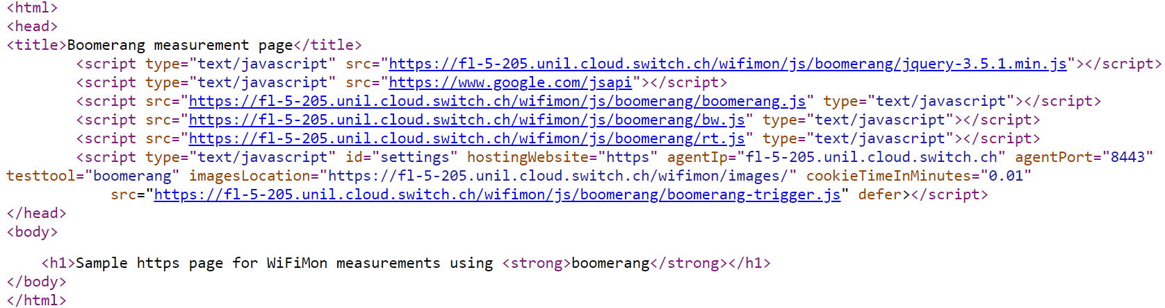
WiFiMon Software Probes (WSPs)
User devices (laptops, smartphones, …)
Crowdsourced measurements triggered against the WTS when users visit a WiFiMon-enabled site (not triggered by end users themselves)
No requirement for additional software within user devices
Repetitive measurements regulated via a cookie value (WAS/WTS not overloaded)
Example: Lines for Akamai Boomerang test tool
(injected in a sample web site)

Slide 7
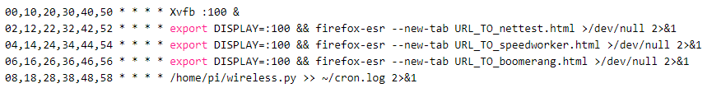
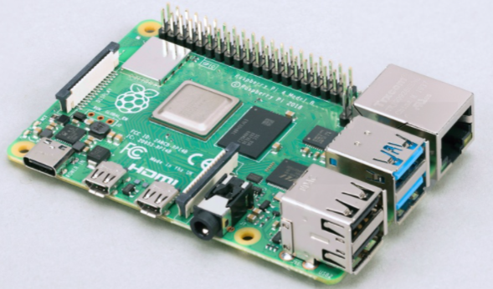
WiFiMon Hardware Probes (WHPs)
Wi-Fi performance measurements from fixed points within the network
(distance between WHPs and APs is relatively constant)
Baseline throughput that complements crowdsourced measurements
Performance measurements similar to WSPs (on predefined intervals)
Additional data about monitored and nearby ESSID’s
(APs, signal strength, link quality, bit rate, TX power)
Triggering measurements based on crontabs:
Tested for Raspberry Pi v3 and v4,
→ Possible for any single-board computer

Slide 8
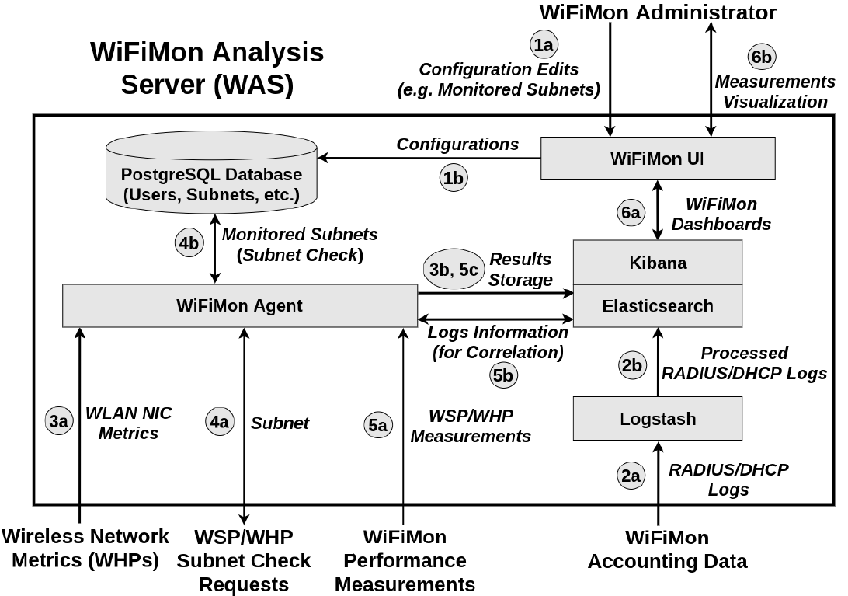
WiFiMon Analysis Server (WAS)
WAS Modules:
WiFiMon Agent: Collects and processes the received monitoring data
WiFiMon User Interface (UI): Depicts the results of data processing

Slide 9
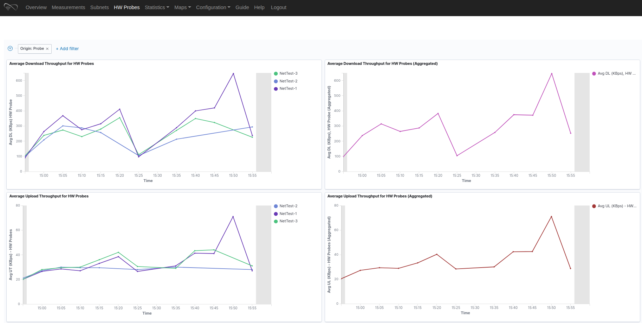
WiFiMon User Interface (UI)
Results per WHP
Aggregated Results
Results from 3 WHPs during a 60-minute interval

Slide 10
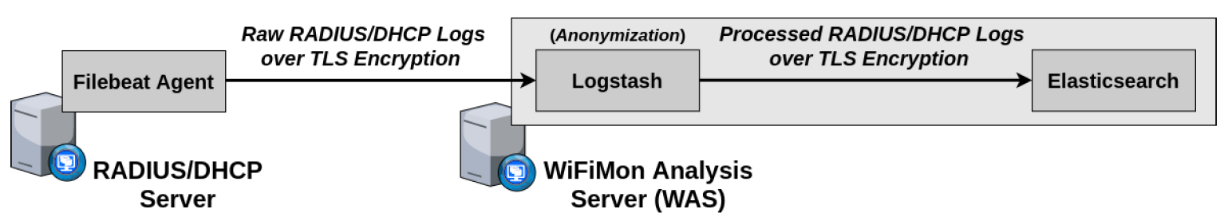
Correlation with RADIUS/DHCP Logs
Logs are:
Extracted from RADIUS/DHCP servers using Filebeat
Processed and transformed by Logstash in WAS
Stored in Elasticsearch of WAS
Correlation options:
With end user IP address (relying solely on RADIUS logs)
With end user MAC address (using both RADIUS and DHCP logs)
Personally Identifiable Information (PII): IP and MAC addresses are secured in transit using a TLS-encrypted channel and stored hashed in WAS (based on X-Pack)
→ Correlation comparisons are performed on hashed strings.

Slide 11
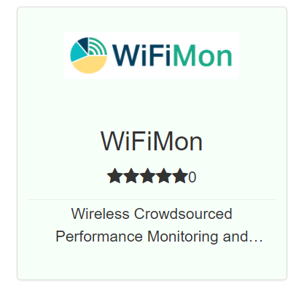
WiFiMon Installation
GÉANT Service since 2020!
Options:
Institutions install all components on their premises
- Ansible playbook for WAS automated installation
- Manual installation for WTS
- All data stay within the institution premises
- Support from WiFiMon team for all components
NMaaS Portfolio
NMaaS (more appropriate for testing/trying WiFiMon)
- WiFiMon WAS instance per institution deployed on NMaaS
- WTS installation still required by institutions
(should be close to the monitored network)
- Support from WiFiMon team for interfacing
WTS and Dockerized WAS on NMaaS
Manual WAS installation: Will be soon abandoned by WiFiMon

Slide 12
Recent WiFiMon Additions
Notifications of WiFiMon version updates
WiFiMon Users are informed of new WiFiMon code versions
Eduroam Log Exporter
WHP data exported towards the JSON collector of eduroam
Enriched Kibana dashboards
Apart from average values, WiFiMon dashboards include information about max/min/median/95th percentile values

Slide 13
Future Steps
Enrich WiFiMon toolset with additional Wi-Fi performance monitoring options
Contacting interested organizations/NRENs for WiFiMon setups
- Recent setups: NTUA, UoB, SWITCH, GRENA, RASH, UPatras, RENU
Enrichment of Kibana dashboards
Time series analysis and/or machine learning for Wi-Fi outage prediction
Dissemination of WiFiMon in NREN and/or peer-reviewed conferences

Slide 14

Check out the WiFiMon video!
https://www.youtube.com/watch?v=9LuGlF6JSnA
… or the WiFiMon Infoshare
https://www.youtube.com/watch?v=VXQV2zWRKgo
… or earlier presentations
https://wiki.geant.org/display/WIF/WiFiMon+Publications
… or the WiFiMon paper at IEEE/IFIP WONS 2021
http://dl.ifip.org/db/conf/wons/wons2021/1570695031.pdf

