Slide 2
Evaluation
Based on pilots in 2 recent conference venues:
TNC19 Conference (Tallinn, 2019)
GÉANT Symposium 2020 (Ljubljana, 2020)
TNC19:
More than 800 participants
Monitored Wi-Fi network setup for the conference days
Monitoring using only WHPs (Five Raspberry Pi 3 model B devices)
WHP monitoring interval: 20 minutes
WTS in TalTech: RTT between WTS and venue less than 4 msec
GÉANT Symposium 2020 :
Around 250 participants
Monitored eduroam ESSID
WHPs: Seven Raspberry Pi 3 model B devices (Interval: 5 minutes)
Also including WSPs: HTML lines in the conference agenda after receiving consent during the online registration process
WTS in ARNES, the Slovenian NREN

Slide 3
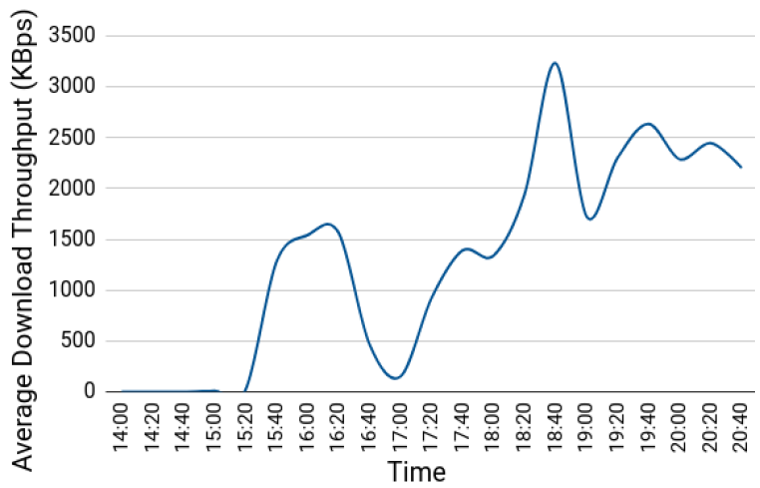
TNC19 Pilot (1)
Average download throughput reported by a WHP placed in the main hall during the 1st conference day:
14:00 – 15:20: Low throughput and connectivity issues during lightning talks
15:20 – 16:30: Less people in the venue → Higher throughput
Around 17:00: Significant drop because of opening ceremony
After 18:00: Wi-Fi performance restored after people had left the venue

Slide 4
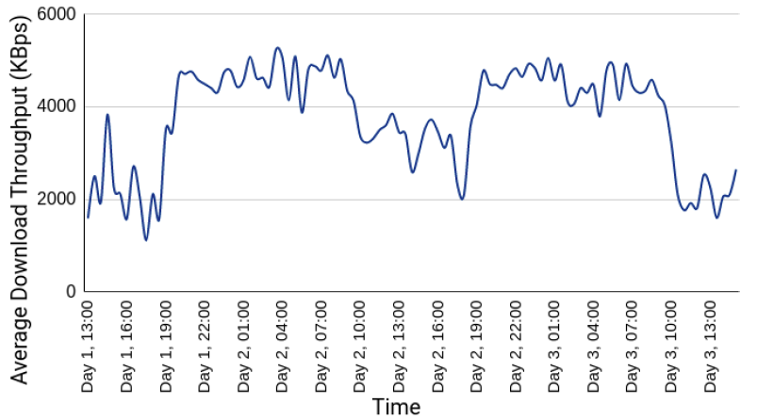
TNC19 Pilot (2)
Average download throughput reported by a WHP placed in the room where coffee/lunch breaks and the opening ceremony occurred:
Wi-Fi performance degraded when people were at the venue, while the throughput was higher and more stable when participants were absent.

Slide 5
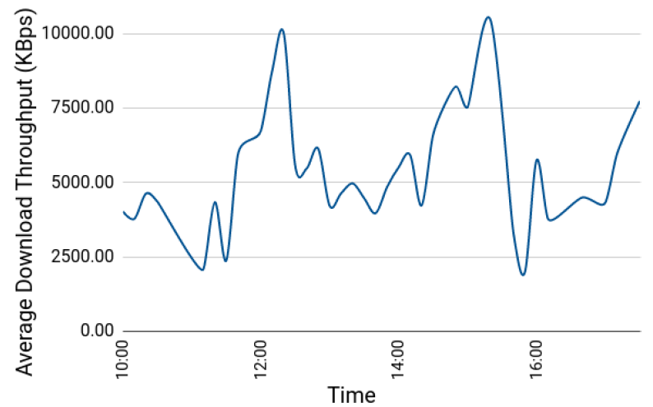
GÉANT Symposium 2020 Pilot (1)
Average download throughput reported by crowdsourced measurements (1st Symposium Day between 10:00 and 17:00):
3
3
2
1
1
Major drops: 11:00 – 11:40 and 15:30 – 16:00
→ Periods after coffee break (more people visiting symposium agenda)
Notable drop: 12:30 – 14:00
→ During and after lunch time when most participants gathered in less space
Higher levels: Around 12:20 and 15:20 → Participants distributed across many different sessions
1
2
3

Slide 6
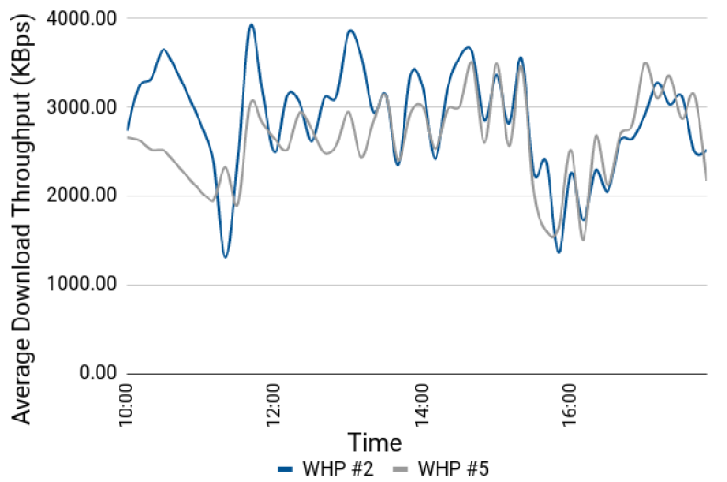
GÉANT Symposium 2020 Pilot (2)
Average download throughput reported by WHPs #2 and #5 (1st Symposium day):
Both WHPs follow similar trends
Both WHPs conceive the throughput drops reported by WSP measurements
WHPs reported less throughput as they were placed near the available power plugs, typically farther from Access Points than the audience (e.g. on the floor)

Slide 7
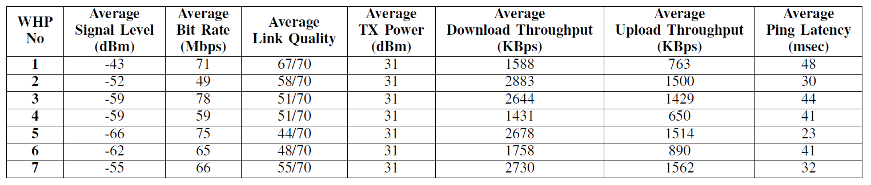
GÉANT Symposium 2020 Pilot (3)
WLAN metrics and performance measurements from the 1st Symposium day:
Observation: WLAN metric trends may not follow those of performance measurements
WHP #1: best average link quality, but among the worst throughput results
WHP #5: worst average link quality, but among the best throughput results
Conclusion: Multiple sources of information, i.e. crowdsourced and probe measurements, are vital for proper Wi-Fi performance evaluation
→ High values of signal strength/link quality do not necessarily guarantee high Wi-Fi throughputs

