Slide 2
WiFiMon team
Kurt Baumann (SWITCH)
Nikos Kostopoulos (NTUA/GRNET)
Sokol Gjeci (RASH)
Kostas Stamos (University of Patras/GRNET)
Tsotne Gozalishvili (GRENA)

Slide 3
WiFiMon infoshare - agenda
Intro (15 min) - Kurt and Pavle
Technical overview - how it works - tools and technical solutions, components and installation (15 min) - Nikos
Log streaming and correlation (10 min) - Sokol
Demo and measurement results (20 min) - Nikos

Slide 4
Why a system for WiFi monitoring?
WiFi is among the most popular network access methods
Measuring the performance of the WiFi networks is challenging:
Air is a shared medium – other users and their usage patterns
Physical obstacles
Other networks
type of antenna, positioning, signal reflection, diffraction, refraction…
Measuring only signal strength or link quality from fixed points is not sufficient to get the impression about the Quality of user’s Experience (QoE)
Vendor solutions – closed and focused on the network equipment (APs)

Slide 5
What WiFiMon offers?
It is a vendor-independent, open-source monitoring tool
It is transparent to the users
It creates a low network overhead (active monitoring tool)
It captures user’s perception of the network quality
It provides metrics like: throughput, latency, signal strength, link quality,…
It is built upon the well-known open-source tools like: ELK, Akamai Boomerang, SpeedTest

Slide 6
WiFiMon – brief history
Idea from GN4-1 – how to capture the user’s perception of the WiFi network performance
Development in GN4-2 – crowdsourced WiFi monitoring
New features in GN4-3 – fixed hardware probes
The same tools as for the crowdsourced monitoring
Information about the signal strength and quality
Correlation with RADIUS logs
GEANT service since July 2020

Slide 7

WiFiMon building blocks and operation
Client – any user’s device
WHP – WiFiMon hardware probe (rPi)
WTS – WiFiMon Test Server - measurements
WAS – WiFiMon Analysis Server (ELK)
Site – popular web site (University, captive portal,…)
Some site
WAS
jS code
visit
results
WTS
tests
Client
WHP

Slide 8
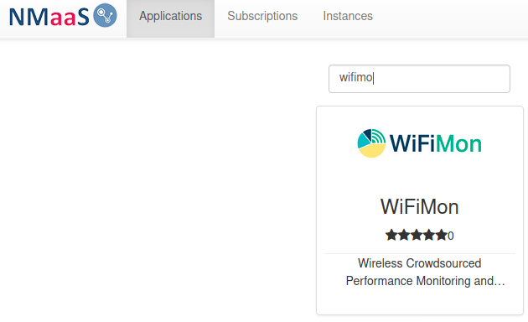
WiFiMon service model
Two service delivery options:
(prefered) Download and install. Support from WiFiMon team. Interested institutions install all the components at their premises
If needed (for testing/trying) WiFiMon team offers a central WiFiMon WAS instance per institution on NMaaS (dockerized application store)
With Option 1 there is no personal data and PII sharing with the third party. WiFiMon offers data protection and pseudonymisation methods as will be described.
If you are interested, register at (our mailing lists) you will get news, updates, new feature description: https://www.geant.org/wifimon/Pages/Register.aspx

Slide 9
WiFiMon resources
GEANT WiFiMon page: https://www.geant.org/wifimon/Pages/default.aspx
WiFiMon wiki page: https://wiki.geant.org/display/WIF
WiFiMon code: https://bitbucket.software.geant.org/projects/WFMON/repos/agent/browse
Publications and Presentations: https://wiki.geant.org/display/WIF/WiFiMon+Publications

Slide 11
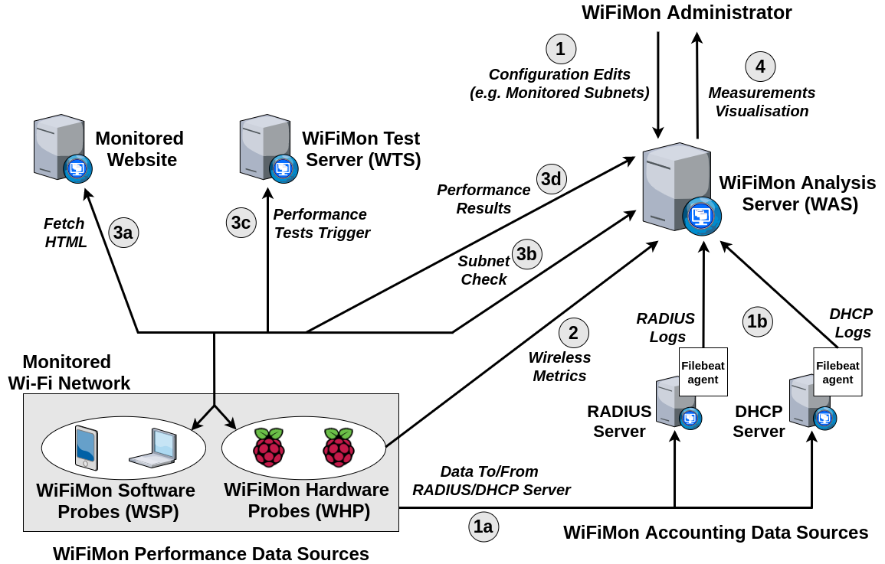
WiFiMon Architecture

Slide 12
WiFiMon Test Server (WTS) Installation
The WTS holds the images and code required to WiFiMon measurements
Install Apache web server
Enable CORS
Include JavaScript code of WiFiMon testtools:
- NetTest (https://code.google.com/archive/p/nettest/
- Akamai Boomerang (https://github.com/akamai/boomerang)
- Speedtest (https://github.com/librespeed/speedtest)

Slide 13
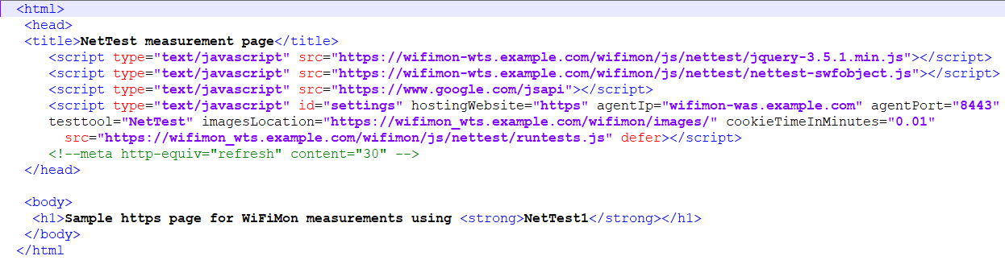
JS lines embedded in HTML page
Example for NetTest testing tool
Attributes: hostingWebsite, agentIp, agentPort, imagesLocation, cookieTimeInMinutes
Tests are triggered after the page loads
These lines should be embedded in a website so that WiFiMon tests are triggered upon visiting them

Slide 14
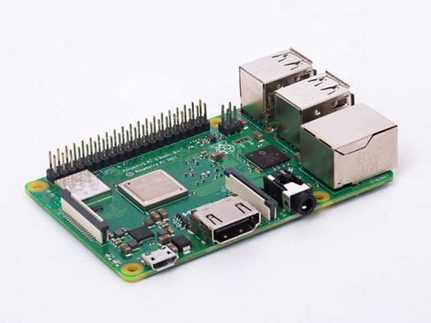
WiFiMon Hardware Probes
WiFiMon tests from fixed points that can be compared with crowdsourced tests
Raspberry Pi 3 Model B+ or later
(Pi4 - 5Ghz band info)
MicroSD card of 16 GB at least
Installation options:
WiFiMon HW Probe image
Instructions to install on an already installed Raspberry Pi OS

Slide 15
WHP Installation Steps with the preconfigured WiFiMon image
Step 1: Write the image to the micro SD card
Step 2: Insert micro SD card and start the Raspberry Pi
Step 3: Connect to the wireless network that you want to measure
Step 4: Configurations for scheduling WiFiMon testtools (add test tool address and schedule cron job)
Step 5: Configuration for wireless network metrics (Python script)

Slide 16
WiFiMon Wireless network metrics
Collected wireless network metrics
Metrics about the monitored network:
Access Point, associated ESSID, link quality, bit rate, signal level, TX power
Metrics about the WiFi networks around the monitored network (potential interference and reasons for the lower network quality):
BSSID, ESSID, signal level, link quality (channel, encryption)

Slide 17
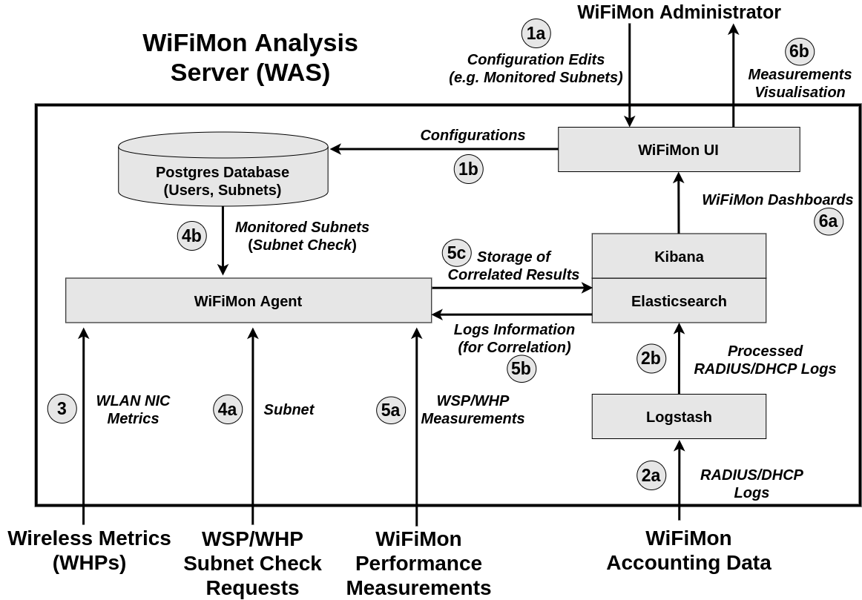
WiFiMon Analysis Station Functionality

Slide 18
WiFiMon Analysis Station Installation
WiFiMon measurements analysis and storage
PostgreSQL Installation
Creation of database, users & tables in PostgreSQL
Installation of Java (Java 11)
Elasticsearch, Kibana, Logstash: Installation & Configuration
Installation of WiFiMon Agent & WiFiMon User Interface
Elasticsearch indices creation & Kibana Dashboards import
Optionally:
Configuration of the WiFiMon Secure Agent certificate
Correlation with RADIUS/DHCP logs
Configuration of X-Pack for ELK Stack security

Slide 19
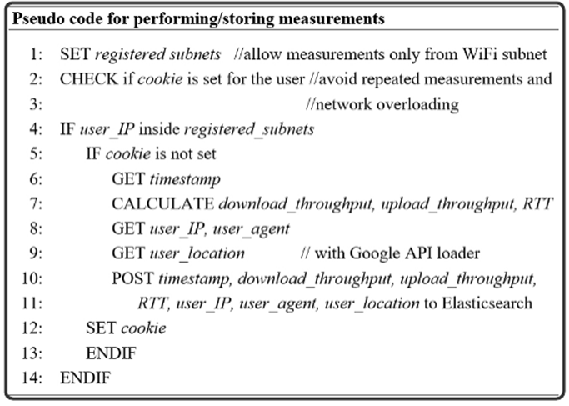
WiFiMon Performing/Storing Measurements
Network Overloading Avoidance:
Measurements accepted only from registered subnets
Cookie: repeated measurements in short time intervals are not permitted
Default cookie duration is 1.5 mins, can be set lower or higher

Slide 20
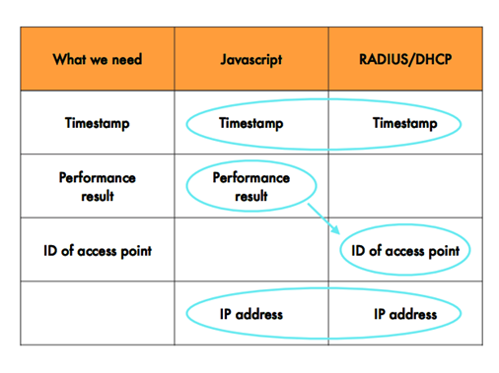
WiFiMon Correlation with RADIUS/DHCP Logs
The aim here is to get the most recent measurement for a given (authenticated) IP
Correlation enables more accurate performance analysis, e.g. analysis per Access Point in the wireless network

Slide 22
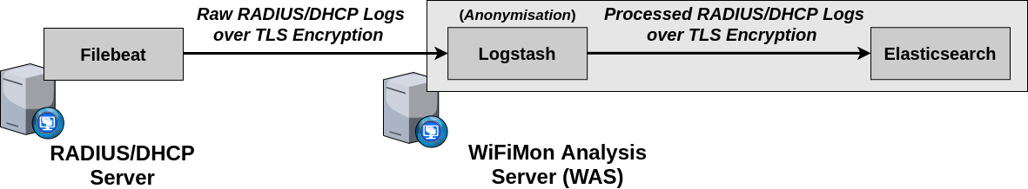
Streaming Logs Into ELK Cluster
RADIUS/DHCP server as logs sources.
Filebeat agents installed in RADIUS/DHCP servers.
Logs travel over SSL/TLS encrypted channels.
Hashing applied at Logstash pipelines to anonymise sensitive data.

Slide 23
Filebeat Agents
RADIUS Filebeat
multiline.pattern: '^[[:space:]]' multiline.negate: false multiline.match: after
(lines starting with white space appended to the previous line not matching the pattern)
processors: - add_fields: target: '' fields: logtype: radius
DHCP Filebeat
include_lines: ['DHCPACK']
(lines containing DHCPACK - the final phase of DHCP operations - are included in the stream)
processors: - add_fields: target: '' fields: logtype: dhcp
The logtype field sent at Logstash to differentiate between RADIUS and DHCP streams.

Slide 24
Logstash Pipelines
Beats Pipeline
Configures port on which Logstash listens for log events.
Configures Logstash as an SSL/TLS server.
Forwards logs on RADIUS or DHCP pipeline, based on logtype value coming from Filebeat.
RADIUS Pipeline
Calling-Station-Id (hashed) Framed-IP-Address (hashed) Called-Station-Id NAS-IP-Address (geoip) Acct-Status-Type RADIUS-Timestamp
Configures Logstash as an SSL/TLS client.
References ILM Policy to be applied over radiuslogs index.
Forwards logs on radiuslogs index.
DHCP Pipeline
IP-Address (hashed) MAC-Address (hashed) DHCP-Timestamp
Configures Logstash as an SSL/TLS client.
References ILM Policy to be applied over dhcplogs index.
Forwards logs on dhcplogs index.

Slide 25
Elasticsearch Nodes
Three master-eligible/data nodes and one coordinating node.
Coordinating node as load balancer for the data nodes.
X-Pack for security (SSL/TLS for HTTP, Transport) and monitoring.
Kibana platform on coordinating node.
Each node is aware of the cluster state.
Elasticsearch built-in users passwords.
ILM policy to delete radiuslogs and dhcplogs indexes of one day old.
Keystore for sensitive data (users passwords, certificates key passphrases).

Slide 26
WiFiMon ELK Cluster
Current Version
Logstash and Coordinating nodes are SPOFs.
Monitoring data stored in data nodes.
Makes use of legacy collection methods for monitoring.
Next Version
Adds another node for each SPOF functionality.
Configures a separate monitoring ELK cluster .
Makes use of Metricbeat collection methods for monitoring.
Automation
Next version as automated in Ansible (under construction).

Slide 28
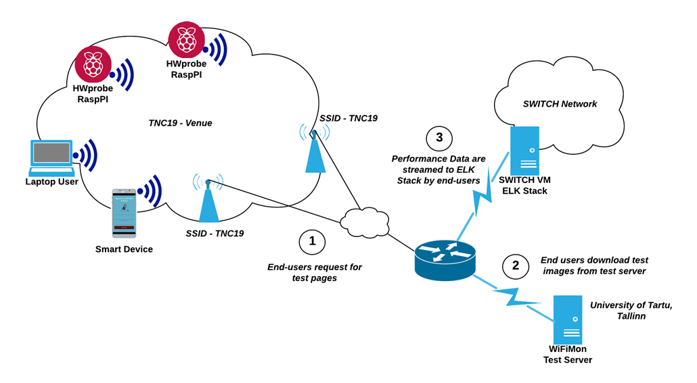
WiFiMon Pilot in TNC19 (Tallinn, Estonia)
Equipment: 5 Hardware Probes, Team members’ laptops
TalTech, Tallinn

Slide 29
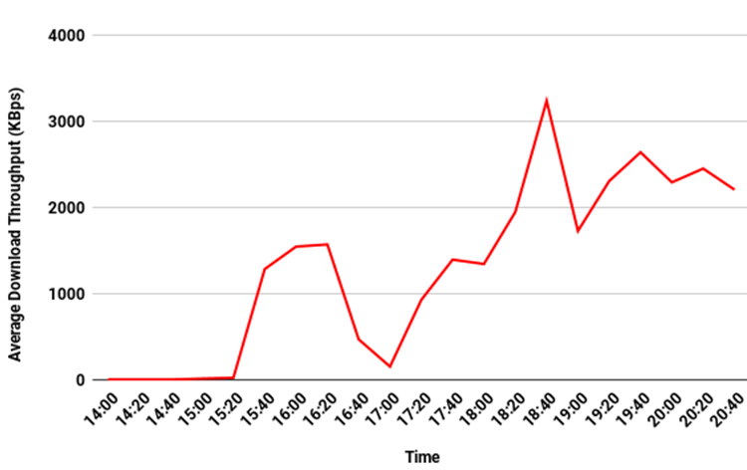
Average Download Throughput in Main Room
Problems in Wi-Fi during lightning talks (14:00 - 15:30)
Wi-Fi OK in the afternoon when most people have left the room
Worse throughput during the opening reception (17:00)
Wi-Fi OK in the evening when people leave

Slide 30
WiFiMon Pilot in GÉANT Symposium 2020
Ljubljana, Slovenia
Crowdsourced measurements JavaScript lines added in the Symposium Agenda
Deterministic measurements 7 Hardware Probes, 5 min measurements interval

Slide 31
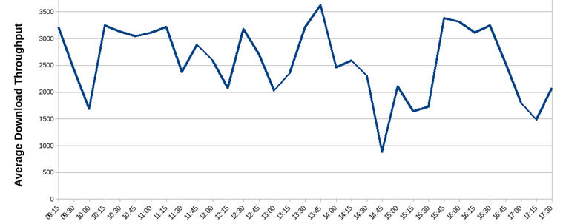
Monitoring the Grand Foyer (HW Probe #3)
WiFiMon is able to detect Wi-Fi performance degradation:
9:00 - 10:15 (Opening Plenary next to Grand Foyer)
14:45 - 15:30 (Coffee break, demo’s next to Grand Foyer)
16:45 - 17:30 (people move to the Grand Foyer after evening plenary)
Better performance when people are in the sessions, thus away from APs nearby the probe

Slide 32
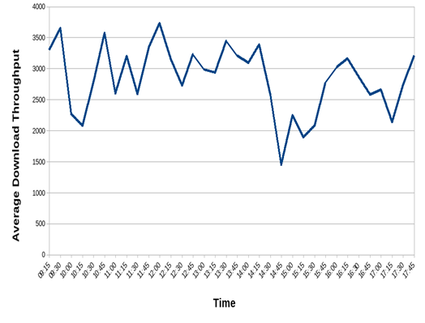
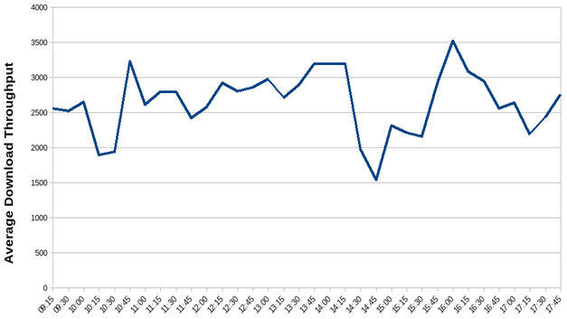
Monitoring the Main Hall (HW Probes #2 and #5)
Probes are placed at the 2 sides of the Main Hall.
WiFiMon is able to detect Wi-Fi performance degradation: 9:00 - 10:15 (Opening Plenary in the Main Hall) 14:45 - 17:00 (Evening sessions and evening plenary in the Main Hall)
Both probes in the room follow the same patterns

Slide 33
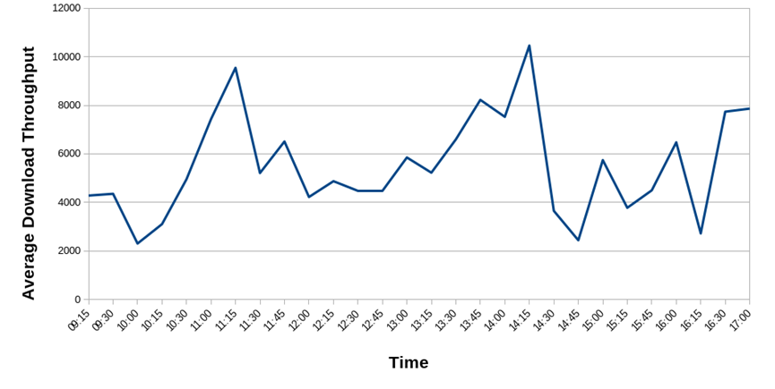
Crowdsourced Measurements
Crowdsourced measurements follow the same trends with deterministic ones.
Presumably, people visit the Symposium Agenda when new sessions start

Slide 34
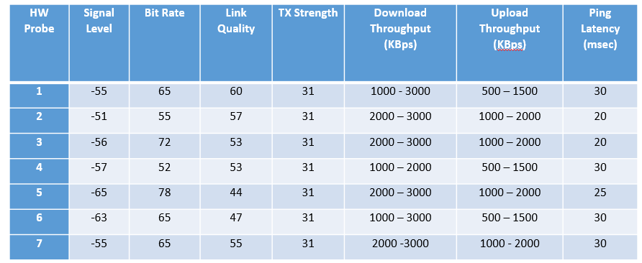
Correlation with Wireless Metrics
from HW Probes
Throughput measurements do not necessarily follow the trends or Wlan metrics
- HW Probe 1 has the best link quality, but lower throughput
- HW Probe 5 has lower link quality, but better throughputs
Deterministic & Crowdsourced measurements are essential to conclude about Wi-Fi performance

Slide 35
WiFiMon demo
The WiFiMon UI
Kibana WiFiMon Dashboards
Example of a WiFiMon measurement
Correlation with RADIUS Logs
Metrics from WiFiMon Hardware Probes

Slide 36
WiFiMon - Highlighted Details
Crowd sourced network performance management
Opportunistic and Deterministic performance measurement
HWprobes, SWprobes
Metrics:
Bandwidth, Latency, Signal Strength, Link Quality...
Test tools: JS, NetTest, Akamai Boomerang Speedtest
Infrastructure (Building Blocks)
HW/SW probes, WAS, WTS, UI (Monitoring ELK Cluster)
Correlation - Triangulation: Performance per AP/User
Valid network session ⇐ Session Time Stamp
Performance Results ⇐ HW and SW probes
Access Point Identifier ⇐ AP-ID
Privacy protection - Correlation of anonymised data
Anonymisation at Logstash + RADIUS/DHCP logs over TLS
WiFiMon Service
SW Image / Central WAS offered by NMaaS
Real Prototype tests
TNC2019 / GEANT Symposium 2020

