Slide 2
WiFiMon: Introduction
Monitors the performance of Wi-Fi networks as experienced by their end users using an objective Quality of Experience (QoE) approach.
Combines crowdsourced and hardware probe measurements to provide complete insight into Wi-Fi network performance.
In IEEE 802.1X networks, e.g. eduroam, data from RADIUS and DHCP logs may be used to provide additional analysis options, e.g. per Access Point (AP).
Contribution: Supporting administrators to detect Wi-Fi throughput degradation, hence allowing them to determine underperforming areas in a network and enhance Wi-Fi performance, e.g. by installing more APs
WiFiMon vs other monitoring solutions:
WiFiMon monitors from the end user perspective (end user experience).
WiFiMon does not require end user intervention or installation of an app.
WiFiMon provides a centralized view of Wi-Fi performance and informs the Wi-Fi administrator of the performance results.

Slide 3
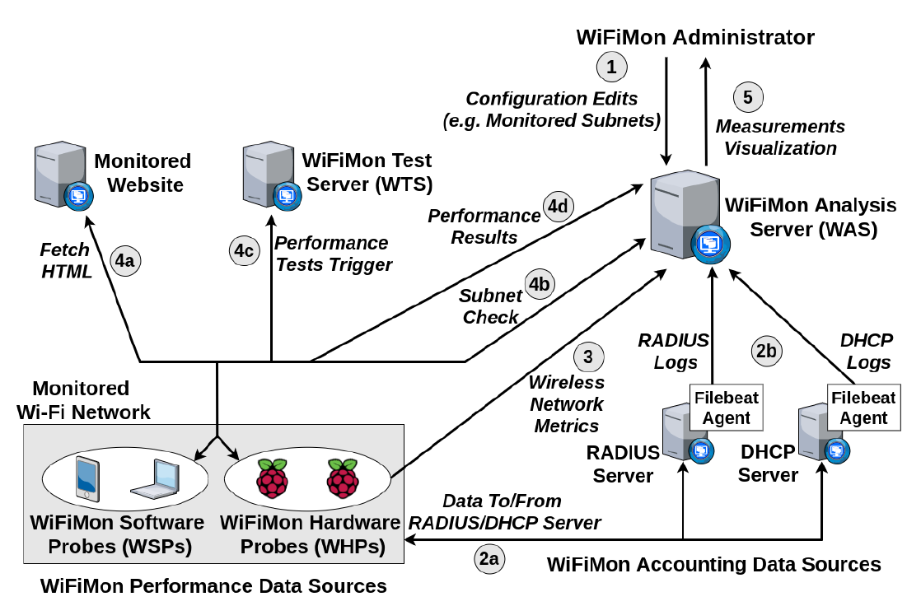
WiFiMon Operation
WiFiMon Components:
WiFiMon Software Probes (WSPs)
WiFiMon Hardware Probes (WHPs)
WiFiMon Test Server (WTS)
WiFiMon Analysis Server (WAS)

Slide 4
WiFiMon Test Server (WTS)
Purpose: Holds the code and test data required for performance measurements.
Based on JavaScript technology.
HTML lines pointing to WTS JavaScript-based test tools are embedded to a frequently visited site.
Measurements of the HTTP service (major part of the Internet traffic).
Three available test tools:
NetTest (https://code.google.com/archive/p/nettest/)
Akamai Boomerang (https://github.com/akamai/boomerang)
LibreSpeed Speedtest (https://github.com/librespeed/speedtest)
WTS Placement: Should be as close as possible to the monitored networks so that the distance between the end devices and the WTS is minimized, thus minimizing accuracy loss.
→ Even if WTS placement close to the monitored network is not possible, WiFiMon can capture the relative changes among received measurements

Slide 5
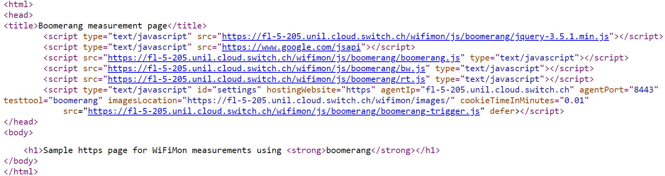
WiFiMon Software Probes (WSPs)
User devices, e.g. laptops, smartphones, etc.
Crowdsourced measurements are triggered against the WTS when users visit a WiFiMon-enabled site (not triggered by end users themselves).
WiFiMon does not require additional software to be installed on user devices.
WiFiMon regulates repetitive measurements through a cookie parameter in order not to overload WAS and WTS.
Example: HTML lines required for Akamai Boomerang test tool
(injected in the frequently visited web site)

Slide 6
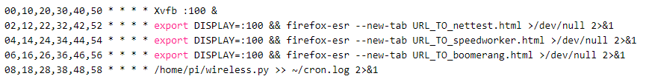
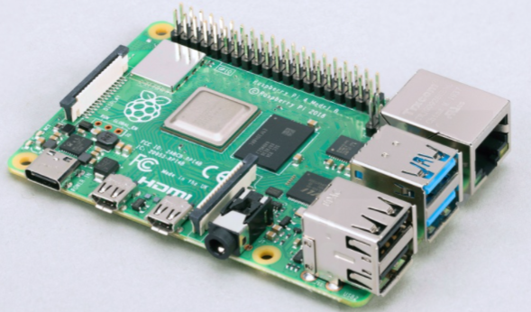
WiFiMon Hardware Probes (WHPs)
They measure Wi-Fi performance from fixed points within the network
(distance between WHPs and Access Points remains relatively constant).
They complement crowdsourced measurements by providing a baseline throughput.
Performance measurements similar to WSPs (based on predefined period)
They collect data about monitored ESSID and nearby ESSIDs
(APs, signal strength, link quality, bit rate, TX power)
Triggering measurements based on crontab:
WiFiMon currently uses Raspberry Pi v3 and v4,
but any small form factor device may be used.

Slide 7
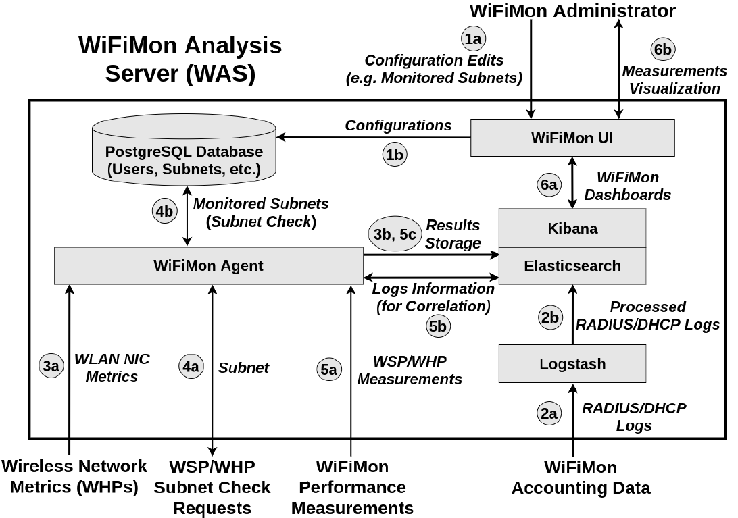
WiFiMon Analysis Server (WAS)
WAS Modules:
WiFiMon Agent: collects and processes the received monitoring data
WiFiMon User Interface (UI): depicts the results of data processing

Slide 8
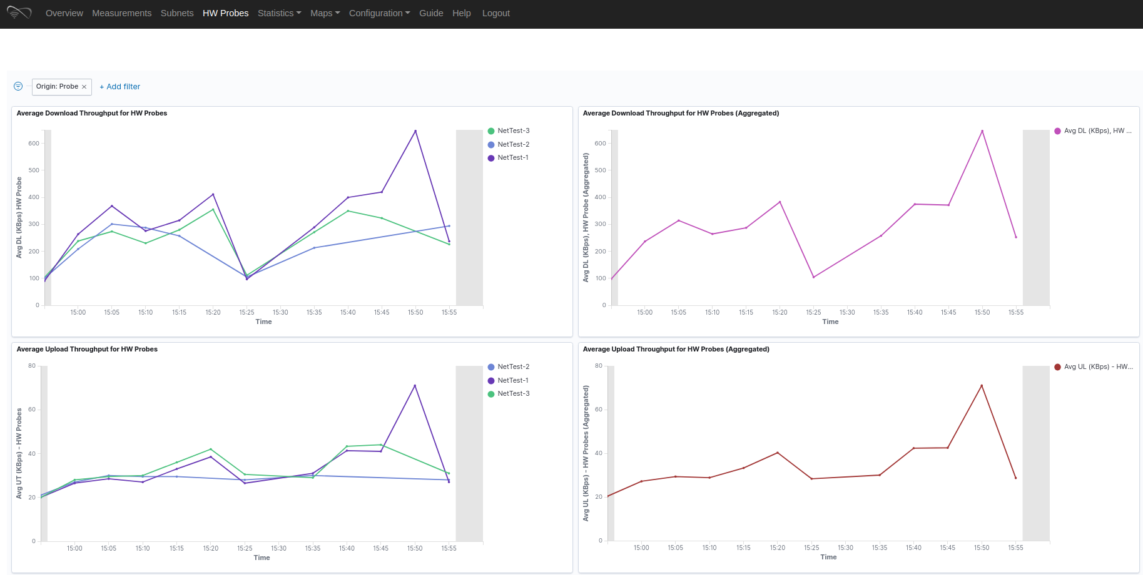
WiFiMon User Interface (UI)
Results per WHP
Aggregated Results
Results from 3 WiFiMon Hardware Probes during an hour

Slide 9
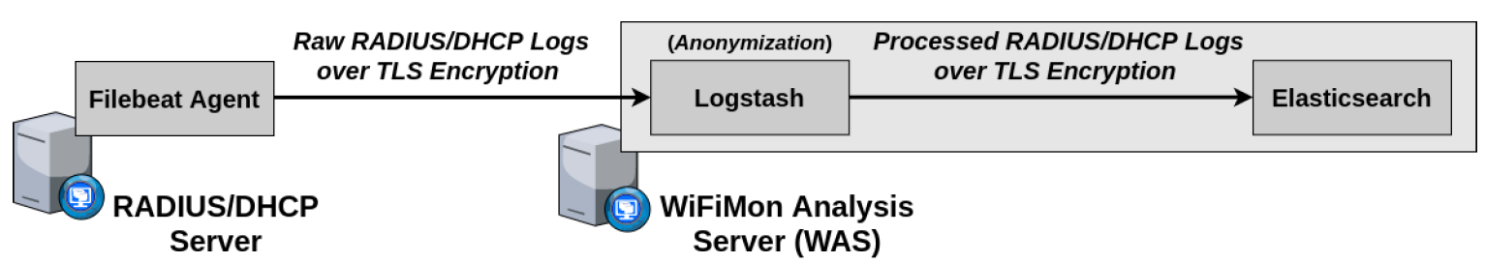
Correlation with RADIUS/DHCP Logs
Logs are:
Extracted from RADIUS/DHCP servers using Filebeat
Processed and transformed by Logstash in WAS
Stored in Elasticsearch of WAS
Correlation options:
With end user IP address (relying solely on RADIUS logs)
With end user MAC address (using both RADIUS and DHCP logs)
Personally Identifiable Information (PII): IP and MAC addresses are secured in transit using a TLS-encrypted channel and stored hashed in WAS (based on X-Pack)
→ Correlation comparisons are performed on hashed strings.

Slide 10
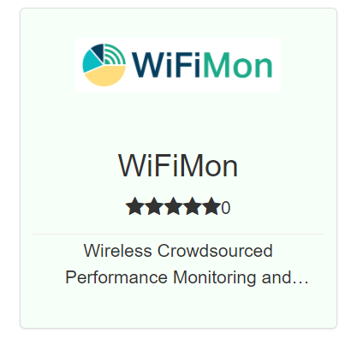
Installing WiFiMon
GÉANT Service since 2020!
Options:
Interested institutions install all the components on their premises
- Download and installation by institutions.
- All data stay within the premises of the institution.
- Support from WiFiMon team for all components.
NMaaS Portfolio
NMaaS (more appropriate for testing/trying WiFiMon)
- WiFiMon WAS instance per institution deployed on NMaaS.
- WTS installation still required by institutions
(should be close to the monitored network).
- Support from WiFiMon team in interfacing
WTS and Dockerized WAS on NMaaS
Recent addition: Ansible script for automating WAS installation (1st option)

Slide 11
Evaluation
Based on pilots in 2 recent conference venues:
TNC19 Conference (Tallinn, 2019) → Skipped in this presentation (see older ones!)
GÉANT Symposium 2020 (Ljubljana, 2020)
GÉANT Symposium 2020 :
Around 250 participants
Monitored eduroam ESSID
WHPs: Seven Raspberry Pi 3 model B devices (Interval: 5 minutes)
WSPs: HTML lines in the conference agenda after receiving consent during the online registration process
WTS: in ARNES, the Slovenian NREN (close to the Symposium venue)

Slide 12
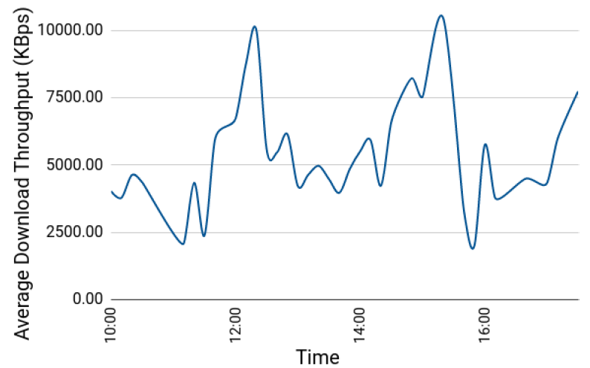
GÉANT Symposium 2020 Pilot (1)
Average download throughput reported by crowdsourced measurements (1st Symposium Day between 10:00 and 17:00):
3
3
2
1
1
Major drops: 11:00 – 11:40 and 15:30 – 16:00
→ periods after coffee break (more people visiting symposium agenda)
Notable drop: 12:30 – 14:00
→ during and after lunch time when most participants gathered in less space
Higher levels: around 12:20 and 15:20 → participants distributed across many different sessions
1
2
3

Slide 13
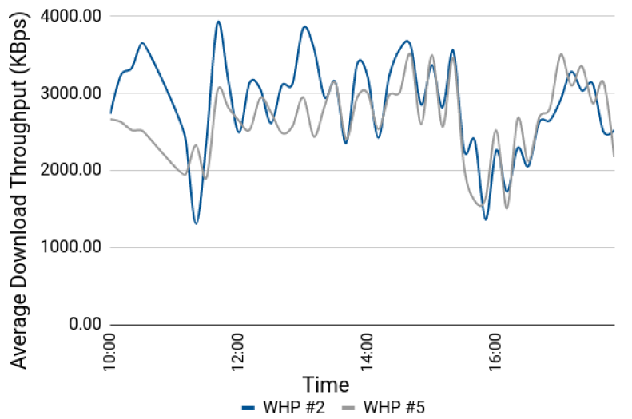
GÉANT Symposium 2020 Pilot (2)
Average download throughput reported by WHPs #2 and #5 (1st Symposium day):
Both WHPs follow similar trends
Both WHPs conceive the throughput drops reported by WSP measurements
WHPs reported less throughput as they were placed near the available power plugs, typically farther from Access Points than the audience (e.g. on the floor)

Slide 14
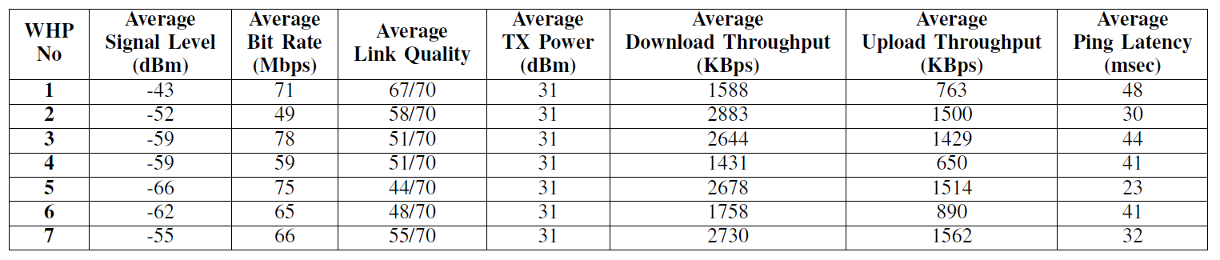
GÉANT Symposium 2020 Pilot (3)
Wireless network metrics and performance measurements for the 1st Symposium day:
Observation: The trends of wireless network metrics do not necessarily follow those of the performance measurements
WHP #1: best average link quality, but among the worse throughput results
WHP #5: worst average link quality, but among the best throughput results
Conclusion: Multiple sources of performance information, i.e. crowdsourced and probe measurements, are vital for the proper evaluation of Wi-Fi performance
→ High values of signal strength and link quality do not necessarily guarantee high Wi-Fi throughputs

Slide 15
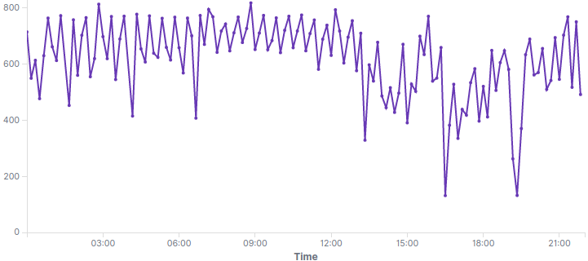
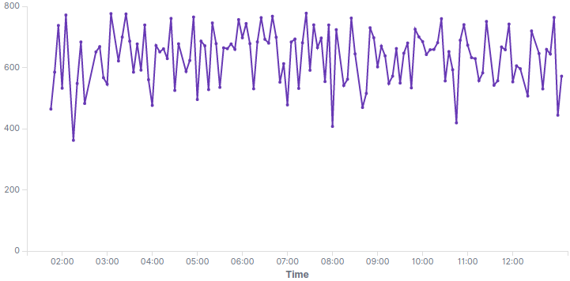
Results from a Home Network
Depicting Average Download Throughput reported by a WHP
Two different days
Average Download Throughput (KBps)
Two notable drops, while downloading a big file from another PC within the network

Slide 16
Future Steps
Enrich WiFiMon toolset with additional Wi-Fi performance monitoring options
Contacting interested NRENs and assisting them in installing WiFiMon
- Most recent setup in RENU
WiFiMon setups in home/enterprise networks of WiFiMon team members for long term analysis
Version tracking for WiFiMon

Slide 17

Check out the WiFiMon video!
https://www.youtube.com/watch?v=9LuGlF6JSnA
… or the WiFiMon Infoshare
https://www.youtube.com/watch?v=VXQV2zWRKgo
… or earlier presentations
https://wiki.geant.org/display/WIF/WiFiMon+Publications

