Slide 2
WiFiMon: Introduction
Monitors the performance of Wi-Fi networks as experienced by their end users using an objective Quality of Experience (QoE) approach.
Combines crowdsourced and hardware probe measurements to provide complete insight into Wi-Fi network performance.
Incorporates data from RADIUS and DHCP logs to provide additional analysis options, e.g. per Access Point.
Contribution: Supporting administrators to detect Wi-Fi throughput degradation, hence allowing them to determine underperforming areas in a network and enhance Wi-Fi performance, e.g. by installing more APs
WiFiMon vs other monitoring solutions:
WiFiMon monitors from the end user perspective (end user experience).
WiFiMon does not require end user intervention or installation of an app.
WiFiMon provides a centralized view of Wi-Fi performance and informs the Wi-Fi administrator of the performance results.

Slide 3
Design Features
Combination of crowdsourced and deterministic measurements
Correlation with RADIUS and DHCP logs respecting end user privacy
Independence of Wi-Fi technology and hardware vendor
Lightweight, active monitoring that does not impact end user browsing experience

Slide 4
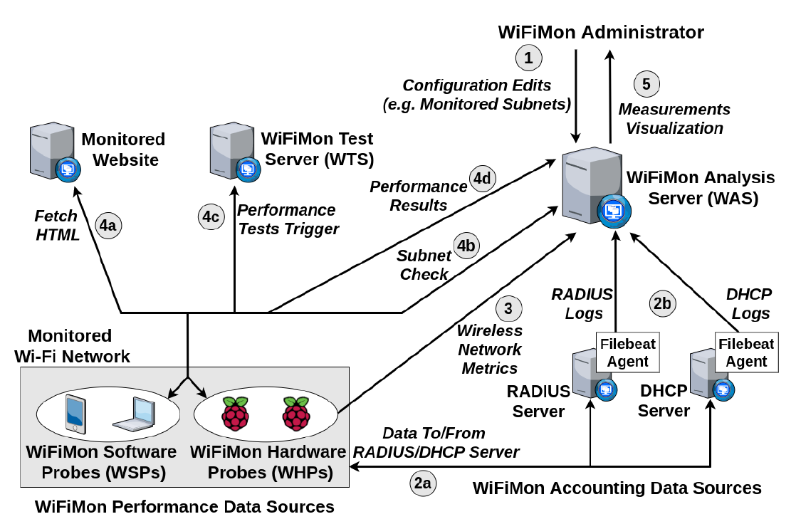
WiFiMon Operation
WiFiMon Components:
WiFiMon Software Probes (WSPs)
WiFiMon Hardware Probes (WHPs)
WiFiMon Test Server (WTS)
WiFiMon Analysis Server (WAS)

Slide 5
WiFiMon Test Server (WTS)
Purpose: Holds the code and test data required for performance measurements.
Based on JavaScript technology.
HTML lines pointing to WTS JavaScript-based test tools are embedded to a frequently visited site.
Measurements of the HTTP service (major part of the Internet traffic).
Three available test tools:
NetTest
Akamai Boomerang
LibreSpeed Speedtest
WTS Placement: Should be as close as possible to the monitored networks so that the distance between the end devices and the WTS is minimized, thus minimizing accuracy loss.
→ Even if WTS placement close to the monitored network is not possible, WiFiMon can capture the relative changes among received measurements

Slide 6
WiFiMon Software & Hardware Probes
WiFiMon Software Probes (WSPs):
User devices, e.g. laptops, smartphones, etc.
Crowdsourced measurements triggered against the WTS when users visit a WiFiMon-enabled site (not triggered by end users themselves).
WiFiMon does not require additional software to be installed on user devices.
WiFiMon regulates repetitive measurements through a cookie parameter in order not to overload WAS and WTS.
WiFiMon Hardware Probes (WHPs):
They measure Wi-Fi performance from fixed locations within the network (distance between WHPs and Access Points remains relatively constant).
They complement crowdsourced measurements by providing a baseline throughput.
Performance measurements similar to WSPs (based on predefined period)
They collect data about monitored ESSID as well as nearby ESSIDs
(Access Points, signal strength, link quality, bit rate, TX power)

Slide 7
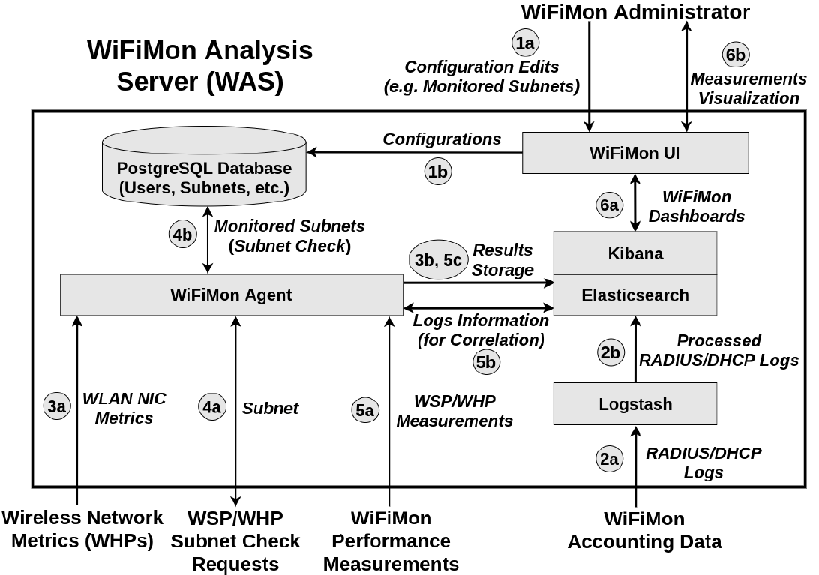
WiFiMon Analysis Server (WAS)
WiFiMon Analysis Server Modules:
WiFiMon Agent: collects and processes the received monitoring data
WiFiMon User Interface (UI): depicts the results of data processing

Slide 8
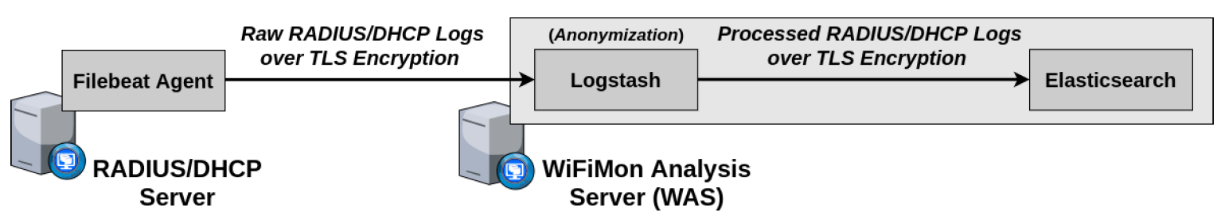
Correlation with RADIUS/DHCP Logs
Logs are:
Extracted from RADIUS/DHCP servers using Filebeat
Processed and transformed by Logstash in WiFiMon Analysis Server
Stored in Elasticsearch of WiFiMon Analysis Server
Correlation options:
With end user IP address (relying solely on RADIUS logs)
With end user MAC address (using both RADIUS and DHCP logs)
Personally Identifiable Information (PII): IP and MAC addresses are secured in transit using a TLS-encrypted channel and stored hashed in WAS (based on X-Pack)
→ Correlation comparisons are performed on hashed strings.

Slide 9
Evaluation
Based on pilots in 2 recent conference venues:
TNC19 Conference (Tallinn, 2019)
GÉANT Symposium 2020 (Ljubljana, 2020)
TNC19:
More than 800 participants
Monitored Wi-Fi network setup for the conference days
Monitoring using only WHPs (Five Raspberry Pi 3 model B devices)
WHP monitoring interval: 20 minutes
WTS in TalTech: RTT between WTS and venue less than 4 msec
GÉANT Symposium 2020 :
Around 250 participants
Monitored eduroam ESSID
WHPs: Seven Raspberry Pi 3 model B devices (Interval: 5 minutes)
Also including WSPs: HTML lines in the conference agenda after receiving consent during the online registration process
WTS in ARNES, the Slovenian NREN

Slide 10
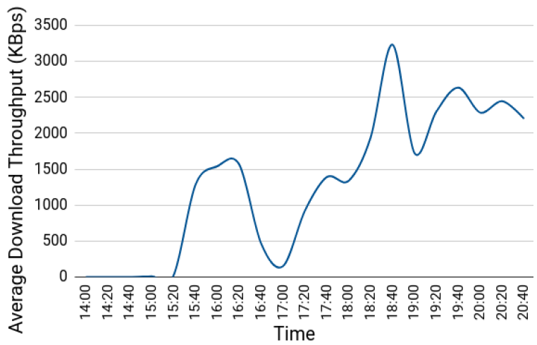
TNC19 Pilot (1)
Average download throughput reported by a WHP placed in the main hall during the 1st conference day:
14:00 – 15:20: Low throughput and connectivity issues during lightning talks
15:20 – 16:30: Less people in the venue, thus higher throughput
Around 17:00: Significant drop because of opening ceremony
After 18:00: Wi-Fi performance restored after people had left the venue

Slide 11
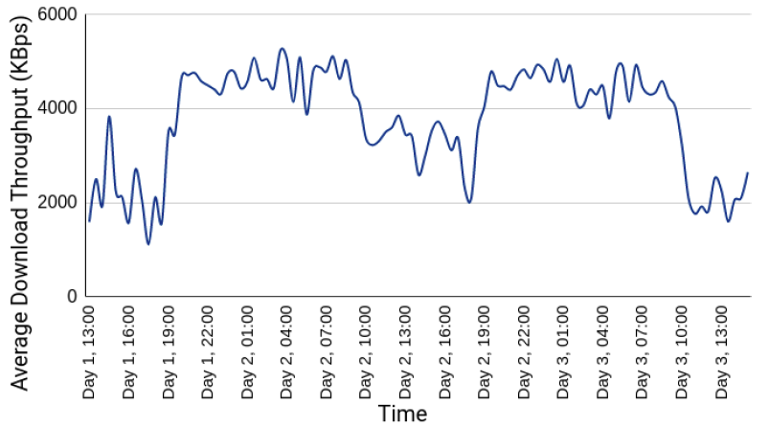
TNC19 Pilot (2)
Average download throughput reported by a WHP placed in the room where coffee/lunch breaks and the opening ceremony occurred:
Wi-Fi performance degraded when people were at the venue, while the throughput was higher and more stable when participants were absent.

Slide 12
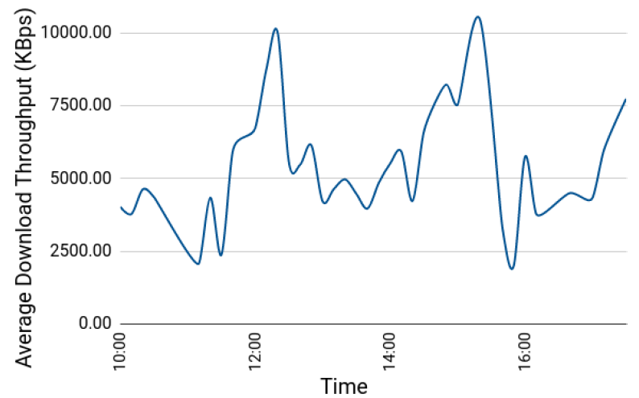
GÉANT Symposium 2020 (1)
Average download throughput reported by crowdsourced measurements (1st Symposium Day between 10:00 and 17:00):
Major drops: 11:00 – 11:40 and 15:30 – 16:00
→ periods after coffee break (more people visiting symposium agenda)
Notable drop: 12:30 – 14:00
→ during and after lunch time when most participants gathered in less space
Higher levels: around 12:20 and 15:20 → participants distributed across many different sessions

Slide 13
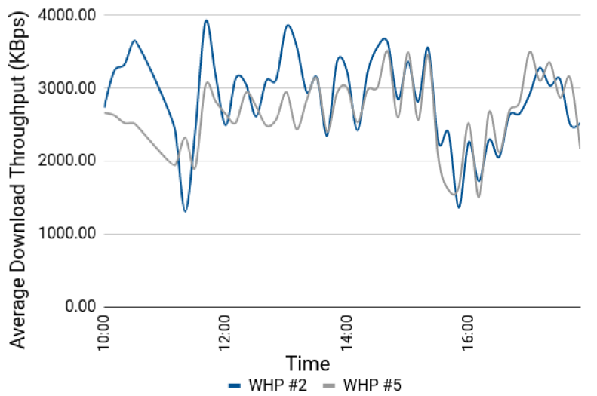
GÉANT Symposium 2020 (2)
Average download throughput reported by WHPs #2 and #5 (1st Symposium day):
Both WHPs follow similar trends
Both WHPs conceive the throughput drops reported by WSP measurements
WHPs reported less throughput as they were placed near the available power plugs, typically farther from Access Points than the audience (e.g. on the floor)

Slide 14
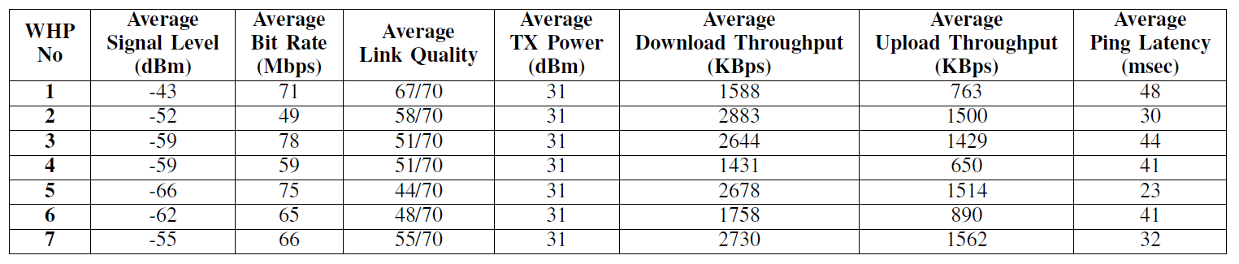
GÉANT Symposium 2020 (3)
Wireless network metrics and performance measurements for the 1st Symposium day:
Observation: The trends of wireless network metrics do not necessarily follow those of the performance measurements
WHP #1: best average link quality, but among the worse throughput results
WHP #5: worst average link quality, but among the best throughput results
Conclusion: Multiple sources of performance information, i.e. crowdsourced and probe measurements, are vital for the proper evaluation of Wi-Fi performance
→ High values of signal strength and link quality do not necessarily guarantee high Wi-Fi throughputs

Slide 15
Conclusion & Future Work
WiFiMon can detect performance fluctuations in Wi-Fi networks to help determine underperforming network areas and act accordingly.
(based on our pilots that monitored a big number of diverse users and devices)
Future steps:
Use time series analysis and/or machine learning methods to predict Wi-Fi outages
Enrich WiFiMon toolset with additional Wi-Fi performance monitoring options
Install WiFiMon in campus/enterprise networks to test our system for longer time periods, while including data from RADIUS and DHCP logs omitted from our recent pilots

