Slide 2

Introduction

Slide 3
WiFiMon: Introduction
Monitoring Wi-Fi network performance as experienced by end users
Combination of crowdsourced and hardware probe measurements
IEEE 802.1X networks (eduroam): Data from RADIUS and DHCP logs strengthen analysis options, e.g. per Access Point (AP)
Contribution:
Detection of Wi-Fi throughput degradation
Determination of underperforming areas within a Wi-Fi network
→ Admins may enhance performance, e.g. by installing more APs
WiFiMon vs other monitoring solutions:
Monitoring from the end user perspective (end user experience)
No requirements for end user intervention or installation of apps
Centralized view of Wi-Fi performance available to the Wi-Fi administrator

Slide 4
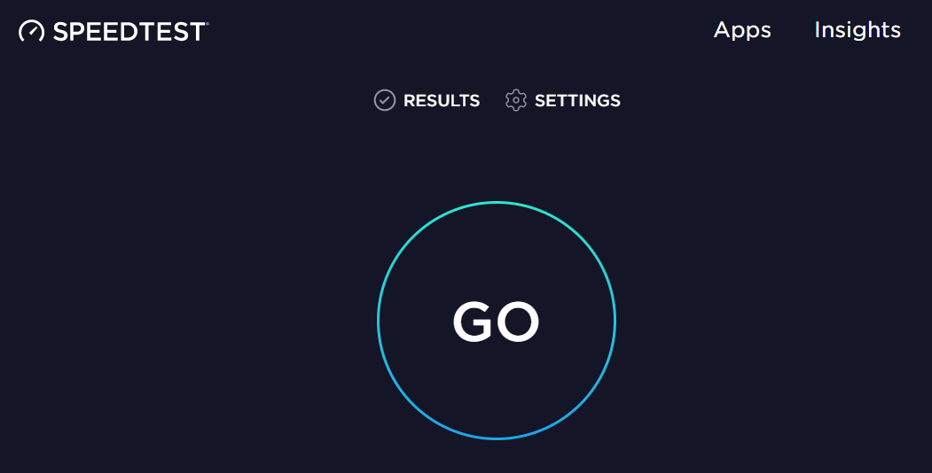
Example: WiFiMon vs Ookla Speedtest
WiFiMon | Ookla Speedtest
automatically by visiting a site | by pressing “GO”
the Wi-Fi administrator | the end users
Measurements are triggered:
Results are collected by:

Slide 5
Design Features & Operation

Slide 6
Design Features of WiFiMon
Combination of crowdsourced and deterministic measurements
Correlation with RADIUS and DHCP logs respecting end user privacy
Independence of Wi-Fi technology and hardware vendor
Lightweight, active monitoring without significant impact on end user browsing experience

Slide 7
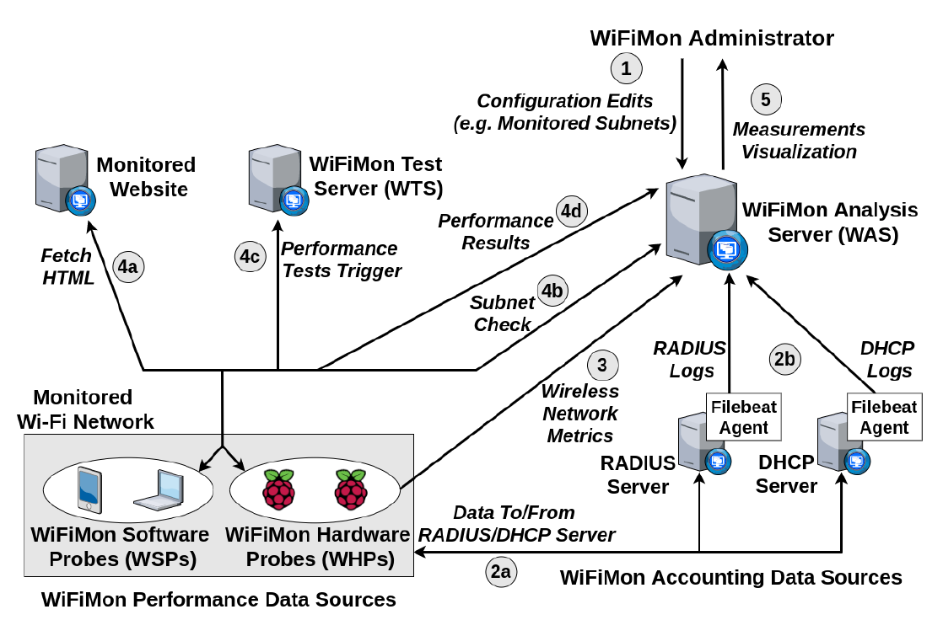
WiFiMon Operation
WiFiMon Components:
WiFiMon Software Probes (WSPs)
WiFiMon Hardware Probes (WHPs)
WiFiMon Test Server (WTS)
WiFiMon Analysis Server (WAS)

Slide 8
Components

Slide 9
WiFiMon Test Server (WTS)
Purpose: Holds code and test data for performance measurements
Based on JavaScript (JS) technology
HTML script tags pointing to test tools are added to frequently visited sites
Measurements of the HTTP service (Majority of Internet traffic)
3 available test tools:
NetTest (https://code.google.com/archive/p/nettest/)
Akamai Boomerang (https://github.com/akamai/boomerang)
LibreSpeed Speedtest (https://github.com/librespeed/speedtest)
WTS Placement: Close to monitored networks (RTT between end devices and WTS included in results)
→ If not possible: WiFiMon captures relative changes in Wi-Fi performance

Slide 10
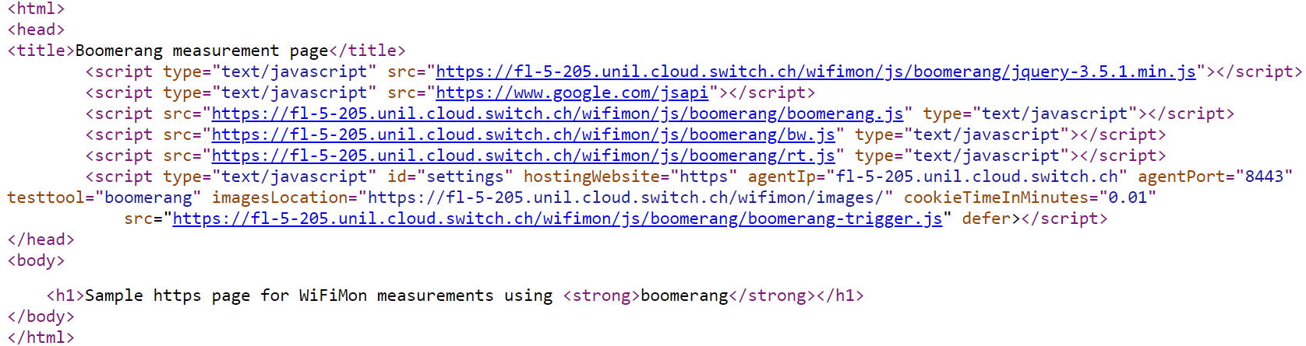
WiFiMon Software Probes (WSPs)
User devices (laptops, smartphones, …)
Crowdsourced measurements triggered against the WTS when users visit a WiFiMon-enabled site (not triggered by end users themselves)
No requirement for additional software within user devices
Repetitive measurements regulated via a cookie value (WAS/WTS not overloaded)
Example: Lines for Akamai Boomerang test tool
(injected in a sample web site)

Slide 11
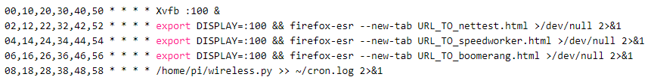
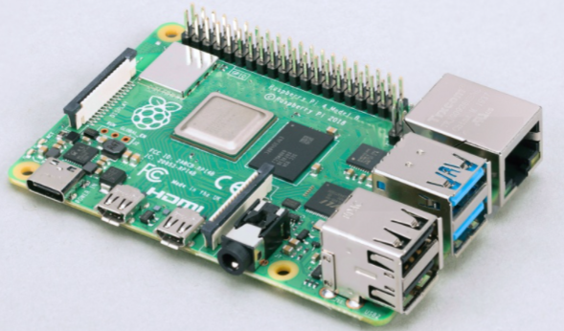
WiFiMon Hardware Probes (WHPs)
Wi-Fi performance measurements from fixed points within the network
(distance between WHPs and APs is relatively constant)
Baseline throughput that complements crowdsourced measurements
Performance measurements similar to WSPs (on predefined intervals)
Additional data about monitored and nearby ESSID’s
(APs, signal strength, link quality, bit rate, TX power)
TWAMP Measurements, System data (memory, CPU utilization)
Triggering measurements based on crontabs:
Tested for Raspberry Pi v3 and v4

Slide 12
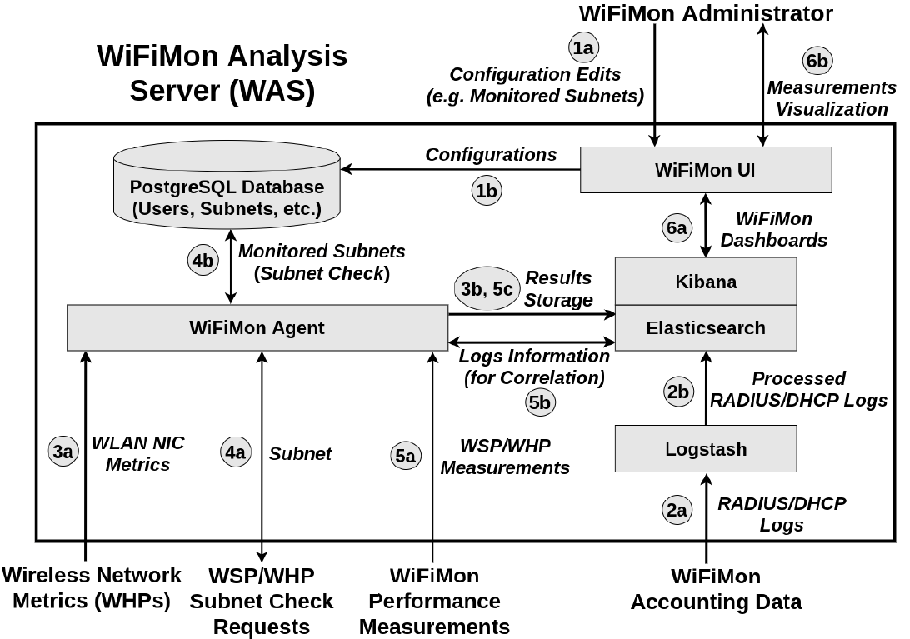
WiFiMon Analysis Server (WAS)
WAS Modules:
WiFiMon Agent: Collects and processes the received monitoring data
WiFiMon User Interface (UI): Depicts the results of data processing

Slide 13
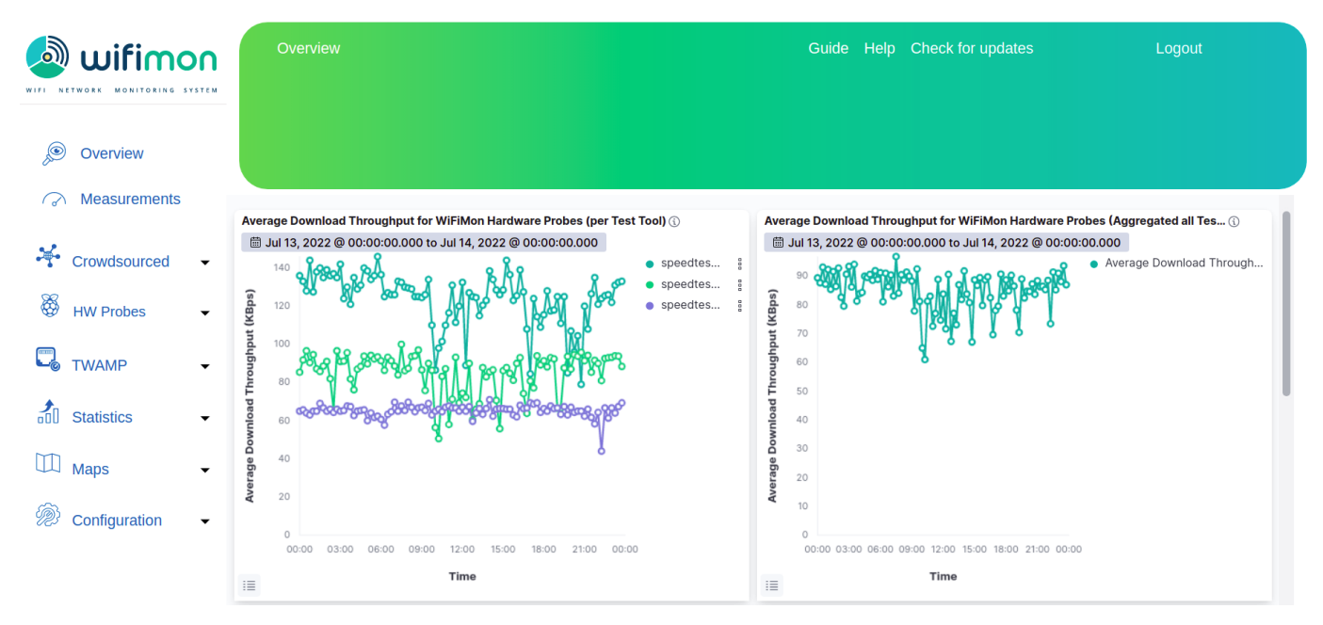
WiFiMon User Interface (1)
Results per WHP
Aggregated Results
Results from 3 WHPs during a day

Slide 14
WiFiMon User Interface (2)
Dashboards available for:
Average values
Median values
Maximum values
Minimum values
95th Percentile values
Depicting estimations of:
Download throughput
Upload throughput
HTTP ping Round Trip Time (RTT)
That may be:
Uncorrelated
Correlated with the available APs
Sources:
Crowdsourced measurements
Hardware Probe measurements

Slide 15
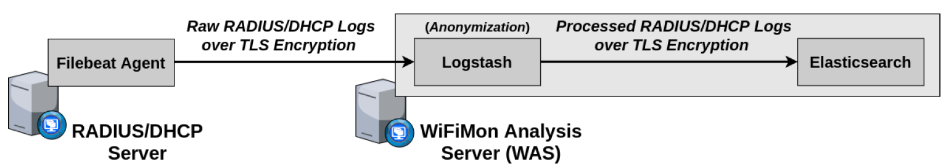
Correlation with RADIUS/DHCP Logs
Logs are:
Extracted from RADIUS/DHCP servers using Filebeat
Processed and transformed by Logstash in WAS
Stored in Elasticsearch of WAS
Correlation options:
With end user IP address (relying solely on RADIUS logs)
With end user MAC address (using both RADIUS and DHCP logs)
Personally Identifiable Information (PII): IP and MAC addresses are secured in transit using a TLS-encrypted channel and stored hashed in WAS (based on X-Pack)
→ Correlation comparisons are performed on hashed strings.

Slide 16
Other Features of WiFiMon
Notification of WiFiMon version updates
- WiFiMon Users are informed of new versions from the UI
- Enables monitoring WiFiMon utilization (optional feature)
Log Exporter specifically designed for eduroam
- WHP data exported towards the JSON collector of eduroam (optional)
- May be used with any JSON collector
WTS location information
- Facilitates using multiple WTS instances
- Monitoring multiple sites with a single WAS
IPv6 Support
Currently Tested:
TWAMP measurements from WHPs to complement performance data
End user number approximation
Jitter measurements from LibreSpeed

Slide 17
Installation

Slide 18
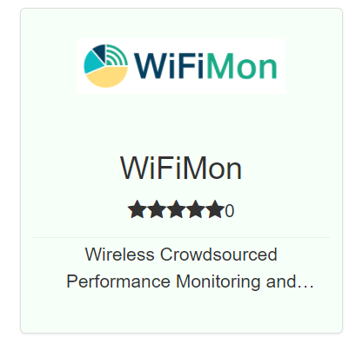
WiFiMon Installation
GÉANT Service since 2020!
Options:
Institutions install all components within their premises
- Ansible playbook for WAS automated installation
- Manual installation for WTS
- All data stay within the institution premises
- Support from WiFiMon team for all components
NMaaS Portfolio
NMaaS (more appropriate for testing/trying WiFiMon)
- Another GÉANT Service
- WiFiMon WAS instance deployed on NMaaS
- WTS installation still required by institutions
(should be close to the monitored network)
- Support from WiFiMon team for interfacing
WTS and Dockerized WAS on NMaaS
Manual WAS installation: Abandoned by WiFiMon

Slide 19
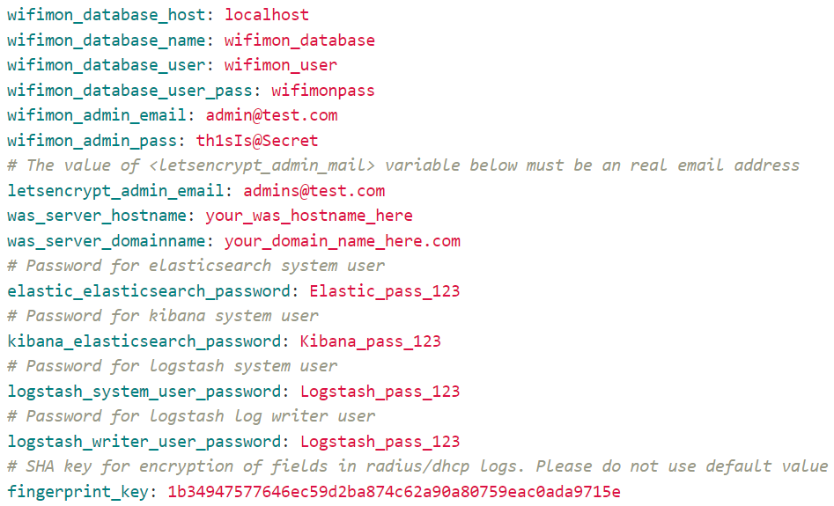
Ansible WAS Installation
Specs (minimum/recommended):
Operating Systems Tested:
4 CPU cores
8 GB / 16 GB RAM
10 GB / 50 GB Free Space
Debian 10
Debian 11
Ubuntu 18.04
Ubuntu 20.04
Other Requirements:
Ansible (and its requirements)
Root access
Appropriate DNS records
Filling details (e.g. passwords)
within a file (see figure)

Slide 20
Experience from WiFiMon Pilots

Slide 21
Evaluation
Based on pilots in 2 GÉANT conference venues:
TNC19 Conference (Tallinn, 2019)
GÉANT Symposium 2020 (Ljubljana, 2020)
TNC19:
More than 800 participants
Monitored Wi-Fi network setup for the conference days
Monitoring using only WHPs (Five Raspberry Pi 3 model B devices)
WHP monitoring interval: 20 minutes
WTS in TalTech: RTT between WTS and venue less than 4 msec
GÉANT Symposium 2020 :
Around 250 participants
Monitored eduroam ESSID
WHPs: Seven Raspberry Pi 3 model B devices (Interval: 5 minutes)
Also including WSPs: HTML lines in the conference agenda after receiving consent during the online registration process
WTS in ARNES, the Slovenian NREN

Slide 22
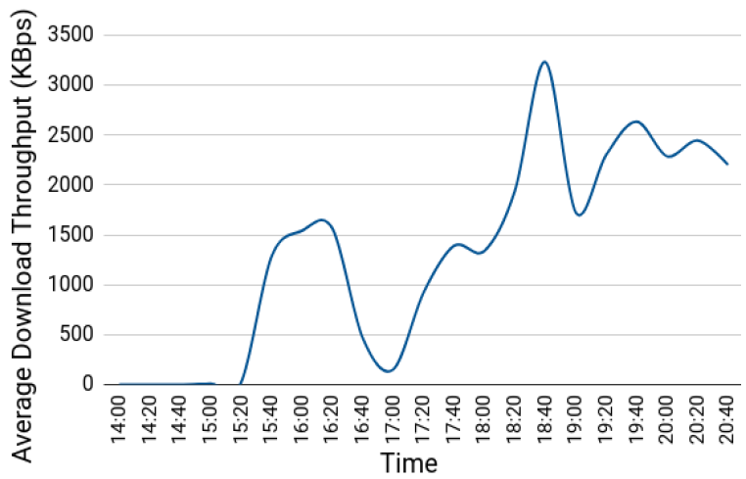
TNC19 Pilot (1)
Average download throughput reported by a WHP placed in the main hall during the 1st conference day:
14:00 – 15:20: Low throughput and connectivity issues during lightning talks
15:20 – 16:30: Less people in the venue → Higher throughput
Around 17:00: Significant drop because of opening ceremony
After 18:00: Wi-Fi performance restored after people had left the venue

Slide 23
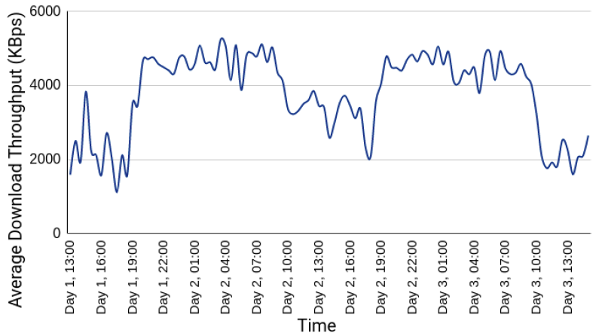
TNC19 Pilot (2)
Average download throughput reported by a WHP placed in the room where coffee/lunch breaks and the opening ceremony occurred:
Wi-Fi performance degraded when people were at the venue, while the throughput was higher and more stable when participants were absent.

Slide 24
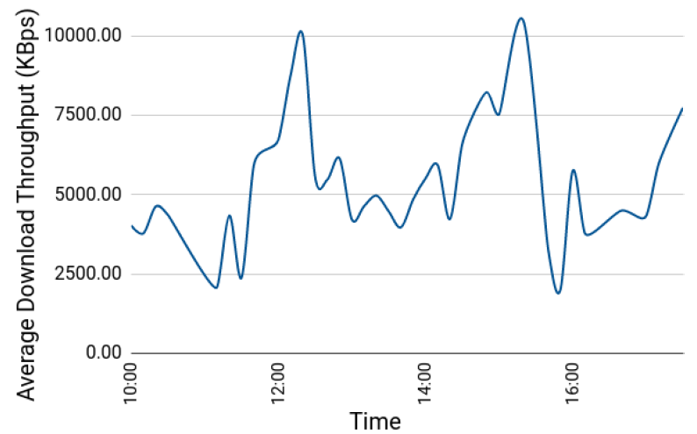
GÉANT Symposium 2020 Pilot (1)
Average download throughput reported by crowdsourced measurements (1st Symposium Day between 10:00 and 17:00):
3
3
2
1
1
Major drops: 11:00 – 11:40 and 15:30 – 16:00
→ Periods after coffee break (more people visiting symposium agenda)
Notable drop: 12:30 – 14:00
→ During and after lunch time when most participants gathered in less space
Higher levels: Around 12:20 and 15:20
→ Participants distributed across many different sessions
1
2
3

Slide 25
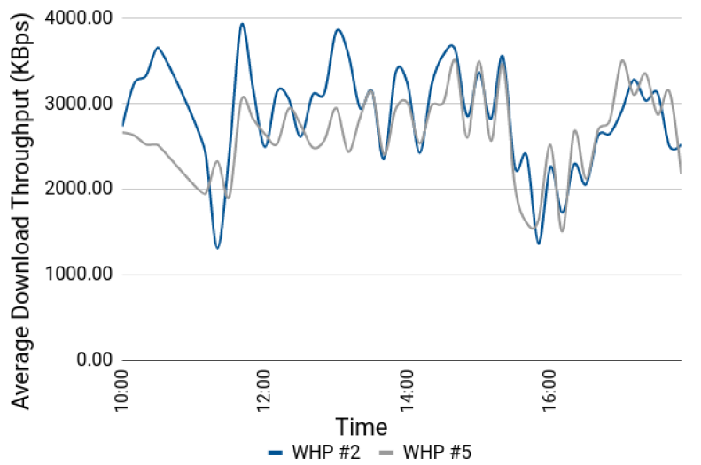
GÉANT Symposium 2020 Pilot (2)
Average download throughput reported by WHPs #2 and #5 (1st Symposium day):
Both WHPs follow similar trends
Both WHPs conceive the throughput drops reported by WSP measurements
WHPs reported less throughput as they were placed near the available power plugs, typically farther from Access Points than the audience (e.g. on the floor)

Slide 26
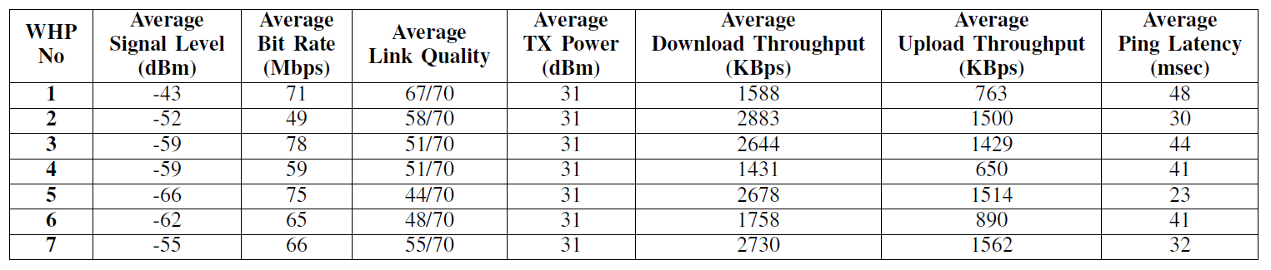
GÉANT Symposium 2020 Pilot (3)
WLAN metrics and performance measurements from the 1st Symposium day:
Observation: WLAN metric trends may not follow those of performance measurements
WHP #1: best average link quality, but among the worst throughput results
WHP #5: worst average link quality, but among the best throughput results
Conclusion: Multiple sources of information, i.e. crowdsourced and probe measurements, are vital for proper Wi-Fi performance evaluation
→ High values of signal strength/link quality do not necessarily guarantee high Wi-Fi throughputs

Slide 27
Future Steps and Useful Links

Slide 28
Future Steps
Additional monitoring tools
- Research for appropriate UNIX-based tools
Automatic prediction of Wi-Fi performance drops (Time series analysis)
Automatic correlation between crowdsourced and probe measurements
Monitoring campus environments

Slide 29
Check out the WiFiMon video!
https://www.youtube.com/watch?v=9LuGlF6JSnA
… or the WiFiMon Infoshare
https://www.youtube.com/watch?v=VXQV2zWRKgo
… or previous presentations
https://wiki.geant.org/display/WIF/WiFiMon+Publications
… or the WiFiMon paper at IEEE/IFIP WONS 2021
http://dl.ifip.org/db/conf/wons/wons2021/1570695031.pdf

