Slide 1

Machine Translation with recurrent neural networks
Amsterdam Women in Machine Learning and Data Science
Marina Hader
January 28, 2020

Slide 2
Overview
What is Natural Language Processing (NLP)?
How does a recurrent neural network work? What is a sequence-to-sequence model and why is it suitable for NLP tasks?
Practice makes perfect: Implement a recurrent neural network for machine translation (EN → FR) in keras
Notes:
Questions?

Slide 3


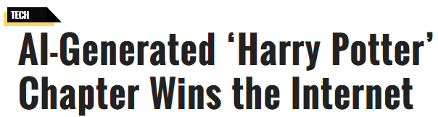

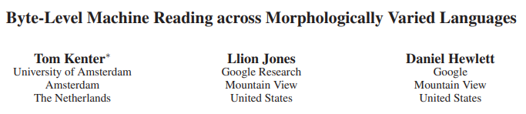

Language Generation…
Sentiment Analysis…
… Speech
Recognition
Machine Translation…
Machine Reading…
Notes:
How does NLP or Machine translation differ from other AI tasks such as image classification for example?

Slide 4
Terminology
Sequence-to-Sequence
models
Recurrent Neural Networks
Encoder-Decoder model
…
Encoder: Recurrent neural network
Decoder: Recurrent neural network

Slide 5
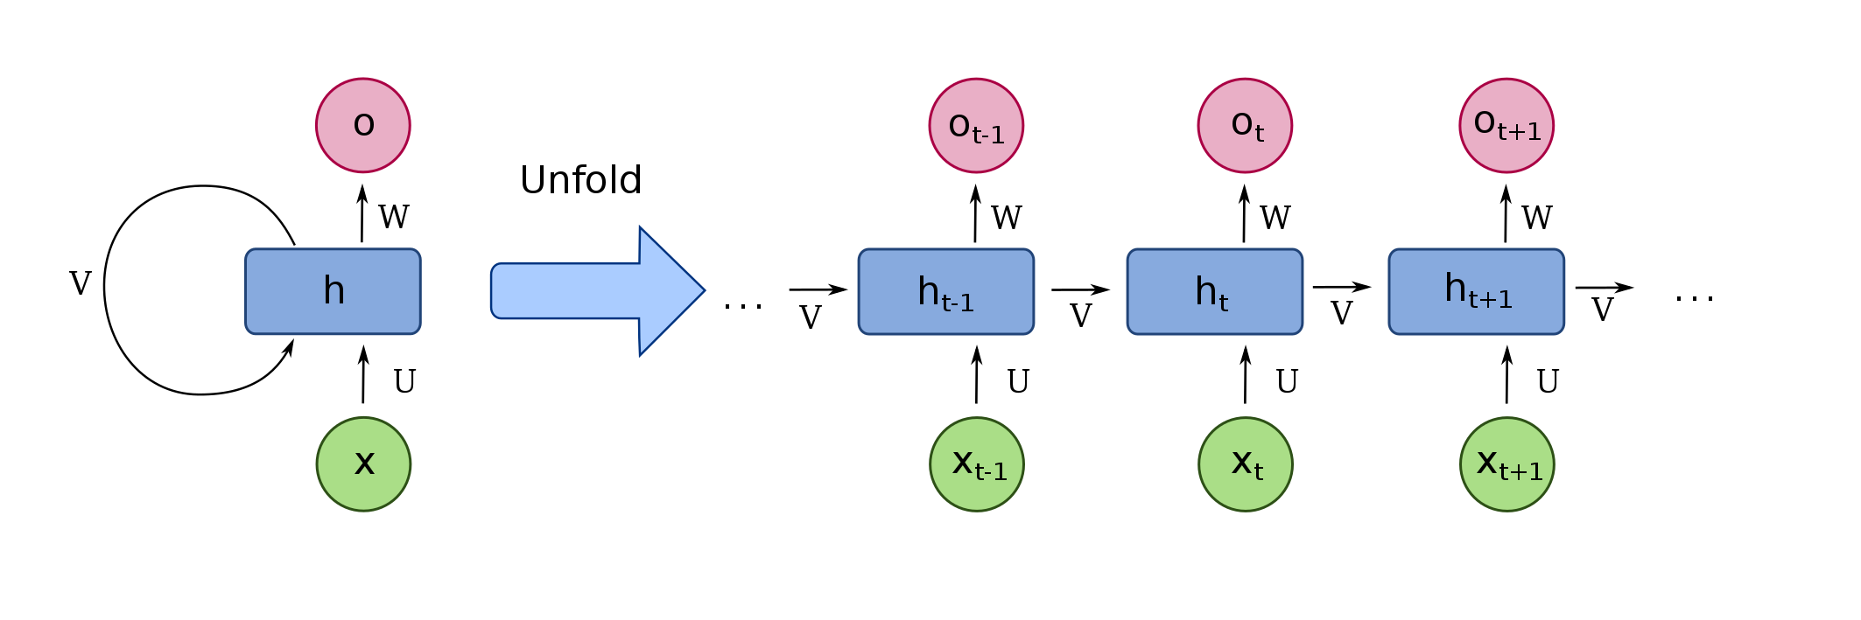
Recurrent Neural Networks
Output
Input

Slide 6
Recurrent Neural Networks
Output 1
La
Output 2
maison
Output 3
<end>
Output
Input
Input 1
The
Input 2
house
Input 3
<end>

Slide 7
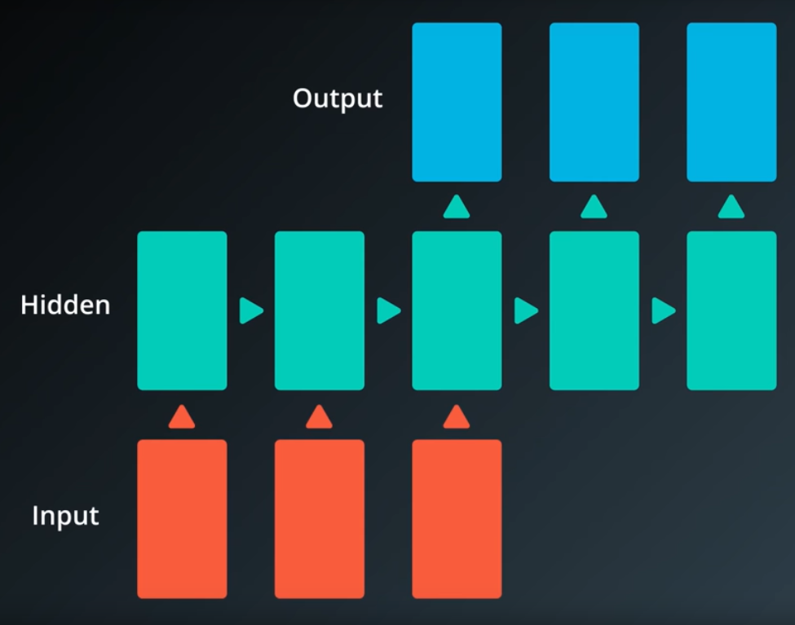
Sequence-to-sequence models
Sequence of
output vectors:
Summarized text
Answer
English text
Sequence of
input vectors:
Text sequence
Question
French text
Notes:
Suitable for translations, summaries, questions (input) – answers (output)

Slide 8
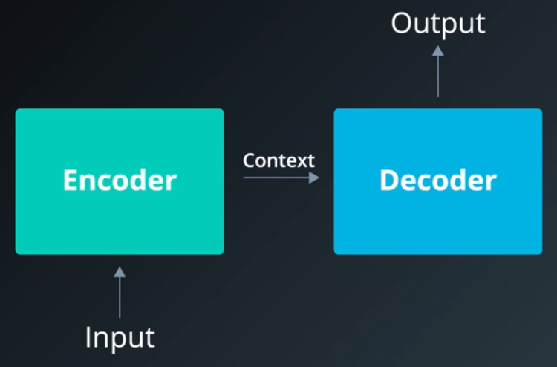
Sequence-to-sequence models: Encoder-Decoder
Recurrent neural
network
Recurrent neural
network
Notes:
Context is a fixed-size tensor, also called state
Both encoder and decoder are RNNs

Slide 9
The Encoder
Output
Context
vector
Input
Word 1
The
Word 2
house
Word 3
<end>

Slide 10
The Decoder
Output
word 1
La
Output
word 2
maison
Output
word 3
<end>
Output
Context
vector
Input
Output
word 1
La
Output
word 2
maison
Word 1
<start>

Slide 11
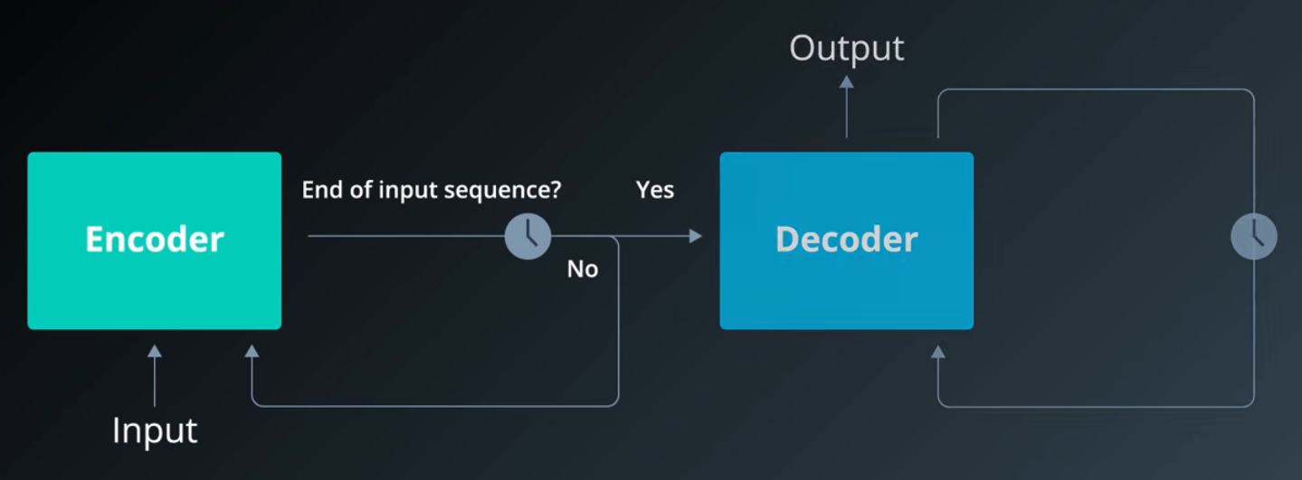
Sequence-to-sequence models
Notes:
Context is a fixed-size tensor, also called state
Both encoder and decoder are RNNs

Slide 12
Our translation machine
We start now
Wir fangen jetzt an
Notes:
Context is a fixed-size tensor, also called state
Both encoder and decoder are RNNs

Slide 13
Getting started
Go to https://colab.research.google.com/ and login to your Google account
Upload the Jupyter notebook
Run the 1st cell of the Jupyter notebook to create 3 folders (you should then see them in the Files tab on the left of your screen)
Upload the loader.py to loader/ and the project_tests.py to project_tests/ and rename both files to __init__.py
Upload small_vocab_en.txt and small_vocab_fr.txt to data/
Fingers crossed! You should be ready ☺

Slide 14
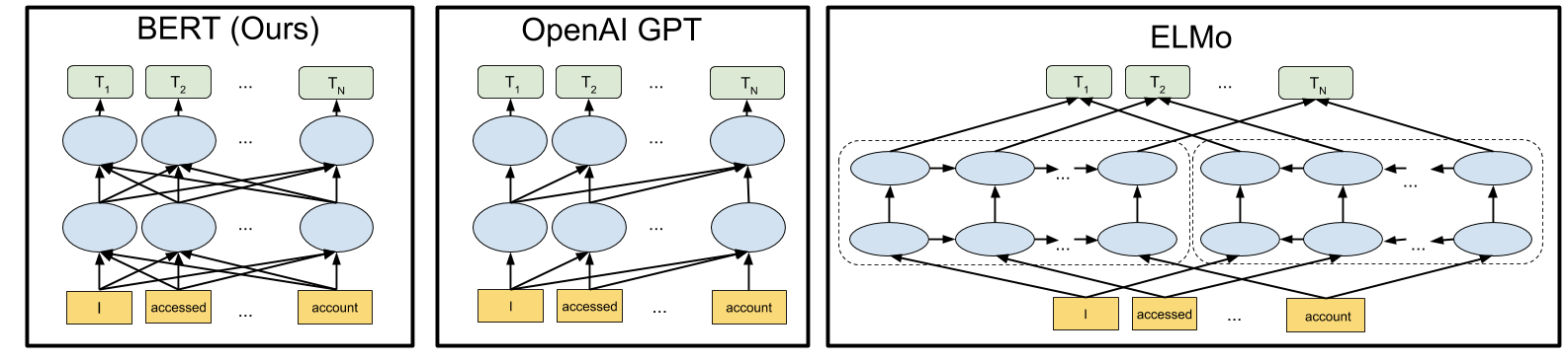
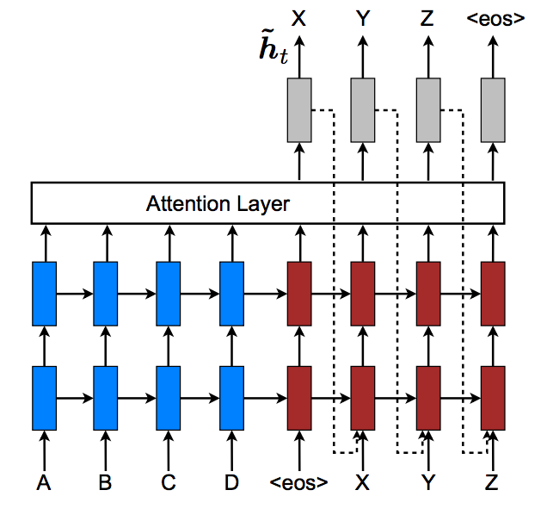
Improving our translation machine
Bidirectional Encoders
BERT by Google
Attention
Notes:
Context is a fixed-size tensor, also called state
Both encoder and decoder are RNNs

