Slide 1
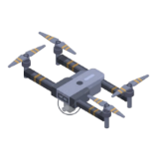
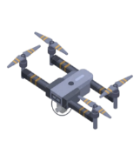


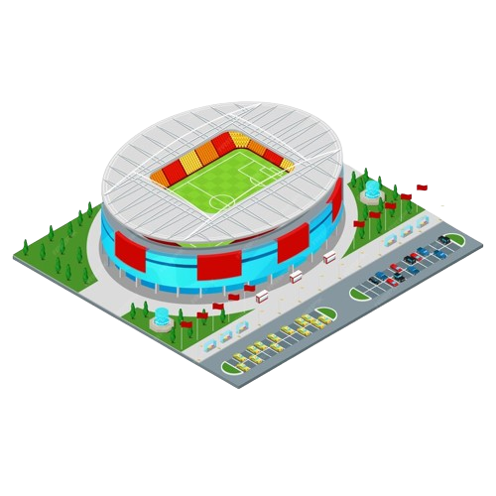



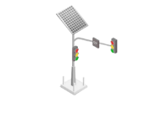


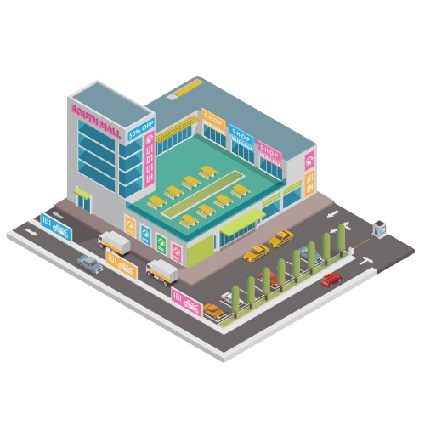








RF link
FSO link
OIRS
Multiple sources installed-GS
LOS link
Block link

Slide 2
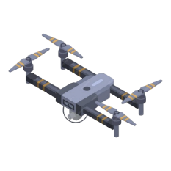
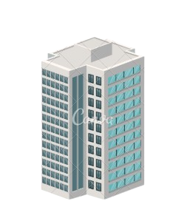
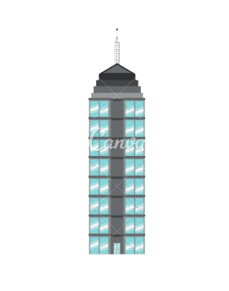








$${UAV}_{i}$$
OIRS
$$d_{i}^{B}$$
h($x_{i}^{u},y_{i}^{u}$)
$$d_{ij}$$
$$h^{o}$$
$$θ_{ij}$$
$${MU}_{j}$$
Multiple sources
installed-GS

