Slide 1

CSE342-Computer Vision
Project Name – Evaluating Performance of YOLO family models for small object detection
Group Name- Pixel Predators
Name | Enrollment number
Romir Bedaekar | AU2240254
Namra Maniar | AU2240080
Hetav Shah | AU2240253
Submitted to: Prof Mehul Raval
CSE342 – Computer Vision

Slide 2
Problem Statement :
This study focuses on evaluating the performance of the YOLO family model and its variants for small object detection.
Objectives –
• Explore various publicly available YOLO family models.
• Understanding the evaluation criteria and dataset.
• Understanding the architecture and identifying modules improving small object
Detection.
• Evaluating their performance in case of small objects.
CSE342 – Computer Vision

Slide 3
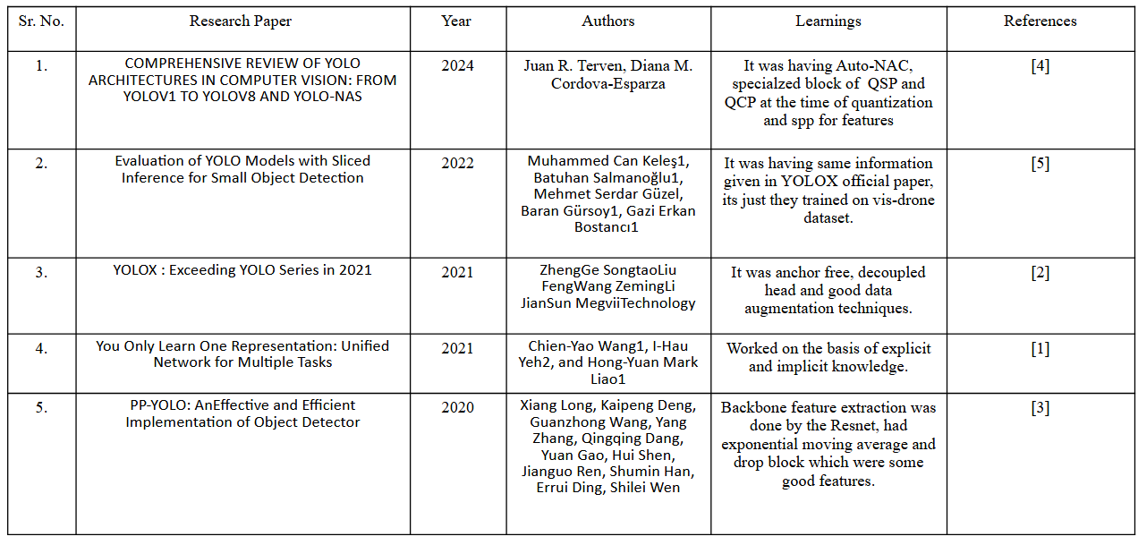
Literature Survey :
CSE342 – Computer Vision

Slide 4
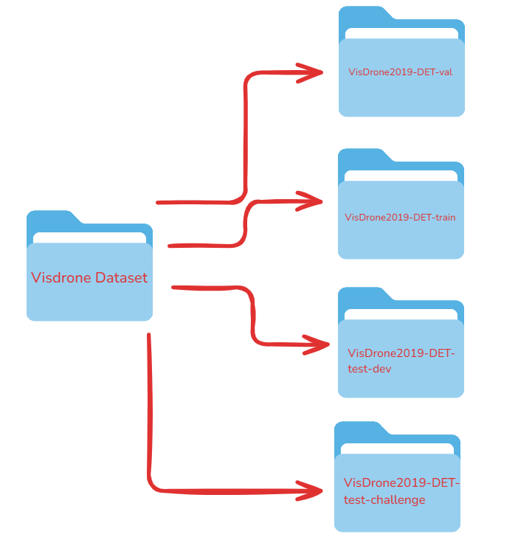
Dataset Discussion:
We are using VisDrone dataset for evaluating our YOLO family models
like YOLOR, YOLOX and PPYOLO.
The dataset is has 5 main subsets for each specific task
Task1- Object detection in images
Task2- Object detection in videos
Task3- Single-object tracking
Task4- Multi-object tracking
Task5- Crowd counting
Each subset has same dataset structure –
Trainset- Images for training along with ground truth annotations.
Valset- Images for validation and ground truth annotations.
Testset- Images for testing with no annotations.
Testset-challenge- Hidden images for evaluations during competition.
The dataset consists of
Composition- 288 video clips with 261,908 frames and 10,209 static images.
Annotations- Over 2.6 million bounding boxes for objects like pedestrians, cars, bicycles, and tricycles.
CSE342 – Computer Vision

Slide 5
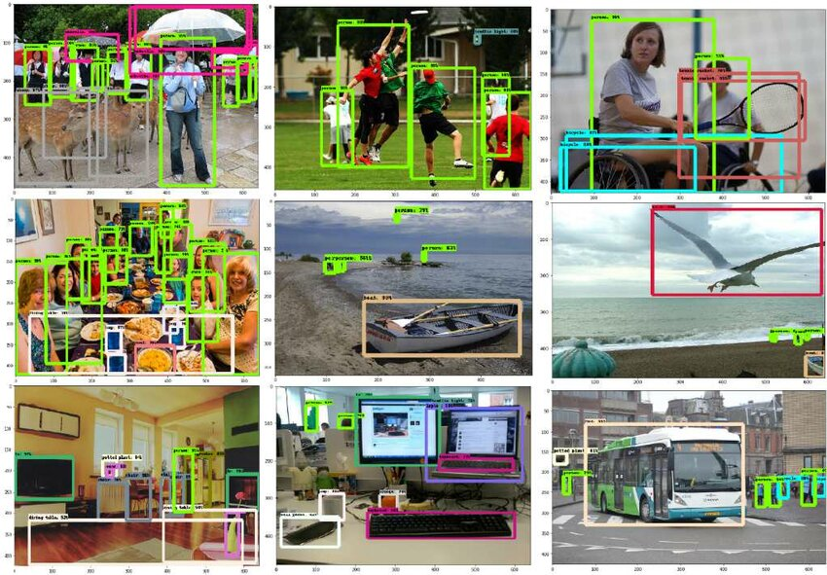
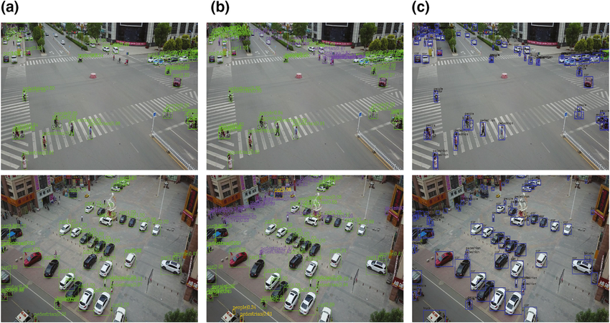
VisDrone uses txt files for annotations where each file is a image or a video. The format of the data
in this files is x, y, w, h, score, category_id, truncation, occlusion.
x, y – top left corner of bounding box
w, h –width and height of bounding box
score –confidence scores generally -1 in training or validation
category_id –class of an object, 10 objects which are person, car, truck, motorbike, bus, bicycle, van
pedestrian, awning-tricycle and tricycle.
truncation – 1 if object cut-off by image boundary else 0.
Occlusion -0 fully visible , 1 partial occlusion and 2 fully occluded.
COCO Dataset
VisDrone Dataset​
​
CSE342 – Computer Vision

Slide 6
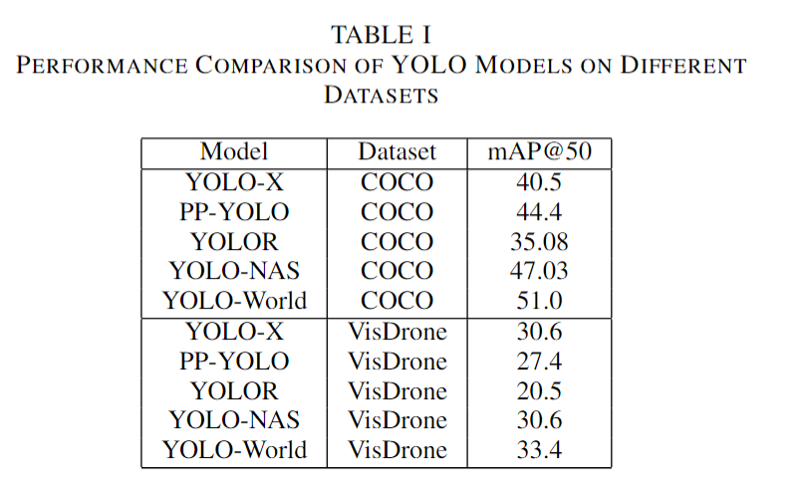
Approach :
We used pre-trained models and tested them on our dataset, evaluating their performance using key metrics: mean Average Precision (mAP).
Why Do the Scores Differ?
YOLO-X
Anchor-free design & decoupled detection.
SimOTA.
PP-YOLO
Feature pyramid & adaptive spatial fusion enhance detection.
Struggles on VisDrone due to cluttered backgrounds & small objects.
YOLOR
Combines explicit & implicit knowledge for learning.
Weak implicit knowledge.
Lowest mAP in both datasets.
YOLO-NAS
NAS optimizes feature extraction.
Strong performance.
YOLO-World
Vision-language learning.
Adaptive tokenization aids.
Multi-scale feature fusion & cross-modal learning.
CSE342 – Computer Vision

Slide 7
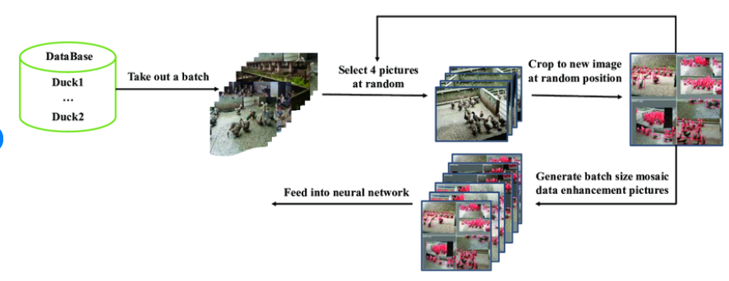
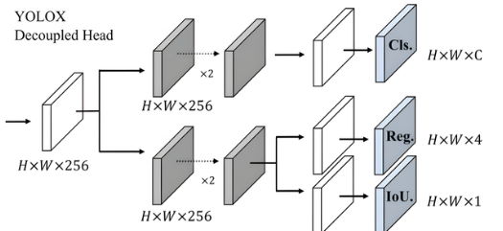
Future Work:
There some techniques that can help in small object detection-
1. Decoupled head- Separate subsets for classification and localization
2. SIMOTA- Label assignment method during training
3. Mosaic – Combines part of different images and stitch them together.
4. Large kernel size in early layer.
5. DropBlock which drops patches of feature map preventing small objects from getting ignored.
6. Anchor free detection
Mosaic
Decoupled head
CSE342 – Computer Vision

Slide 8
References :
[1] Wang, C., Yeh, I., & Liao, H. M. (2021, May 10). You Only Learn One Representation: Unified Network for Multiple Tasks. arXiv.org. https://arxiv.org/abs/2105.04206
[2] Ge, Z., Liu, S., Wang, F., Li, Z., & Sun, J. (2021, July 18). YOLOX: Exceeding YOLO Series in 2021. arXiv.org. https://arxiv.org/abs/2107.08430
[3] Long, X., Deng, K., Wang, G., Zhang, Y., Dang, Q., Gao, Y., Shen, H., Ren, J., Han, S., Ding, E., & Wen, S. (2020, July 23). PP-YOLO: an effective and efficient implementation of object detector. arXiv.org. https://arxiv.org/abs/2007.12099
[4] A comprehensive review of YOLO architectures in computer vision: from YOLOV1 to YOLOV8 and YOLO-NAS. (n.d.). https://arxiv.org/html/2304.00501v6
[5] Keles, M. C., Salmanoglu, B., Guzel, M. S., Gursoy, B., & Bostanci, G. E. (2022, March 9). Evaluation of YOLO Models with Sliced Inference for Small Object Detection. arXiv.org. https://arxiv.org/abs/2203.04799
[6] T. Cheng, L. Song, Y. Ge, W. Liu, X. Wang, and Y. Shan, “YOLO-World: Real-Time Open-Vocabulary Object Detection,” arXiv.org, Jan.30, 2024. https://arxiv.org/abs/2401.17270
CSE342 – Computer Vision

