Slide 1
FEAther: A Self-Learning Multi-Agent System for Lightweight Load-Bearing Part Design with Finite Element Analysis
Capstone research proposal, Research Methods, Lab 8
Rifqi Wibisono · Nanjing Xiaozhuang University · November 2026
Notes:
[0:00] Ask an AI to design a shelf bracket, and it will give you something that looks like a shelf bracket. Nobody checks whether it holds the shelf.

Slide 2
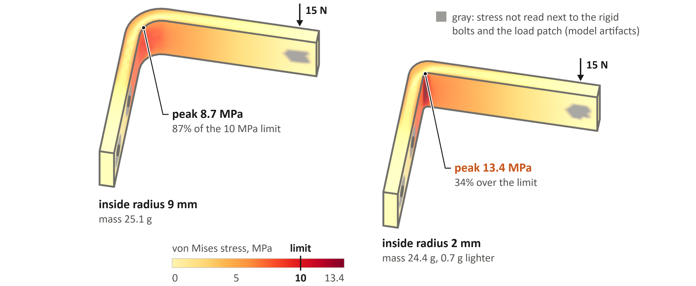
Tightening a bend from 9 mm to 2 mm inside radius raises its peak stress by half; the shape barely changes
FEA by the FEAther checker (CalculiX, quadratic tetrahedra) on reference parts L3 and L1: same 15 N load at 70 mm, same 6 × 24 mm section, same bolts. Stress is not read in the gray zones (model artifacts).
Notes:
[0:12] AI can now write CAD programs: code that builds a 3D part. But it is trained on looks: does the shape match a reference? For a load-bearing part, that is the wrong test. These two brackets differ only in the inside radius of the bend: 9 millimeters against 2. The peak stress rises by half, to 34 percent over the limit, while the shape barely changes. And when researchers checked with physics, the best AI agents passed none of fifty briefs on the first try [8].

Slide 3
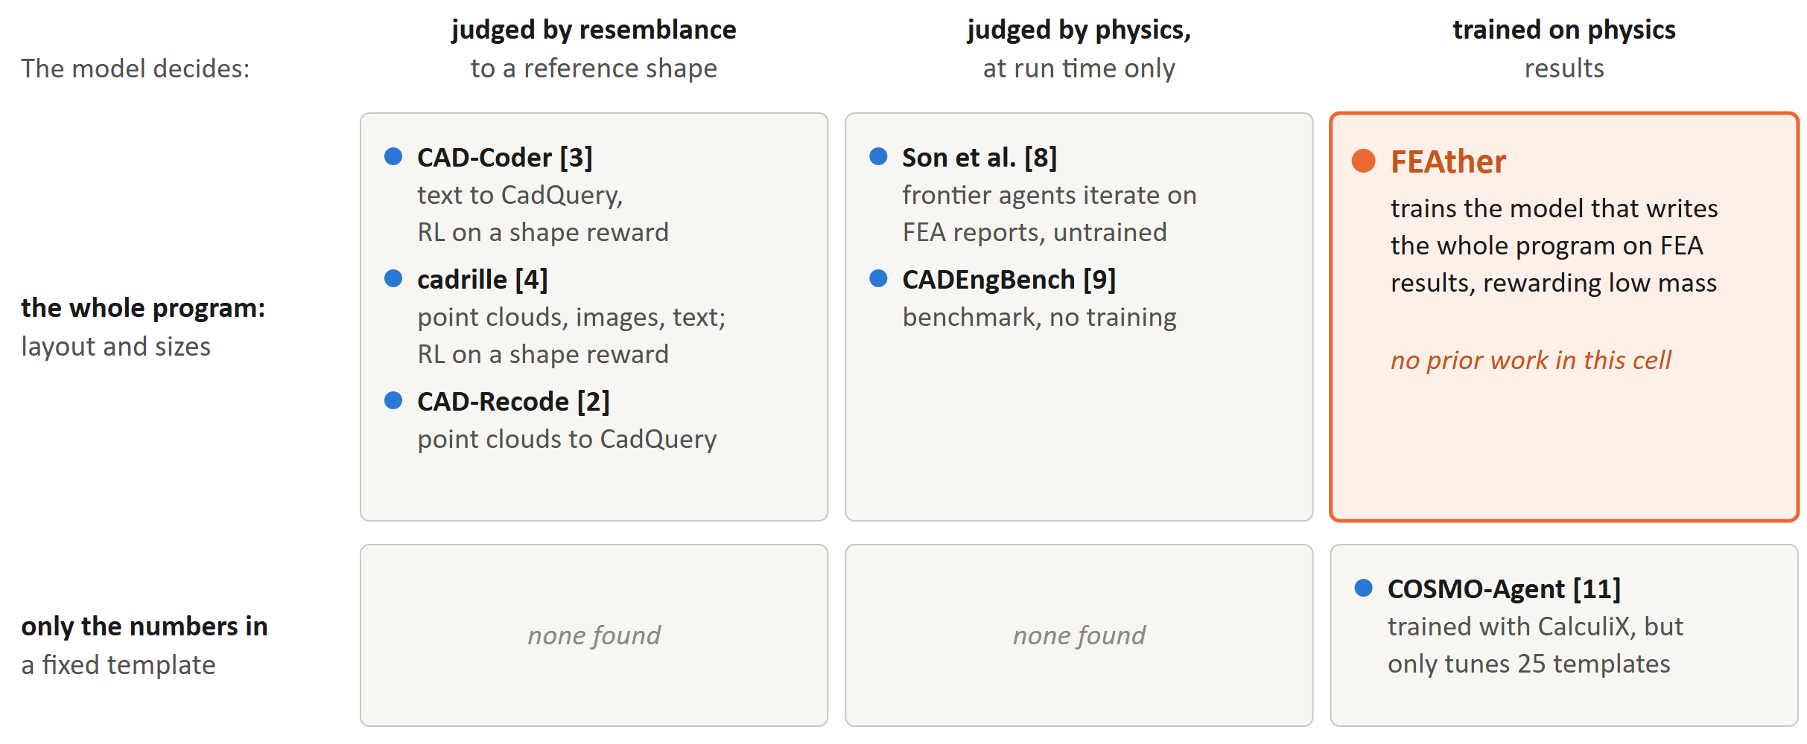
No work yet trains a model to choose a part's layout against physics
Placement of each work from the paper itself; arXiv search of 1 November 2026. Numbers in brackets: references, last slide.
Notes:
[0:48] In software terms, a CAD program is code whose test oracle is physics. On the left, models like CAD-Coder are trained, but on resemblance. In the middle, Son and colleagues let models retry with physics feedback, but never train them. Bottom right, COSMO-Agent trains with a solver, but only to tune numbers in fixed templates. Nobody trains a model to decide the design itself against physics. That empty cell is FEAther.

Slide 4
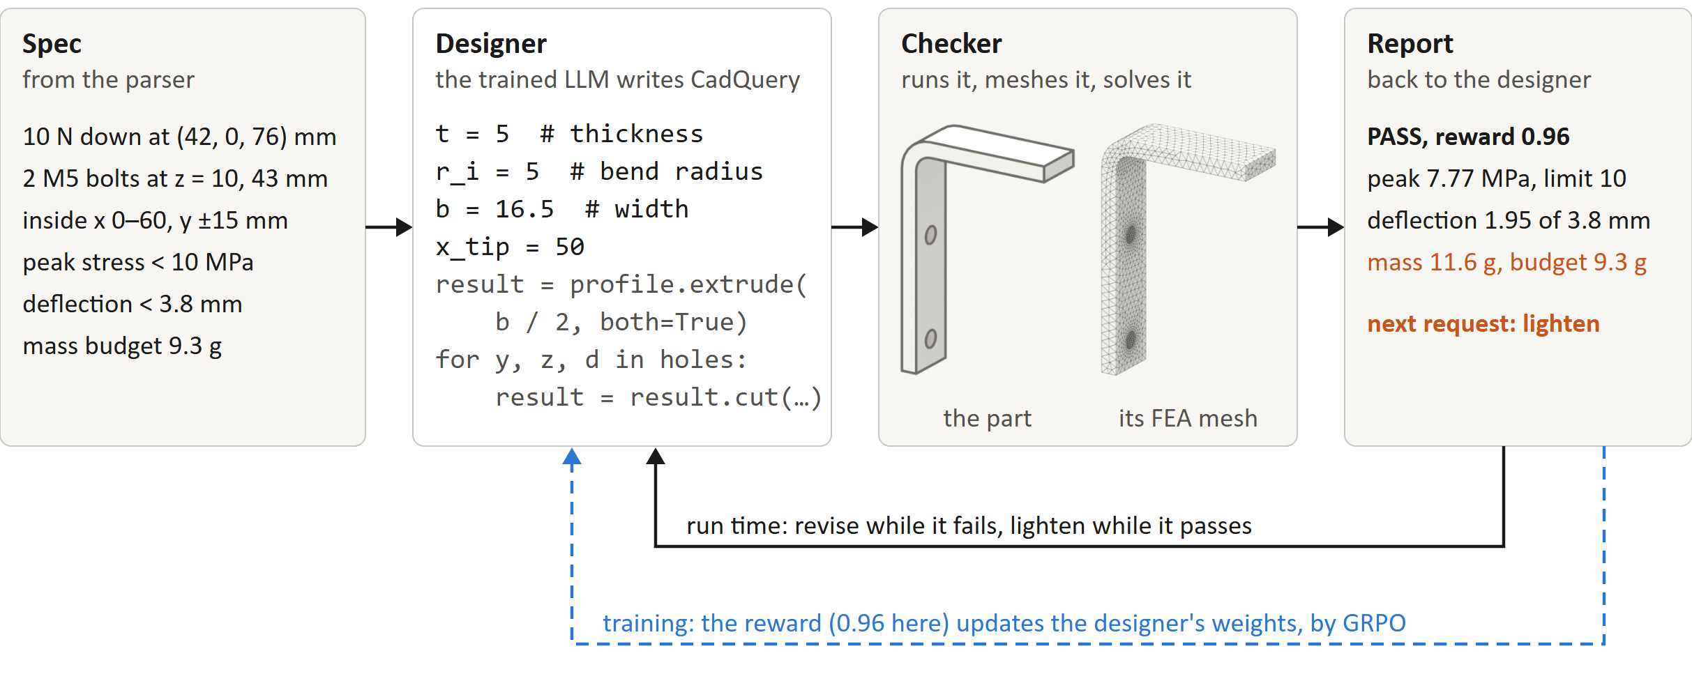
The designer is checked by physics, revises until the part passes, then lightens it while it still passes
One real pass: pilot spec l_bracket-0000, its reference program, the checker's mesh, and its report (FEAther repository).
Notes:
[1:19] That is FEAther: a multi-agent system with one trained agent at its center. A parser turns your request into a precise spec. The designer writes the CAD program. A checker runs it, simulates it with finite element analysis, and reports where the stress is too high, and by how much. In this real report, the part passes but is too heavy, so the next request is: make it lighter. And it is self-learning: the designer trains on its own scored attempts, by reinforcement learning.

Slide 5
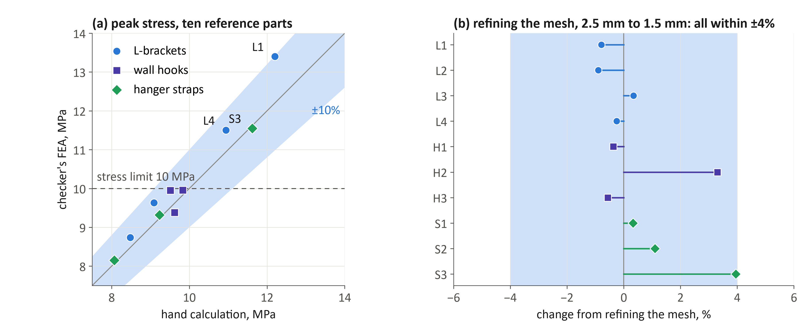
The checker's FEA agrees with textbook hand calculations within 10% on all ten reference parts
Hand calculations: curved-beam theory (Winkler) for bends, Heywood's formula for a hole in a strip [5], [6]. FEA: the checker, CalculiX with quadratic tetrahedra.
Notes:
[1:55] I have already built the foundation. Each dot is one test part: the hand calculation across, the checker's simulation up. All ten agree within ten percent, so the checker can be trusted as the reward.

Slide 6
Untrained models pass none of the 40 specs, and 79% of their revisions repeat the failed program
Revisions in the loop
FEAther baseline: Qwen3-1.7B (16-bit) and Qwen3-8B (FP8), thinking off, 8 checker runs per spec; 40 generated specs, each proven solvable.
Notes:
[2:10] Then I generated forty specs, each proven solvable, and tested two untrained open models: over twelve hundred programs, and not one passed. Worse, shown their failed program and the error, they handed back the exact same program about eighty percent of the time. Training has to fix that.

Slide 7
Three questions test whether training on physics pays off
 | Question | Hypothesis | Measured by | Test
RQ1 | Does an FEA reward beat a shape reward? | It raises the full pass rate over SFT alone and over a shape reward | full pass rate on held-out specs and families | McNemar
RQ2 | Does run-time feedback add anything beyond training, or only more attempts? | Untrained, independent tries beat the loop (pilot: 34 against 18 specs). Trained on revisions, the loop wins | specs passed within k = 1, 3, 5, 10 attempts; tokens per solved spec | McNemar at each k
RQ3 | How much material do passing designs use? | With the mass term, passing designs are lighter than sizing alone | mass against sizing-only and topology-optimized references | Wilcoxon signed-rank
Hypotheses, baselines, and statistics: proposal, Sections III and VI.
Notes:
[2:30] So I ask three questions. Does a physics reward beat a looks reward? Does feedback help beyond training, or is it just extra attempts? And how much lighter can the parts get? If it works, we get AI that designs parts that are not just plausible, but proven, and lighter. Thank you.

Slide 8
References, numbered as in the proposal
[2] D. Rukhovich et al., “CAD-Recode: Reverse engineering CAD code from point clouds,” arXiv:2412.14042, 2024.
[3] Y. Guan et al., “CAD-Coder: Text-to-CAD generation with chain-of-thought and geometric reward,” NeurIPS 38, 2025.
[4] M. Kolodiazhnyi et al., “cadrille: Multi-modal CAD reconstruction with reinforcement learning,” ICLR, 2026.
[5] R. G. Budynas and J. K. Nisbett, Shigley’s Mechanical Engineering Design, 11th ed. McGraw-Hill, 2020.
[6] W. D. Pilkey and D. F. Pilkey, Peterson’s Stress Concentration Factors, 3rd ed. Wiley, 2008.
[8] G. Son et al., “Self-improving CAD generation agents with finite element analysis as feedback,” arXiv:2605.17448, 2026.
[9] H. Singh et al., “CADEngBench: It looks like CAD, but does it work?” arXiv:2608.09296, 2026.
[10] T. X. Olausson et al., “Is self-repair a silver bullet for code generation?” ICLR, 2024.
[11] L. Deng et al., “COSMO-Agent: Tool-augmented agent for closed-loop optimization, simulation, and modeling orchestration,” arXiv:2604.05547, 2026.
Notes:
Not presented; for reviewers who want the sources behind the slides.

