Slide 1
ออกแบบฐานข้อมูล Ecommerce (PostgreSQL)
ER Diagrams — ThaiShopFun Ecommerce schema v3 (Phase 1 evidence + Role & Permission support)
70 tables · 173 foreign keys · 17 modules · UUID primary keys · PostgreSQL 17
จ่ายก่อน → ร้านยืนยัน → ตัดสต็อก → ส่ง OMS → จัดส่ง/ติดตาม → ลูกค้ารับของ → COMPLETED
Version v3 + authz · 2026-10-04 · ยังไม่รองรับ COD

Slide 2
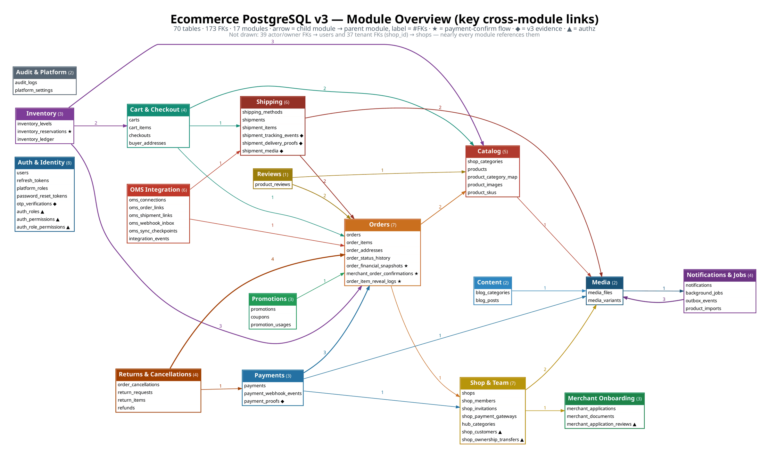
Overview — 17 modules & key cross-module links
ภาพรวมโมดูล
ThaiShopFun Ecommerce · PostgreSQL schema v3 + authz (2026-10-04) · 70 tables · 173 FKs · times in Asia/Bangkok
2

Slide 3
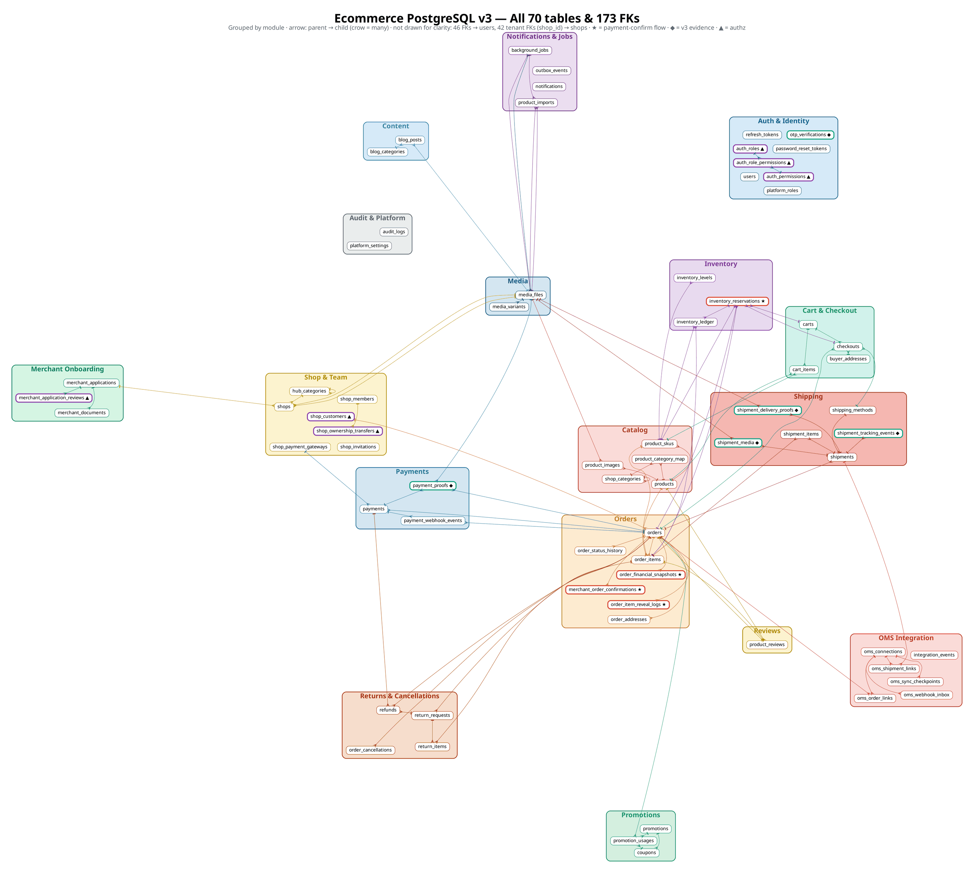
Overview — all 70 tables grouped by module
ภาพรวมตารางทั้งหมด
ThaiShopFun Ecommerce · PostgreSQL schema v3 + authz (2026-10-04) · 70 tables · 173 FKs · times in Asia/Bangkok
3

Slide 4
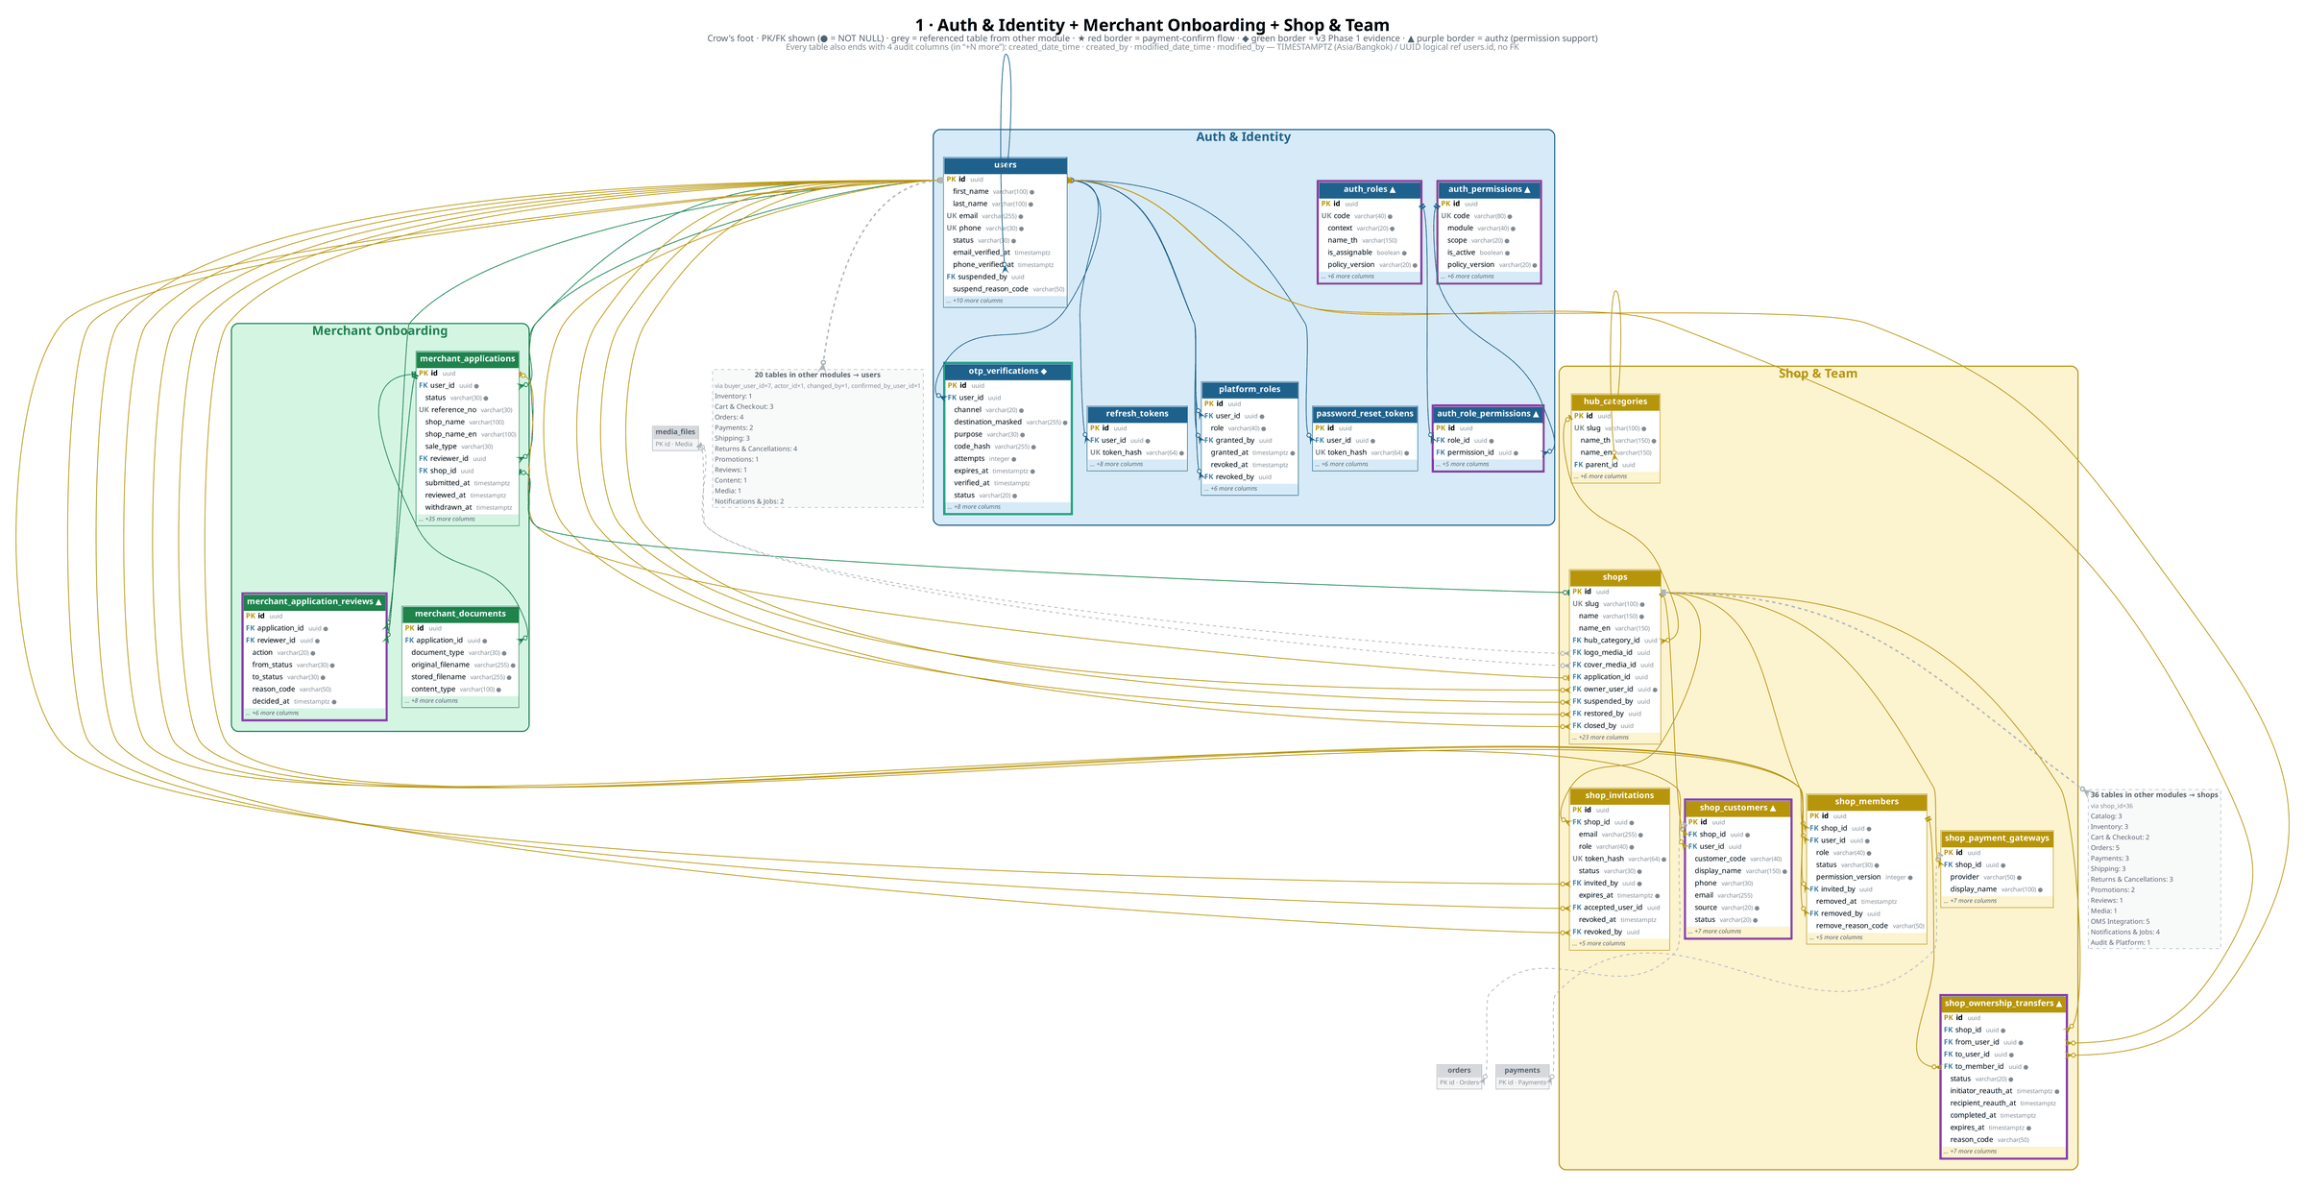
Auth & Identity · Merchant Onboarding · Shop & Team
ผู้ใช้ · สมัครร้านค้า · ร้านและทีม
ThaiShopFun Ecommerce · PostgreSQL schema v3 + authz (2026-10-04) · 70 tables · 173 FKs · times in Asia/Bangkok
4

Slide 5
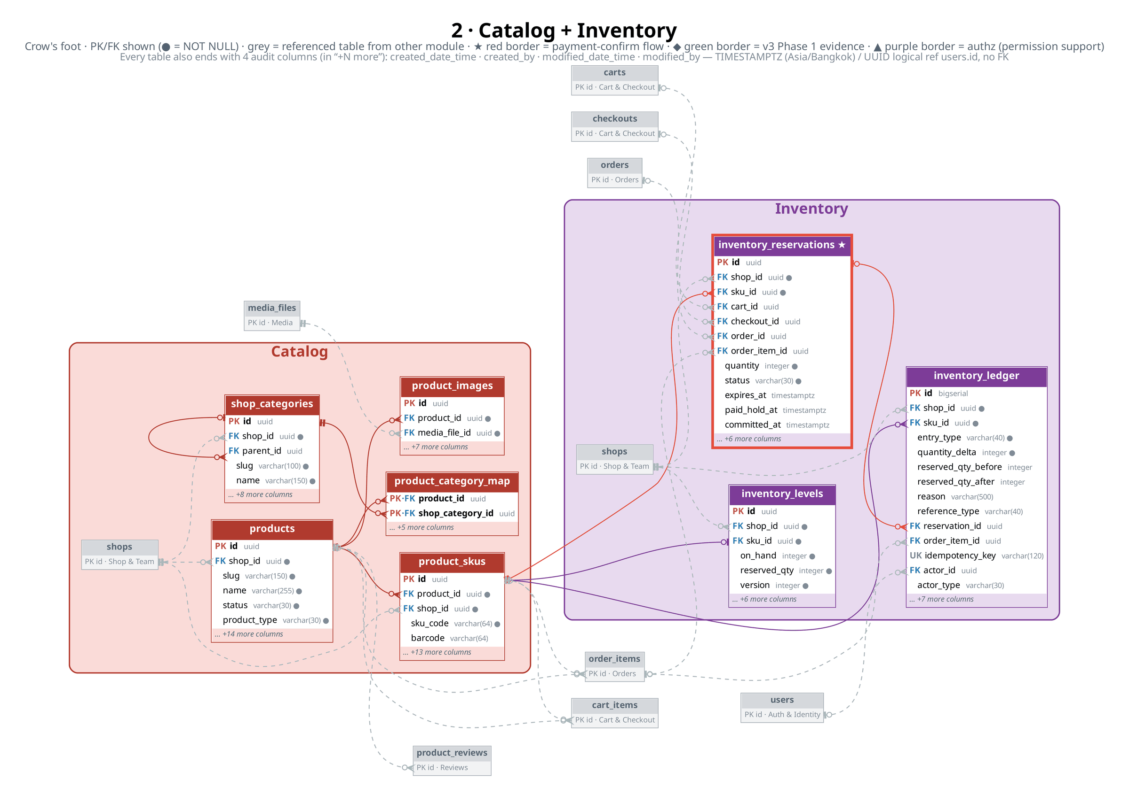
Catalog · Inventory
สินค้า · สต็อก
ThaiShopFun Ecommerce · PostgreSQL schema v3 + authz (2026-10-04) · 70 tables · 173 FKs · times in Asia/Bangkok
5

Slide 6
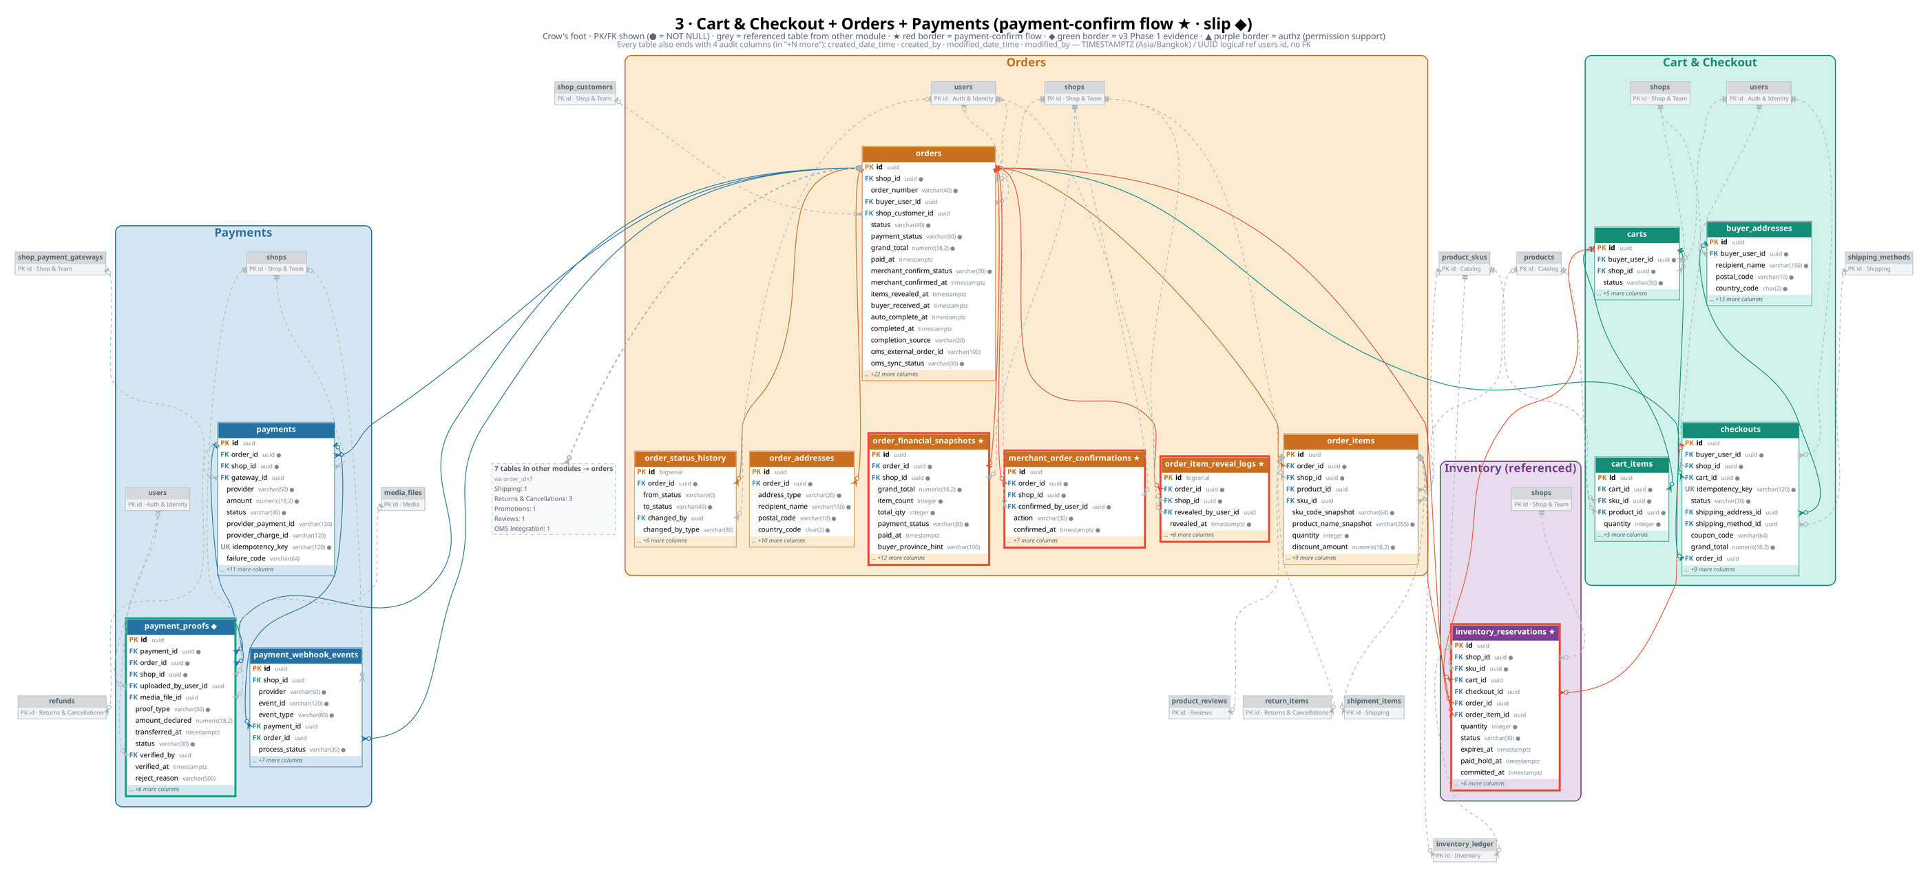
Cart & Checkout · Orders · Payments (★ confirm · ◆ slip)
ตะกร้า · ออเดอร์ · ชำระเงิน
ThaiShopFun Ecommerce · PostgreSQL schema v3 + authz (2026-10-04) · 70 tables · 173 FKs · times in Asia/Bangkok
6

Slide 7
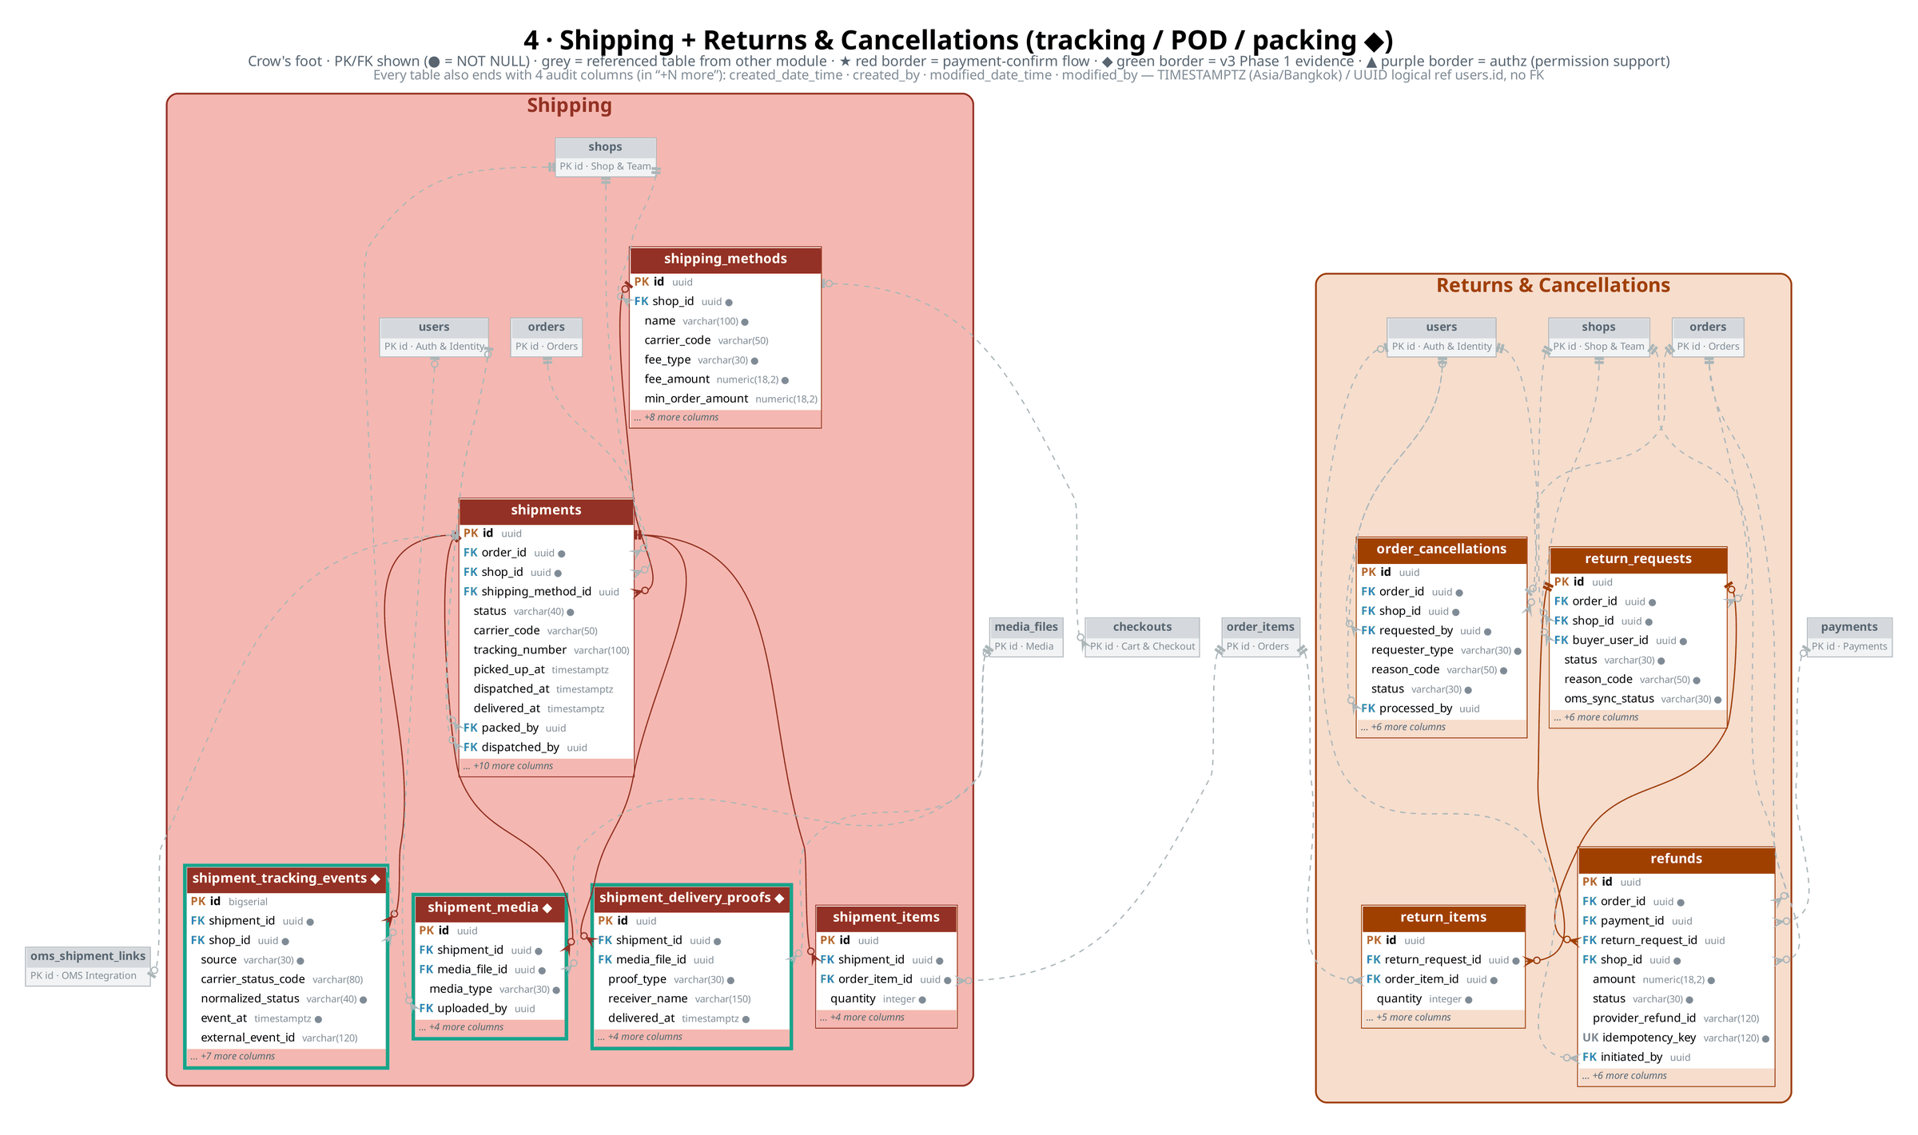
Shipping · Returns (◆ tracking · POD · packing)
จัดส่ง · คืนสินค้า / ยกเลิก
ThaiShopFun Ecommerce · PostgreSQL schema v3 + authz (2026-10-04) · 70 tables · 173 FKs · times in Asia/Bangkok
7

Slide 8
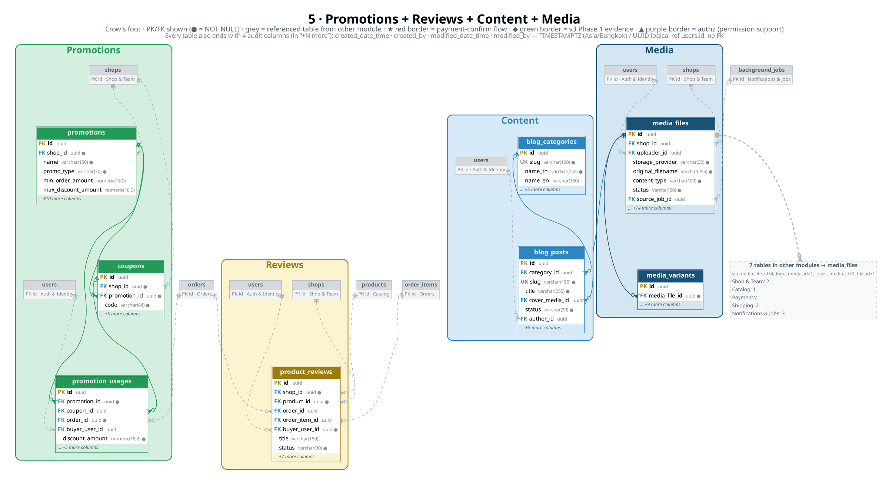
Promotions · Reviews · Content · Media
โปรโมชัน · รีวิว · บทความ · ไฟล์
ThaiShopFun Ecommerce · PostgreSQL schema v3 + authz (2026-10-04) · 70 tables · 173 FKs · times in Asia/Bangkok
8

Slide 9
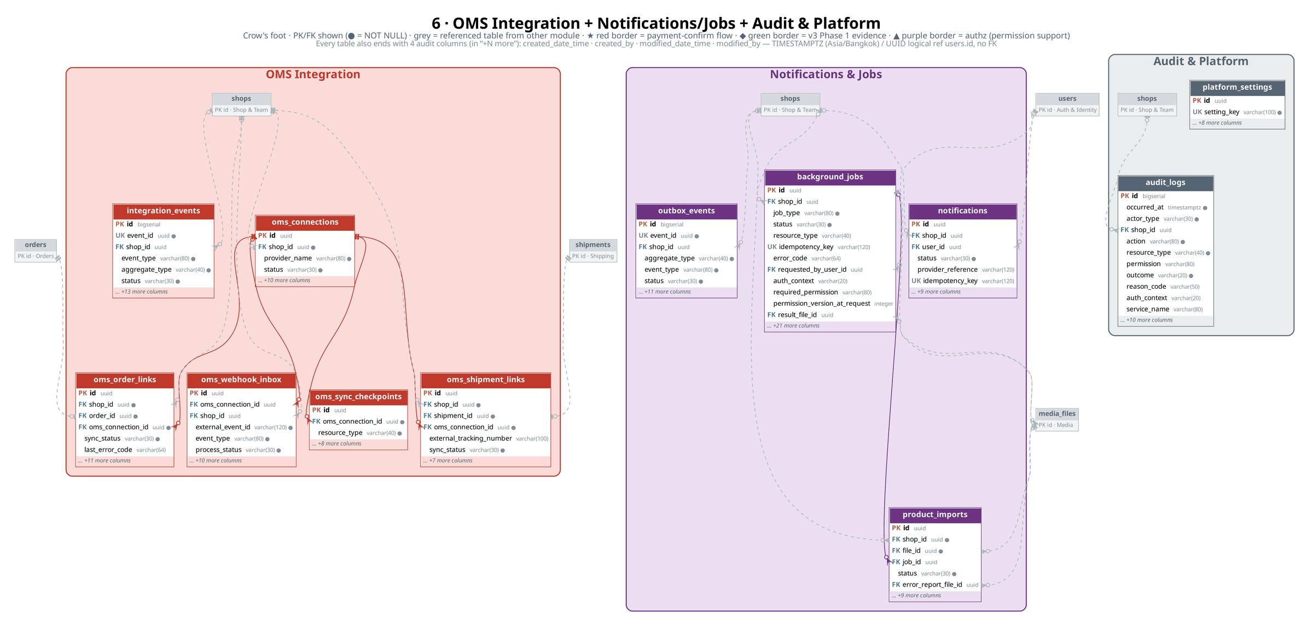
OMS Integration · Notifications/Jobs · Audit
เชื่อม OMS · งานเบื้องหลัง · Audit
ThaiShopFun Ecommerce · PostgreSQL schema v3 + authz (2026-10-04) · 70 tables · 173 FKs · times in Asia/Bangkok
9

Slide 10
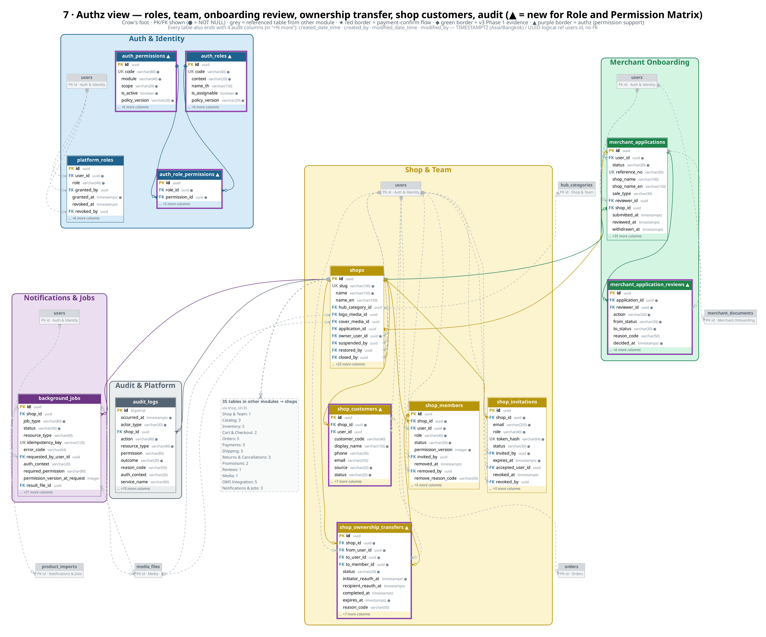
Authz view — roles · team · review · transfer · customers (▲ new)
สิทธิ์และบทบาท (Role and Permission Matrix)
ThaiShopFun Ecommerce · PostgreSQL schema v3 + authz (2026-10-04) · 70 tables · 173 FKs · times in Asia/Bangkok
10

Slide 11
Role & Permission support (authz 2026-10-04)
Role and Permission Matrix v1.1 → schema v3
Role | Context | Perms | Stored in
GUEST | PUBLIC | 1 | —
BUYER | ACCOUNT | 12 | users (login)
APPLICANT | APPLICANT | 6 | merchant_applications
STORE_OWNER | STORE | 34 | shop_members.role
STORE_ADMIN | STORE | 32 | shop_members.role
STORE_MANAGER | STORE | 25 | shop_members.role
STORE_SALES | STORE | 12 | shop_members.role
STORE_WAREHOUSE | STORE | 11 | shop_members.role
STORE_VIEWER | STORE | 7 | shop_members.role
PLATFORM_ADMIN | PLATFORM | 10 | platform_roles.role
TOTAL | 10 roles | 150 | 62 permissions
DB guarantee | Definition
New tables ▲ | shop_customers (+ orders.shop_customer_id) · shop_ownership_transfers · merchant_application_reviews · auth_roles · auth_permissions · auth_role_permissions
uq_platform_roles_user_id_active | user_id WHERE revoked_at IS NULL
uq_merchant_applications_user_id_open | user_id WHERE status IN ('DRAFT', 'SUBMITTED', 'UNDER_REVIEW', 'NEEDS_INFORMATION')
ck_merchant_applications_reviewer_not_applicant | reviewer_id IS NULL OR reviewer_id <> user_id
uq_shop_members_shop_id_owner | shop_id WHERE role = 'STORE_OWNER' AND status = 'ACTIVE'
uq_shop_invitations_shop_id_email_pending | shop_id, lower(email) WHERE status = 'PENDING'
uq_shop_customers_shop_id_user_id | shop_id, user_id WHERE user_id IS NOT NULL AND deleted_at IS NULL
uq_shop_ownership_transfers_shop_id_pending | shop_id WHERE status = 'PENDING'
ck_shop_ownership_transfers_parties | from_user_id <> to_user_id
ck_inventory_ledger_adjust_reason | entry_type <> 'ADJUST' OR reason IS NOT NULL
ck_audit_logs_service_name | actor_type <> 'SERVICE' OR service_name IS NOT NULL
ck_auth_roles_code_format | code ~ '^[A-Z][A-Z0-9_]*$'
ck_auth_permissions_code_format | code ~ '^[A-Z][A-Z0-9]*(_[A-Z0-9]+)+$'
trg_shop_members_owner_guard / trg_shops_owner_guard | check_shop_single_owner() DEFERRABLE INITIALLY DEFERRED — ACTIVE STORE_OWNER = 1 = shops.owner_user_id (ร้านที่ไม่ CLOSED)
auth_roles / auth_permissions / auth_role_permissions = READ-ONLY reference (seed, policy_version 1.0)
การตัดสินสิทธิ์ยังอยู่ในโค้ด (Spring Security + policyVersion + permission_version) — ห้ามแอปอ่านตารางนี้เพื่อ authorize
users.role = DEPRECATED (V3 step 1: คัดลอก ADMIN → platform_roles, คงคอลัมน์ไว้)
ข้อกำหนด 67 ข้อ: Supported 51 · App-layer 14 · Partial 2 (users.role ยังอยู่, doc ไม่มี PAYMENT_PROOF_REVIEW)
ThaiShopFun Ecommerce · PostgreSQL schema v3 + authz (2026-10-04) · 70 tables · 173 FKs · times in Asia/Bangkok
11

Slide 12
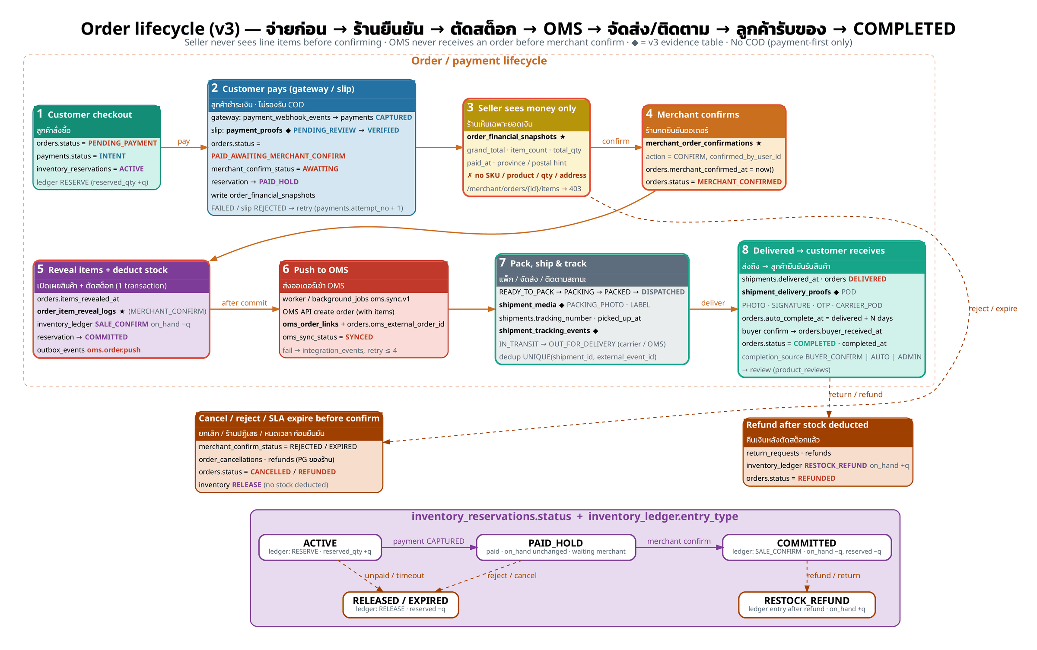
Order lifecycle: pay → confirm → ship → COMPLETED
จ่าย → ยืนยัน → ส่ง → รับของ
ThaiShopFun Ecommerce · PostgreSQL schema v3 + authz (2026-10-04) · 70 tables · 173 FKs · times in Asia/Bangkok
12

Slide 13
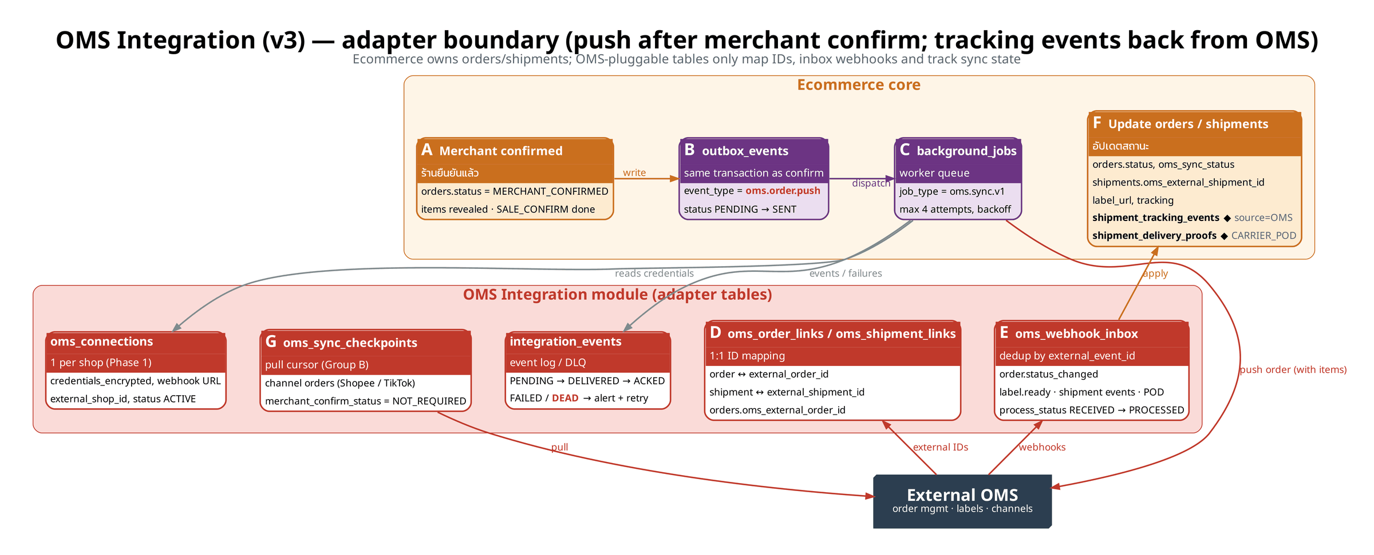
OMS Integration — push after merchant confirm
การเชื่อมต่อ OMS
• Adapter only — no OMS-internal tables; 1 oms_connection per shop (Phase 1)
• Push only when merchant_confirm_status = CONFIRMED (outbox oms.order.push)
• OMS never receives line items the seller has not yet seen
• Webhooks → oms_webhook_inbox (dedup external_event_id) → orders / shipments
• Pull path: oms_sync_checkpoints, channel orders = NOT_REQUIRED confirm
• Failures → integration_events FAILED/DEAD + background_jobs retry (max 4)
• v3: OMS shipment events → shipment_tracking_events (source=OMS) + POD
ThaiShopFun Ecommerce · PostgreSQL schema v3 + authz (2026-10-04) · 70 tables · 173 FKs · times in Asia/Bangkok
13

Slide 14
Process → schema evidence map (1/3)
◆ ใหม่ v3 · ▲ ใหม่ authz · ครบใน Excel: Process_Evidence_Map
Step | Lane | Evidence | Table(s) | Key column(s) | Status value
1 · Sign up + verify | Merchant | OTP sent / verified ◆ | otp_verifications | otp_verifications: purpose, channel, destination_masked, code_hash… | purpose=SIGNUP · status PENDING → VERIFIED
 | Merchant | User info | users | users: first_name, last_name, email, phone… | users.status=ACTIVE
 | Platform | Account ready (verified) | users merchant_applications | users: phone_verified_at, email_verified_at merchant_applications: status, reviewer_id | application APPROVED
2 · Create shop | Merchant | Shop name / URL | shops | shops: name, slug, owner_user_id, application_id…
 | Platform | Storefront visible | shops shop_members | shops: status, published_at shop_members: role | shops.status=ACTIVE · role STORE_OWNER
3 · Add product | Merchant | Product list | products | products: name, slug, status, created_by… | status=DRAFT
 | Merchant | Product images | product_images media_files | product_images: media_file_id, is_primary media_files: purpose, storage_key | media_files.purpose=PRODUCT
 | Merchant | Price / stock | product_skus inventory_levels inventory_ledger | product_skus: price, sku_code inventory_levels: on_hand, available inventory_ledger: entry_type | ledger entry_type=RECEIVE
4 · Publish | Merchant | Shop status ACTIVE / product published | shops products | shops: status, published_at products: status, published_at | shops ACTIVE · products PUBLISHED
 | Customer | Storefront reachable | shops products | shops: slug products: slug, status | products.status=PUBLISHED
5 · Add to cart | Customer | Cart with items | carts cart_items | carts: status cart_items: sku_id, quantity, unit_price_snapshot | carts.status=ACTIVE
6 · Pay & confirm order | Customer | Order number | orders checkouts | orders: order_number, placed_at, status checkouts: order_id | orders.status=PENDING_PAYMENT
 | Customer | Order detail | order_items order_addresses order_financial_snapshots | order_items: product_name_snapshot, quantity, line_total order_addresses: recipient_name order_financial_snapshots: grand_total
 | Payment provider | Payment result (gateway) | payments payment_webhook_events | payments: status, provider_payment_id, captured_at payment_webhook_events: event_id, signature_valid | payments.status=CAPTURED
ThaiShopFun Ecommerce · PostgreSQL schema v3 + authz (2026-10-04) · 70 tables · 173 FKs · times in Asia/Bangkok
14

Slide 15
Process → schema evidence map (2/3)
◆ ใหม่ v3 · ▲ ใหม่ authz · ครบใน Excel: Process_Evidence_Map
Step | Lane | Evidence | Table(s) | Key column(s) | Status value
6 · Pay & confirm order | Customer | Payment slip (bank transfer / PromptPay) ◆ | payment_proofs media_files | payment_proofs: media_file_id, amount_declared, transferred_at, reference_no… | PENDING_REVIEW → VERIFIED
 | Platform | Status Paid | orders order_status_history | orders: payment_status, paid_at, status order_status_history: to_status | payment_status=PAID · status=PAID_AWAITING_MERCHANT_CONFIRM
6x · Payment failed → retry | Payment provider | Failed attempt + retry ◆ | payments payment_webhook_events payment_proofs | payments: status, failure_code, attempt_no orders: payment_status payment_proofs: reject_reason | payments FAILED → new INTENT (attempt_no+1) · slip REJECTED
7 · Check order & pack | Platform | Order created & merchant notified | notifications orders | notifications: template_key, status, sent_at orders: merchant_confirm_status | merchant_confirm_status=AWAITING · notification SENT
 | Merchant | Merchant confirms order | merchant_order_confirmations order_item_reveal_logs orders | merchant_order_confirmations: action, confirmed_at order_item_reveal_logs: revealed_at orders: items_revealed_at | orders.status=MERCHANT_CONFIRMED
 | Warehouse | Pick / pack | shipments shipment_items inventory_ledger | shipments: status, packed_at, packed_by shipment_items: quantity inventory_ledger: entry_type | READY_TO_PACK → PACKING → PACKED
 | Warehouse | Packing photo ◆ | shipment_media media_files | shipment_media: media_file_id, media_type, uploaded_by, created_date_time media_files: purpose | media_type=PACKING_PHOTO
8 · Ship & record tracking | Merchant | Tracking number / label ◆ | shipments shipment_media | shipments: carrier_code, tracking_number, label_url shipment_media: media_type | media_type=LABEL
 | Platform | Status Shipped | shipments orders | shipments: status, dispatched_at, dispatched_by orders: status | DISPATCHED
 | Carrier | Carrier pickup ◆ | shipment_tracking_events shipments | shipment_tracking_events: source, carrier_status_code, event_at shipments: picked_up_at | normalized_status=DISPATCHED
9 · Track status | Customer | Status updates | orders order_status_history | orders: status order_status_history: from_status, to_status, created_date_time | DISPATCHED → DELIVERED → COMPLETED
 | Carrier | Tracking events ◆ | shipment_tracking_events oms_webhook_inbox | shipment_tracking_events: normalized_status, description, location, event_at… | IN_TRANSIT / OUT_FOR_DELIVERY
10 · Received / completed | Carrier | Delivered status | shipments orders | shipments: status, delivered_at orders: status, auto_complete_at | DELIVERED
 | Evidence | Proof of delivery (POD) ◆ | shipment_delivery_proofs media_files | shipment_delivery_proofs: proof_type, receiver_name, delivered_at, media_file_id | PHOTO | SIGNATURE | OTP | CARRIER_POD
ThaiShopFun Ecommerce · PostgreSQL schema v3 + authz (2026-10-04) · 70 tables · 173 FKs · times in Asia/Bangkok
15

Slide 16
Process → schema evidence map (3/3)
◆ ใหม่ v3 · ▲ ใหม่ authz · ครบใน Excel: Process_Evidence_Map
Step | Lane | Evidence | Table(s) | Key column(s) | Status value
10 · Received / completed | Customer | Customer confirms receipt / auto-complete | orders | orders: buyer_received_at, completed_at, completion_source, status | COMPLETED (BUYER_CONFIRM | AUTO | ADMIN)
 | Customer | Review | product_reviews | product_reviews: rating, body, order_item_id, status | PUBLISHED
All steps | Evidence | Audit trail | audit_logs order_status_history | audit_logs: action, occurred_at order_status_history: changed_by_type, reason
Applicant · ยื่น/ถอนใบสมัคร | Merchant | One open application, withdraw | merchant_applications | merchant_applications: user_id, status, submitted_at, withdrawn_at | DRAFT|SUBMITTED|UNDER_REVIEW|NEEDS_INFORMATION (≤1 ต่อ user) → WITHDRAWN
Platform · พิจารณาใบสมัคร | Platform | Review history (no self-review) ▲ | merchant_application_reviews merchant_applications | merchant_application_reviews: reviewer_id, action, from_status, to_status… merchant_applications: reviewer_id | START_REVIEW | REQUEST_INFO | APPROVE | REJECT
Store · Owner membership | Merchant | Exactly one ACTIVE STORE_OWNER = shops.owner_user_id | shops shop_members | shops: owner_user_id shop_members: role, status, permission_version | STORE_OWNER ACTIVE = 1
Store · เชิญ/นำสมาชิกออก | Merchant | Invite / revoke / remove staff | shop_invitations shop_members | shop_invitations: email, role, status, revoked_at… shop_members: removed_by, remove_reason_code | PENDING (≤1 ต่อ email) → ACCEPTED | EXPIRED | REVOKED
Store · โอนเจ้าของร้าน | Merchant | Ownership transfer with step-up ◆ ▲ | shop_ownership_transfers otp_verifications | shop_ownership_transfers: from_user_id, to_user_id, status, initiator_reauth_at… otp_verifications: purpose, step_up_action | PENDING (≤1 ต่อร้าน) → COMPLETED | DECLINED | CANCELLED | EXPIRED | FAILED
Store · ลูกค้าและออเดอร์ขายเอง | Merchant | Shop customers (PII) for manual orders ▲ | shop_customers orders | shop_customers: display_name, phone, source, status orders: shop_customer_id, row_version | ACTIVE | ARCHIVED
Platform · บัญชี/ร้าน | Platform | Suspend / restore / close | users shops | users: suspended_at, suspended_by, suspend_reason_code shops: suspended_by, restored_at, restored_by, closed_at… | users.status SUSPENDED · shops.status SUSPENDED | ACTIVE | CLOSED
All · Permission catalog | Platform | Role × permission reference (read-only) ▲ | auth_roles auth_permissions auth_role_permissions | auth_roles: code, context auth_permissions: code, scope auth_role_permissions: role_id, permission_id, policy_version | policy_version 1.0 — 10 roles / 62 permissions / 150 mappings
All · Authorization audit + jobs | Evidence | Who/what/permission/outcome; worker re-check | audit_logs background_jobs media_files | audit_logs: actor_type, auth_context, service_name, permission… background_jobs: requested_by_user_id, required_permission, permission_version_at_request media_files: required_permission, expires_at | SUCCESS | DENIED | FAILURE
ThaiShopFun Ecommerce · PostgreSQL schema v3 + authz (2026-10-04) · 70 tables · 173 FKs · times in Asia/Bangkok
16

Slide 17
Summary
สรุป
v3 + authz · 70 tables · 173 foreign keys · 17 modules
• UUID PKs (gen_random_uuid); BIGSERIAL only for append-only logs
• Audit standard (ทุกตาราง): created_date_time · created_by · modified_date_time · modified_by — trigger set_modified_date_time(); created_by/modified_by ไม่มี FK
• TIMESTAMPTZ ทุกคอลัมน์เวลา แสดงผลเวลาไทย Asia/Bangkok (+07)
• shop_id tenant key on almost every business table
• Money = NUMERIC(18,2) + currency CHAR(3) 'THB'
• Inventory only via ledger + reservations: RESERVE → PAID_HOLD → SALE_CONFIRM / RELEASE / RESTOCK_REFUND
• Payment-first: PAID_AWAITING_MERCHANT_CONFIRM — seller sees order_financial_snapshots only
• Merchant confirm → items revealed (order_item_reveal_logs) + stock deducted
• OMS push happens only after merchant confirm (outbox → worker → oms_order_links)
• v3: payment_proofs (slip) · shipment_tracking_events · shipment_delivery_proofs (POD) · shipment_media (packing photo) · otp_verifications
• v3: DELIVERED → COMPLETED (buyer confirm / auto-complete / admin) · ยังไม่รองรับ COD
• authz: shop_customers · shop_ownership_transfers · merchant_application_reviews · auth_* catalog (read-only) · Owner เดียว (partial unique + deferred trigger) · ห้าม self-review
• ลูกค้าจ่ายก่อน → ร้านยืนยันจึงเห็นสินค้าและตัดสต็อก → sync OMS → ส่ง/ติดตาม → ลูกค้ารับของ
Editable: ecommerce_schema.dbml (dbdiagram.io) · ecommerce_erd.mmd (Mermaid)
Module | Tables
Auth & Identity | 8
Merchant Onboarding | 3
Shop & Team | 7
Catalog | 5
Inventory | 3
Cart & Checkout | 4
Orders | 7
Payments | 3
Shipping | 6
Returns & Cancellations | 4
Promotions | 3
Reviews | 1
Content | 2
Media | 2
OMS Integration | 6
Notifications & Jobs | 4
Audit & Platform | 2
ThaiShopFun Ecommerce · PostgreSQL schema v3 + authz (2026-10-04) · 70 tables · 173 FKs · times in Asia/Bangkok
17

