Slide 1
Gender Inequality Index Prediction by Machine Learning
Course : STAT 473 Machine Learning
Professor: Dr. Xiyue Liao
Participants : Grace Huang and Sowon Jung

Slide 2
About GII
GII is a composite metric of gender inequality using three dimensions: reproductive health, empowerment and the labour market. A low GII value indicates low inequality between women and men, and vice-versa.
It shows the loss in potential human development due to inequality between female and male achievements in these dimensions. It ranges from 0, where women and men fare equally, to 1, where one gender fares as poorly as possible in all measured dimensions.

Slide 3
Research Question
Developing a predictive model for the Gender Inequality Index (GII) by applying machine learning techniques, while considering multiple variables.
Which machine learning models are most effective for predicting gender inequality, and how do their performance metrics compare?
Which countries have the highest and lowest levels of gender inequality, and what factors contribute to these disparities? Is there a correlation between a country's level of human development and its level of gender inequality?

Slide 4
EDA
Dataset : 194 rows and 14 columns
Response variable
GII:Gender Inequality Index (response variable).
Low value = good equality, high value = high inequality
13 features
Human development category: Low- medium-high-Very High
Rank: Country Rank (highly correlated with GII)
Maternal mortality ratio (deaths per 100,000 live births)
Adolescent birth rate (births per 1,000 women ages 15–19)
Seats_parliament: Share of seats in parliament (% held by women)
F_secondary_educ: Females with at least some secondary education (% ages 25 and older)
M_secondary_educ: Males with at least some secondary education (% ages 25 and older)
F_Labour_force: Female - Labour force participation rate (% ages 15 and older)
M_Labour_force: Male - Labour force participation rate (% ages 15 and older)
Continent : Asia, Africa, North America, South America, Europe, and Australia
Country :190 Countries
Gender_ratio
Development_status : Developed or developing countries

Slide 5
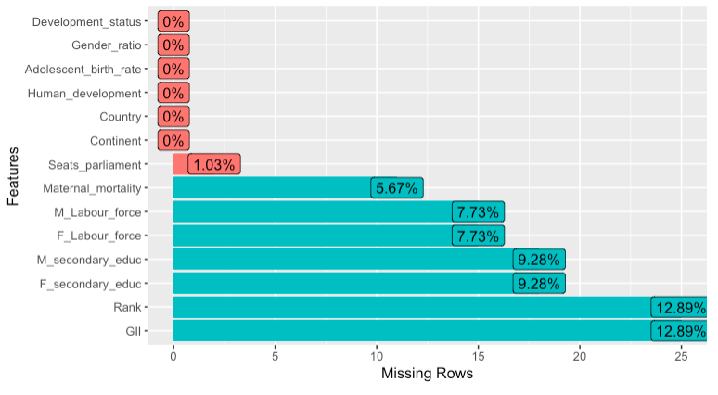
Missing data

Slide 6
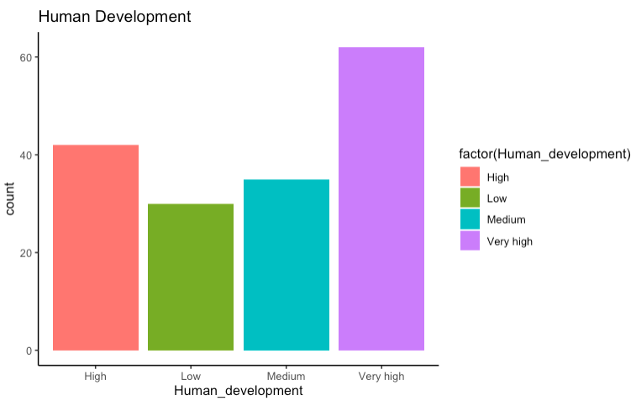
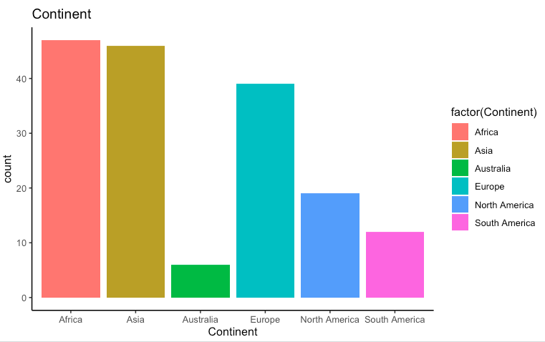
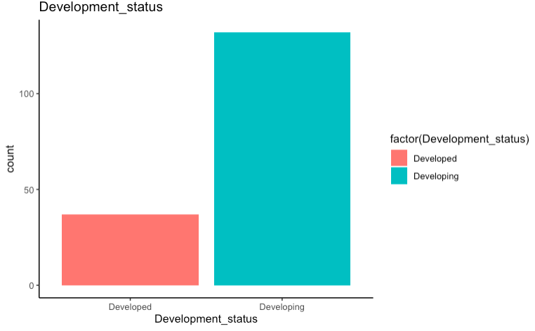
Character Variables

Slide 7
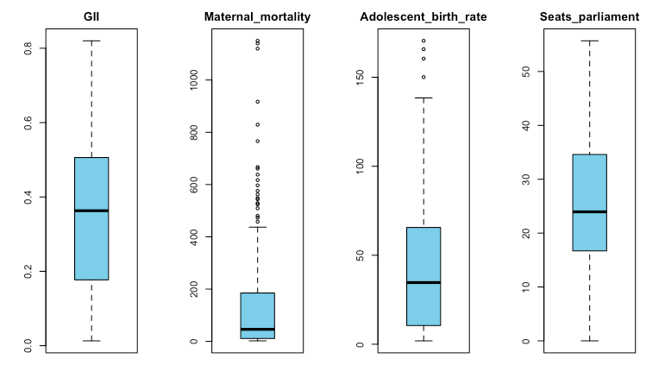
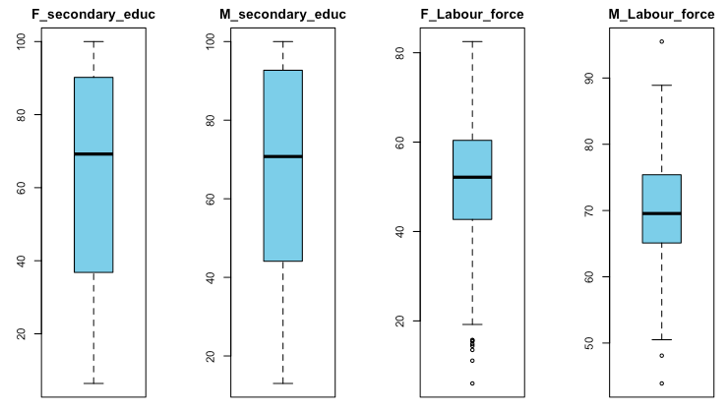
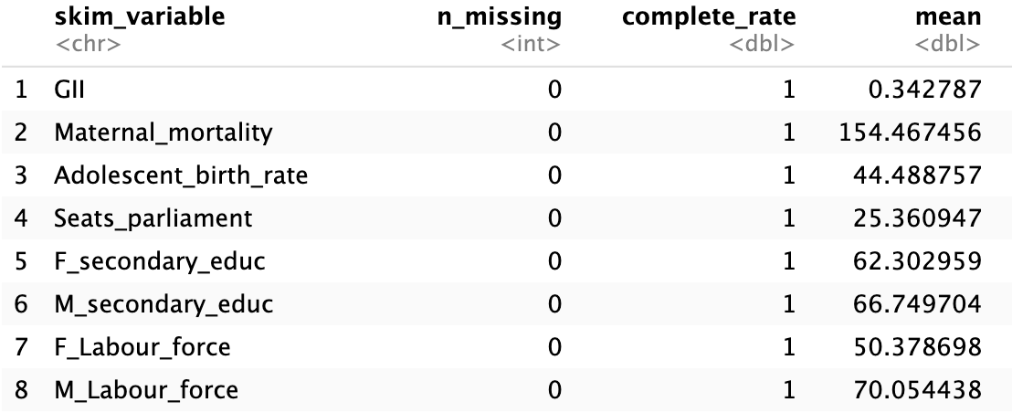
Numerical Variables

Slide 8
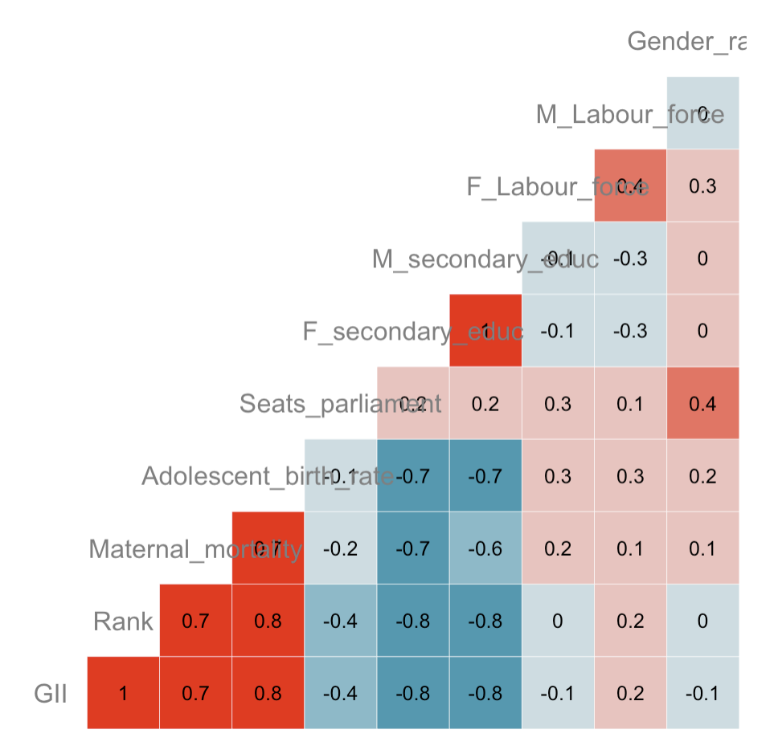
Correlation
Strong relationship with GII
:Rank(removed)
Maternal_mortality,
Adolescent_birth_rate,
F_secondary_education,
M_secondary_education,
Development_status

Slide 9
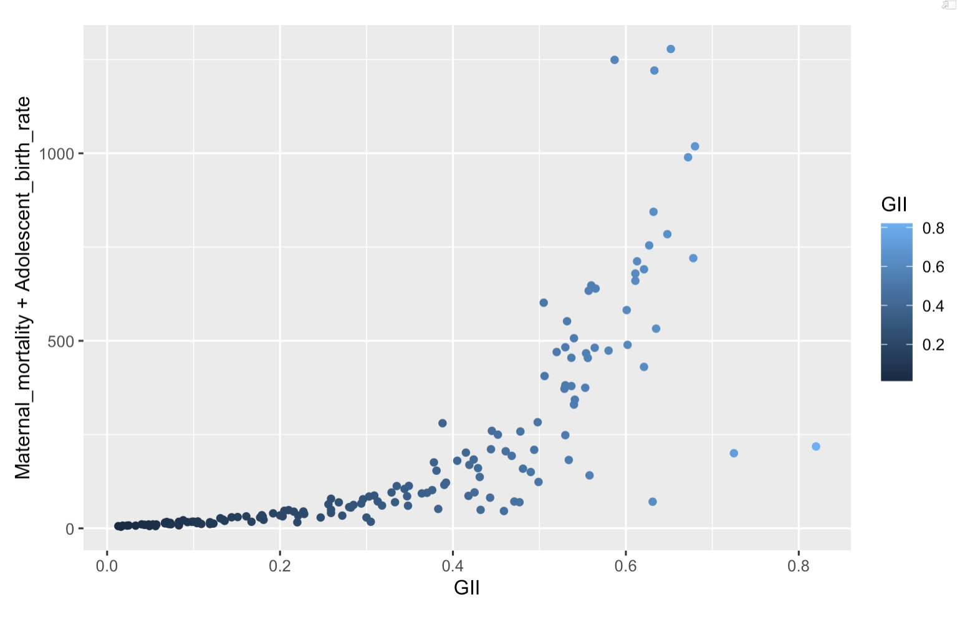
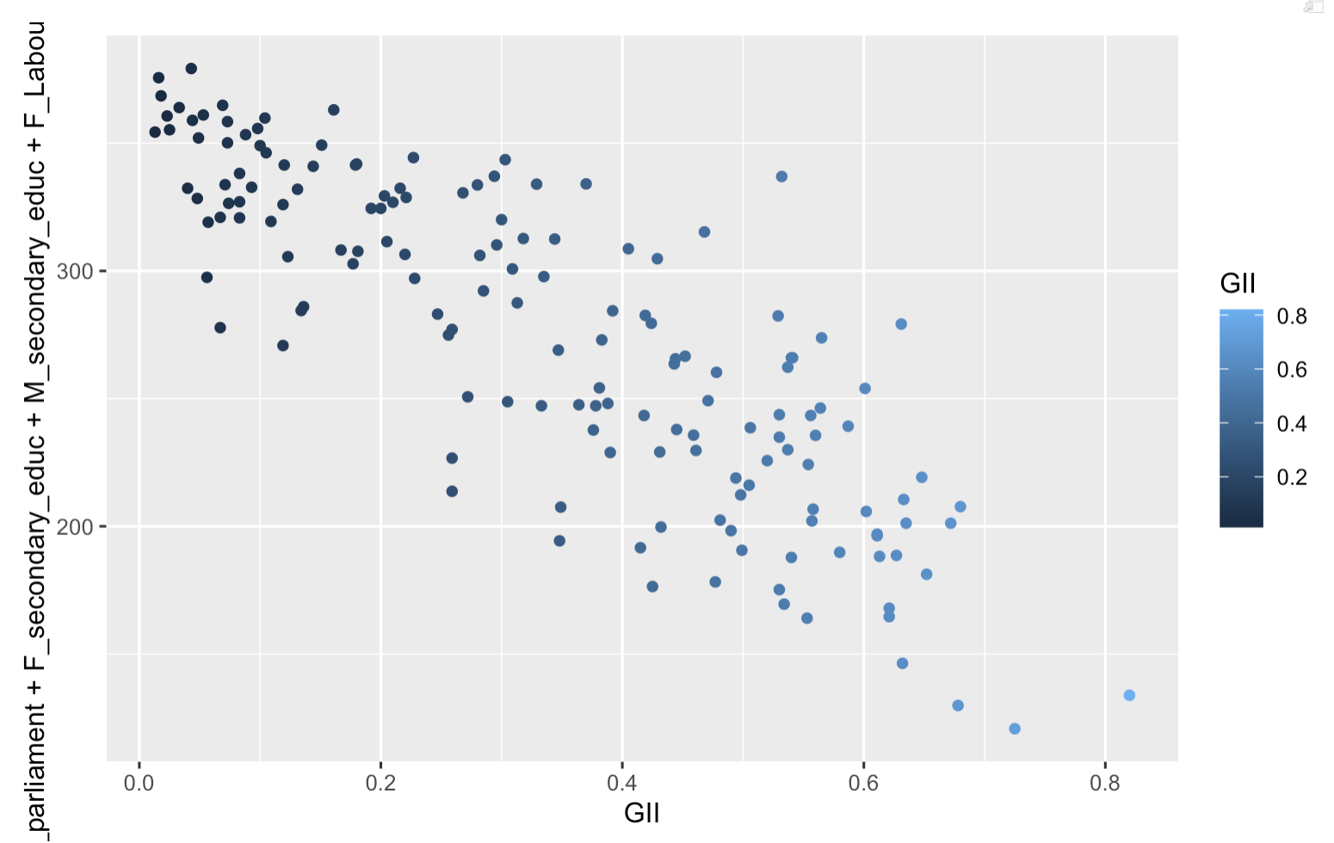
Scatterplot
Proportional relationship with GII
Inverse relationship with GII

Slide 10
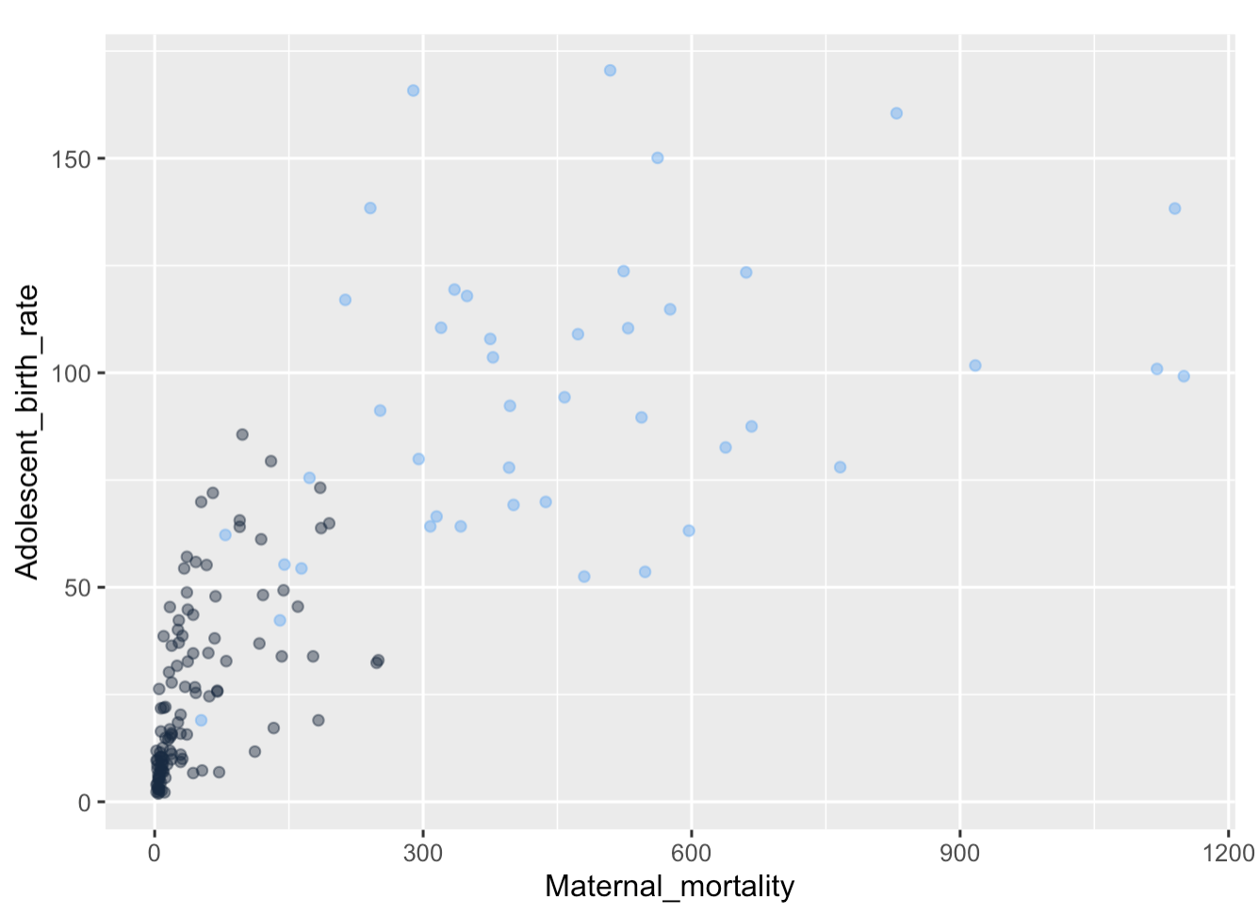
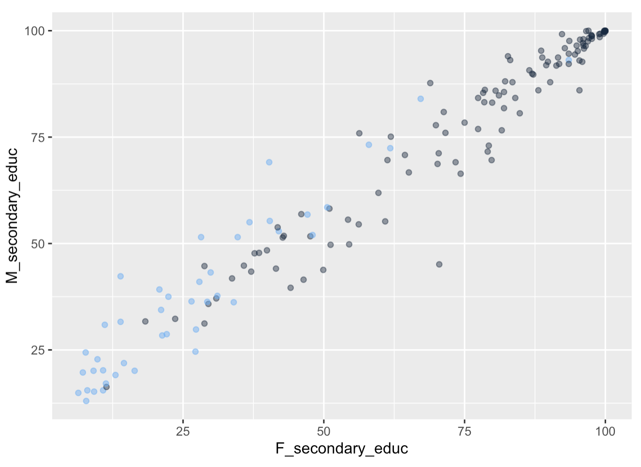
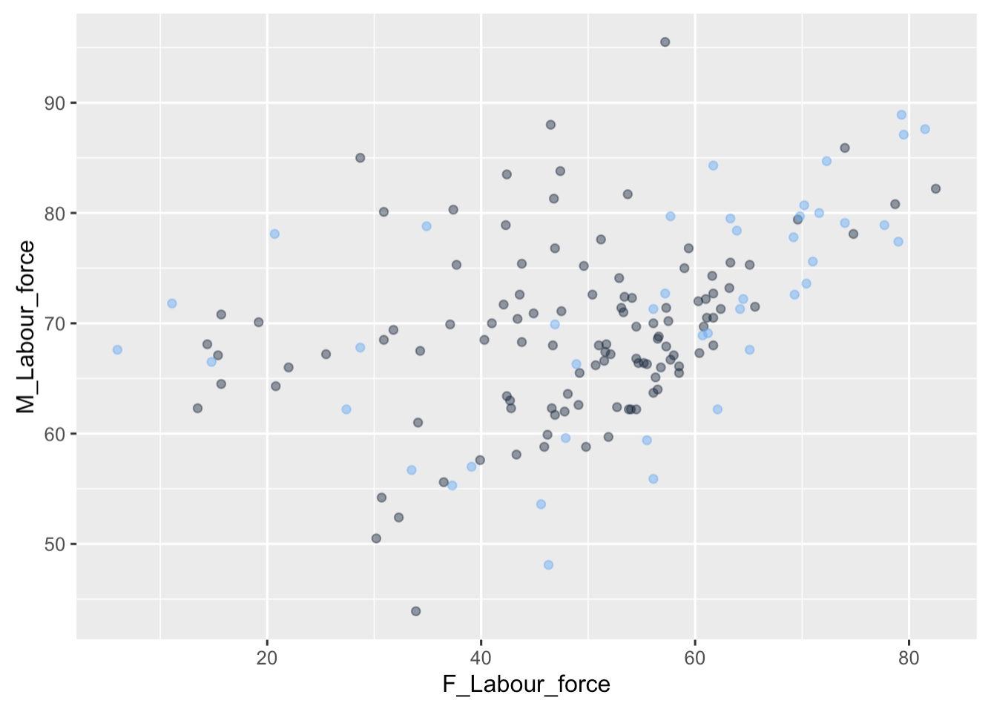
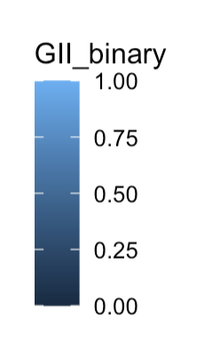
Check if GII is separable or not

Slide 11
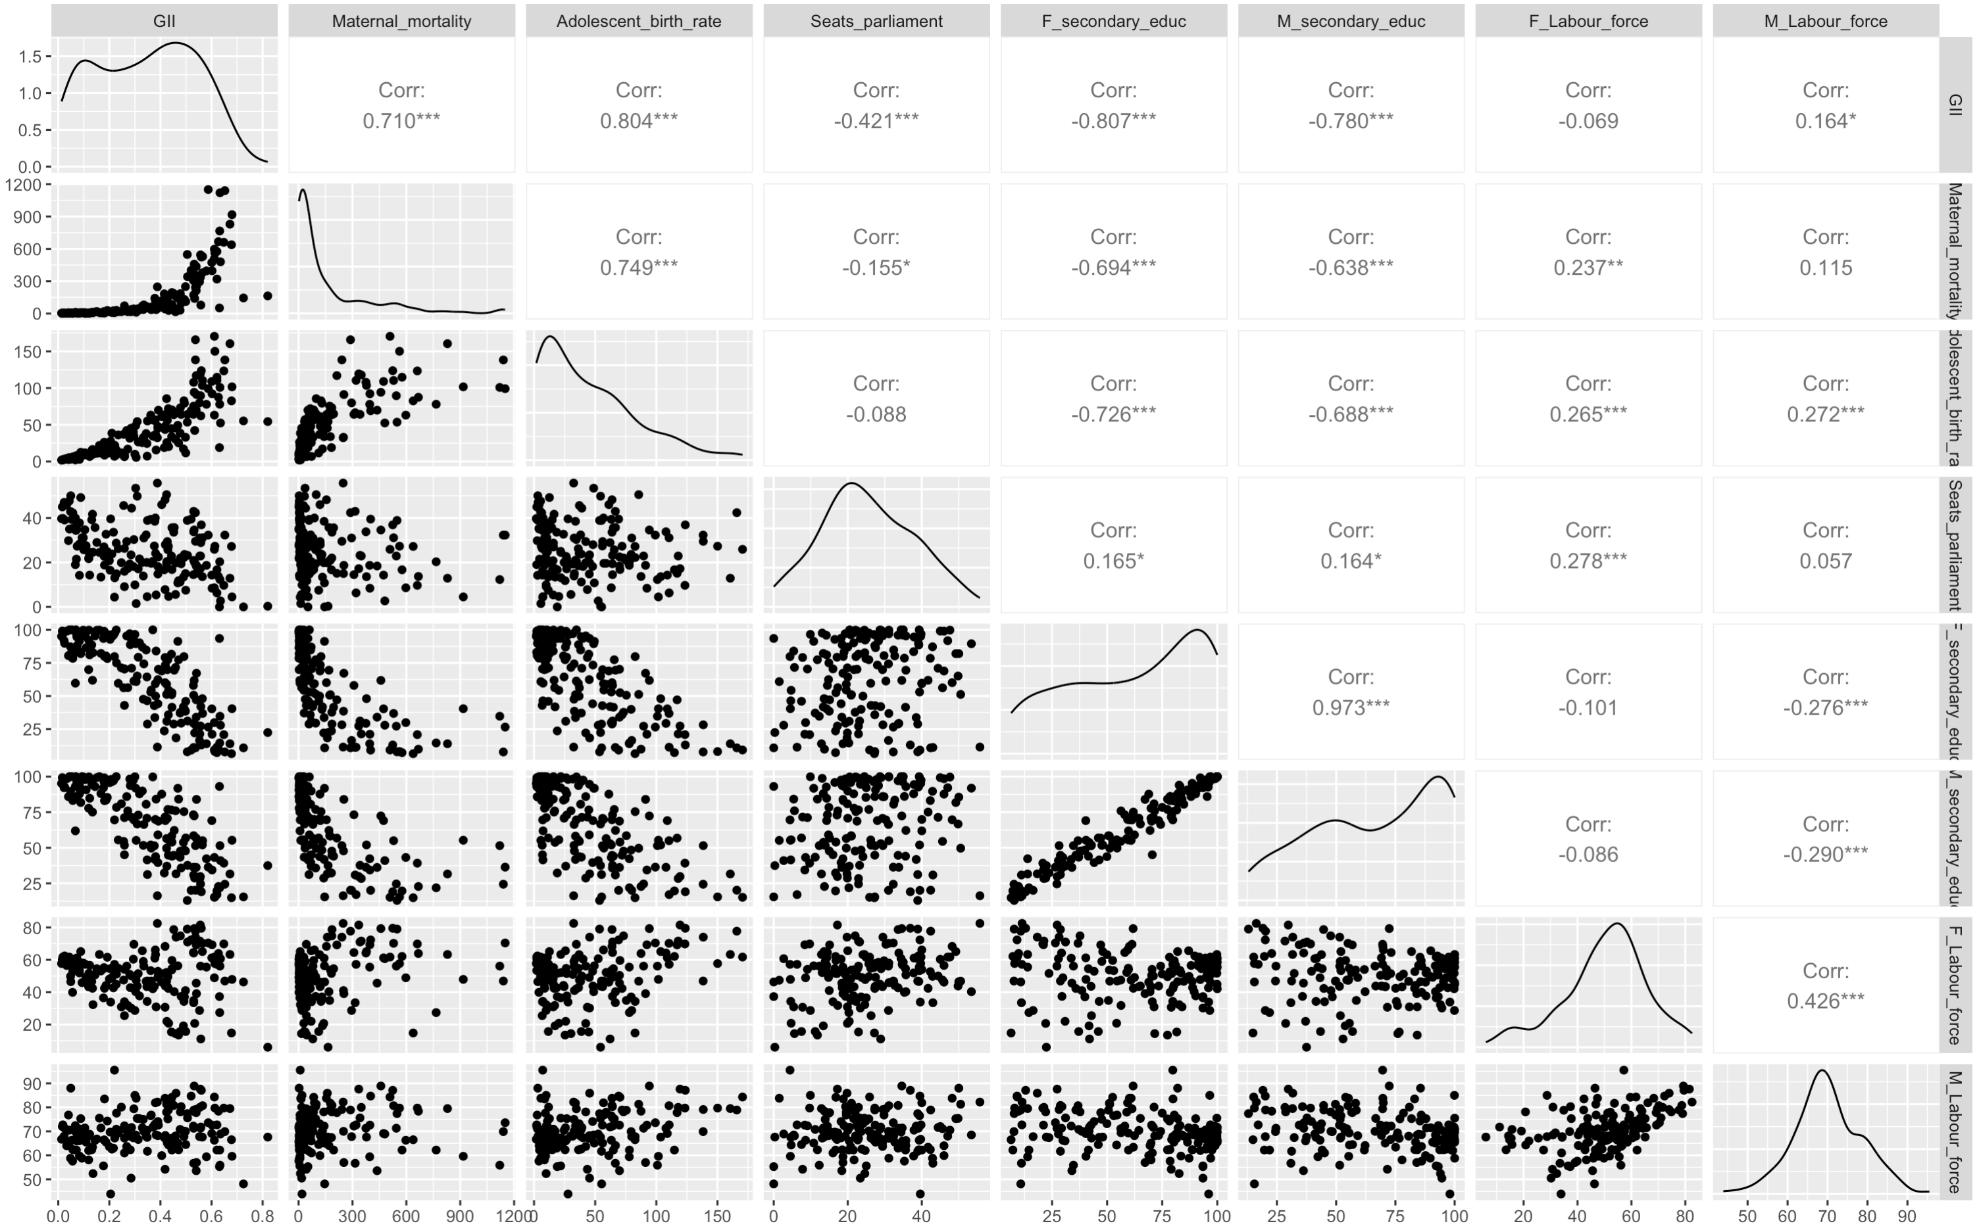

Slide 12
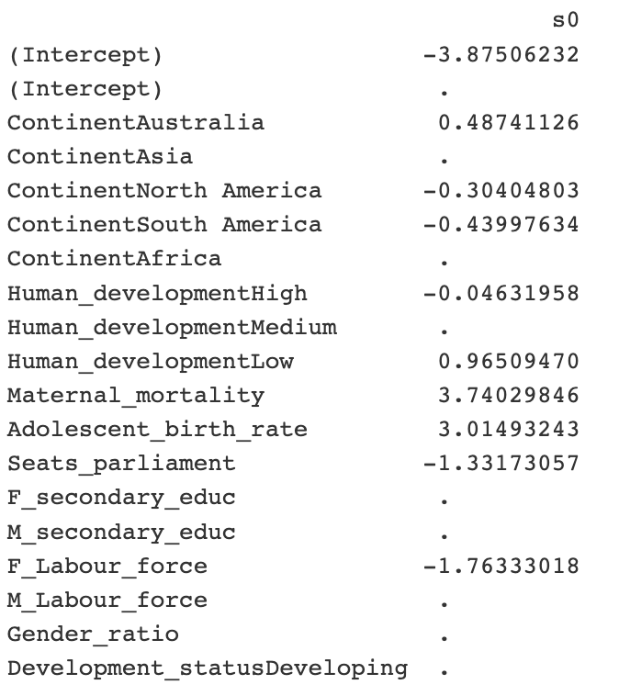
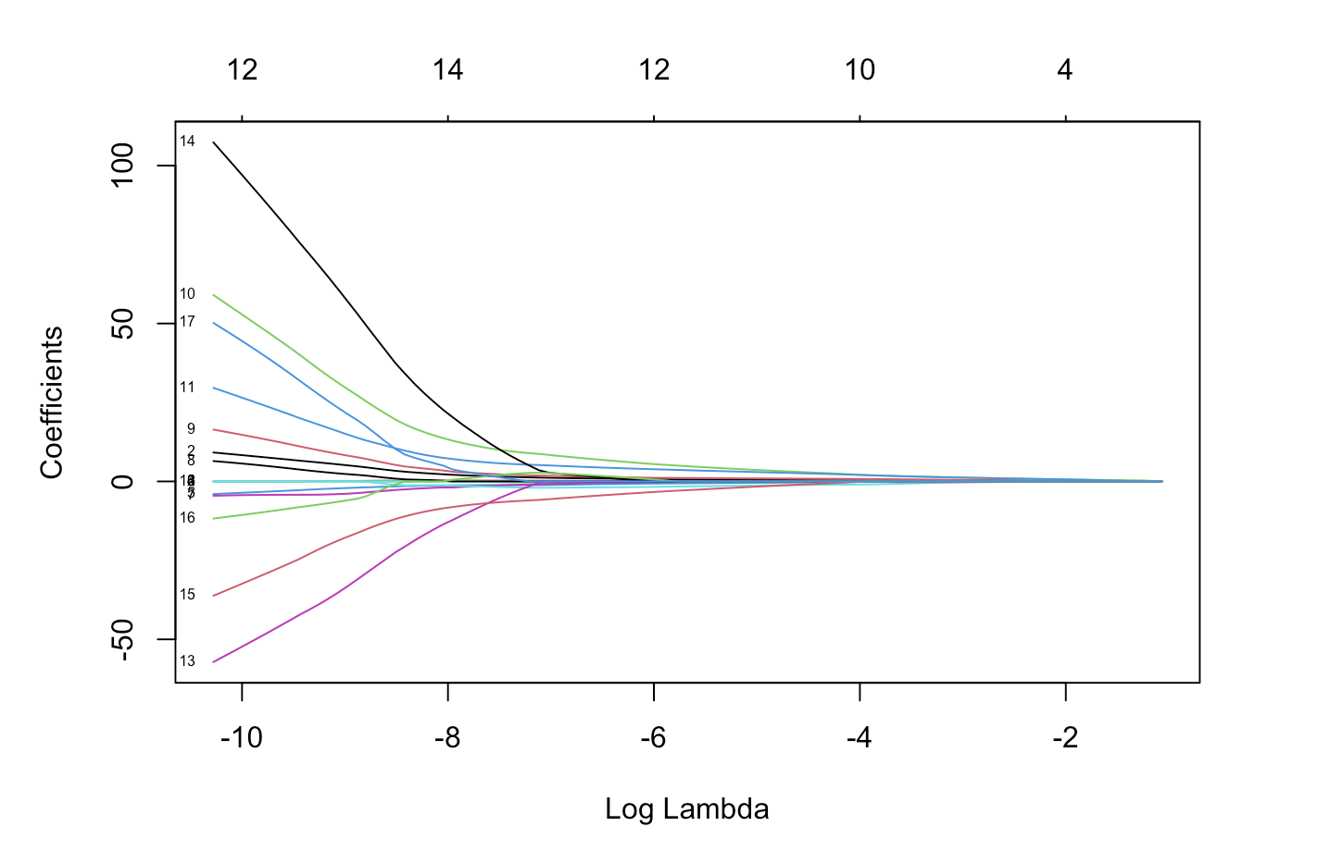
Lasso

Slide 13
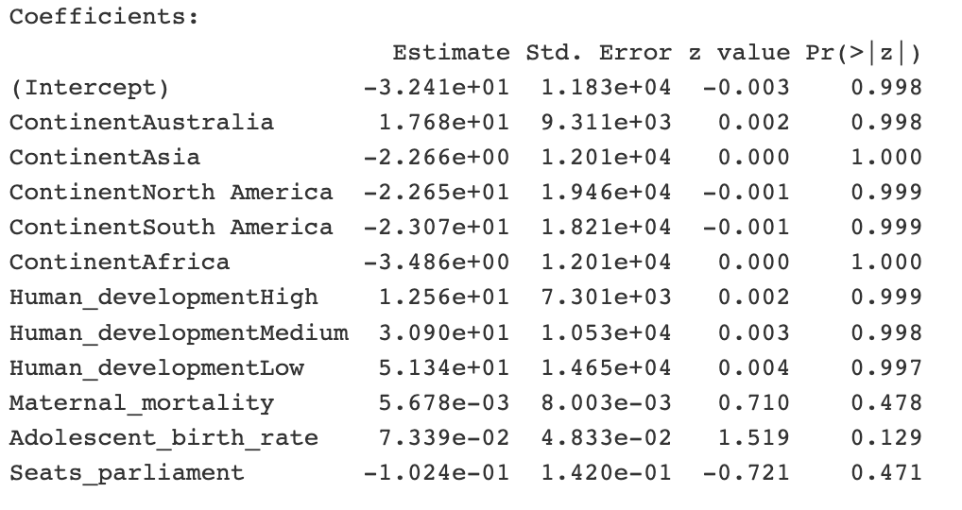
Logistic Model
None of the variables are significant predictors.

Slide 14
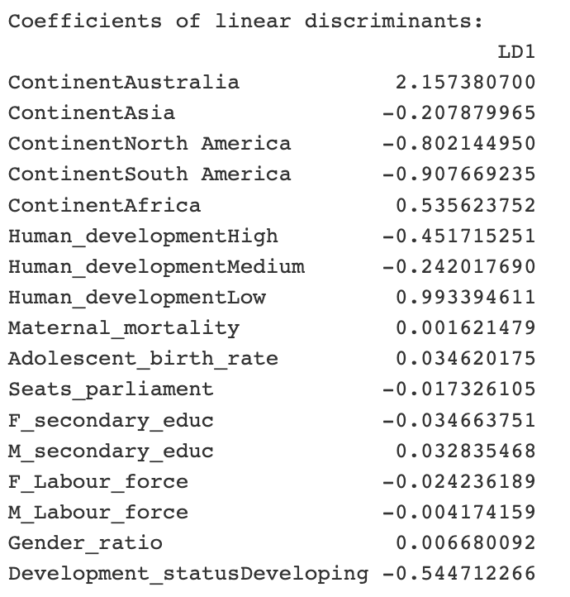
Linear Discriminant Analysis (LDA)
Some variables have larger coefficients than others in absolute value
"ContinentAustralia"
"ContinentAfrica"
"Human_developmentLow"
"Development_statusDeveloping"

Slide 15
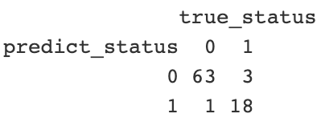

LDA
The accuracy score measure of how well the model performs overall.
The sensitivity score measure of how well the model performs in identifying positive cases.
The specificity score measure of how well the model performs in identifying negative cases.

Slide 16
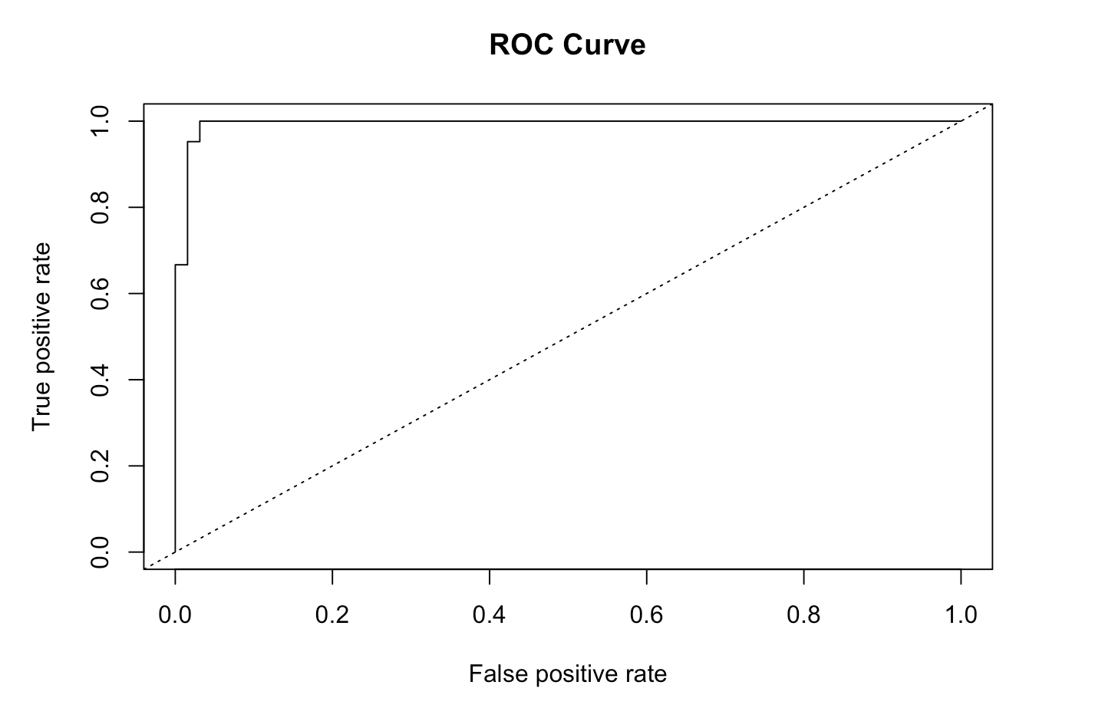
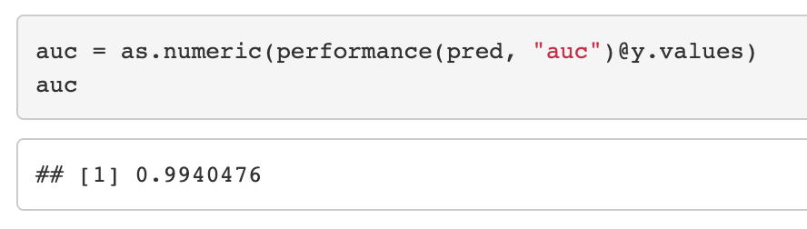
LDA
In this case, the ROC curve shows that the LDA model has an excellent performance, as the curve is very close to the top-left corner of the plot.
This indicates that the model has a high true positive rate (TPR) and a low false positive rate (FPR) across all threshold settings.
The AUC (area under the curve) is also very high at 0.994, which further confirms the high predictive power of the LDA model.

Slide 17
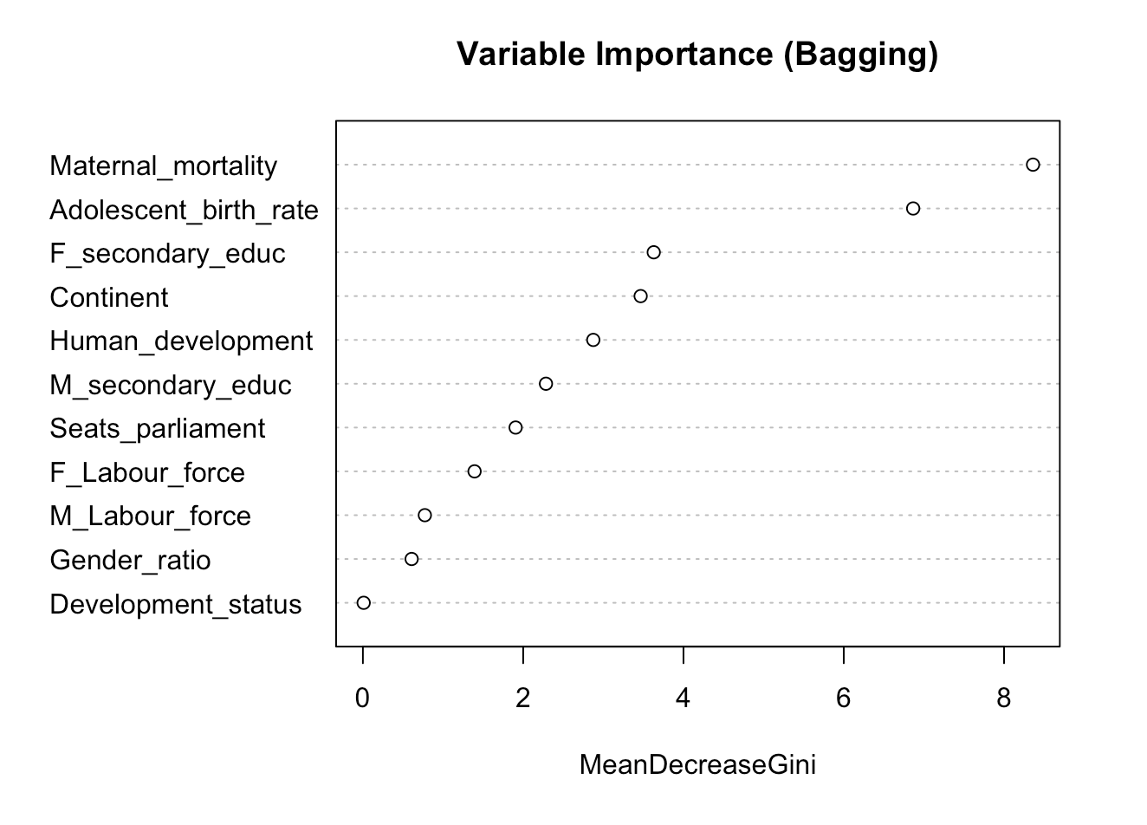

Random Forest
The higher the value of MeanDecreaseGini, the more important that variable is for the model.
`Maternal_mortality` has the highest importance value

Slide 18
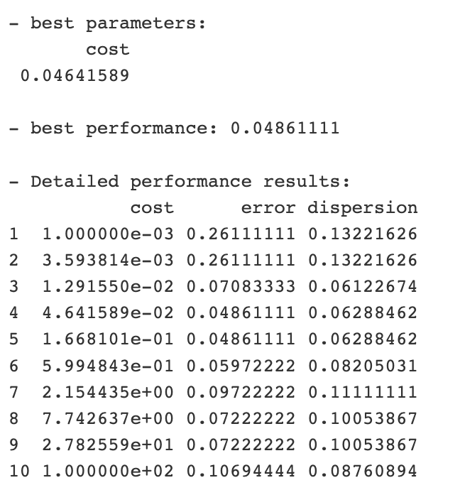
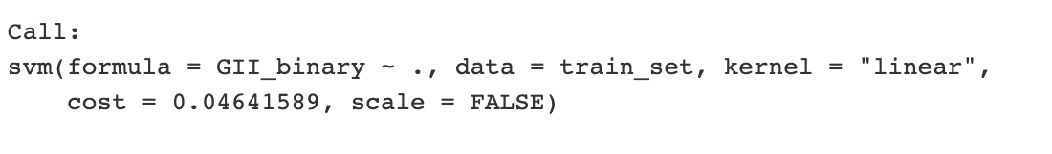

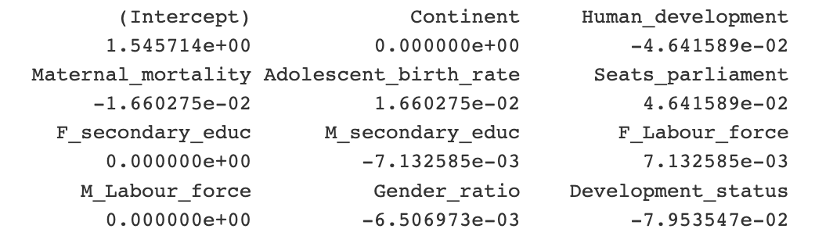
Support Vector Machine
We can see that the error rate is relatively low across all of the cost values tested, but the lowest error rate is achieved at the smallest value of cost.
This suggests that a simpler model with a lower cost may be more appropriate for this data set.

Slide 19
Results
LDA
Random Forest
SVM

Slide 20
Results & Challenges
LDA
Continent
Human Development
Development Status
Random Forest
Maternal Mortality
Adolescent Birth Rate
Development Status
SVM
Continent
Female Secondary Education
Male Labor Force

Slide 21
Thank you!

