Slide 1
IvSEM DBMS (15ECSC208) Course project socse,kle technological university,2020-2021 Team id:- 4D16 Category: Explorative Project Title: Image Caption Generator Team Leader : Abbasali A jamadar List of Team Members: Abbasali A Jamadar (USN: 01FE20BCS414 Roll No: 466) Neha Kardant (USN: 01FE20BCS422 Roll No: 469) Nihal Fernandis (USN: 01FE19BCS237 Roll No: 437)

Slide 2
Table of contents:-
-Responsibilities of each team member for each phase of the project.
- Introduction Proposal Phase Problem Statement Proposed Method of Solving Image Caption Generator Model Explanation on each modules -Design Phase Dataset being used -Implementation Phase Importing all the necessary packages Getting and performing data cleaning Extracting feature vector from all images Loading dataset for training the model Tokenizing the vocabulary Create Data Generator Defining the CNN-RNN model Training the model Testing the model
Results
-Conclusion
-References
-Team experience on course project

Slide 3
Responsibilities: *Proposal Phase: Abbasali A Jamadar: Working on CNN, LSTM, CV, NLP, tensorflow, Datasets(Only parts related to our project)read research papers Neha Kardant: Working on CNN, LSTM, CV, NLP, Datasets(Only parts related to our project)read research papers Nihal Fernandis: Working on CNN, LSTM, CV, NLP, Datasets

Slide 4
*Design phase: Abbasali A Jamadar: Working on CNN, LSTM, CV, NLP, tensorflow, Datasets(Only parts related to our project) Neha Kardant: Working on CNN, LSTM, CV, NLP, Datasets(Only parts related to our project) Nihal Fernandis: Working on CNN, LSTM, CV, NLP, Datasets *Implementation phase: Abbasali A Jamadar: Working on CNN, LSTM, CV, NLP, tensorflow, Datasets(Only parts related to our project),coding Neha Kardant: Working on CNN, LSTM, CV, NLP, Datasets(Only parts related to our project)some part of the code Nihal Fernandis: Working on CNN, LSTM, CV, NLP, Datasets

Slide 5
Introduction:- Image caption generator is a task that involves computer vision and natural language processing concepts to recognize the context of an image and describe them in a natural language like English.
Problem Statement:-
Humans can see an image and can easily tell what the image is about, but can a computer tell what the image is representing?
Computer vision researchers worked on this a lot and they considered it impossible until now!
With the advancement in Deep learning techniques, availability of huge datasets and computer power, we can build models that can generate captions for an image.

Slide 6
Proposal Phase:- Proposed method of solving: In this Python project, we will be implementing the caption generator using CNN (Convolutional Neural Networks) and LSTM (Long short term memory). The image features will be extracted from Xception which is a CNN model trained on the images dataset and then we feed the features into the LSTM model which will be responsible for generating the image captions.

Slide 7
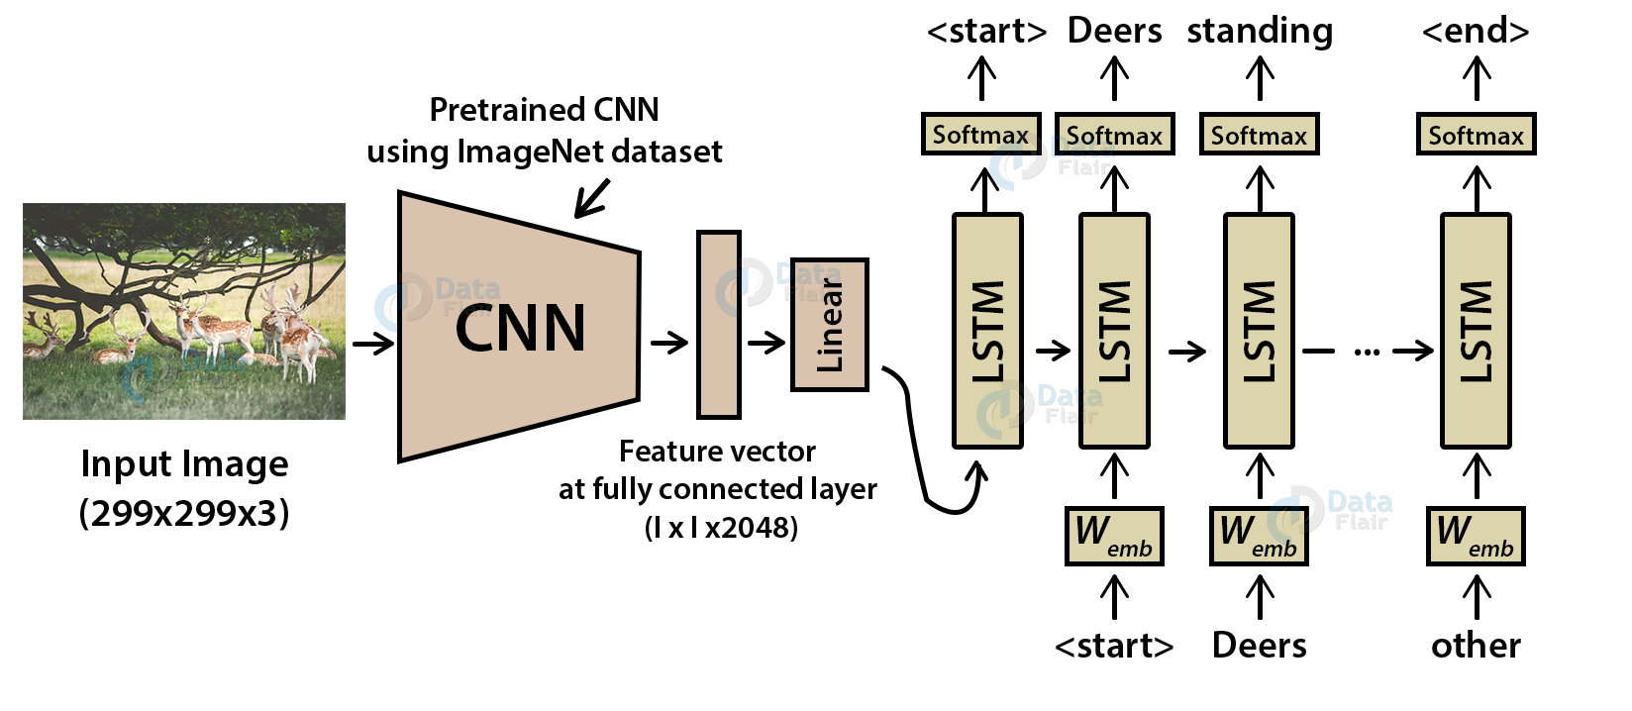
Image Caption Generator Model:
CNN is used for extracting features from the image. We will use the pre-trained model Xception. LSTM will use the information from CNN to help generate a description of the image. It is also called a CNN-RNN model.

Slide 8
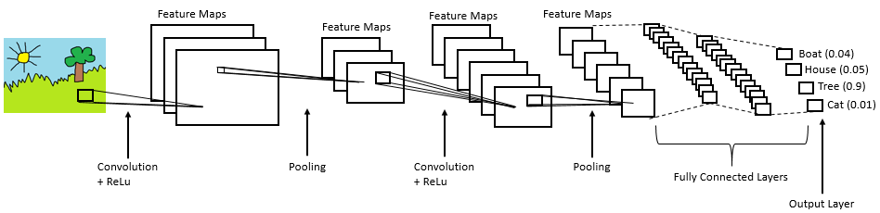
Explanation on each of the modules in the methodology: Convolutional Neural networks (CNN):
Convolutional Neural networks are specialized deep neural networks which can process the data that has input shape like a 2D matrix. Images are easily represented as a 2D matrix and CNN is very useful in working with images.

Slide 9
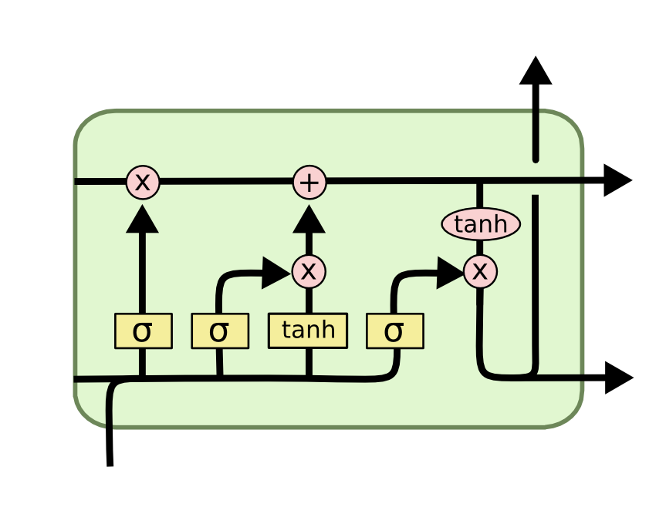
Long short term memory (LSTM):
LSTM stands for Long short term memory is a RNN (recurrent neural network) which is well suited for sequence prediction problems.
Based on the previous text, we can predict what the next word will be. It has proven itself effective from the traditional RNN by overcoming the limitations of RNN which had short term memory.
LSTM can carry out relevant information throughout the processing of inputs and with a forget gate, it discards non-relevant information.

Slide 10
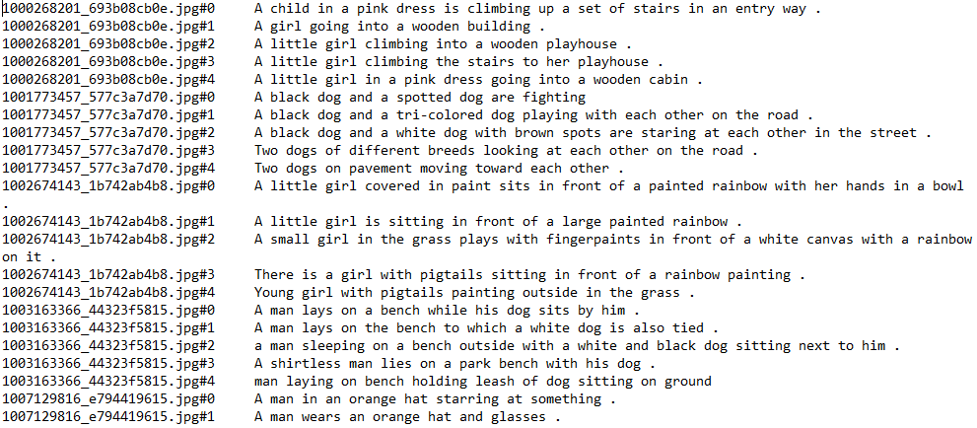
Design phase: Datasets being used details:-

Slide 11
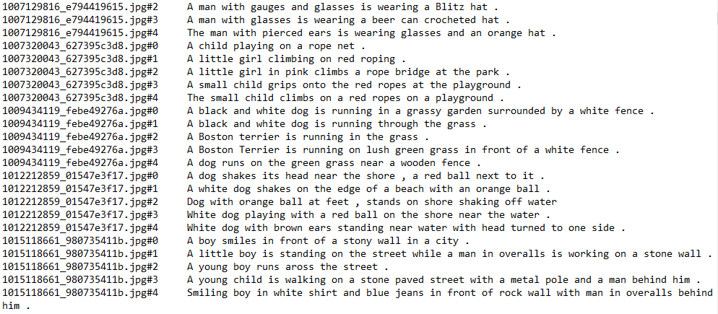

Slide 12
Implementation Phase:
Building the Python based Project
We start by initializing the jupyter notebook server by typing jupyter lab in the console of our project folder. It will open up the interactive Python notebook where we can run code. Create a Python3 notebook and name it training_caption_generator.ipynb
1. First, we import all the necessary packages
2. Getting and performing data cleaning:-
The main text file which contains all image captions is Flickr8k.token in our Flickr_8k_text folder.

Slide 13
3. Extracting the feature vector from all images This technique is also called transfer learning, we don’t have to do everything on our own, we use the pre-trained model that have been already trained on large datasets and extract the features from these models and use them for our tasks. We are using the Xception model which has been trained on imagenet dataset that had 1000 different classes to classify. We can directly import this model from the keras.applications . Make sure you are connected to the internet as the weights get automatically downloaded. Since the Xception model was originally built for imagenet, we will do little changes for integrating with our model. One thing to notice is that the Xception model takes 299*299*3 image size as input. We will remove the last classification layer and get the 2048 feature vector. 4. Loading dataset for Training the model In our Flickr_8k_test folder, we have Flickr_8k.trainImages.txt file that contains a list of 6000 image names that we will use for training.

Slide 14
5. Tokenizing the vocabulary Computers don’t understand English words, for computers, we will have to represent them with numbers. So, we will map each word of the vocabulary with a unique index value. Keras library provides us with the tokenizer function that we will use to create tokens from our vocabulary and save them to a “tokenizer.p” pickle file. 6. Create Data generator Let us first see how the input and output of our model will look like. To make this task into a supervised learning task, we have to provide input and output to the model for training. We have to train our model on 6000 images and each image will contain 2048 length feature vector and caption is also represented as numbers. This amount of data for 6000 images is not possible to hold into memory so we will be using a generator method that will yield batches.

Slide 15
7. Defining the CNN-RNN model To define the structure of the model, we will be using the Keras Model from Functional API. It will consist of three major parts: Feature Extractor – The feature extracted from the image has a size of 2048, with a dense layer, we will reduce the dimensions to 256 nodes. Sequence Processor – An embedding layer will handle the textual input, followed by the LSTM layer. Decoder – By merging the output from the above two layers, we will process by the dense layer to make the final prediction. The final layer will contain the number of nodes equal to our vocabulary size.

Slide 16
8. Training the model To train the model, we will be using the 6000 training images by generating the input and output sequences in batches and fitting them to the model using model.fit_generator() method. We also save the model to our models folder. This will take some time depending on your system capability. 9. Testing the model The model has been trained, now, we will make a separate file testing_caption_generator.py which will load the model and generate predictions. The predictions contain the max length of index values so we will use the same tokenizer.p pickle file to get the words from their index values.

Slide 17
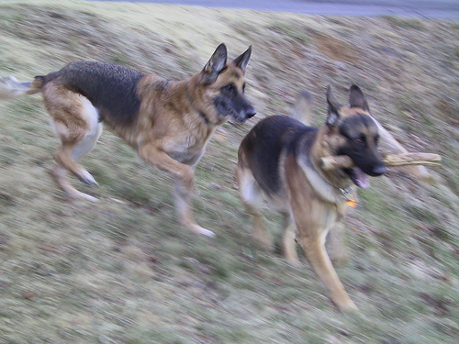
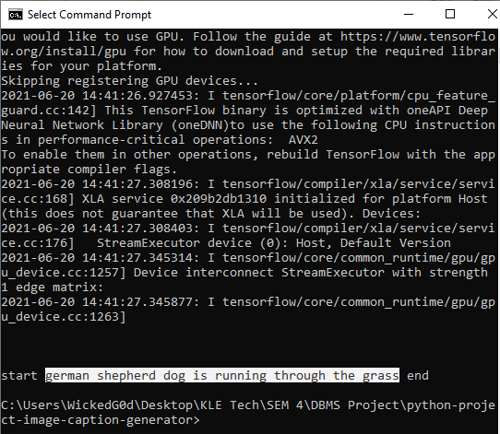
Results:

Slide 18
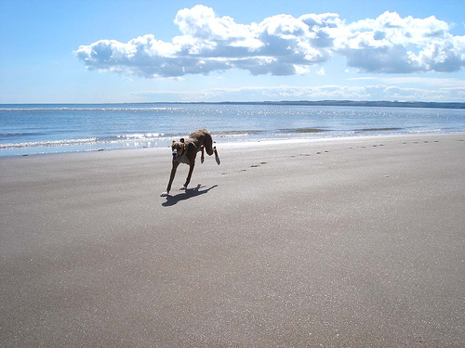
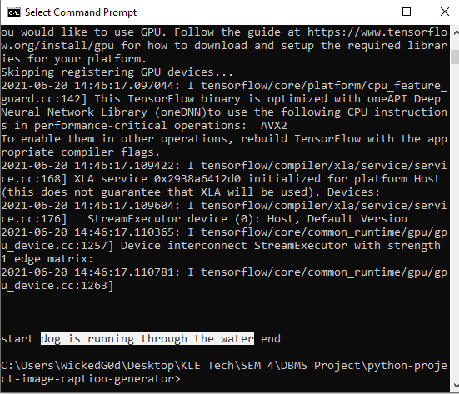
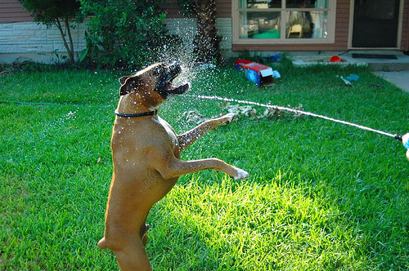
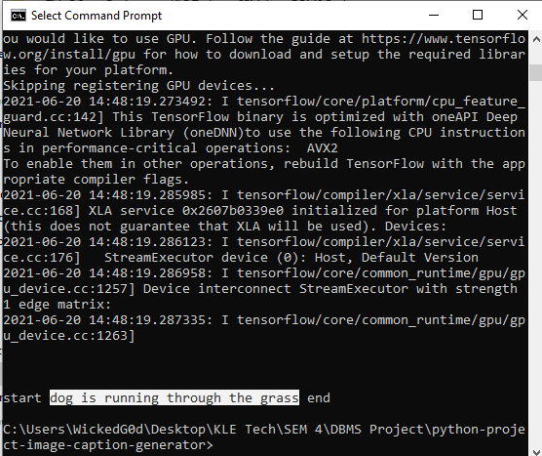

Slide 19
Conclusion:- Some key points we noticed are that our model depends on the data, so, it cannot predict the words that are out of its vocabulary. We used a small dataset consisting of 8000 images. For production-level models, we need to train on datasets larger than 100,000 images which can produce better accuracy models.

Slide 20
References:
Flicker8k_Dataset: https://www.kaggle.com/ming666/flicker8k-dataset
Flciker_8k_text: https://www.kaggle.com/ming666/flicker8k-dataset
CNN: https://data-flair.training/blogs/convolutional-neural-networks-tutorial/
For some ideas, went through Github and other websites.

Slide 21
Team experience on course project: Learnt Python, improved problem solving skills, improved programming skills, better understanding about the working of Deep Learning and Neural Networks

