Slide 1
DATA MINING AND ANALYSIS COURSE PROJECT(18ECSC301) REVIEW – 1 VOLATILITY PREDICTIONS
TEAM MEMBERS:
Sl.No: Name: USN:
1 Abbasali Jamadar 01fe20bcs414
2 Mahadev Rashinkar 01fe20bcs416
3 Suprita M Patil 01fe19bcs243
4 Priyanka M H 01fe20bcs419

Slide 2
INTRODUCTON
Volatility is one of the most prominent terms on any trading floor. In financial markets, volatility captures the amount of fluctuation in prices.
High volatility is associated to periods of market turbulence and to large price swings, while low volatility describes more calm and quiet markets.
About Challenge:
To make a prediction in volatility for hundreds of stocks across different sectors.
Deadline submission on 28 sept 2021

Slide 3
PROBLEM STATEMENT:
To build model that predict short-term volatility for stocks across different sectors.
It also provides a uniquely fine grained look at the microstructure of modern financial markets.

Slide 4
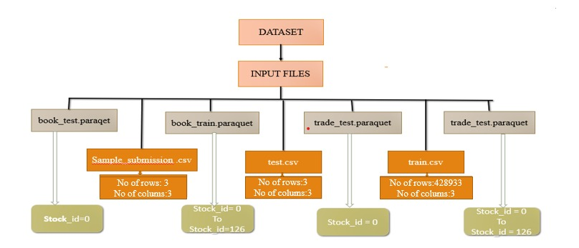
UNDERSTANDING THE DATA:

Slide 5
LIST OF ATTRIBUTES
stock_id - ID code for the stock.
time_id - ID code for the time bucket. Time IDs are not necessarily sequential but are consistent across all stocks.
seconds_in_bucket - Number of seconds from the start of the bucket, always starting from 0.
bid_price - Normalized prices of the most/second most competitive buy level.
ask_price - Normalized prices of the most/second most competitive sell level.
bid_size - The number of shares on the most/second most competitive buy level.
ask_size - The number of shares on the most/second most competitive sell level.

Slide 6
ATTRIBUTE DESCRIPTION:
Attribute | Description | Numberical
Stock_id | These are stock labels | Numerical
time_id, seconds_in_bucket | Time window & end time | Numerical
Size/bid/ask_size | Total shares traded | Numerical
order_count | Unique order taking place | Numerical
bid_price1 ask_price2 | Normalisation prices of most competitive buy/sell level | Numerical
bid_price2 ask_price2 | Normalisation prices of 2nd most competitive buy/sell level | Numerical
Bid_size1 Ask_size1 | The number of shares of most compititve buy/sell level | Numerical
Bid_size1 Ask_size1 | The number of shares of most compititve buy/sell level | Numerical

Slide 7
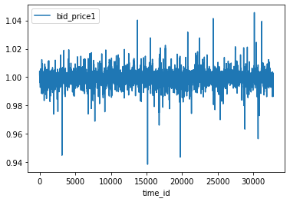
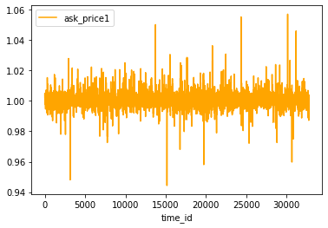
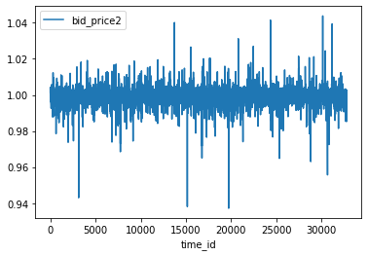
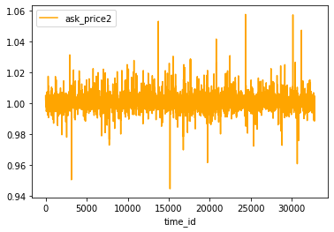
Graphs

Slide 8
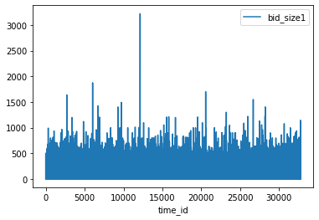
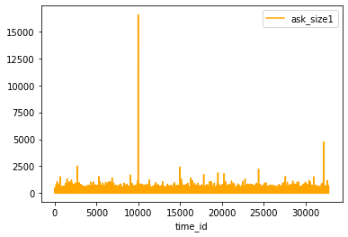
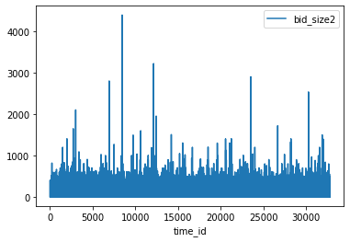
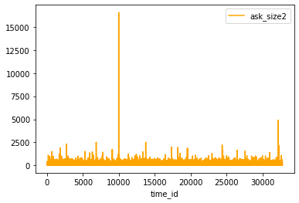

Slide 9
THANK YOU

