Slide 1
Payroll Management System
Software Testing Presentation
Team 11
Overview of Testing Techniques & Evidence

Slide 2
Agenda
Testing Scope & Methodology
Black Box Testing (BVA, ECP, Cause-Effect)
White Box Testing (Code Coverage)
Integration Testing
Defect Reporting
Visual Evidence

Slide 3
Test Execution Matrix
ID | Module | Description | Status
TC-001 | Login | Valid Admin | Pass
TC-012 | Employee | Basic Salary = 500000 (BVA) | Fail (BUG-001)
TC-021 | Attendance | Present > Working | Fail (BUG-002)
TC-030 | Payroll | Gross Salary Calc | Fail (BUG-003)
TC-034 | Payroll | Same month diff year | Fail (BUG-004)

Slide 4
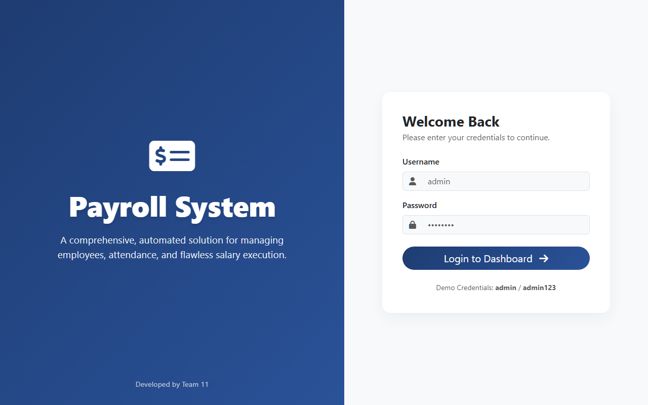
Evidence: BB-001_Login_Page_Valid.png

Slide 5
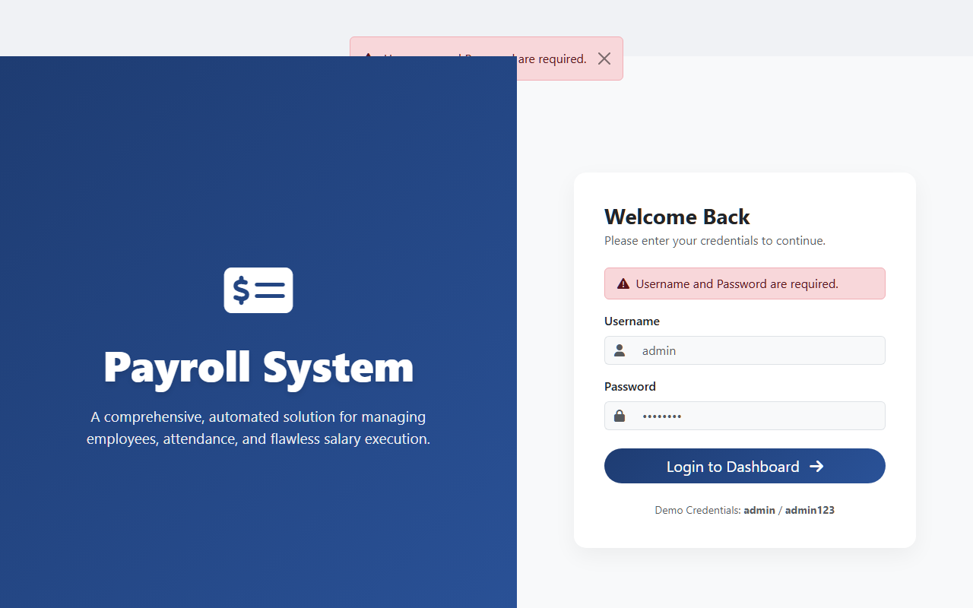
Evidence: BB-002_Login_Invalid_BVA.png

Slide 6
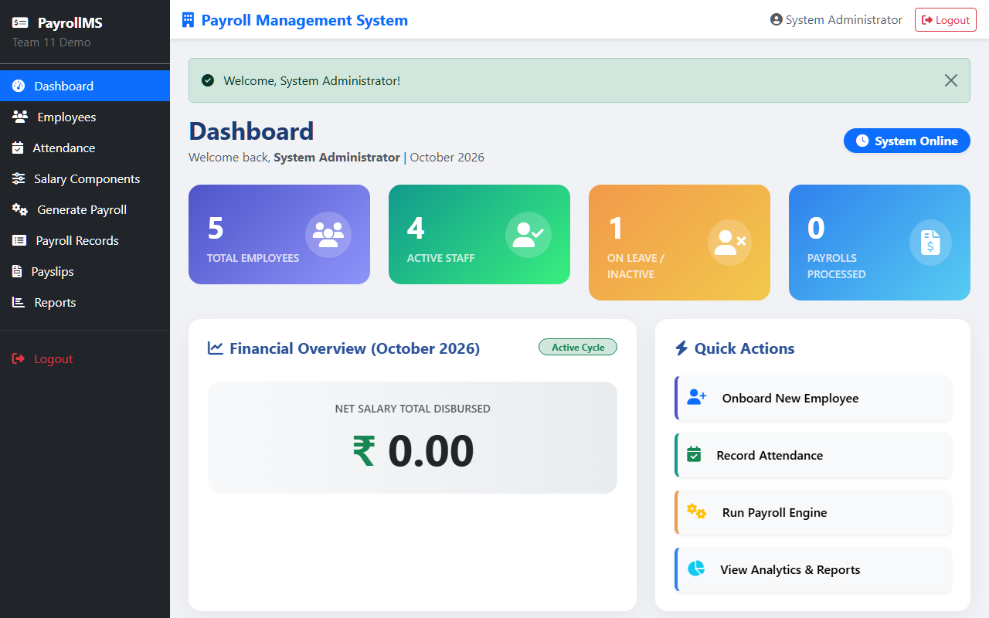
Evidence: BB-003_Dashboard_Valid.png

Slide 7
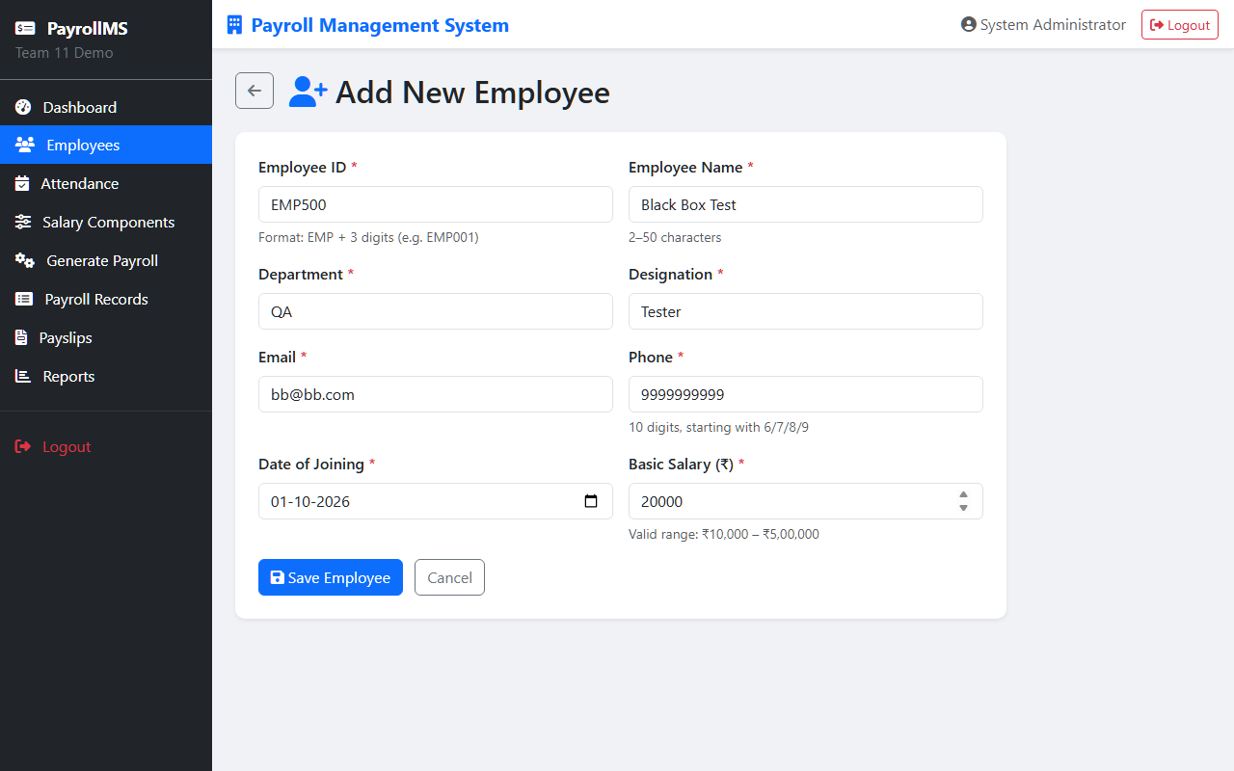
Evidence: BB-004_Employee_Creation_Form.png

Slide 8
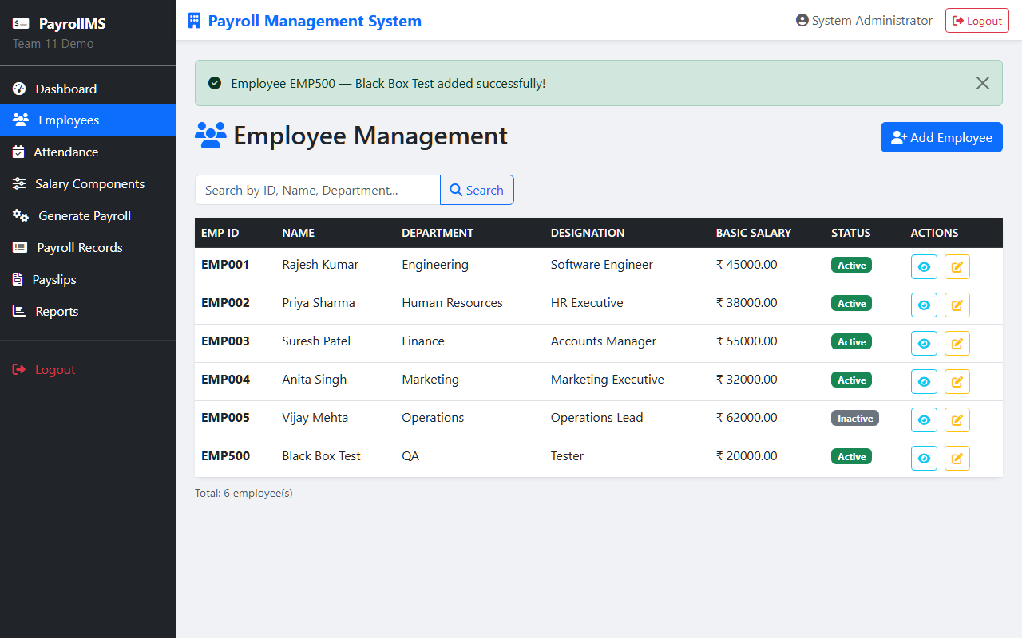
Evidence: BB-005_Employee_Creation_Success.png

Slide 9
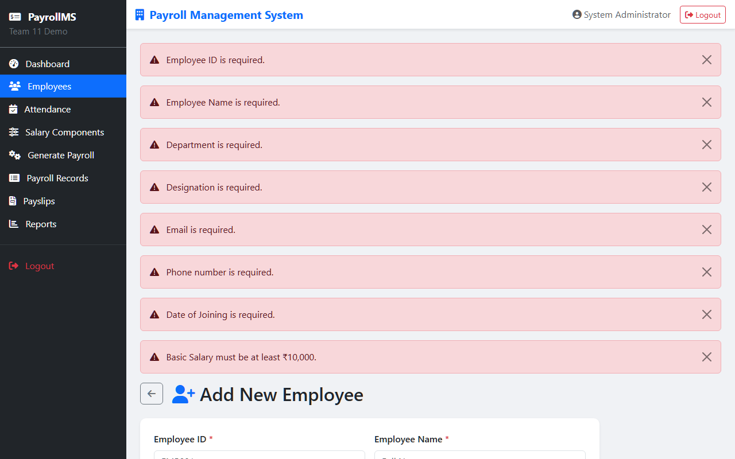
Evidence: BB-006_Employee_Invalid_Salary_BVA.png

Slide 10
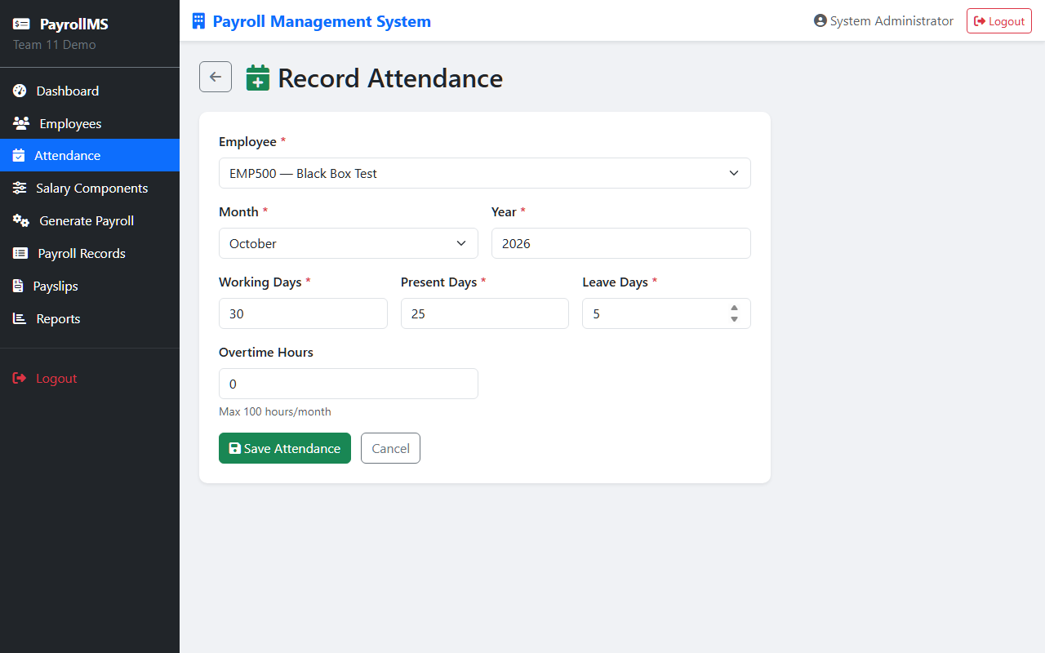
Evidence: BB-007_Attendance_Valid_Form.png

Slide 11
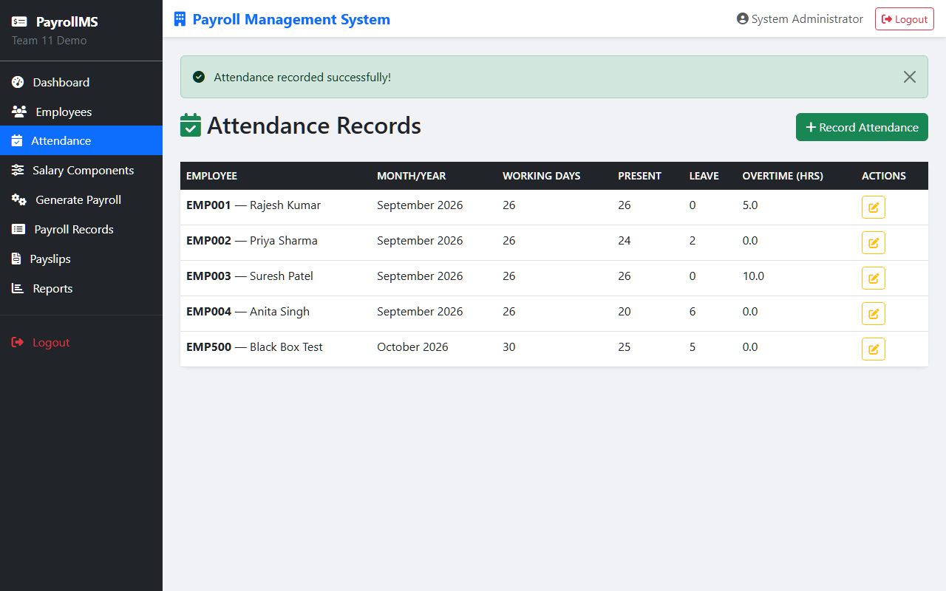
Evidence: BB-008_Attendance_Success.png

Slide 12
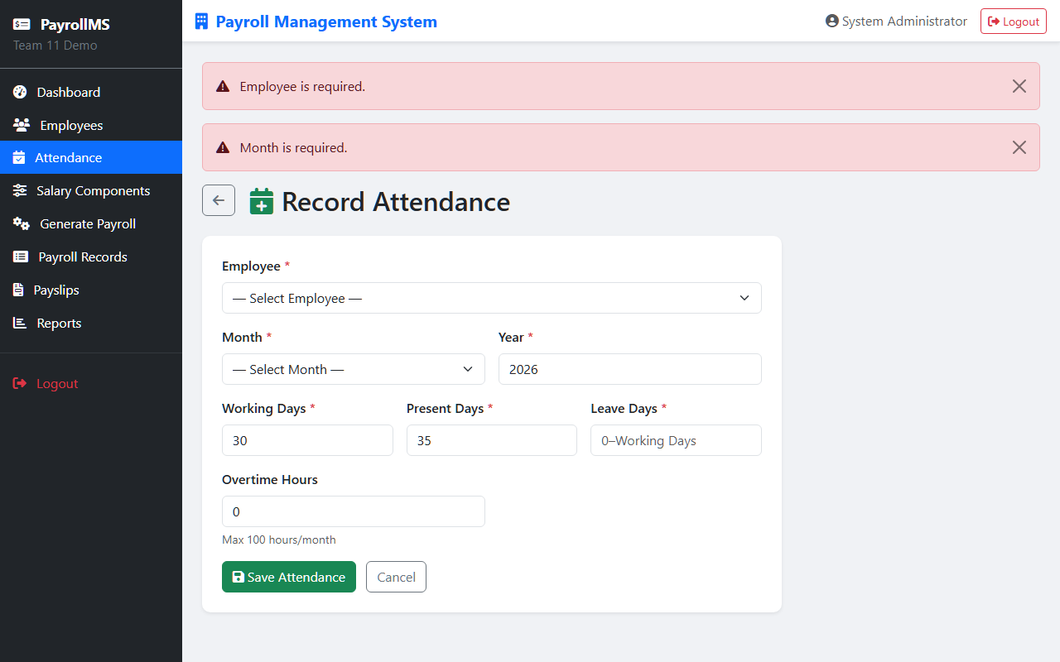
Evidence: BB-009_Attendance_Invalid_Cause_Effect.png

Slide 13
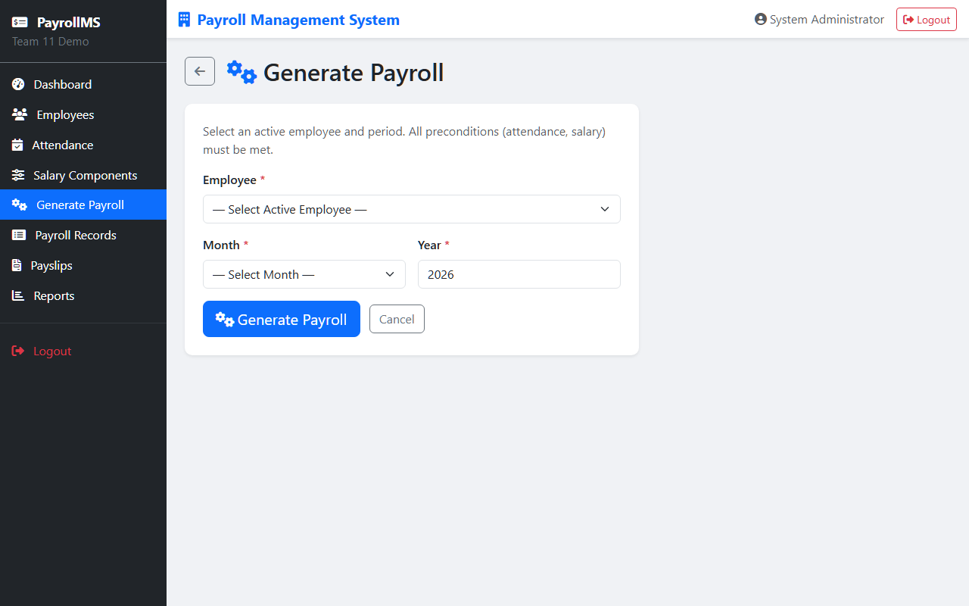
Evidence: BB-010_Payroll_Generation_Page.png

Slide 14
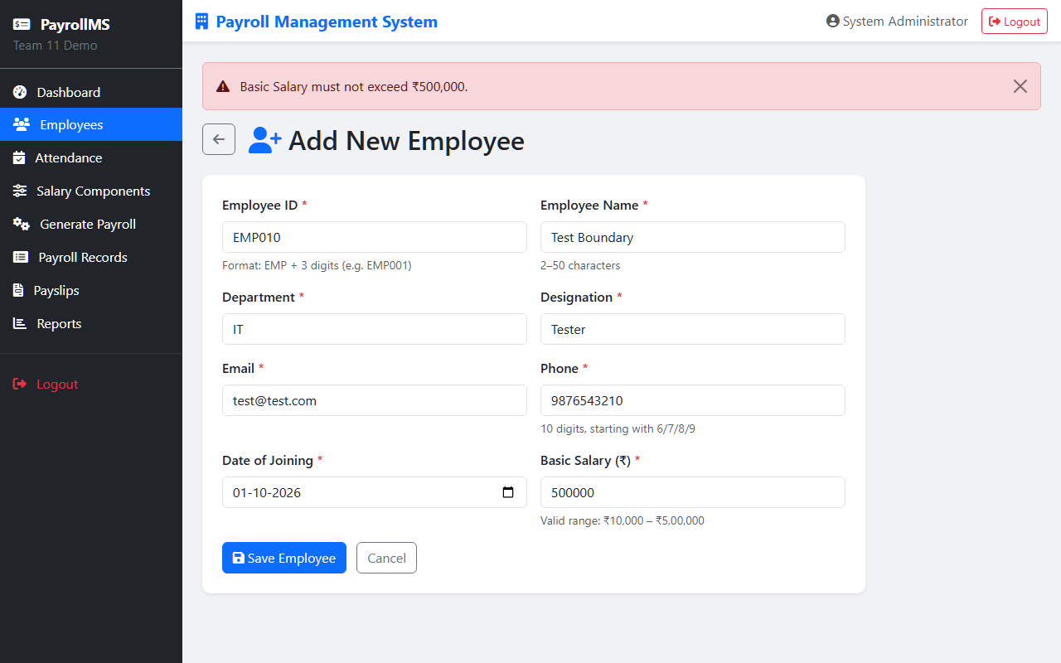
Evidence: BUG-001.png

Slide 15
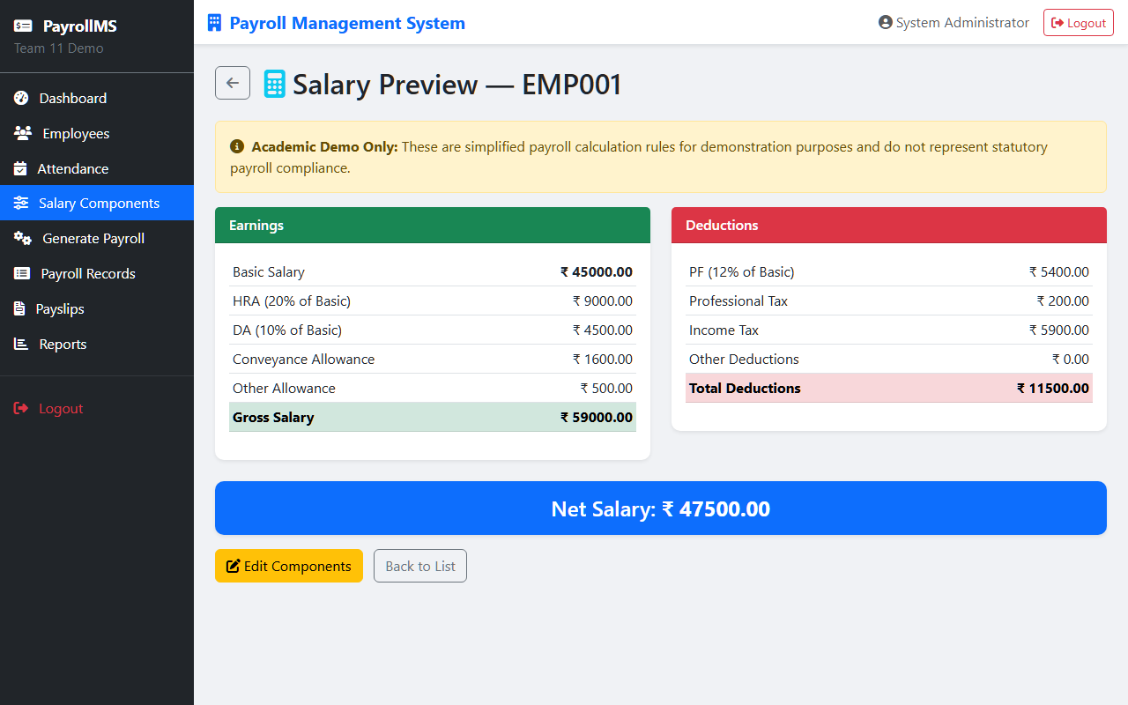
Evidence: BUG-003.png

Slide 16
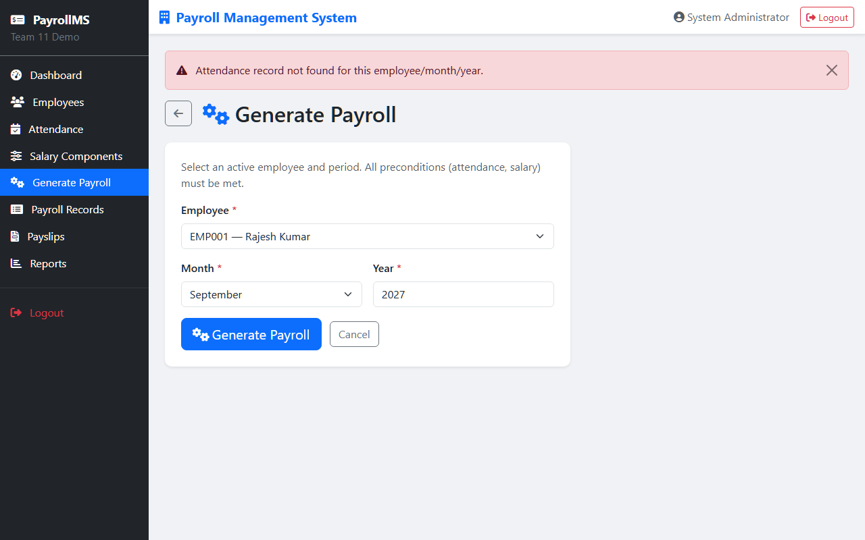
Evidence: BUG-004.png

