Slide 1
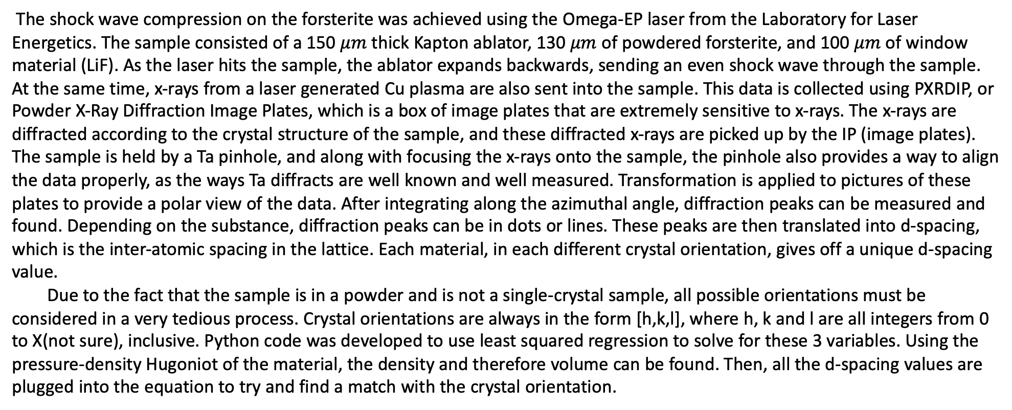
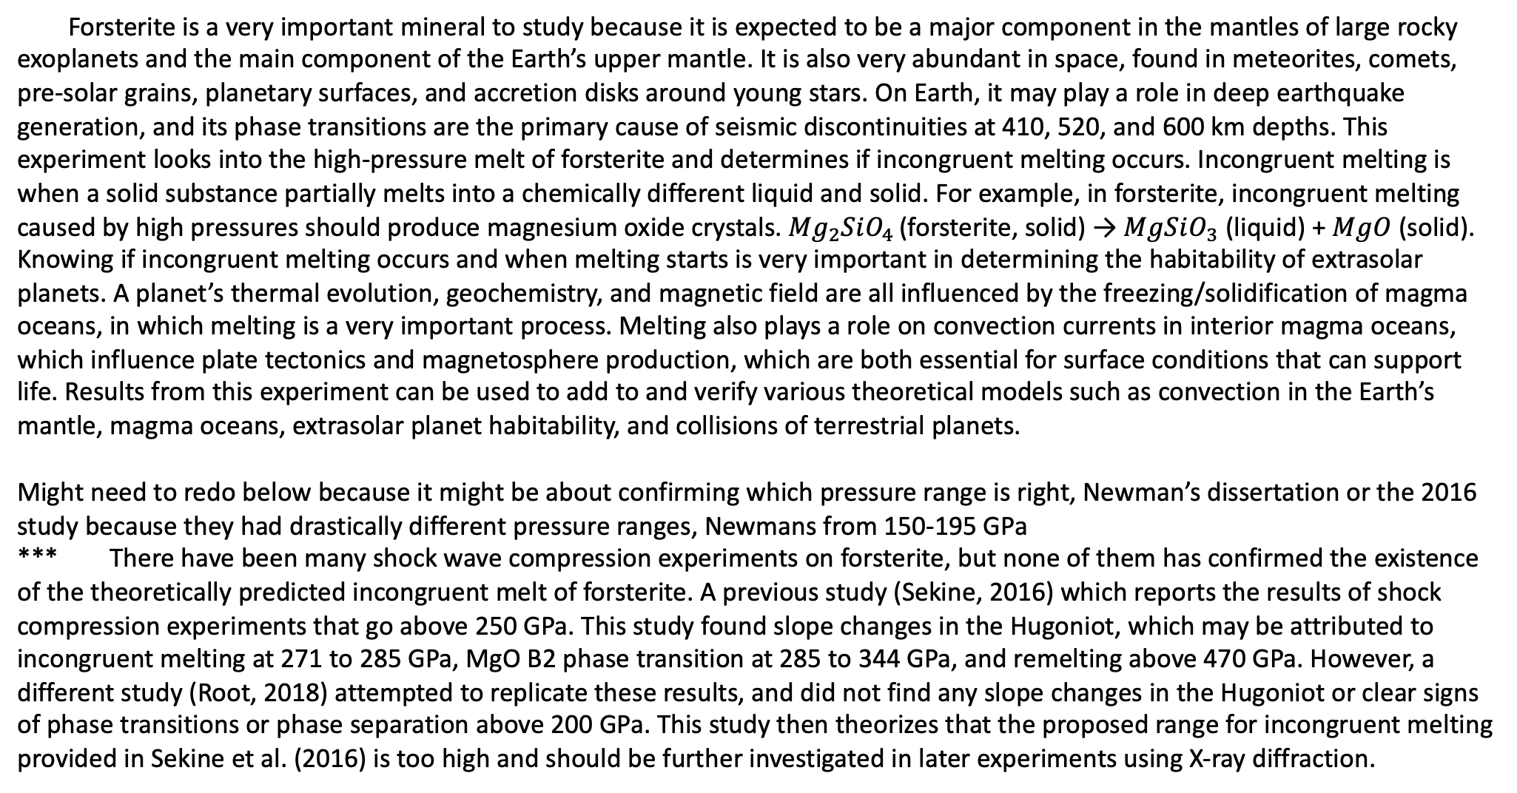
Structure of forsterite in extreme conditions and automated crystal identification
Nara Anusonti-Inthra
Mentored by Patrick LaChapelle and June Wicks
Forsterite is a very important mineral to study because it is expected to be a major component in the mantles of large rocky exoplanets and the main component of the Earth’s upper mantle. It is also very abundant in space, found in meteorites, comets, pre-solar grains, planetary surfaces, and accretion disks around young stars. On Earth, it may play a role in deep earthquake generation, and its phase transitions are the primary cause of seismic discontinuities at 410, 520, and 600 km depths. This experiment looks into the high-pressure melt of forsterite and determines if incongruent melting occurs. Incongruent melting is when a solid substance partially melts into a chemically different liquid and solid. For example, in forsterite, incongruent melting caused by high pressures should produce magnesium oxide crystals. ${Mg}_{2}SiO_{4 }$(forsterite, solid) → $MgSiO_{3}$ (liquid) + $MgO$ (solid). Knowing if incongruent melting occurs and when melting starts is very important in determining the habitability of extrasolar planets. A planet’s thermal evolution, geochemistry, and magnetic field are all influenced by the freezing/solidification of magma oceans, in which melting is a very important process. Melting also plays a role on convection currents in interior magma oceans, which influence plate tectonics and magnetosphere production, which are both essential for surface conditions that can support life. Results from this experiment can be used to add to and verify various theoretical models such as convection in the Earth’s mantle, magma oceans, extrasolar planet habitability, and collisions of terrestrial planets.
Might need to redo below because it might be about confirming which pressure range is right, Newman’s dissertation or the 2016 study because they had drastically different pressure ranges, Newmans from 150-195 GPa
*** There have been many shock wave compression experiments on forsterite, but none of them has confirmed the existence of the theoretically predicted incongruent melt of forsterite. A previous study (Sekine, 2016) which reports the results of shock compression experiments that go above 250 GPa. This study found slope changes in the Hugoniot, which may be attributed to incongruent melting at 271 to 285 GPa, MgO B2 phase transition at 285 to 344 GPa, and remelting above 470 GPa. However, a different study (Root, 2018) attempted to replicate these results, and did not find any slope changes in the Hugoniot or clear signs of phase transitions or phase separation above 200 GPa. This study then theorizes that the proposed range for incongruent melting provided in Sekine et al. (2016) is too high and should be further investigated in later experiments using X-ray diffraction.
The shock wave compression on the forsterite was achieved using the Omega-EP laser from the Laboratory for Laser Energetics. The sample consisted of a 150 $μm$ thick Kapton ablator, 130 $μm$ of powdered forsterite, and 100 $μm$ of window material (LiF). As the laser hits the sample, the ablator expands backwards, sending an even shock wave through the sample. At the same time, x-rays from a laser generated Cu plasma are also sent into the sample. This data is collected using PXRDIP, or Powder X-Ray Diffraction Image Plates, which is a box of image plates that are extremely sensitive to x-rays. The x-rays are diffracted according to the crystal structure of the sample, and these diffracted x-rays are picked up by the IP (image plates). The sample is held by a Ta pinhole, and along with focusing the x-rays onto the sample, the pinhole also provides a way to align the data properly, as the ways Ta diffracts are well known and well measured. Transformation is applied to pictures of these plates to provide a polar view of the data. After integrating along the azimuthal angle, diffraction peaks can be measured and found. Depending on the substance, diffraction peaks can be in dots or lines. These peaks are then translated into d-spacing, which is the inter-atomic spacing in the lattice. Each material, in each different crystal orientation, gives off a unique d-spacing value.
Due to the fact that the sample is in a powder and is not a single-crystal sample, all possible orientations must be considered in a very tedious process. Crystal orientations are always in the form [h,k,l], where h, k and l are all integers from 0 to X(not sure), inclusive. Python code was developed to use least squared regression to solve for these 3 variables. Using the pressure-density Hugoniot of the material, the density and therefore volume can be found. Then, all the d-spacing values are plugged into the equation to try and find a match with the crystal orientation.

