Slide 1
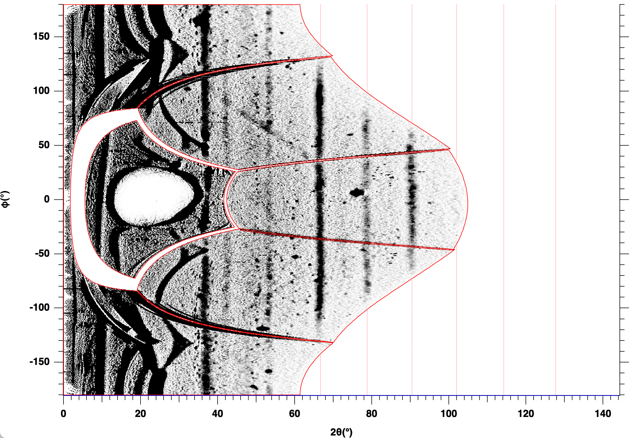
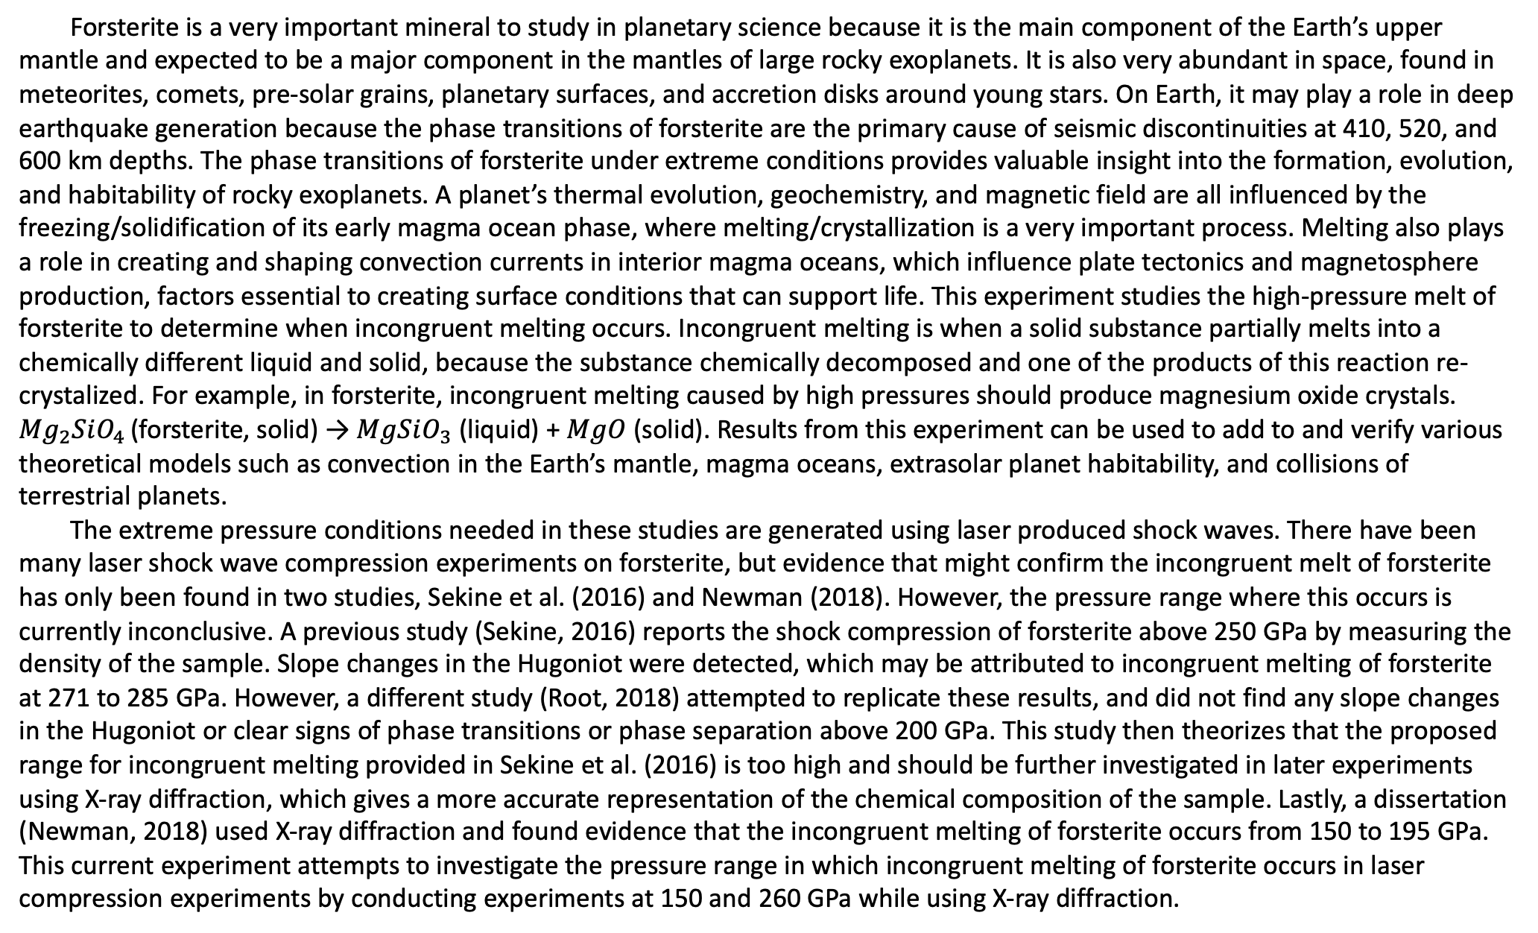
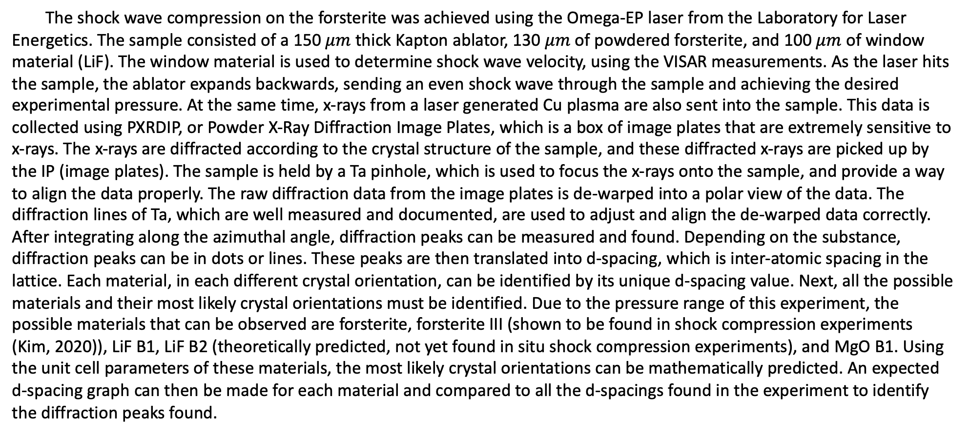
Structure of forsterite in extreme conditions and automated crystal identification
Nara Anusonti-Inthra
Mentored by Patrick LaChapelle and June Wicks
Forsterite is a very important mineral to study in planetary science because it is the main component of the Earth’s upper mantle and expected to be a major component in the mantles of large rocky exoplanets. It is also very abundant in space, found in meteorites, comets, pre-solar grains, planetary surfaces, and accretion disks around young stars. On Earth, it may play a role in deep earthquake generation because the phase transitions of forsterite are the primary cause of seismic discontinuities at 410, 520, and 600 km depths. The phase transitions of forsterite under extreme conditions provides valuable insight into the formation, evolution, and habitability of rocky exoplanets. A planet’s thermal evolution, geochemistry, and magnetic field are all influenced by the freezing/solidification of its early magma ocean phase, where melting/crystallization is a very important process. Melting also plays a role in creating and shaping convection currents in interior magma oceans, which influence plate tectonics and magnetosphere production, factors essential to creating surface conditions that can support life. This experiment studies the high-pressure melt of forsterite to determine when incongruent melting occurs. Incongruent melting is when a solid substance partially melts into a chemically different liquid and solid, because the substance chemically decomposed and one of the products of this reaction re-crystalized. For example, in forsterite, incongruent melting caused by high pressures should produce magnesium oxide crystals. ${Mg}_{2}SiO_{4 }$(forsterite, solid) → $MgSiO_{3}$ (liquid) + $MgO$ (solid). Results from this experiment can be used to add to and verify various theoretical models such as convection in the Earth’s mantle, magma oceans, extrasolar planet habitability, and collisions of terrestrial planets.
The extreme pressure conditions needed in these studies are generated using laser produced shock waves. There have been many laser shock wave compression experiments on forsterite, but evidence that might confirm the incongruent melt of forsterite has only been found in two studies, Sekine et al. (2016) and Newman (2018). However, the pressure range where this occurs is currently inconclusive. A previous study (Sekine, 2016) reports the shock compression of forsterite above 250 GPa by measuring the density of the sample. Slope changes in the Hugoniot were detected, which may be attributed to incongruent melting of forsterite at 271 to 285 GPa. However, a different study (Root, 2018) attempted to replicate these results, and did not find any slope changes in the Hugoniot or clear signs of phase transitions or phase separation above 200 GPa. This study then theorizes that the proposed range for incongruent melting provided in Sekine et al. (2016) is too high and should be further investigated in later experiments using X-ray diffraction, which gives a more accurate representation of the chemical composition of the sample. Lastly, a dissertation (Newman, 2018) used X-ray diffraction and found evidence that the incongruent melting of forsterite occurs from 150 to 195 GPa. This current experiment attempts to investigate the pressure range in which incongruent melting of forsterite occurs in laser compression experiments by conducting experiments at 150 and 260 GPa while using X-ray diffraction.
The shock wave compression on the forsterite was achieved using the Omega-EP laser from the Laboratory for Laser Energetics. The sample consisted of a 150 $μm$ thick Kapton ablator, 130 $μm$ of powdered forsterite, and 100 $μm$ of window material (LiF). The window material is used to determine shock wave velocity, using the VISAR measurements. As the laser hits the sample, the ablator expands backwards, sending an even shock wave through the sample and achieving the desired experimental pressure. At the same time, x-rays from a laser generated Cu plasma are also sent into the sample. This data is collected using PXRDIP, or Powder X-Ray Diffraction Image Plates, which is a box of image plates that are extremely sensitive to x-rays. The x-rays are diffracted according to the crystal structure of the sample, and these diffracted x-rays are picked up by the IP (image plates). The sample is held by a Ta pinhole, which is used to focus the x-rays onto the sample, and provide a way to align the data properly. The raw diffraction data from the image plates is de-warped into a polar view of the data. The diffraction lines of Ta, which are well measured and documented, are used to adjust and align the de-warped data correctly. After integrating along the azimuthal angle, diffraction peaks can be measured and found. Depending on the substance, diffraction peaks can be in dots or lines. These peaks are then translated into d-spacing, which is inter-atomic spacing in the lattice. Each material, in each different crystal orientation, can be identified by its unique d-spacing value. Next, all the possible materials and their most likely crystal orientations must be identified. Due to the pressure range of this experiment, the possible materials that can be observed are forsterite, forsterite III (shown to be found in shock compression experiments (Kim, 2020)), LiF B1, LiF B2 (theoretically predicted, not yet found in situ shock compression experiments), and MgO B1. Using the unit cell parameters of these materials, the most likely crystal orientations can be mathematically predicted. An expected d-spacing graph can then be made for each material and compared to all the d-spacings found in the experiment to identify the diffraction peaks found.
Forsterite shocked to 260 GPa showed signs of incongruent melting. A total of 7 possible diffraction points were found from analyzing the PXRDIP images. These diffraction points matched d-spacings from forsterite, forsterite III, MgO B1, and LiF B2. Unfortunately, the d-spacings of these materials often overlap and some of the diffraction points could belong to several different materials. Two points that could possibly be MgO points could also be LiF B2 or forsterite. Again, the LiF B2 phase has not been seen before in laser shock compression experiments, and that requires further study to confirm. The problem of many possible materials per diffraction point could be clarified by finding percent error between each experimentally found d-spacing and the predicted d-spacing for the predicted material. Additionally, when mathematically predicting what are the possible crystal orientations, some are more prevalent than others which can help determine how prominent a d-spacing point should be. This can be indicated using varying line thickness. Therefore, if a diffraction point overlaps with a prominent orientation of crystal A and a weak orientation of crystal B, that diffraction point most likely belongs to crystal A.

