Slide 1







IBM DATA ANALYST CAPSTONE PROJECT
WICLIFF TAH ANGWAH
31/08/2021

Slide 2



OUTLINE
Executive Summary
Introduction
Methodology
Results
Visualization – Charts
Dashboard
Discussion
Findings & Implications
Conclusion
Appendix

Slide 3

EXECUTIVE SUMMARY
This is a report on the analysis of the various technologies in the world as of now
Analysis have been done to compare top technologies worked with and the top predicted technologies desired. These are:
Databases
Programming Languages
Platforms and Web frames
The results have been visualized in charts for better explanation and understanding
Analysis of Github Job postings have been done to identify the number of jobs available for each technology

Slide 4

INTRODUCTION
There are lots of controversies on which programming language, database or platform is the best to use.
And due to that, people tend to learn technologies that are out of date, or that are not in the job market
This report works with data that has been collected by people from various countries, age groups, professions, races, and the list continues
This presentation seeks to answer the following questions
What are the top 10 technologies that people work with presently?
Which technology should I learn in order to be job ready in the future?

Slide 5

METHODOLOGY
Data collection using API
Web scrapping of Github website
Data wrangling to remove duplicates and fill missing values
Exploratory Data Analysis to get correlation between various attributes in the dataset and to identify the key performance indicators
Data visualization between various attributes in the dataset and lastly creation of a dashboard that answers the problems listed above

Slide 6
RESULTS

Slide 7
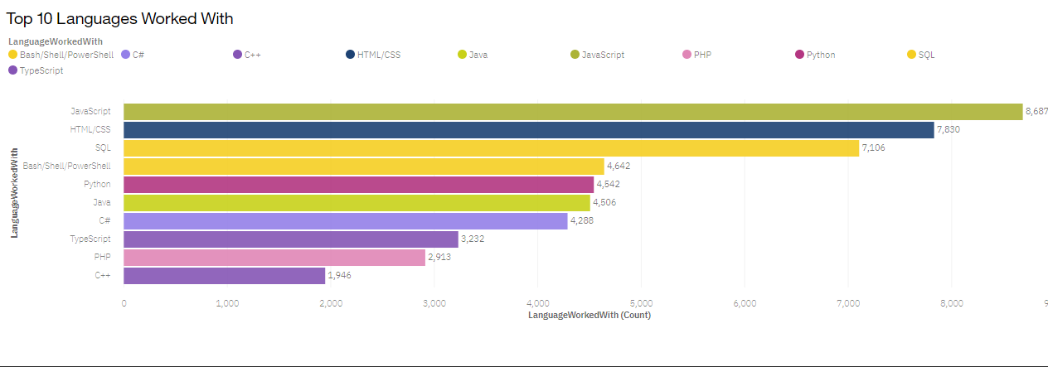
PROGRAMMING LANGUAGE TRENDS
Current Year

Slide 8
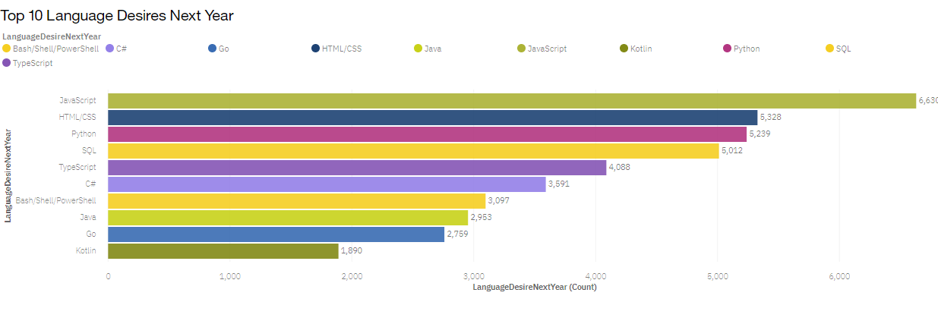
PROGRAMMING LANGUAGE TRENDS

Slide 9
PROGRAMMING LANGUAGE TRENDS - FINDINGS & IMPLICATIONS
Findings
Javascript remains top in both charts
Python has moved from 5th to 3rd position in the second chart
Typescript has suddenly replaced dash and shell in the top 5 list
Implications
The demand for javascript is high
Python is an upcoming language in the trend
Typescript is an upcoming language that needs to be learned

Slide 10
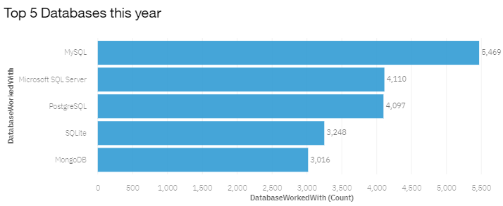
DATABASE TRENDS

Slide 11
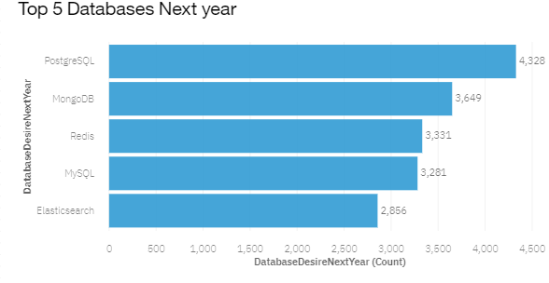
DATABASE TRENDS

Slide 12
DATABASE TRENDS - FINDINGS & IMPLICATIONS
Findings
PostregreSQL moved from 3rd to 1st
MongoDB moved from 5th to 2nd
Redis and Electric search are now present in the top 5
Implications
High demand for this database skills
High demand
Upcoming databases that are highly needed

Slide 13

DASHBOARD
Here is the link for the dashboard that was created
https://eu-de.dataplatform.cloud.ibm.com/dashboards/7fb44a71-c3ed-4f69-89ea-341b4eaed23b/view/7837c4171d9002cf57bcc8e407cd290e2934270cb2bb8101d4d37b490b347497a96c4697c82e4c0e8c120064a2be16519d

Slide 14
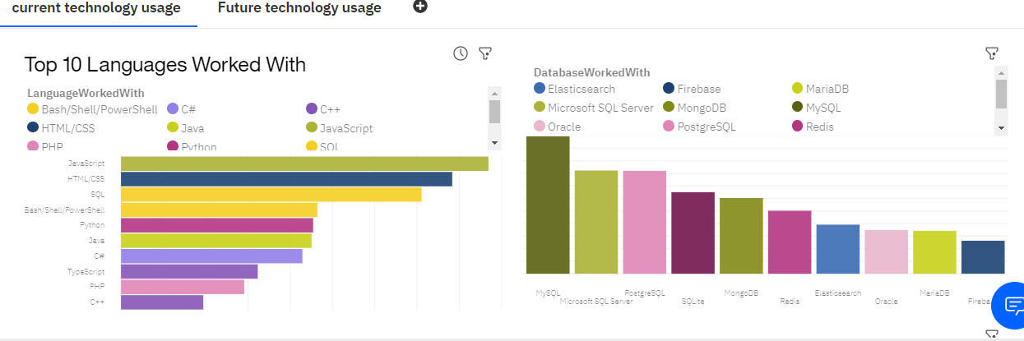
DASHBOARD TAB 1

Slide 15
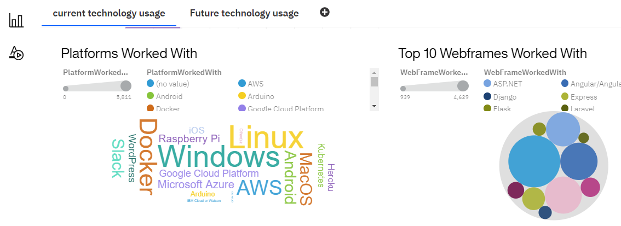
DASHBOARD TAB 1

Slide 16
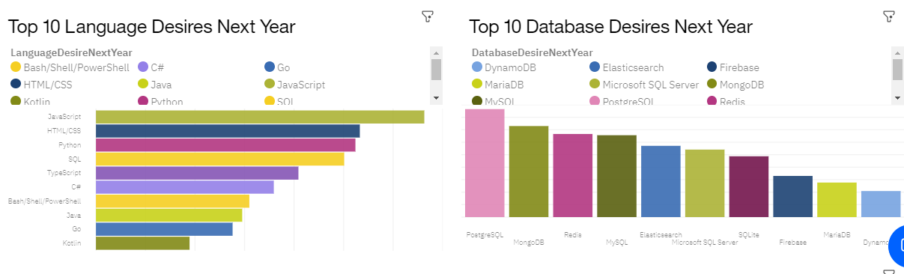
DASHBOARD TAB 2

Slide 17
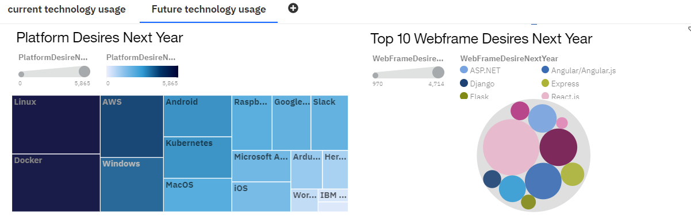
DASHBOARD TAB 2

Slide 18

CONCLUSION
Technology emerges everyday as there are new technologies that replace old ones
Hence we can see that the top technologies to learn are as follows:
Programming Language: javascript
Database: PostreSQL
Webframes: Reactis
These skills will earn you a top stop in the job market

Slide 19
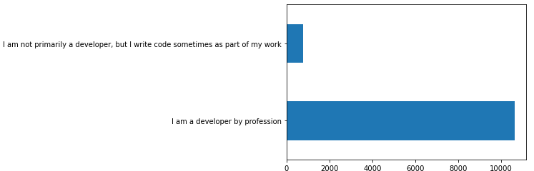
APPENDIX

