Slide 1
Miniprojekt Grupp 5
Ida Ryberg, Kseniya Rahouskay, Wictor Rindebrant, Erik Pirntke

Slide 2
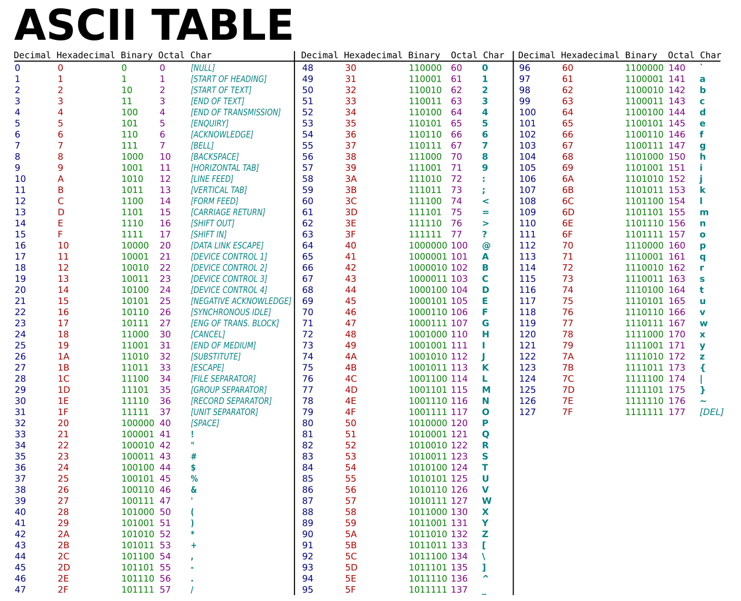
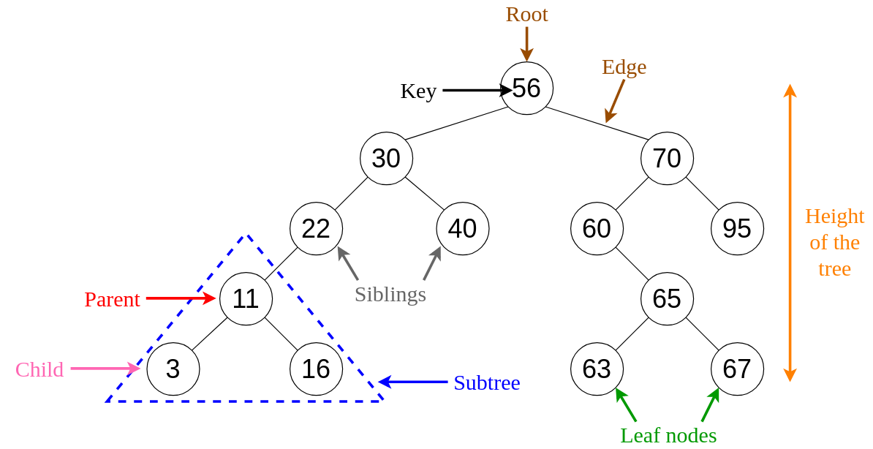
Experiences from part 2

Slide 3
Struggles
BST
Hash
put
to_string
get_hash
Hur HashSet fungerade

Slide 4
Sorterat efter Key:
Sorterat efter Value:
Root Node
Root Node
Key: Ella
Value: 39
Left: Adam
Right: Owen
Key: Ella
Value: 39
Left: Adam
Right: Owen
Key: Adam
Value: 27
Left: None
Right: Ceve
Key: Owen
Value: 40
Left: Fred
Right: Zoe
Key: Adam
Value: 27
Left: None
Right: Ceve
Key: Owen
Value: 40
Left: None
Right: Fred
Key: Ceve
Value: 37
Left: None
Right: None
Key: Fred
Value: 44
Left: None
Right: None
Key: Zoe
Value: 41
Left: None
Right: None
Key: Ceve
Value: 37
Left: None
Right: None
Key: Fred
Value: 44
Left: Zoe
Right: None
Key: Zoe
Value: 41
Left: None
Right: None

Slide 5
Sorted by ascii value % len(bucket):
Sorted by hash() value % len(bucket):
List 1: | Fred
List 2:
List 3: | Adam, Ceve
List 4: | Morgan
List 5: | Amer
List 6: | Simon, Albin
List 7: | Fredrik
List 8: | David
List 9: | Owen
List 10:
List 11: | Jonas
List 12: | Ola
List 13:
List 14: | Ella, Zoe
List 15:
List 16:
List 1:
List 2: | Jonas, Morgan,
List 3: | Owen, Fred, Albin
List 4:
List 5: | Fredrik
List 6:
List 7:
List 8: | Amer
List 9:
List 10: | Ceve, Ola, Simon
List 11:
List 12: | Zoe, Adam,
List 13: | Ella
List 14: | David
List 15:
List 16:
Facit filen:

Slide 6
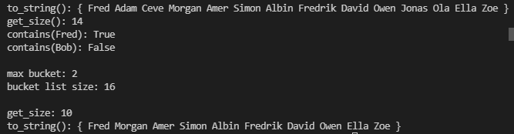
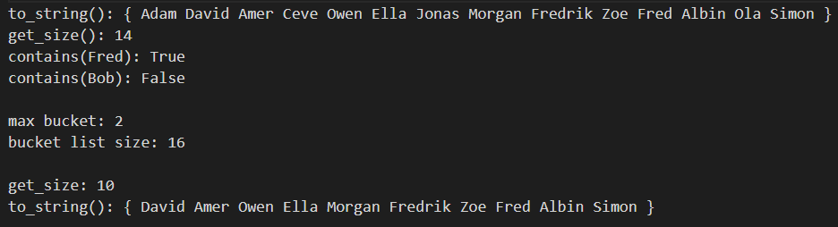
Output HASH
Results Hash
Demo program Hash

Slide 7
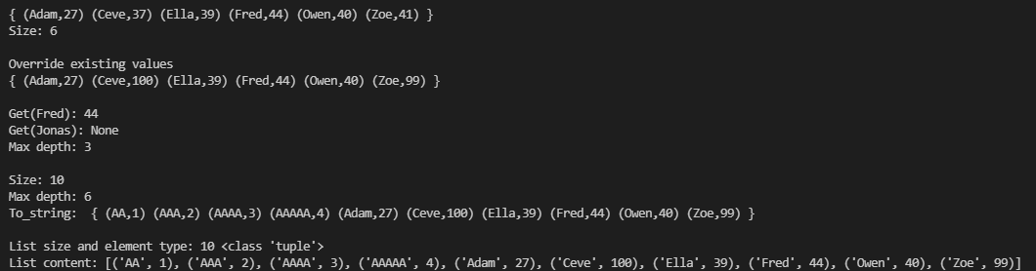
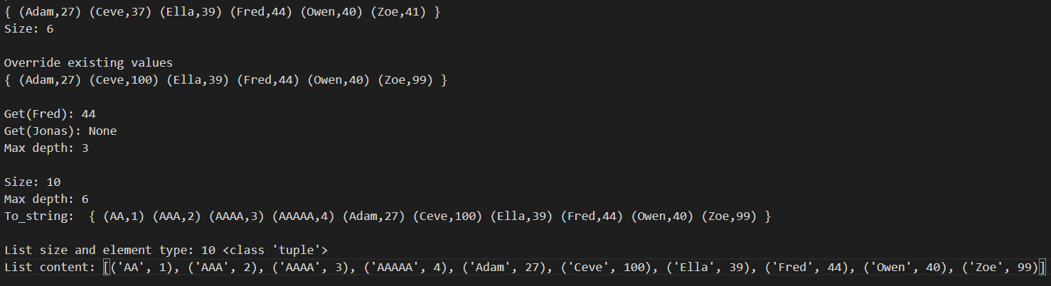
output BST
Results Bst
Demo program bst

Slide 8
Part 3 - Count unique words 2
Dictionary och set --->HashSet och BST map
def unique_words(words): unique = hset.HashSet()
def occurrences_words(words): occurrences = bst.BstMap()
def bucket_size(words1, words2): unique = hset.HashSet()
def max_depth(words1, words2): occurrences = bst.BstMap()
Resultat
Samma resultat men olika metoder!
HashSet
BstMap
Set

Slide 9
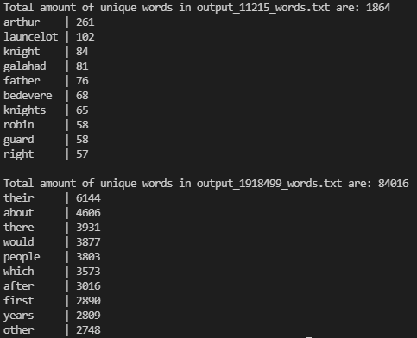
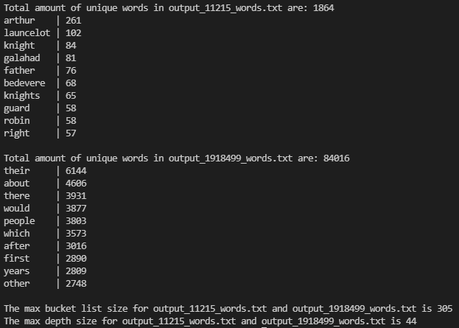
Outputs
Part 1 output:
Part 3 output:

Slide 10
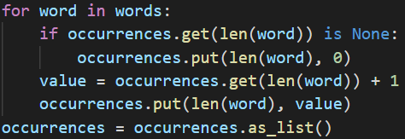
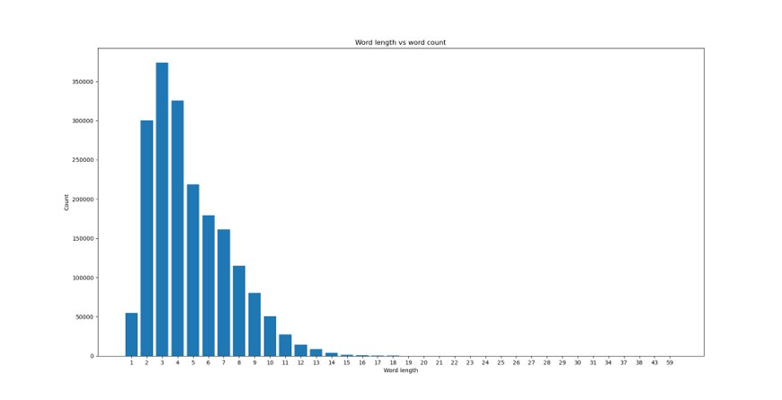
Part 4 - Plotting

Slide 11
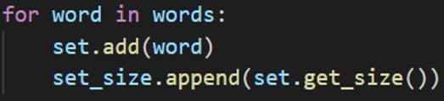
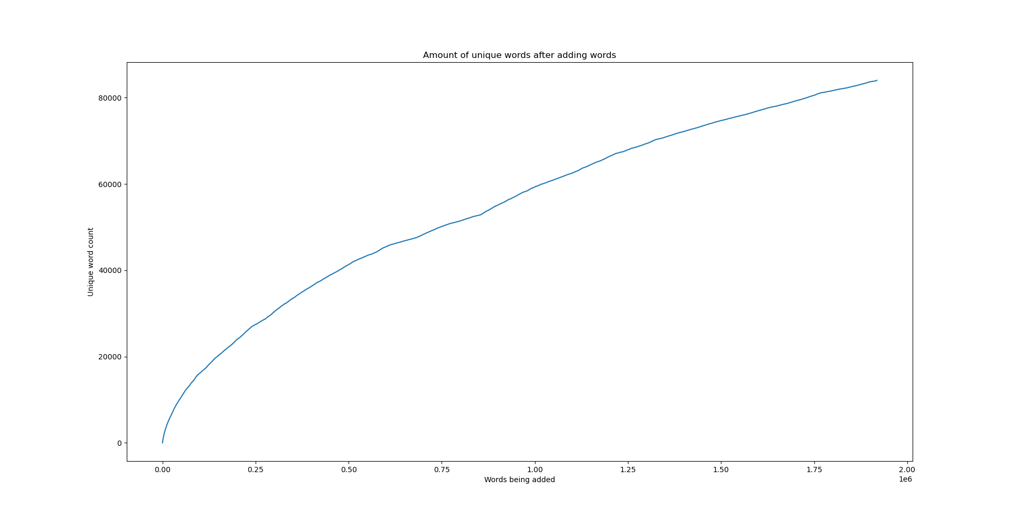

Slide 12
Hash set och BST
Resultat/Facit
Gitlab
Technical issues:

Slide 13
Arbetsätt
Discord
Träffar
Uppdelning

Slide 14
Till nästa gång
Alla uppgifter
Mer samarbete
Mer tid
Bättre resultat
Resultat/Facit
Förförståelse

