Slide 1
KPZ EnO Layout Top left corner
CGM
KPZ_EnO_wafer_top_left_corner_V3.v30

Slide 2
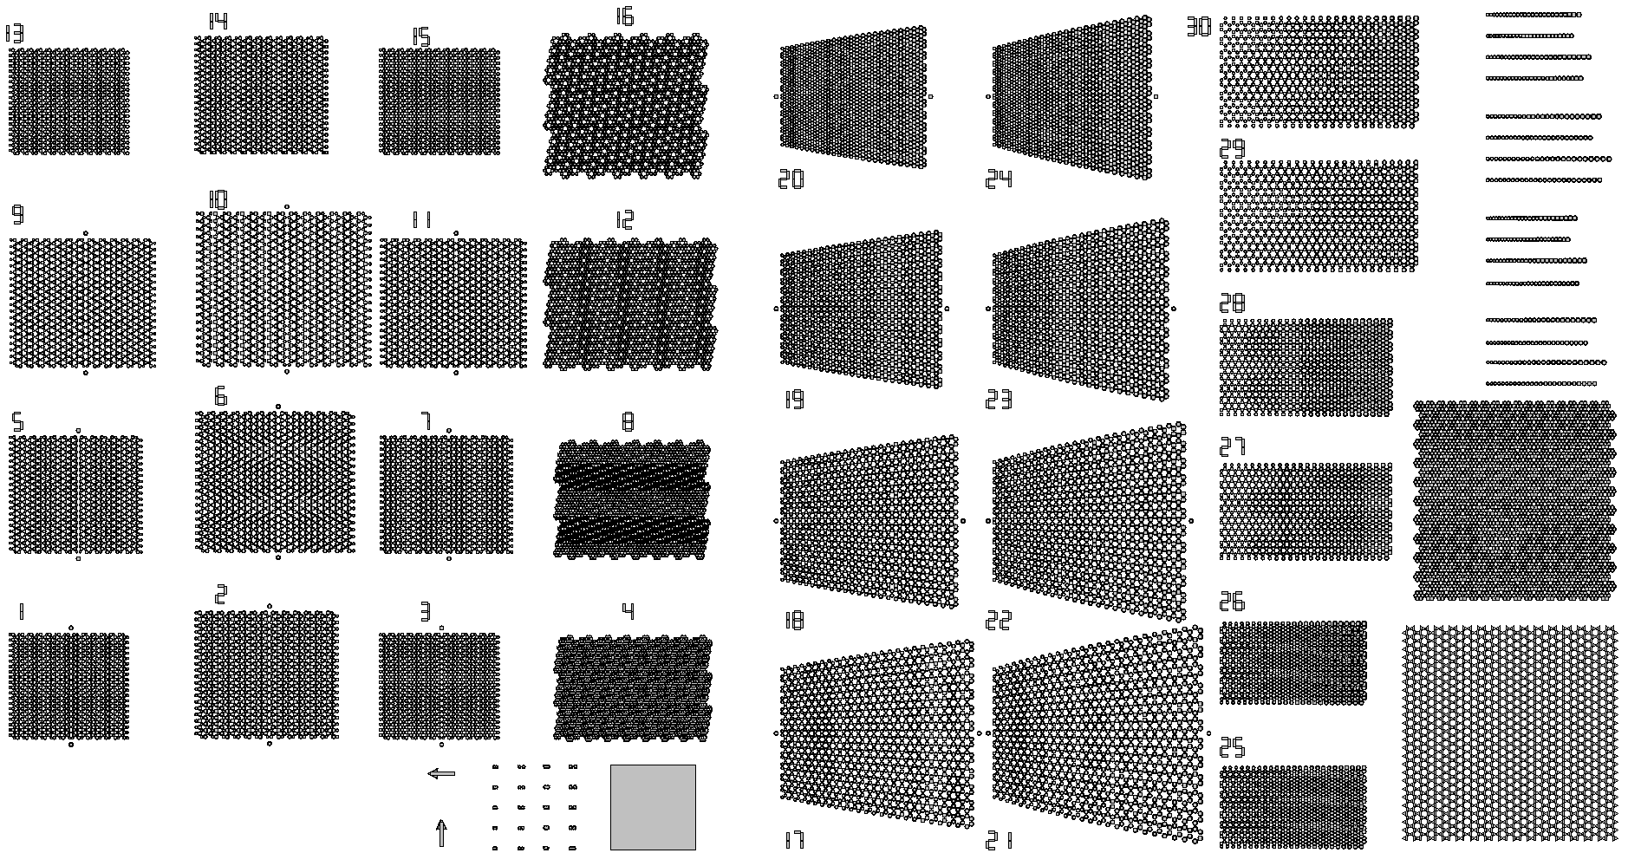
Overview
Semenoff
Maple Leaf
Adiabatic honeycomb constant
overlap
lattice parameter
Adiabatic chain constant overlap
TCI 30 Pillars
Triangle Honeycomb

Slide 3
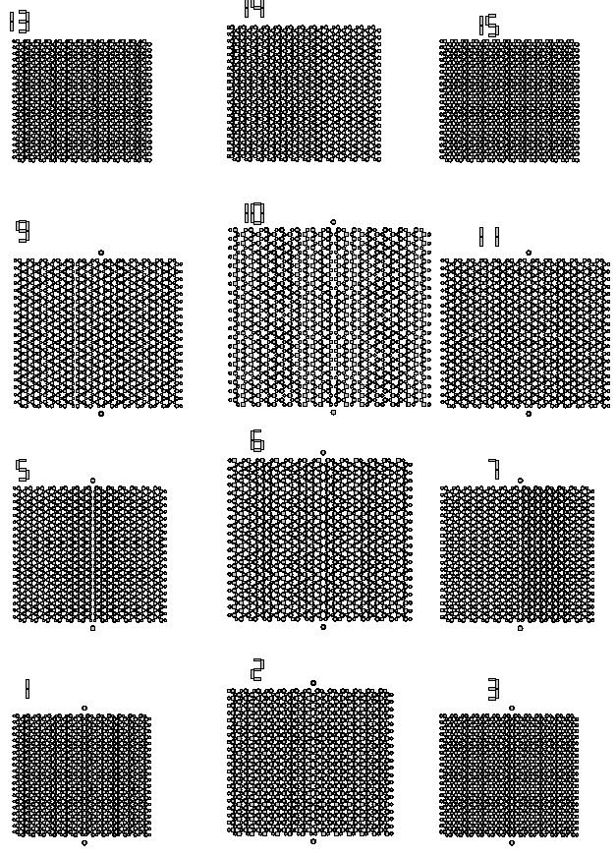
Semenoff
Variations: Pillar size d (Larger): 2.0µm and 2.4 µm Pillar overlap v: 0.9, 1.0, 1.1 Onsite difference: 0.7 and 0.8
13 v0.9_d2000_diff0.7 | 14 v1.0_d2000_diff0.7 | 15 v0.9_d2000_diff0.8
9 v1.1_d2000_diff0.7 | 10 v1.1_d2400_diff0.7 | 11 v1.1_d2000_diff0.8
5 v1.0_d2000_diff0.7 | 6 v1.0_d2400_diff0.7 | 7 v1.0_d2000_diff0.8
1 v0.9_d2000_diff0.7 | 2 v0.9_d2400_diff0.7 | 3 v0.9_d2000_diff0.8
Full Semenoff lattice
Short-short interface with marker

Slide 4
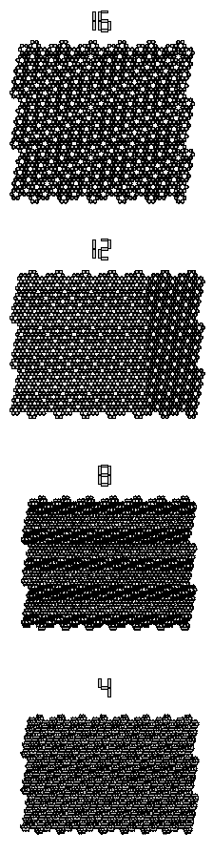
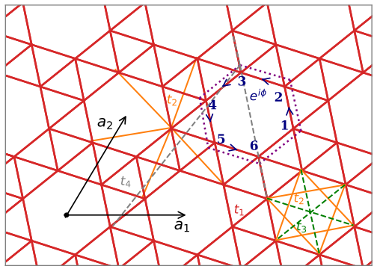
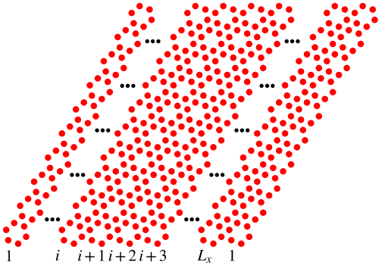
Maple Leaf
2.0µm Pillar size with varying overlaps
16
V=1.1
12
V=1.0
8
V=0.9
4
V=0.8
https://doi.org/10.1103/PhysRevB.109.075118

Slide 5
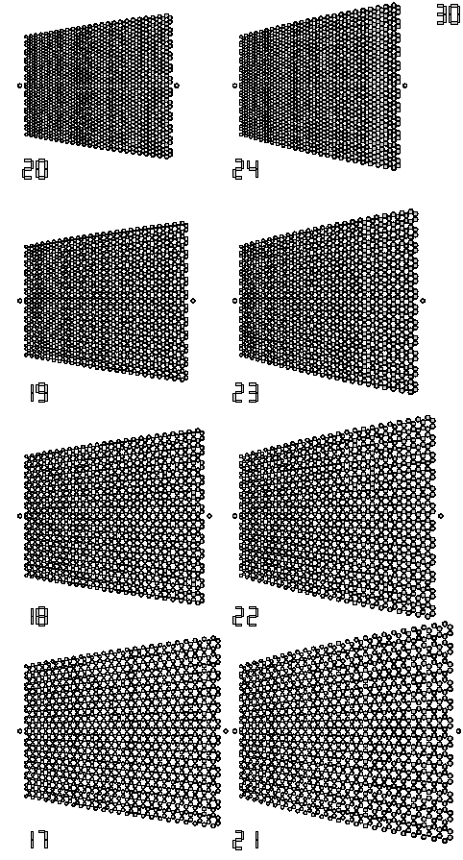
Adiabatic honeycomb – constant overlap
Adiabatic changing onsite energy (pillar diameter) marker at center Starting diameter 1.8 µm Ending diameter variations: 2.6 and 3.0 µm Overlap variations: 0.9, 1.0, 1.1, 1.2
20 v0.9_ds1800_dl2600 | 24 v0.9_ds1800_dl3000
19 v1.0_ds1800_dl2600 | 23 v1.0_ds1800_dl3000
18 v1.1_ds1800_dl2600 | 22 v1.1_ds1800_dl3000
17 v1.2_ds1800_dl2600 | 21 v1.2_ds1800_dl3000

Slide 6
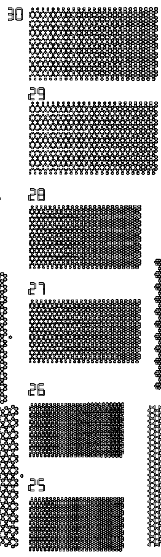
Adiabatic honeycomb – constant lattice parameter
Adiabatic changing onsite energy (pillar diameter) marker at center Starting diameter 1.8 µm Ending diameter variations: 2.6 and 3.0 µm Variable Overlap of the starting diameter: 1.1, 1.3, and 1.5
29 v1.5_ds1800_dl2600 | 30 v1.5_ds1800_dl3000
27 v1.3_ds1800_dl2600 | 28 v1.3_ds1800_dl3000
25 v1.1_ds1800_dl2600 | 26 v1.1_ds1800_dl3000

Slide 7
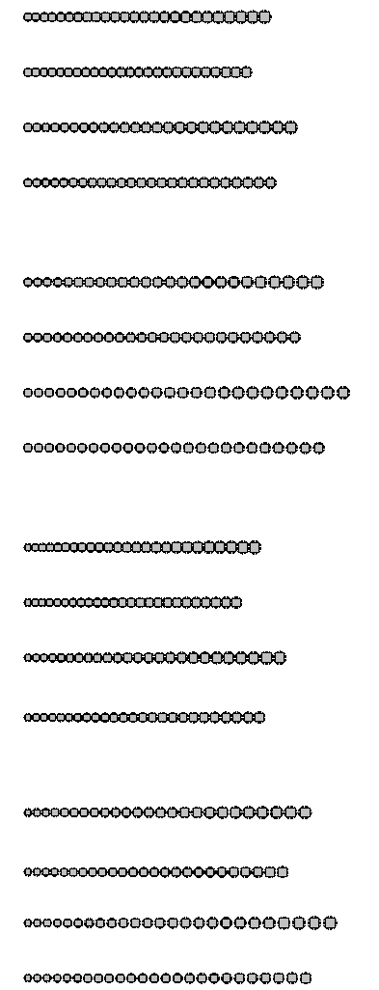
Adiabatic chain – constant overlap
Adiabatic chain changing onsite energy (pillar diameter) Starting diameter 1.8 µm Ending diameter variations: 2.6 and 3.0 µm Variable Overlap of the starting diameter: 0.9, 1.0, 1.1, 1.2
v1.0_ds2000_dl3000 v1.0_ds2000_dl2600 v0.9_ds2000_dl3000 v0.9_ds2000_dl2600
v1.1_ds2000_dl3000 v1.1_ds2000_dl2600 v1.2_ds2000_dl3000 v1.2_ds2000_dl2600
v1.0_ds1800_dl3000 v1.0_ds1800_dl2600 v0.9_ds1800_dl3000 v0.9_ds1800_dl2600
v1.1_ds1800_dl3000 v1.1_ds1800_dl2600 v1.2_ds1800_dl3000 v1.2_ds1800_dl2600

Slide 8
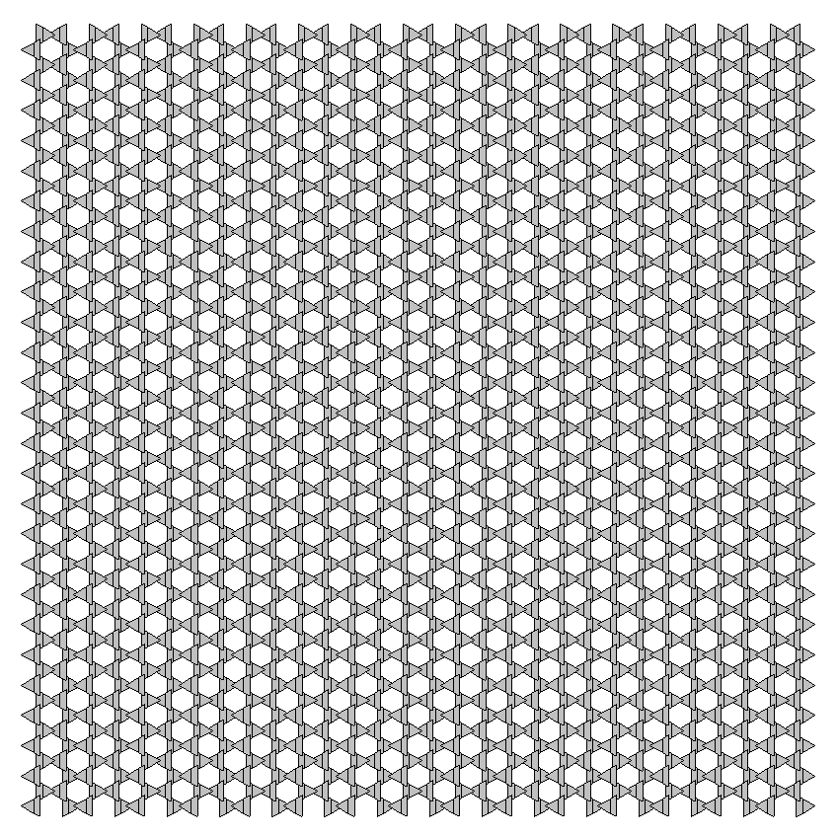
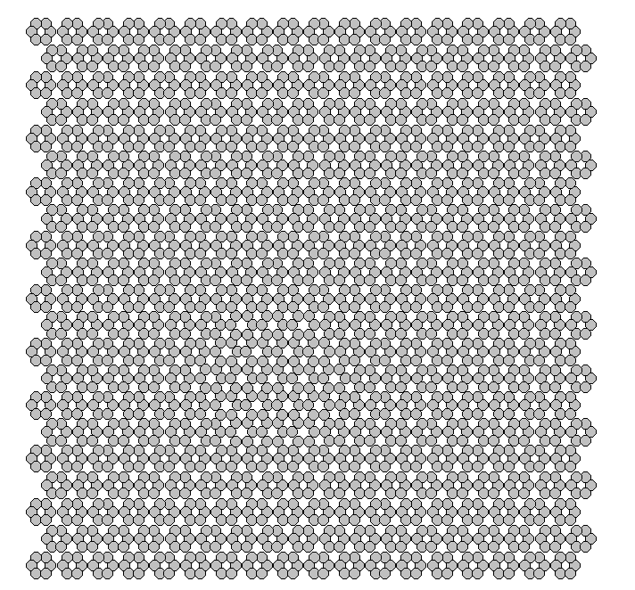
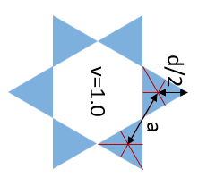
Other lattices
TCI Honeycomb
“Paper layout”:
2.5µm - v^{c}_{i} = 0.80, v^{c}_{e} = 0.98 ; v^{s}_{i}=0.91 v^{s}_{e}=0.74
30 Pillar interface
Triangle Honeycomb
2 µm triangle length
0.7 overlap

