Slide 1
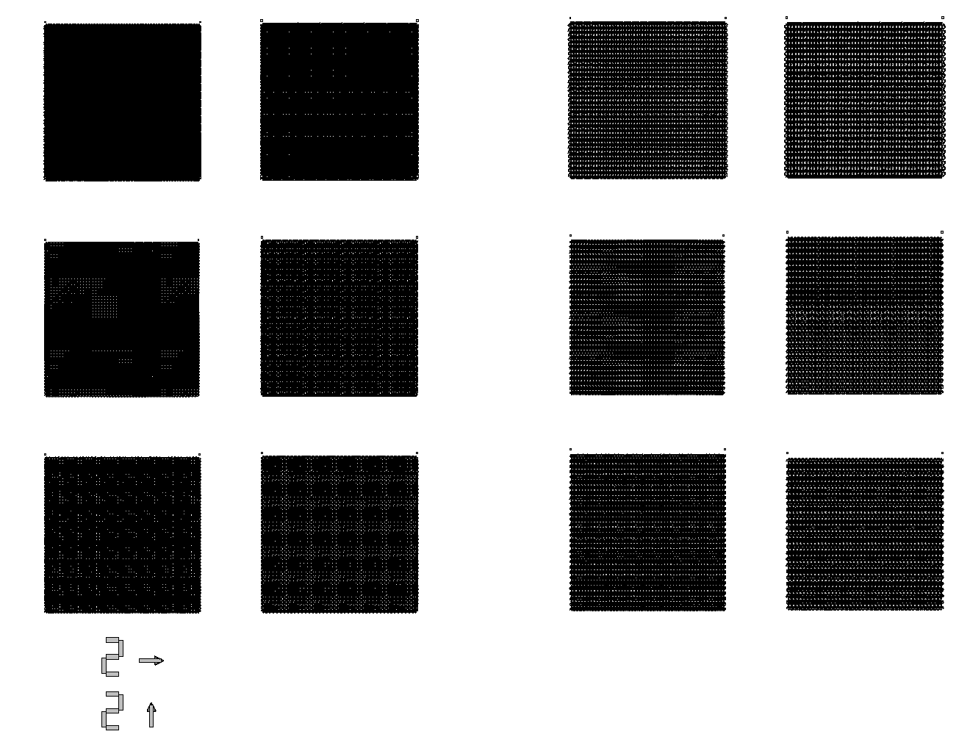







KPZ etch and overgrowth layout
Square lattices
Triangular lattices
$$v=0.97$$
$$v=1.05$$
$$v=1.10$$
$$d=1.8μm$$
$$d=2.1μm$$
$$d=1.8μm$$
$$d=2.1μm$$

Slide 2
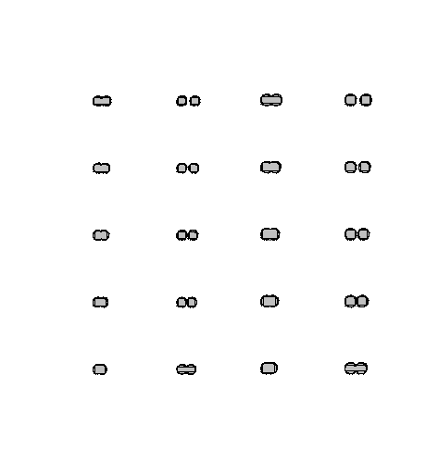

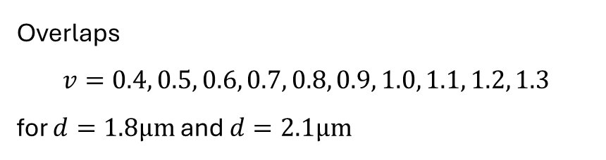

Overlap series
Overlaps
$$v=0.4, 0.5, 0.6, 0.7, 0.8, 0.9, 1.0, 1.1, 1.2, 1.3$$
for $d=1.8μm$and $d=2.1μm$
$$d=1.8μm$$
$$d=2.1μm$$

