Slide 1
Group 3.
Notes:
Hello, everyone! I’m Annie Huang from group 3. Today I will introduce you through our web scraper project about stock market.

Slide 2
Content
1. APIs
- Tushare (Stock market)
2. Web Scraping
- NeurIPS (NIP Essay)
- Ebay (Product information)
- ZOL (Desktop wallpapers)
Notes:
My presentation is divided into 2 parts:
First, I want to share with you a data visualization and analysis project which uses API on Tushare to get the stock market data.
Second, it’s about our other tries on web scraper, naming scarping the natural information papers from

Slide 3

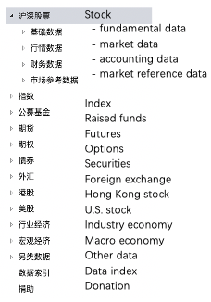
API Tushare (Stock market data)
Tushare is an open-source financial data platform. This platform provides various kinds of APIs, enabling the user to directly download remote data after the deployment.
Notes:
The API we use to get the stock market data is called Tushare.
It’s an open-source financial data platform, which provides various kinds of APIs, enabling the user to directly download remote data after the deployment.
As you can see, it provide us which the market data, which you can see the daily market price and index and so on. It covers data about all kinds of stocks, from Chinese to US stock. And we can get information about the companies and industry.
A really powerful platform, aha!

Slide 4
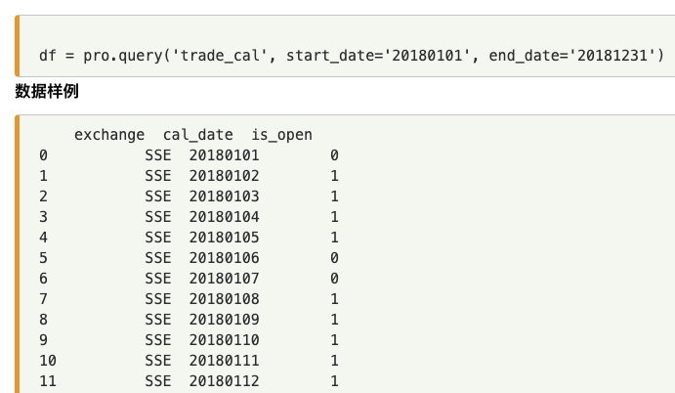
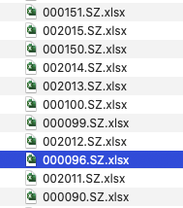

API Tushare (Stock market data)
In this session’s assignment, major extracted data includes：
Daily prices of all stocks on Chinese stock market from 1990 to 2020 (673 MB in total)
Daily changes of the SSE Index from 1990 to 2020 (reflection of the whole market)
Other information: Industry classification
* given the lack of several stock prices data, the analysis was carried out based on stock price changes since 2008
Notes:
In this session’s assignment, major extracted data includes：
Daily prices of all stocks on China stock market from 1990 to 2020 (673 MB in total)
Daily changes of SSE Index from 1990 to 2020 (reflection of the whole market)
Other information: Industry classification, news from Sina Finance (80,000+ pieces)
* given the lack of several stock prices data, the analysis was carried out based on stock price changes since 2008

Slide 5
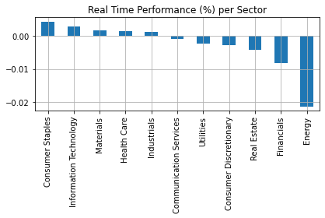
API Tushare (Stock market data)
Different sector’s return (loss) rate.
Stock about consumer staple performs the best.
Notes:
We can compare each sector’s return (loss) rate. As can be seen, consumer staple perform well.

Slide 6
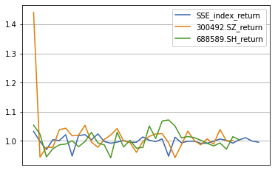
API Tushare (Stock market data)
Return rate of stocks comparing to SSE
*SSE = reflection index of the whole market
It’s important to buy different kinds of stocks to balance the risk.
Notes:
We can compare the return rate of any specific stocks with the SSE index return rates(which is the blue line indicating the performance of the whole market)
Now, let me briefly explain this graph using two stocks.
This graph indicates the volatility of stocks. As we can see from the organ line that the stock market price of the stock starts with 3 suddenly fall down at this point. There must be something that happened. But I don’t want to talk so far.
And another thing we can get from this graph is that some times one of this two stocks earns more than the whole market, sometimes not. Like this green line earns so much at this point. Both of them fluctuates.
So you can't expect a single stock to consistently outperform the market. That’s why we need to buy different kinds of stocks to balance the risk.

Slide 7
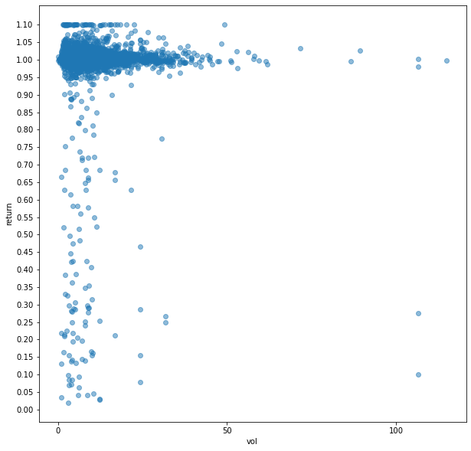
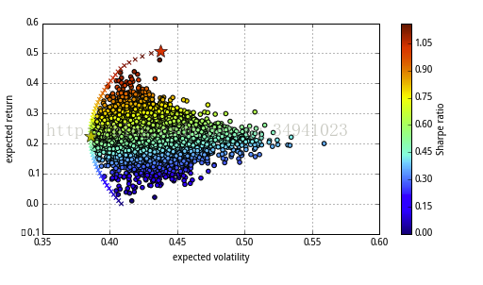
API Tushare (Stock market data)
Return rate and volatility
nearly all the return rates are between 0.95 to 1.05.
not much stocks can make big money
By hand
Ideal
Markowitz Efficient Frontier
Notes:
We calculated the return rate of individual stocks according volatility, presenting as a scatter chart. As we can see, not much stocks can make big money. I mean, if you are an amateur investor who hold a stock all the time, missing good sell points and buy points, you can only get a return rate similar to the one you save the money in bank.
Because nearly all the return rates are between 0.95 to 1.05.
And we draw Markowitz Efficient Frontier, which is a red line on this graph. Stocks on the red line have a better combination of volatility and return rate.
But the ones under the line are at a higher risk, but the return rate is not rising.

Slide 8
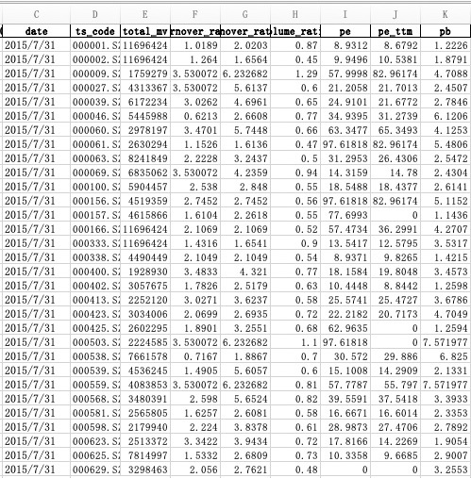
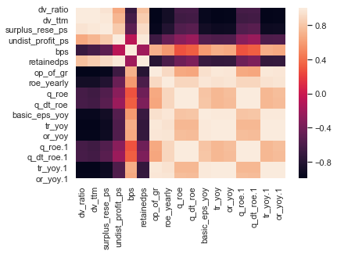
API Tushare (Stock market data)
Financial indicators & their correlations
The financial indicators data provided by the API
the correlation of financial indicators
Notes:
We can get the financial data from Tushare and calculate financial indicators. As you can see, the table on the left lists some popular indicators in finance, such as PE ratio, short for Price-earning ratio, which can indicate if the stock market price is reasonable. Like 000009.sz is too popular on 2015/7/31, so if someone wants to buy it at that day, he needs to be careful.
And we draw a heat map to see the correlation of these indicators, as presented on the right.
The dark points means a negative correlation, while the light-colored ones are positive correlation.
Like the darkest point on the top right corner indicates the dv_radio and or_yoy.1 indicators are negatively correlated. I’ll not explain these indicators, or there will be too much professional knowledge in finance. Anyway, we can do this, it’s very useful for us to choose the indicators.

Slide 9
Content
1. APIs
- Tushare (Stock market)
2. Web Scraping
- NeurIPS (NIP paper)
- Ebay (Product information)
- Zol(Desktop wallpapers)
Notes:
Finally, we get our next part. Our tries on web crawling.
At first, three of our group members did a web spiders, which are for papers, product information and images.

Slide 10
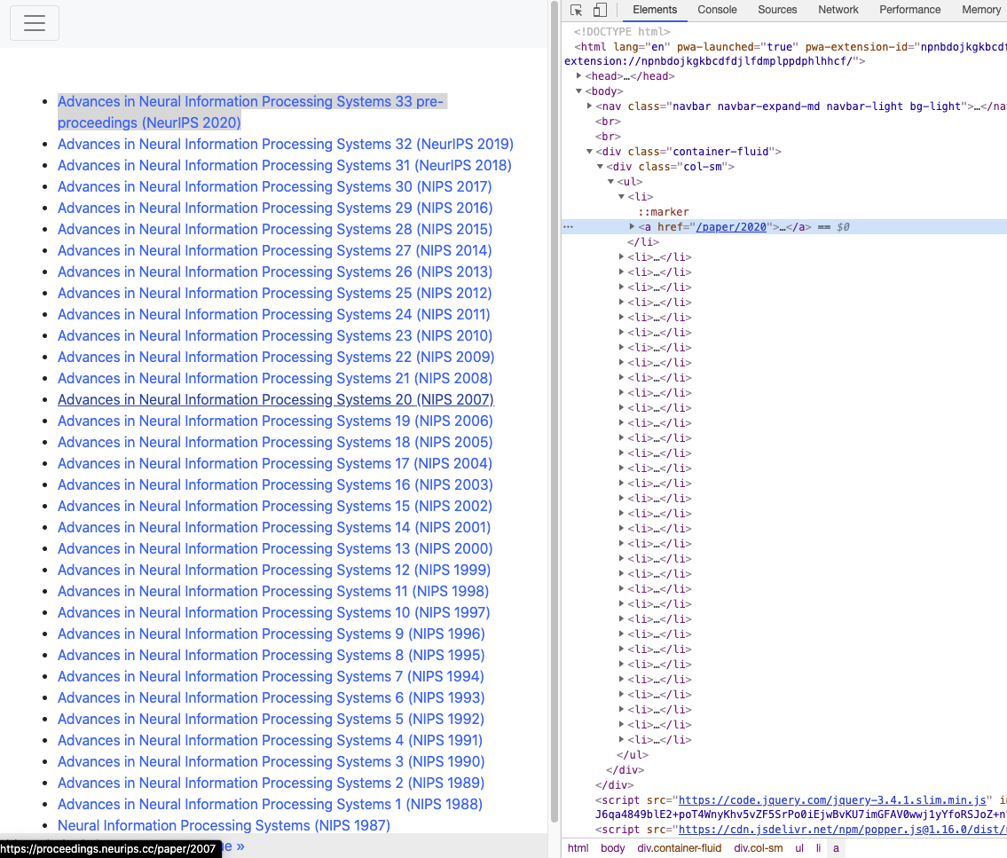
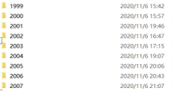
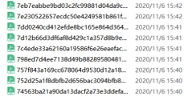
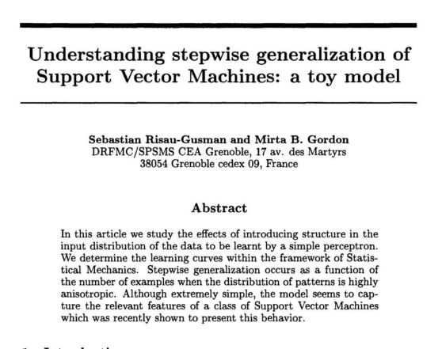
Web Scraping NeurlPS(NIP Essay)
Package : requests
Aim: download papers about NIP
Problem :
1.coding error: pdf to txt
2.hard to visualize
Solution: Statistics word frequency??
Notes:
I use a python package named requests to download papers from a well know conference about neurl information processing.
But I encountered a problem, that when I transfer the paper into text information, the coding

Slide 11
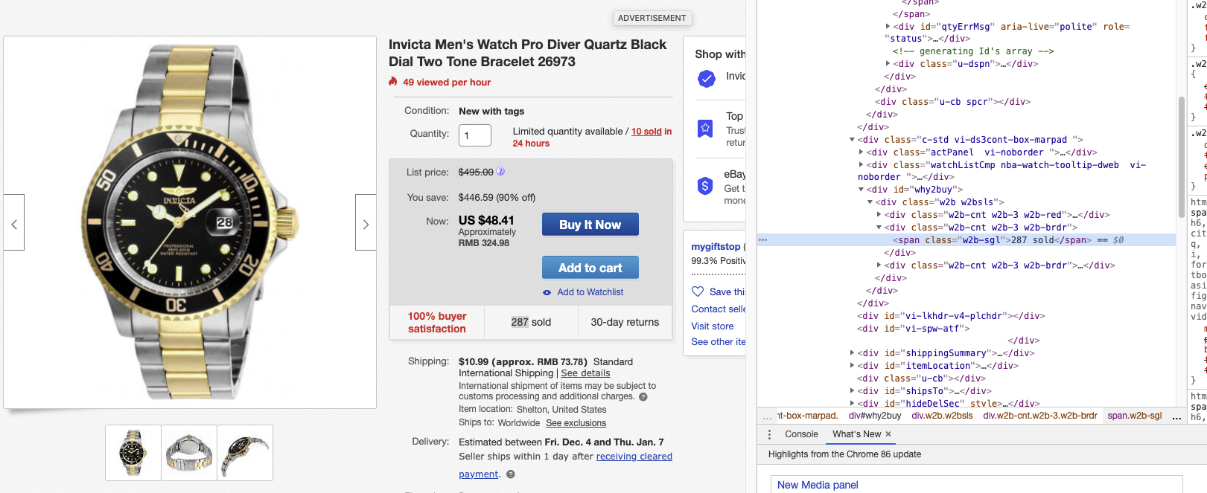
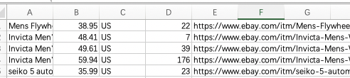
Web Scraping eBay case
Package: BeautifulSoup
Aim: scrape data on men’s watches from eBay, including information such as name, price, sales, delivery fee, materials, product status, etc.
Problem:scrape large-volume textual data accurately (HTML structure will change)and consistently (anti-spider).
Notes:
Daniel uses BeautifulSoup to scrape data on men’s watches from eBay, data included information such as name, price, sales, delivery fee, materials, product status, etc.
However, it is challenging to scrape large-volume textual data accurately (HTML structure will change)and consistently (because the website has an anti-spider strategy).

Slide 12
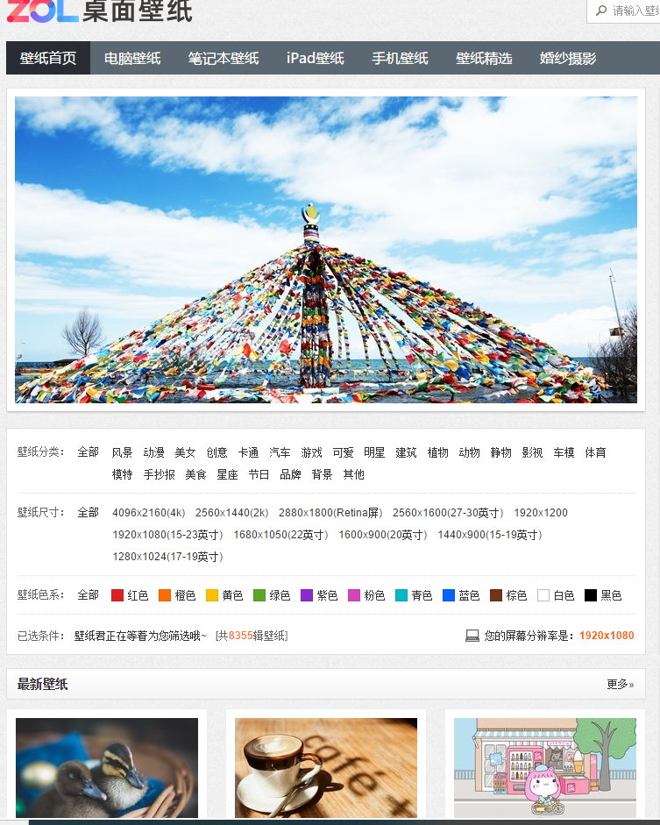
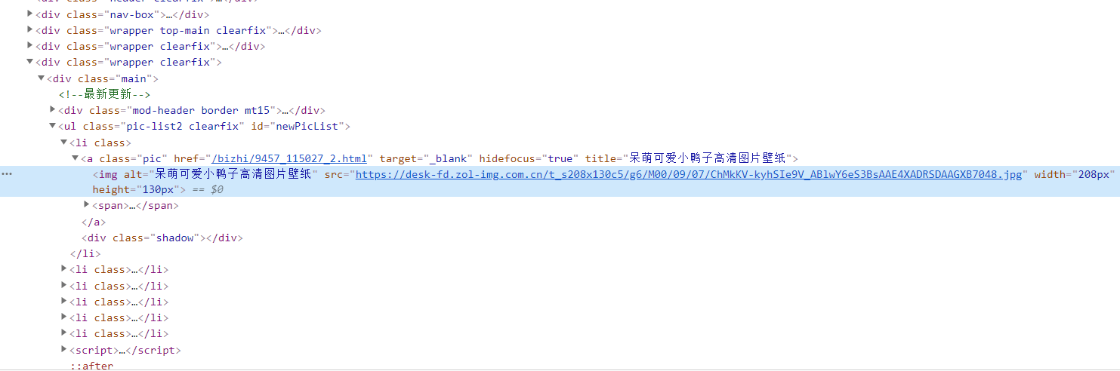
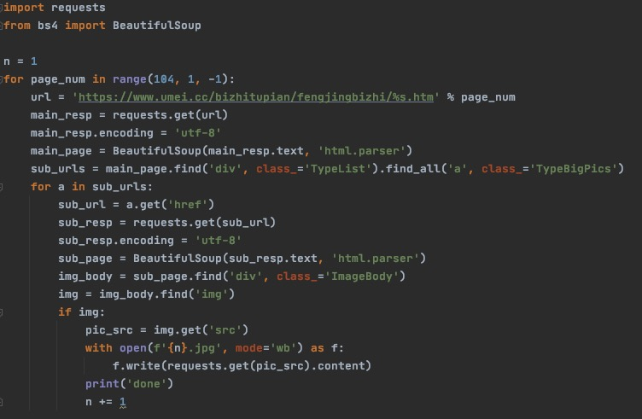
Web Scraping
Aim : download wallpapers from website.
Why choose this? : similar url, easy to use loop to get all urls.
Problem : not all sub pages have a picture
Solution : using ‘if’ to decide whether to proceed.
Notes:
Shawn downloaded wallpapers from website, ZOL, which .
This wallpaper website contains over 100 pages and each has a similar url, which makes it easy to use loop to get all urls.
However, as for sub pages, there is a problem that not all sub pages have a picture which means ‘find’ code may generate a none value which stop the running. The solution I choose is using ‘if’ to decide whether to proceed.

Slide 13
Thank you.
Notes:
That’s all thank you!

