Slide 1
THE (NTLM)RELAY RACE AGAINST THREAT ACTORS

Slide 2
~$ whoami
Mike Venturelli
Incident Response & Threat Hunting Engineer
CISSP, OSCP

Slide 3

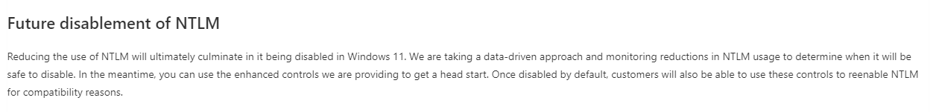

Slide 4
~$ LanManager (LM)
Named after LANManager OS/2 Operating System
1987 - Oldest password storage used by Windows
Included in Windows NT for backwards compatibility with LANManager
1994 – Final release of MS LAN Manager
Weaknesses
Only 14 characters allowed
If the password was 14 characters or less, NULL padding added
Converted password to uppercase prior to hashing, limiting character set/key space
Split into two 7-character strings to be DES’d (56bit)
7 characters 2x much easier than 14 to bruteforce
Encrypted “KGS!@#$%” with each derived key, resulting in 2 8-bit ciphertexts that are then combined to form the 16-bit hash value
If the password is 7 characters or less, the 2nd half is always computed as a static value
No salting
MITM, relaying (ntlmrelayx), rainbow tables
AAD3B435B51404EEAAD3B435B51404EE
Notes:
Weaknesses (hint: most of the implementation)

Slide 5
~$ NTHash (NT)
1993, NTHashes (NTLM)
Commonly confused with Net-NTLMv1
MD4(UTF-16-LE(password))
Stored in SAM, and NTDS.dit (on DCs)

Slide 6
~$ NTLMv1 (Net-NTLMv1)
Challenge:Response
NT:LM both used
Server: sends random challenge
Client: performs operation on challenge with secret shared between server & client (in this case, the password hash[es]) to compute the response, sends response back to server
Server: verifies the operation performed by the client produces a response that matches the response expected
Algorithm
Challenge = 8-byte server challenge, random
K1 | K2 | K3 = NTLM-Hash | 5-bytes-0
Response = DES(K1,C) | DES(K2,C) | DES(K3,C)
Issue(s)
3DES (DESx3)
Notes:
Both the hashes produce 16-byte quantities. Five bytes of zeros are appended to obtain 21 bytes. The 21 bytes are separated in three 7-byte (56-bit) quantities. Each of these 56-bit quantities is used as a key to DES encrypt the 64-bit challenge. The three encryptions of the challenge are reunited to form the 24-byte response. Both the response using the LM hash and the NT hash are returned as the response, but this is configurable.

Slide 7
~$ NTLMv2 (Net-NTLMv2)
1993
Added ability for a server to authenticate to a client
Includes current time(NT), HMAC-MD5 hash of user’s NT hash, username, domain name
Algorithm:
SC = 8-byte server challenge, random
CC = 8-byte client challenge, random
CC* = (X, time, CC2, domain name)
v2-Hash = HMAC-MD5(NT-Hash, user name, domain name)
LMv2 = HMAC-MD5(v2-Hash, SC, CC)
NTv2 = HMAC-MD5(v2-Hash, SC, CC*)
response = LMv2 | CC | NTv2 | CC*
Notes:
Something’s missing from most of these, modern cryptography. No mention of AES, SHA-256(or SHA-Anything), etc.

Slide 8
~$ Kerberos
“Kerberos Carnival”
TGT – Ticket Granting Ticket
User’s initial entry into the “carnival” (domain/Kerberos realm)
TGS – Ticket Granting Service
User’s tickets to the different “rides” (services) at the “carnival”
Fully Qualified Domain Names (FQDN)
Service tickets (with timestamps) encrypted with password hash of the affiliated service account
Kerberoasting, AS-REP roasting, Golden/Silver/Bronze tickets, etc.

Slide 9
~$ Why does this matter?
Service Principal Names (SPNs)
Reliance on SPNs and FQDN (fully qualified domain names)
Accessing a resource via IP
SPN set, any authenticated user can request a service ticket
This service ticket can then be cracked offline with tools like Hashcat, JohnTheRipper, etc.
NTLM enabled == NTLM available as a fallback authentication mechanism
Been around long enough? Your DCs might accept LM hashes!
Push for disabling of NTLM within organizations
Tech debt, reliance on older OSes/applications/etc. that cannot support Kerberos
Took companies years to reverse engineer NTLM to adopt into their applications/protocols
Result of outages – assessment of environments, and trying to gain an understanding of why “everything broke”

Slide 10
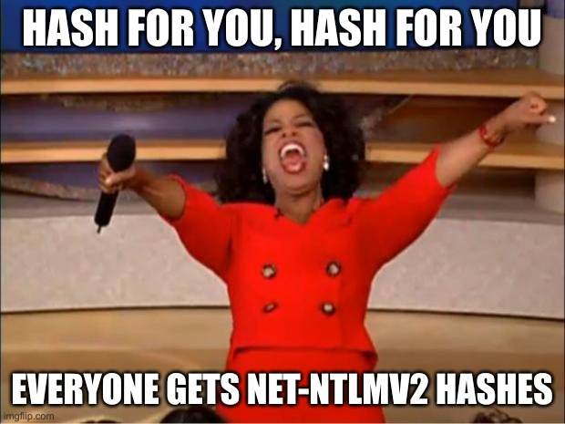
Because it’s abusable!

Slide 11
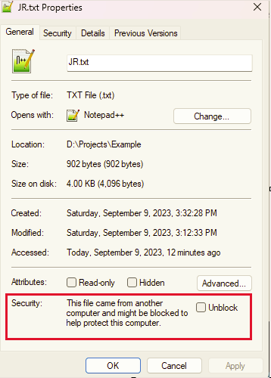
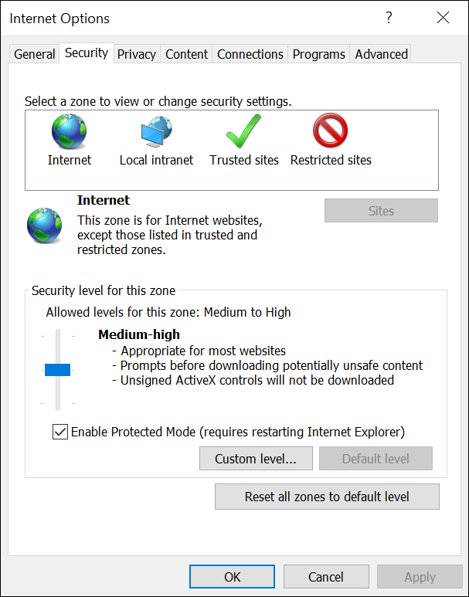
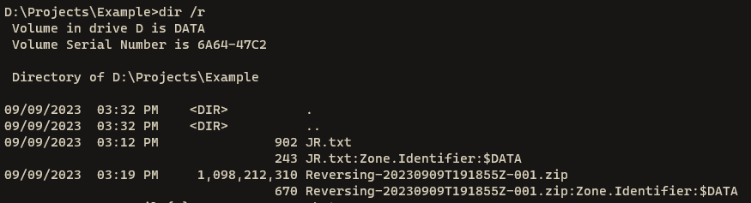
~$ Internet (URL) Security Zones

Slide 12
~$ Internet (URL) Security Zones
0 = Local Computer
1 = Local Intranet Zone (Local Network/Domain)
2 = Trusted Sites
3 = Internet Zone
4 = Restricted Sites
ZoneID=3 - Mark of The Web (MoTW)

Slide 13
~$ Internet (URL) Security Zones
Q: What do Security Zones have to do with NTLM hashes?
A: Windows!

Slide 14

~$ Tooling
CrackMapExec (--gen-relay-list, Modules)
Responder/RunFinger.py
Inveigh
ntlmrelayx.py(Impacket)/MultiRelay.py
Turn off SMB/HTTP on Responder if relaying

Slide 15
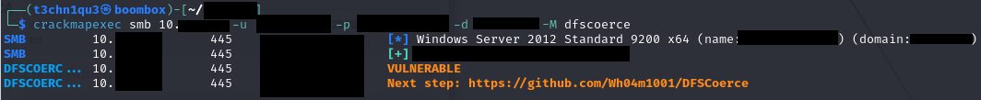
~$ Exploits
MS08-068 (Reflection)
PetitPotam (VDB-179650) (MS-EFSRPC)
DFSCoerce (MS-DFSNM)
Active Directory Certificate Services (ADCS)
ProxyLogon (CVE-2021-26855, CVE-2021-27065)
ProxyShell (CVE-2021-34473, CVE-2021-34523, CVE-2021-31207) by Orange Tsai
Outlook Appointment Reminder (CVE-2023-23397)

Slide 16
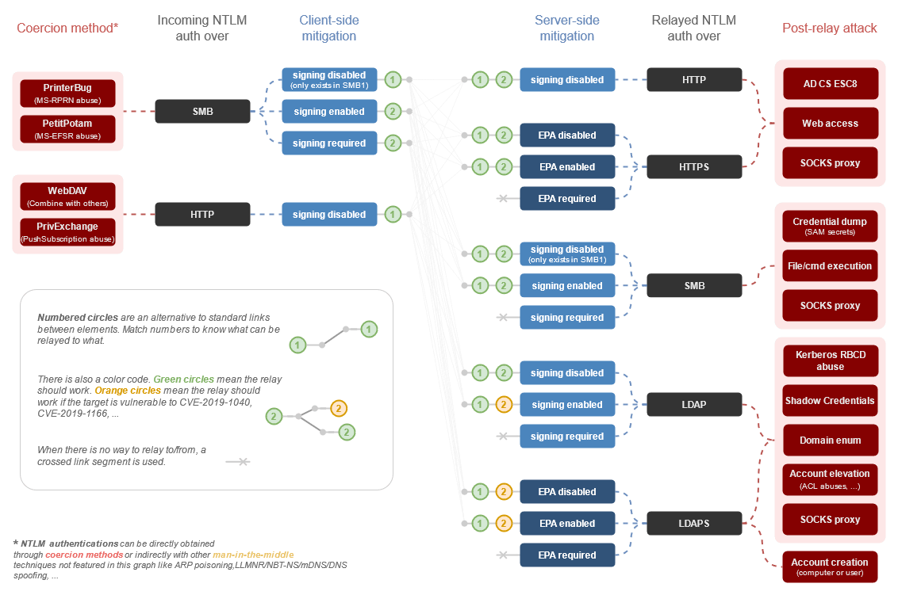
~$ “History” of Coercion & Relaying
Credit: Michael Schneider https://www.scip.ch/en/?labs.20210909

Slide 17
~$ “Quick & Dirty” Patch Rollouts
ProxyShell (CVE-2021-34473, CVE-2021-34523, CVE-2021-31207) by Orange Tsai
PetitPotam (CVE-2021-36942, CVE-2022-26925 [LSARPC])
Follina (CVE-2022-30190)
Outlook EoP/MSHTML Bypass [Appointment Reminder] (CVE-2023-23397, CVE-2023-29324)
Notes:
Follina:
Regex filter – quickly bypassed, encoding was a simple bypass, ProxyShell: CVE-2021-34473
Pre-auth path confusion vulnerability to bypass access control
Patched in KB5001779, released in April
CVE-2021-34523
Privilege elevation vulnerability in the Exchange PowerShell backend
Patched in KB5001779, released in April
CVE-2021-31207
Post-auth remote code execution via arbitrary file write
Patched in KB5003435, released in May

Slide 18
~$ Word Doc Demos

Slide 19
~$ Demos Continued
Mark of the Web
Email?
Outlook Appointment Reminder (CVE-2023-23397)
Post-exploitation
File shares
Enticing locations
Human Element
Mailbox/User compromise, MailSniper

Slide 20
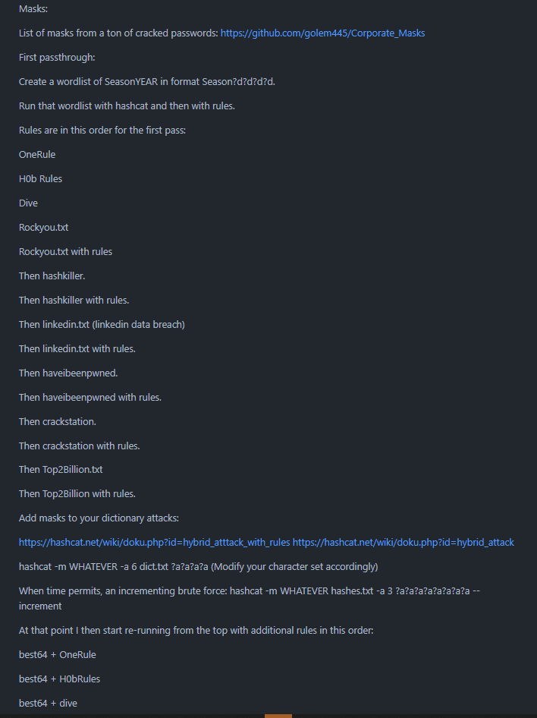
~$ Password Cracking
JohnTheRipper
Hashcat
Building a methodology
https://github.com/J3rryBl4nks/PasswordCrackingMethodology
Curate lists & add to your repositories

Slide 21
Great, now what?!

Slide 22
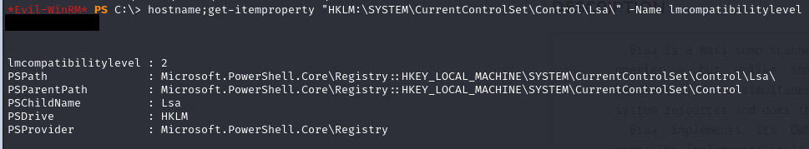
~$ Assessment of your Environment (PowerShell)
LanMan Compatibility Level
On your DCs:
Get-ItemProperty “HKLM:\SYSTEM\CurrentControlSet\Control\Lsa\” –Name lmcompatibilitylevel

Slide 23
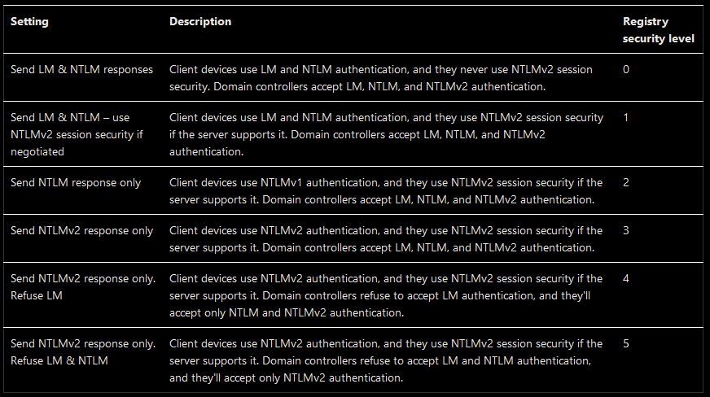

Slide 24
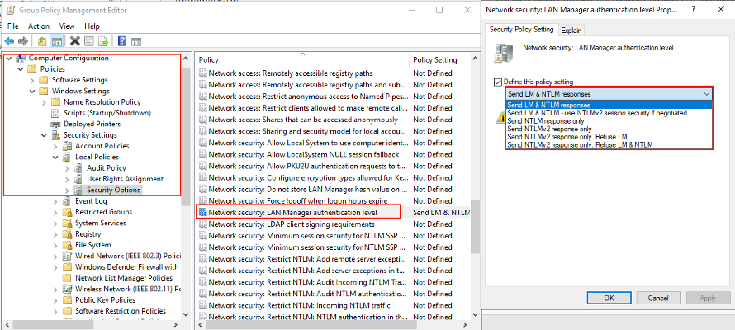
~$ Assessment of your Environment (GPO)

Slide 25
~$ Assessment of your Environment
Asset Management
Vulnerability Scanning
Nessus, Qualys, R7, etc. have plugins to identify hosts that accept insecure protocols
SMB versions enabled/disabled, SMB & LDAP signing enabled/enforced, EPA enabled/enforced
LLMNR/NBNS/WPAD/mDNS enabled (likely an easier win than you think)
Authenticated scans!
Password reuse/password assessment
Configure DCs to write errors to Event Viewer when NTLM is used
Before that: Event Log Retention
DCs in large environments, those logs roll quickly
SIEM: Ingestion vs. log rolling
SIEM: Dashboards, Alerting, Prioritization
No SIEM? Get creative! Even if it’s just some powershell and scheduled tasks.
Notes:
Adding Event ID info from question during session: Event ID 4776 is logged whenever a domain controller (DC) attempts to validate the credentials of an account using NTLM over Kerberos. This event is also logged for logon attempts to the local SAM account in workstations and Windows servers, as NTLM is the default authentication mechanism for local logon.

Slide 26
~$ War Plans – Mitigations
Plan, test, adjust plan, test again.
Start in a dev/test environment, enable auditing for event IDs related to the mitigation, stagger roll out of mitigations, and monitor for errors
LLMNR/NBNS/WPAD/mDNS enabled? Review logs & start disabling protocols.
SMBv1? Review logs & increment versions.
SMB/LDAP signing disabled? Review logs and work your way up to enabling/requiring.
Find your easy wins – systems/apps already compatible/not using deprecated/legacy protocols
Should have a list of assets generating errors from logging setup previously
Asset management key to know all your assets, delta assets NOT generating alerts vs asset management list
Switch these over, monitor logs for any errors.
Operating from a dev/test environment where the systems/apps are 1:1 to production enables teams to take swift action after testing concludes
Password Reuse/Assessment
What do the local admin creds look like per box? Shared?
LAPS/LAPSv2
NTDS.dit – run through password cracking methodology on your own environment

Slide 27
~$ War Plans – Root Cause
Plan, test, adjust plan, test again.
Start in a dev/test environment and work from “bottom → up”
Starting from an LMCompatibilityLevel of 0?
Do NOT try to “boil the ocean” and go from 0 → 5 without fully understand your environment/the implications, stuff WILL break
Find your easy wins – systems/apps already compatible/compliant with “above LM” auth in a dev/test/etc. environment
Should have a list of assets generating errors from logging setup previously
Asset management key to know all your assets, delta assets NOT generating alerts vs asset management list
Switch those “delta” systems over, monitor logs for any errors.
Operating from a dev/test environment where the systems/apps are 1:1 to production enables teams to take swift action after testing concludes

Slide 28
~$ War Plans – Root Cause
Application assessments and configurations
Kerberos HATES any attempt to connect to a system by IP/not by FQDN
Will actively fail/drop
RDP
Gateways? RDS?
Network Level Authentication (NLA)
Exceptions
Utilize exceptions only where no other solutions make sense/app cannot support
“Attack surface” / “Blast radius” reduction
Can someone relay hashes to ALL your systems, or just to a smaller subset?
Big difference!
Do you have additional logging/monitoring/defense in depth controls on that subset?
Autopilot/Intune

Slide 29
~$ Kerberos Troubles
Age of your environment coupled with backwards compatibility of NTLM versions in Kerberos means there are (likely) less than ideal encryption schemes being used in your environment.
Recent Microsoft updates forcing AES, signing PACs, etc.
RC4-HMAC schemed accounts broke as the changes rolled out
DC’s stuck in reboot loops
Forced rollback

