Slide 1

H₃O⁺ Project
Team Meeting 1
(1) Project Background
(2)Procedures

Slide 2
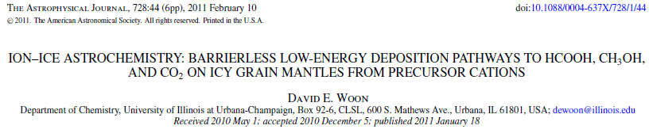
Background: Cation-Ice Reactions
HCO⁺ + asw → HCOOH – H₃O⁺ – asw (amorphous solid water)
→ CO – H₃O⁺ – asw
When HCO⁺ reacts with asw, either HCOOH or CO forms, but H₃O⁺ always forms. Hydronium is a very common product in cation-ice reactions in general.

Slide 3
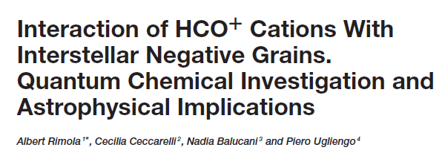
Background: Solvated Electron
Front Astron Space Sci 8, 655405 (2021)
asw + e– → asw– (EA = 0.52 eV) (electron affinity)
Diffuse basis functions (small exponent → large radial extent) are important for describing anions, but describing a solvated electron calls for extra diffuse functions.

Slide 4
Background: Solvated Electron
Albert added a number of diffuse functions to a (mediocre) Pople base set of 6-31++G(d,p): 2 additional diffuse s functions on each H atom for optimizations and additional diffuse s and p functions on O for single point calculations. That’s a lot of extra functions: are they necessary?
My base set is aug-cc-pVDZ on O and cc-pVDZ on H (MVDZ), which provides a much richer description of the valence electrons than Pople basis sets. It does fine for the EA of OH, for example:
B3LYP/MVDZ 1.83 eV
experiment 1.83 eV
I explored the solvated electron EA in a 27H₂O cluster.

Slide 5
Background: Solvated Electron
BASIS EA(eV) (single point calculations)
MVDZ 0.103
AVDZ 0.595
MVDZ+1 0.599
MVDZ+2 0.648
MVDZ+1+1 0.622
27H₂O: 27 O atoms, 54 H atoms
AVDZ add 1s1p per H atom +216 functions!
MVDZ+1 add 1s per O atom +27 functions
MVDZ+2 add 2s per O atom +54 functions
MVDZ+1+1 add 1s each per O/H +81 functions

Slide 6
Background: Solvated Electron
BASIS EA(eV) (single point calculations)
MVDZ 0.103
AVDZ 0.595
MVDZ+1 0.599
MVDZ+2 0.648
MVDZ+1+1 0.622
27H₂O: 27 O atoms, 54 H atoms
AVDZ add 1s1p per H atom +216 functions
MVDZ+1 add 1s per O atom +27 functions
MVDZ+2 add 2s per O atom +54 functions
MVDZ+1+1 add 1s each per O/H +81 functions
A single additional diffuse s function on O is sufficient!

Slide 7
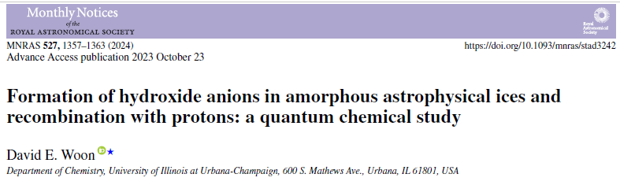
Background: Electrons & Anions
This paper demonstrated that the OH– anion strongly binds an electron in ice, much more so than the solvated e–.
I’ve subsequently found that there are differences between surface and bulk sites, but it’s more about coordination.
It’s also important to distinguish between vertical EA (VEA) (unrelaxed geom) and adiabatic EA (relaxed geom).

Slide 8
Background: Electrons & Anions
CLUSTER TYPE VEA(eV) EA(eV)
24H₂O surf 2.98 5.18
bulk 2.19 5.34
34H₂O surf 2.40 5.37
bulk 2.39 5.32

Slide 9
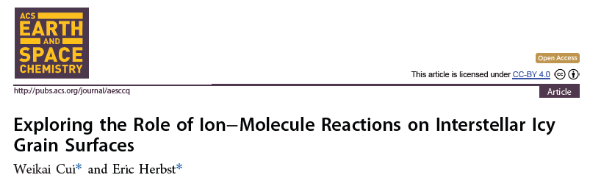
Background: What is the fate of H₃O⁺?
Ion-ice reactions can enhance the production of complex organic molecules (COMs).
We can expect H₃O⁺ to be present in interstellar/protostellar ices where HCO⁺ and other protonated species are present in the gas phase.

Slide 10
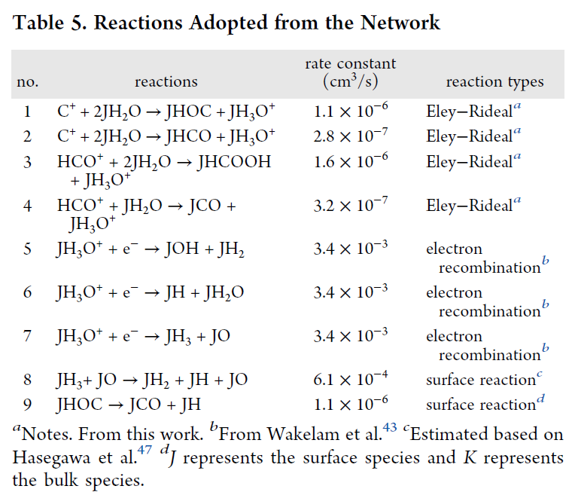
Background: What is the fate of H₃O⁺?
Cui & Herbst (and others) assume that H₃O⁺ in ice is destroyed by electron recombination. This assumption needs to be tested!

Slide 11
Procedure:H₃O⁺-asw + e⁻ → ? (and beyond)
Preliminary calculations show that adding an electron to H₃O⁺ in ice does not result in the destruction of H₃O⁺.
We will initially explore:
1. Adding e– to H₃O⁺ – asw (what happens?)
2. Adding e– to H₃O⁺ – OH – asw (different outcome?)
3. Adding e– to asw (baseline: solvated e –)
Later:
4. Adding e– to H₃O⁺ – CN – asw (alternative anions)
5. Adding e– to NH₄⁺ – asw (alternative cations)

Slide 12
Procedure:H₃O⁺-asw + e⁻ → ? (and beyond)
You will find the following zip files on the Google drive:
21w-hyd_1.zip Collette
22w-hyd_1.zip Alexandra
22w-hyd_2.zip
22w-hyd_3.zip
22w-hyd_4.zip
23w-hyd_1.zip Anna
23w-hyd_2.zip
24w-hyd_1.zip Michelle
25w-hyd_1.zip Dave
The unassigned examples can be done later to bolster our conclusions.

Slide 13
Procedure:H₃O⁺-asw + e⁻ → ? (and beyond)
Here are the files from the 25w-hyd_1 archive:
03.hyd-25w_1A_freq.inp
03.hyd-25w_1A_freq.out
03.hyd-25w_1A_opt.inp
03.hyd-25w_1A_opt.xit
03.hyd-25w_1A.xyz
Most of these are obvious. The xit file shows all of the optimization steps from the initial to converged structures.

Slide 14
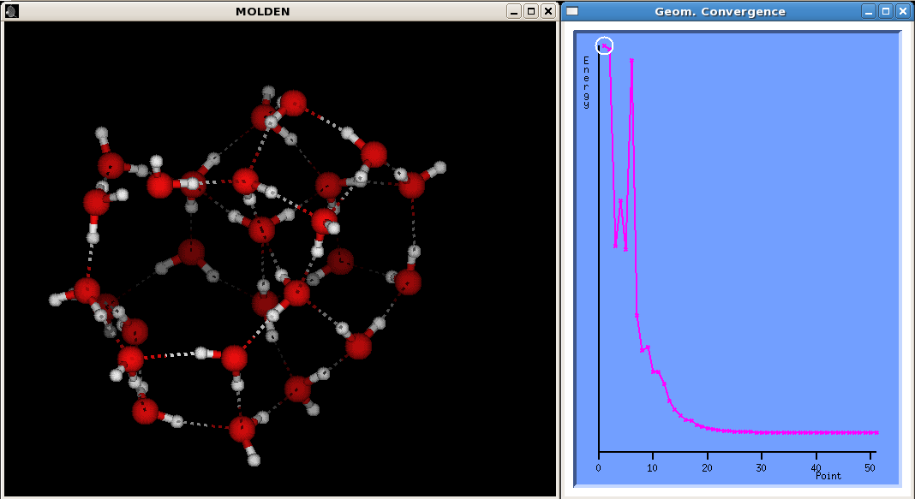
Procedure:H₃O⁺-asw + e⁻ → ? (and beyond)
This run needed about 50 steps to converge. Ice cluster opti-mizations often need ~100–400 steps to converge

Slide 15
Procedure:H₃O⁺-asw + e⁻ → ? (and beyond)
Here are the files from the 25w-hyd_1 archive:
03.hyd-25w_1A_freq.inp
03.hyd-25w_1A_freq.out
03.hyd-25w_1A_opt.inp
03.hyd-25w_1A_opt.xit
03.hyd-25w_1A.xyz
We need to start by refining the methodology I used for the prior calculations, including adding the extra diffuse s function on O atoms.

Slide 16
Procedure:H₃O⁺-asw + e⁻ → ? (and beyond)
1. Refine your hydronium-water cluster:
o move H3O+ to end of atom list
o add new methodology option
o upgrade basis set
o opt
o freq – pool spectrum results
2. Add e- to hydronium-water cluster:
o change charge and multiplicity
o opt - VEA from first step, what happens?
o freq
3. Introduce OH:
o remove H from H2O in nH2O-hyd cluster
o opt+freq OH
o add e- - VEA from first step, what happens?
(opt+freq)
4. Free electron EA:
o remove proton from initial nH2O-hyd cluster
o opt+freq (n+1)H2O cluster
o add e- - VEA from first step, what happens?
(opt+freq)

Slide 17
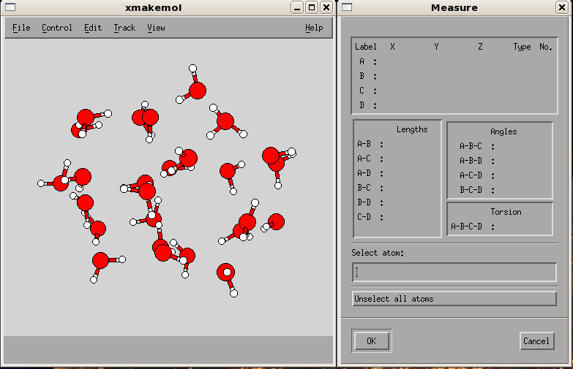
Procedure:H₃O⁺-asw + e⁻ → ? (and beyond)
First, find the H₃O⁺ in your archive – view the xyz file:

Slide 18
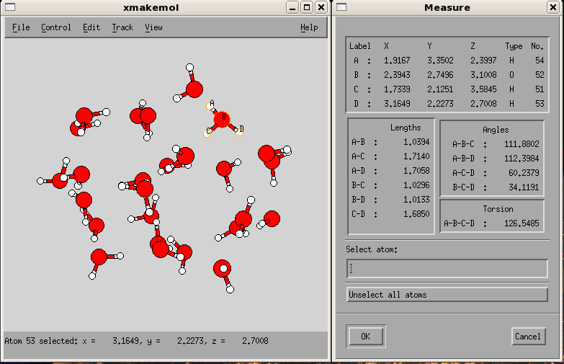
Procedure:H₃O⁺-asw + e⁻ → ? (and beyond)
First, find the H₃O⁺ in your archive – view the xyz file:

Slide 19
Procedure:H₃O⁺-asw + e⁻ → ? (and beyond)
Create a new input opt file, e.g. 01.25w-hyd_1.inp – copy the one in the archive and then edit the new file.

Slide 20
Procedure:H₃O⁺-asw + e⁻ → ? (and beyond)
OLD VERSION – TOP:
$ Rungauss
%mem=30mw
%chk=tmp
%nproc=4
# B3LYP/gen opt=(tight,MaxCyc=100) int=ultrafine
H3O+ + 25H2O (after ejecting NH2CHCO)
+1 1
O 0.928853 -0.390398 0.201312
H 0.412928 -0.942180 0.835530
H 1.836673 -0.375791 0.590889
O 3.299970 -0.354457 1.674587
H 4.125509 -0.192443 1.154596
H 3.192067 0.439075 2.242327

Slide 21
Procedure:H₃O⁺-asw + e⁻ → ? (and beyond)
NEW VERSION – TOP (add option to opt line):
$ Rungauss
%mem=30mw
%chk=tmp
%nproc=4
# B3LYP/gen opt=(tight,MaxCyc=100) int=ultrafine EmpiricalDispersion=gd3
25w-hyd_1 (refined) B3LYP-D3/MVDZ+1
+1 1
O 0.928853 -0.390398 0.201312
H 0.412928 -0.942180 0.835530
H 1.836673 -0.375791 0.590889
O 3.299970 -0.354457 1.674587
H 4.125509 -0.192443 1.154596
H 3.192067 0.439075 2.242327

Slide 22
Procedure:H₃O⁺-asw + e⁻ → ? (and beyond)
OLD VERSION – BOTTOM:
H -2.357525 1.202719 -2.926847
H -4.365925 1.290477 -1.851084
O -4.229860 0.514209 -2.483858
H -4.796152 0.672047 -3.250119
O -1.354500 -3.629324 -2.452566
H -0.483757 -3.178969 -2.263598
H -1.166475 -4.458049 -2.909051
H -2.121388 -4.431052 2.132272
O 0
aug-cc-pvdz
****
H 0
cc-pvdz
****

Slide 23
Procedure:H₃O⁺-asw + e⁻ → ? (and beyond)
NEW VERSION – BOTTOM (upgrade basis, move H3O+)
O -3.129461 -3.557377 -0.687840
H -2.733491 -3.584123 0.262158
H -3.742436 -2.759170 -0.805876
H -2.390021 -3.600148 -1.417040
O 0
aug-cc-pvdz
****
O 0
S 1 1.00 0.000000000000
0.2060000000D-01 0.1000000000D+01
****
H 0
cc-pvdz
****

Slide 24
Procedure:H₃O⁺-asw + e⁻ → ? (and beyond)
Test that H₃O⁺ is behaving correctly with mull app:
[e.g., copy and paste O+3H in temp.dat]
mull < temp.dat
76 O -0.258406
77 H 0.330823
78 H 0.305044
79 H 0.343205
NET 0.720666
[It looks like H3O+.]

Slide 25
Procedure:H₃O⁺-asw + e⁻ → ? (and beyond)
Once you’re optimized the H₃O⁺-water cluster, it’s straight- forward to add an electron.
$ Rungauss
%mem=30mw
%chk=tmp
%nproc=4
# B3LYP/gen opt=(tight,MaxCyc=100) int=ultrafine EmpiricalDispersion=gd3 guess=read
25w-hyd_1 + e- B3LYP-D3/MVDZ+1
0 2
O 0.928853 -0.390398 0.201312
H 0.412928 -0.942180 0.835530
H 1.836673 -0.375791 0.590889
The charge is now zero, and the multiplicity is a doublet.

Slide 26
Procedure:H₃O⁺-asw + e⁻ → ? (and beyond)
If the xit and phasit apps are installed, you can use them to extract optimization step coordinates for any run and combine them into a total xit file for the full optimization.
[e.g.]
xit < 01.25w-hyd_1_opt.out > temp.xyz
[or 01.25w-hyd_1_opt.xit1, etc. for multiple opt runs; then...]
cat 01.25w-hyd_1_opt.xit? | phasit > 01.25w-hyd_1_opt.xit

Slide 27
Procedure:H₃O⁺-asw + e⁻ → ? (and beyond)
Good luck! – if you get stuck, ask me or Michelle for help!

