Slide 1
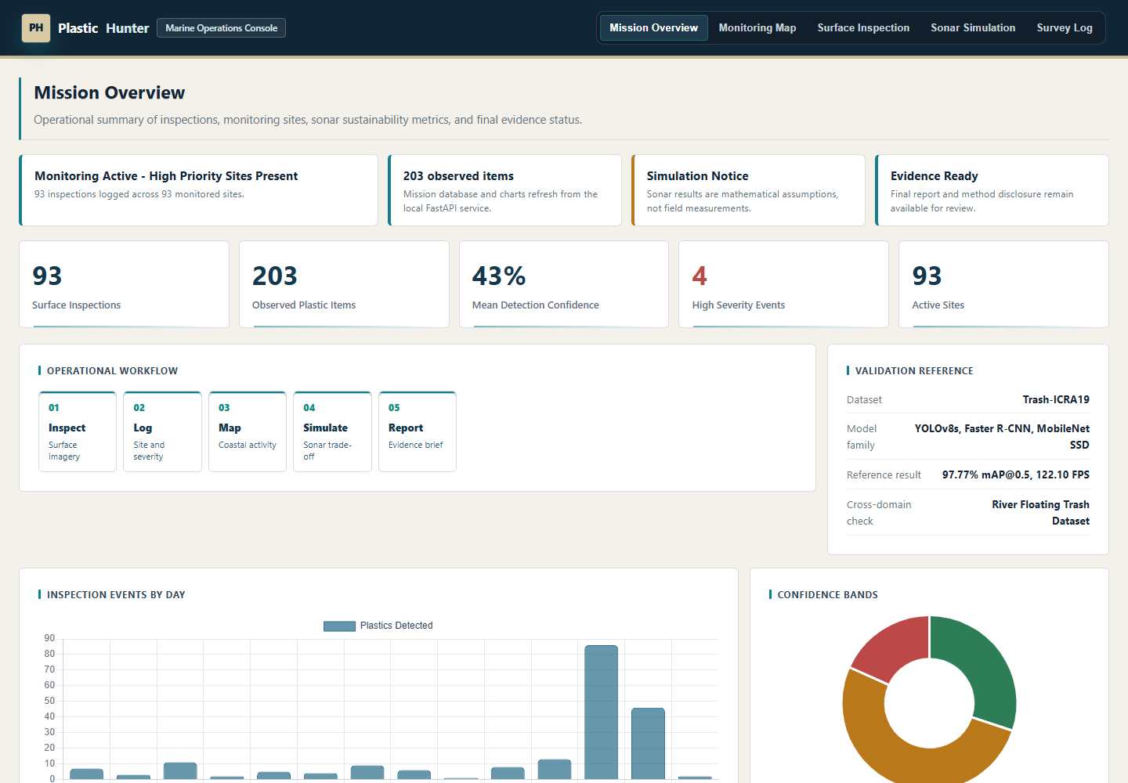
PLASTIC HUNTER
Marine pollution monitoring with quieter sensing
Plastic Hunter combines browser UI, FastAPI, SQLite logging, CV validation, and eco-sonar simulation.
Software demo, not deployed hardware

Slide 2
PLASTIC HUNTER
The workflow turns sensing into judge-ready evidence
The dashboard shows the complete monitoring path from sensing assumptions to reviewable outputs.
Mission -> sonar -> CV -> database -> evidence

Slide 3
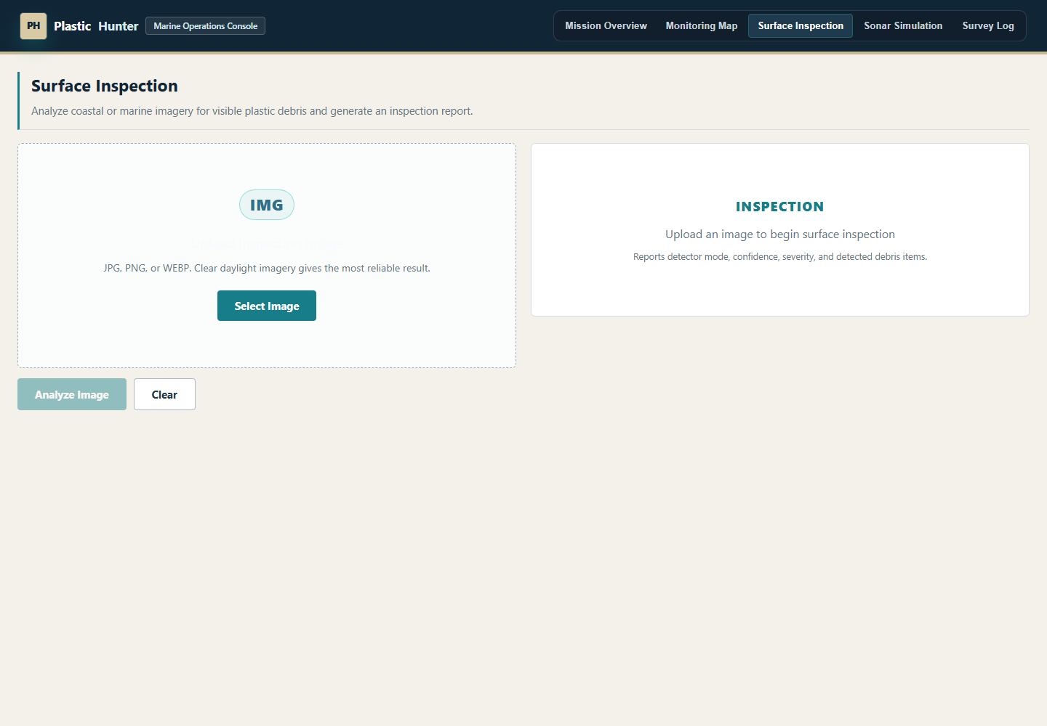
PLASTIC HUNTER
The detection view preserves the inspection workflow
The portable demo keeps the upload, detection, annotation, and logging flow visible for judges.
CV validation: YOLOv8s 97.77% mAP@0.5

Slide 4
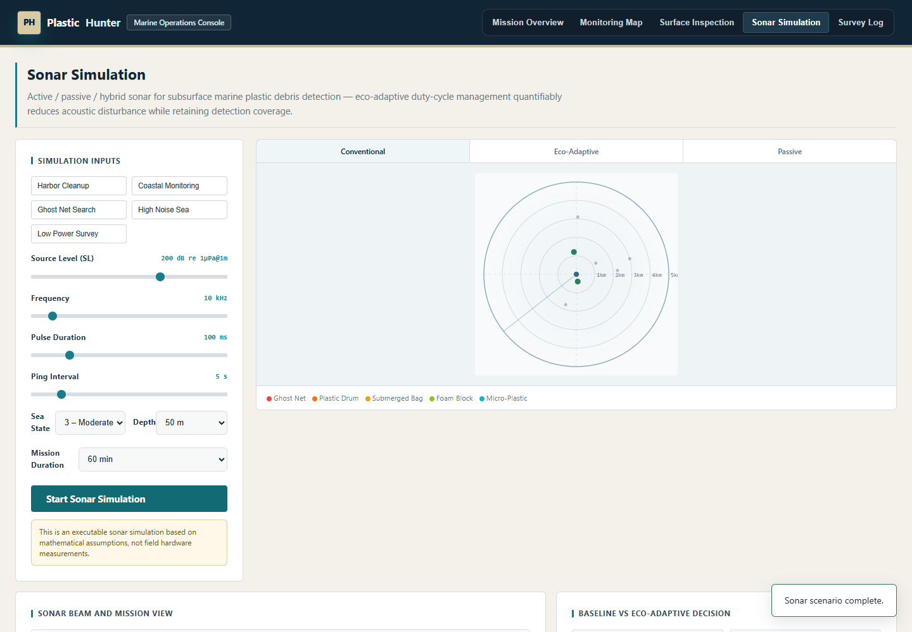
PLASTIC HUNTER
Eco-sonar quantifies the sustainability trade-off
The sonar simulation compares conventional, passive, and eco-adaptive modes with reproducible parameters.
~98% SEL reduction, >90% coverage retained

Slide 5
PLASTIC HUNTER
The dashboard separates measured data from estimates
Mission KPIs, confidence bands, and evidence status are presented with clear scope boundaries.
Observed records stay separate from planning estimates

Slide 6
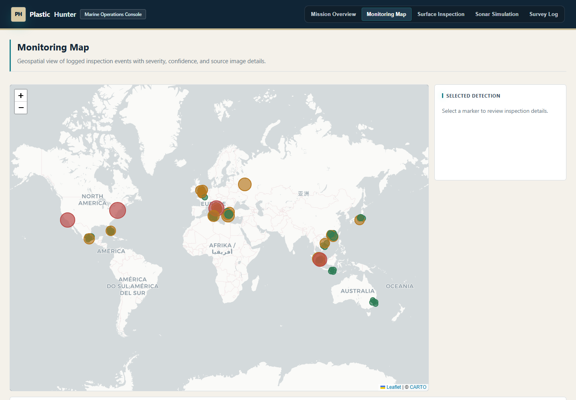
PLASTIC HUNTER
The map makes inspection records spatially interpretable
The map highlights inspection sites while keeping the final log clean and presentation-ready.
Severity and location are visible without image names

Slide 7
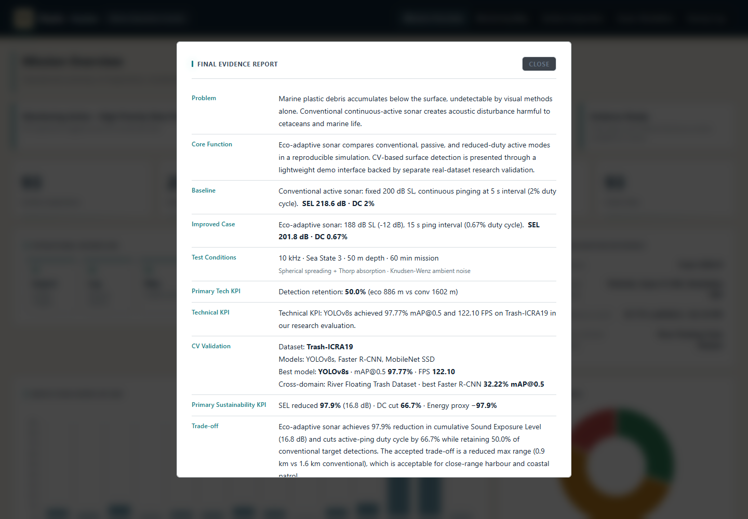
PLASTIC HUNTER
The evidence sheet exposes the assumptions judges need
The app reports baseline, improved case, test conditions, KPIs, assumptions, and limitations.
/evidence and /disclosure are judge-facing

Slide 8
PLASTIC HUNTER
The repository is organized for final review
Runtime files and training outputs were removed; the repository stays reproducible and judge-accessible.
README, technical brief, slides, screenshots, and Codespaces

