Slide 1
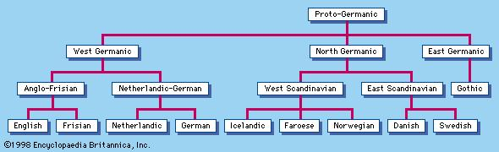
Dutch, Holland & The Netherlands
Dutch
DUTCH BELONGS TO THE GERMANIC LANGUAGES WHICH IS PART OF THE INDO EUROPEAN LANGUAGES
language tree of Germanic languages

Slide 2
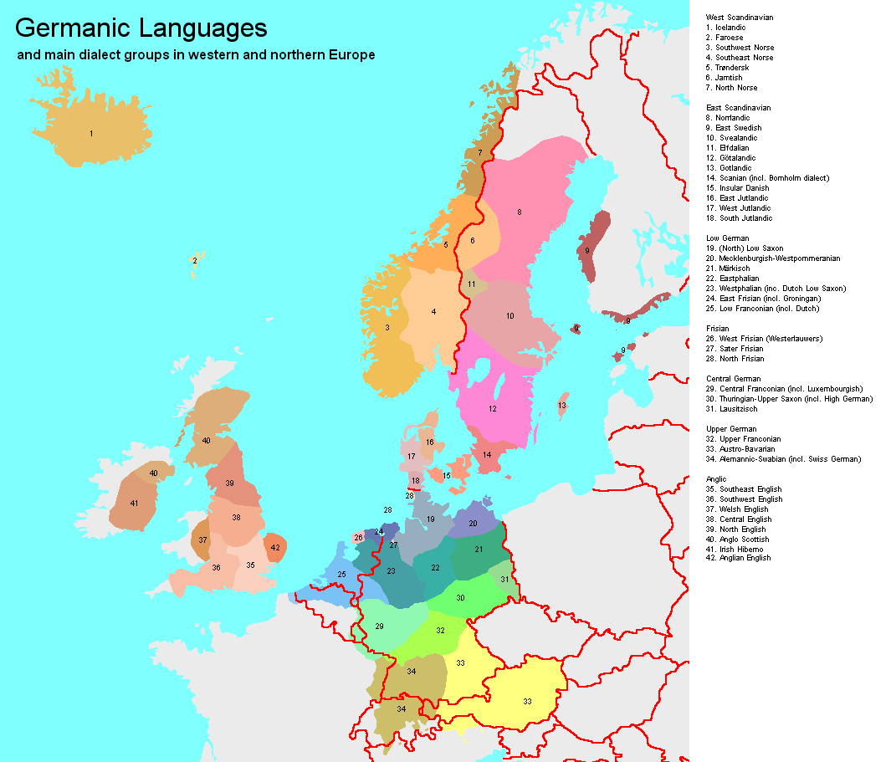
Dutch, Holland & The Netherlands
Dutch
DUTCH BELONGS TO THE GERMANIC LANGUAGES WHICH IS PART OF THE INDO EUROPEAN LANGUAGES

Slide 3
Dutch, Holland & The Netherlands
Dutch
Etymology:
-The HIGH German word for German is DEUTSCH
-THE LOW OR MIDDLE GERMAN WORD FOR LOW GERMAN SPEECH is DIETS
-THE MEANING OF the WORD DEUTSCH OR DIETS OR DUTCH is ‘people’ or plural ‘peoples’
-HENCE DUTCH is LANGUAGE OF THE PEOPLES

Slide 4
Dutch, Holland & The Netherlands
Dutch A FOREIGN COMPARISON:
-IN THE ENGLISH LANGUAGE THOsE WHO SPOKE LOW GERMAN CAME TO BE KNOWN AS DUTCH
-WHILE IN FRENCH The LANGUAGE is ‘NEERLANDAIS’ (after the netherlands, the region) AND The COUNTRY ‘LES PAYS BAs’ (LITERALLY THE LOW COUNTRIES)
-AND in FRENCH GERMANY IS KNOWN AS ‘ALEMAGNE’ NAMED AFTER tHE ALEMANNI TRIBE

Slide 5
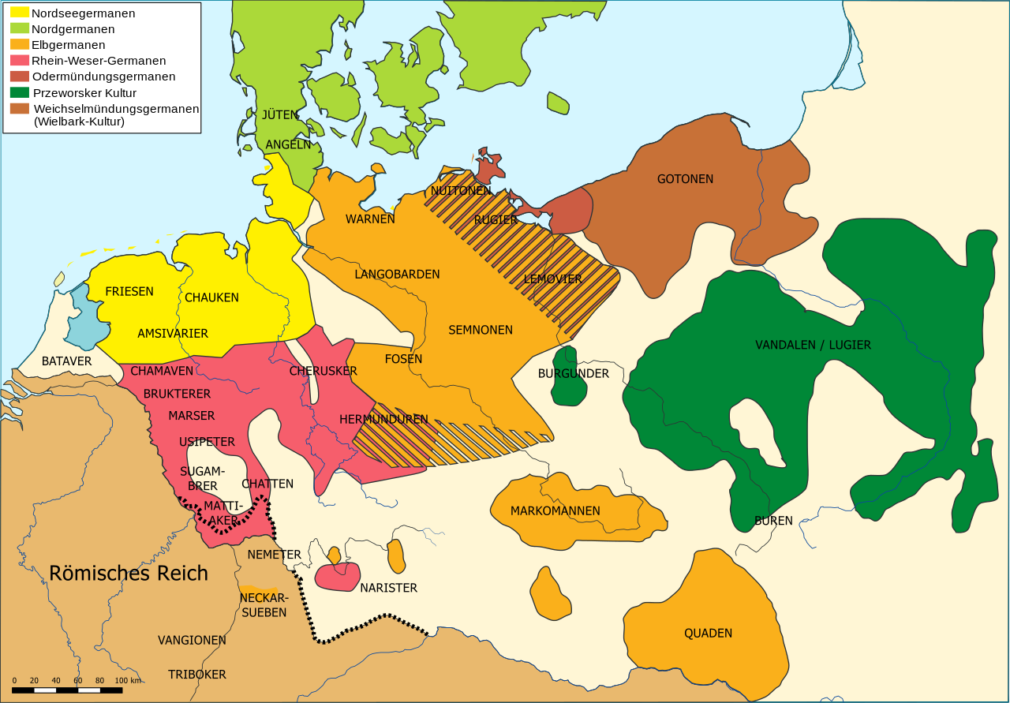
Dutch, Holland & The Netherlands
Dutch
WHO WERE THESE TRIBEs?
Germanic Tribes, 1st century A.D.

Slide 6
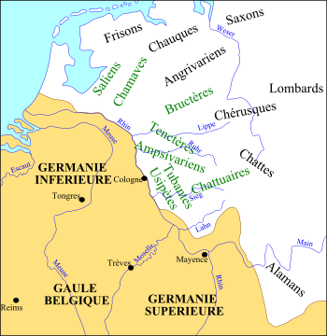
Dutch, Holland & The Netherlands
Netherlands
IT LITERALLY MEANS
‘The LOW COUNTRIES’
WHY THE LOW COUNTRIES?
DoWN STREAM OF MAJOR RIVERS LIKE THE
‘RHINE’ OR ‘MEUSE’
Roman Empire, Germania 1st century A.D.

Slide 7
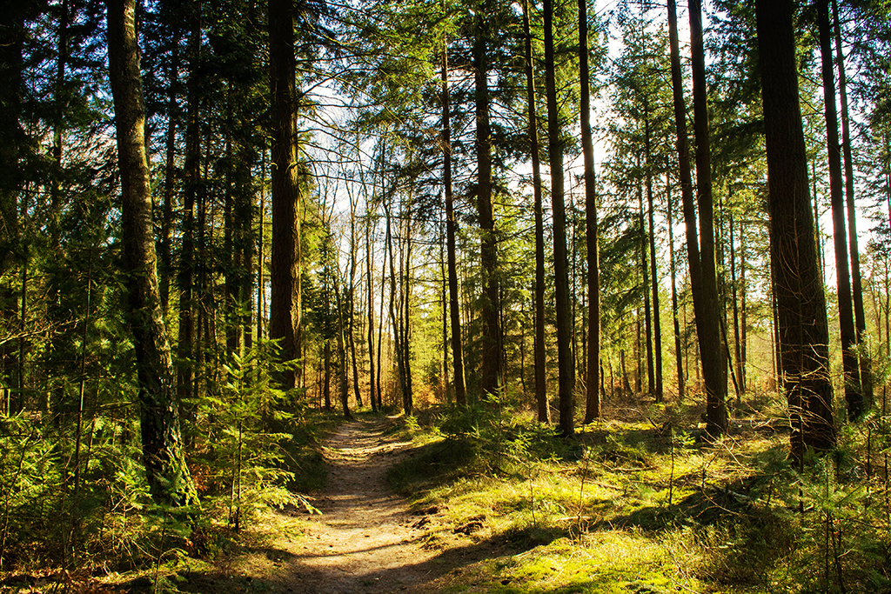
Dutch, Holland & The Netherlands
Etymology of Holland
‘HOL’ is an OLD GERMANIC WORD FOR ‘WoOD’
SO HOLLAND LITERALLY MEANS ‘WOODLAND’

Slide 8
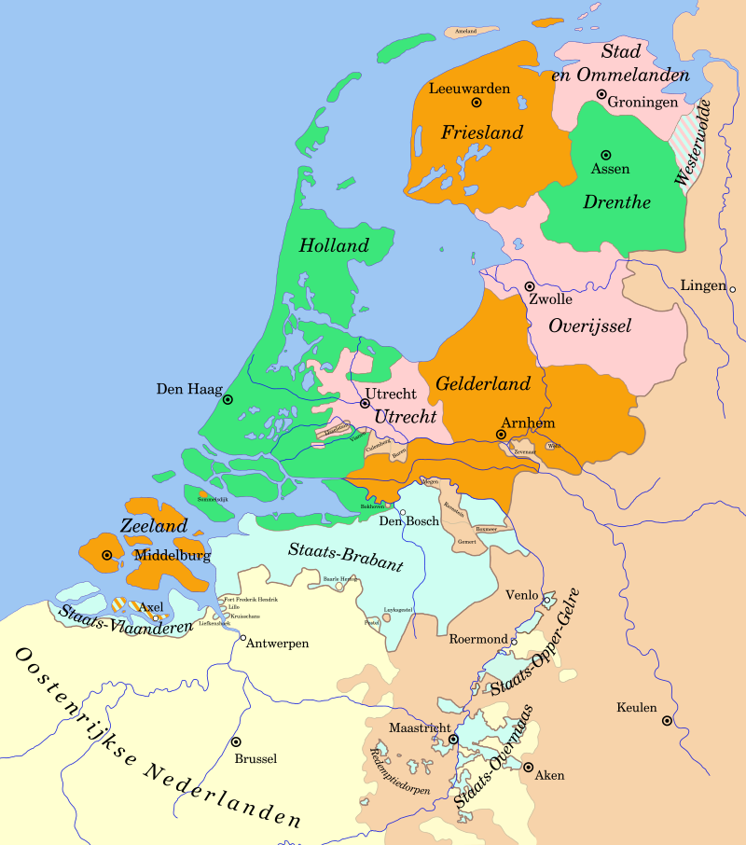
Dutch, Holland & The Netherlands
WHY HOLLAND?
Holland WAS THE RICHEST AND MOST POWERFUL OF the SEVEN UNITED PROVINCES
The seven fought for indepedence against the king of Habsburg spain in the 16th century
Its different then calling china land of qin, even though there may be wei, chu, qi, yan, zhao, han

Slide 9
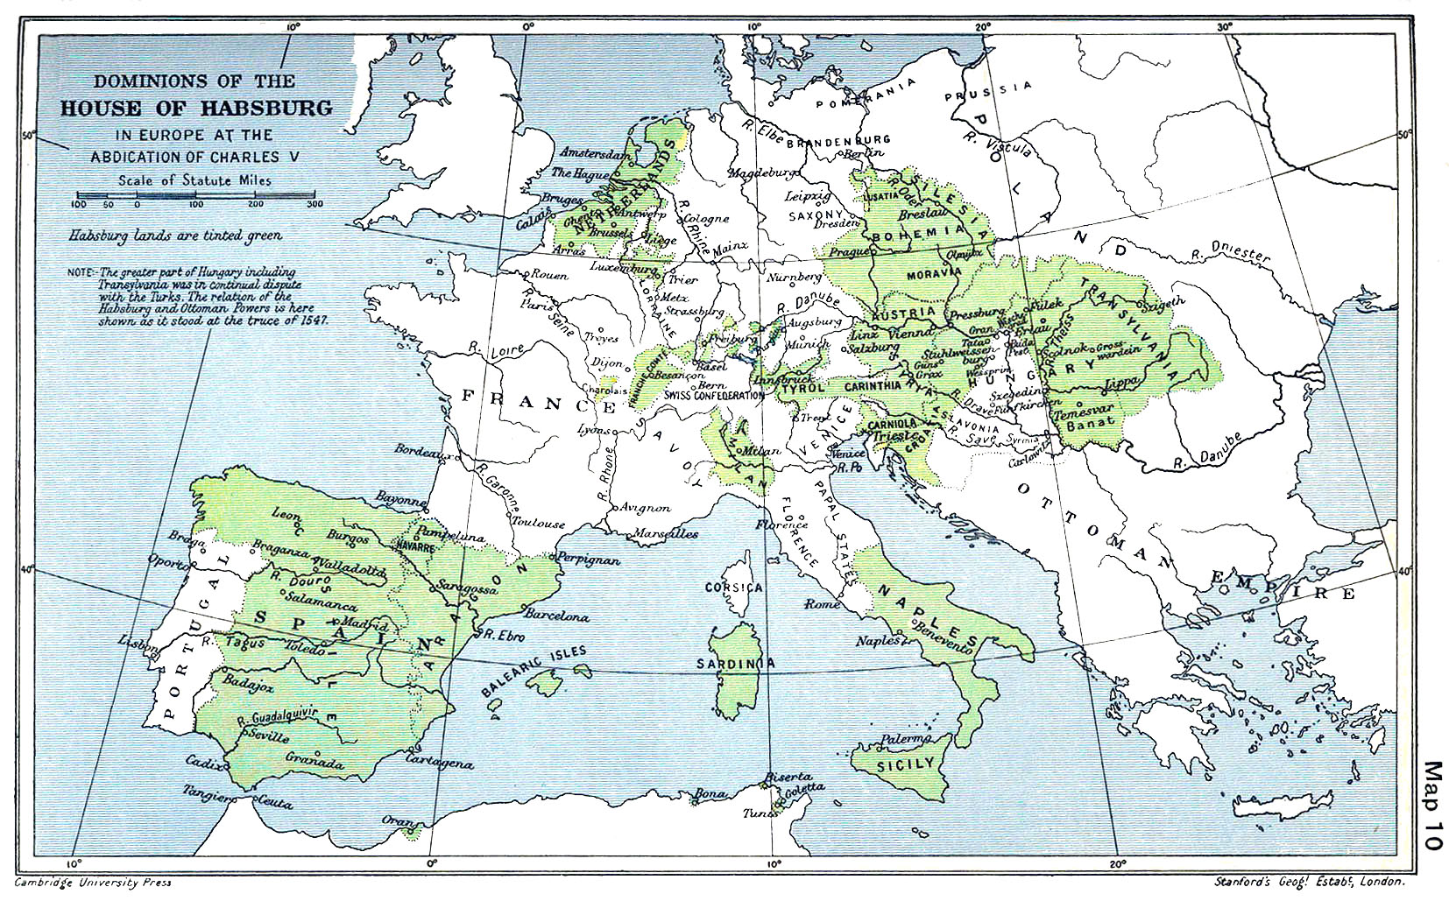
Dutch, Holland & The Netherlands

Slide 10
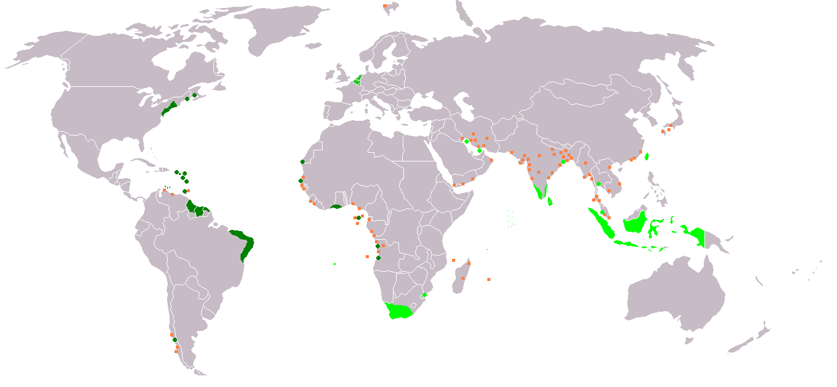
Dutch, Holland & The Netherlands
Holland was richer because it was nearer to its colonies

Slide 11
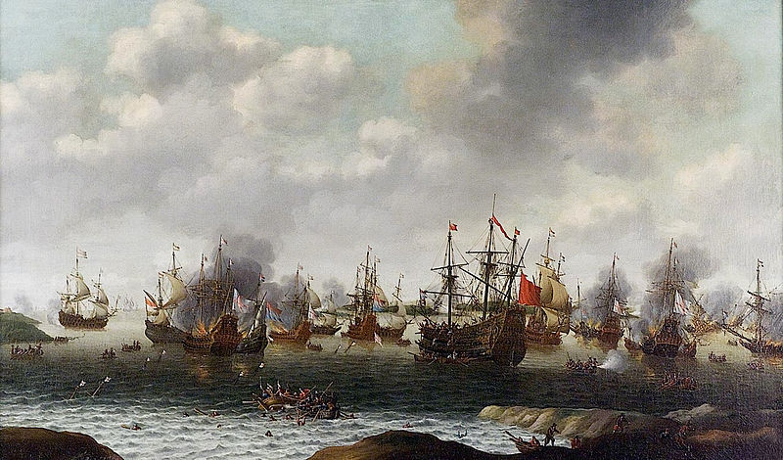
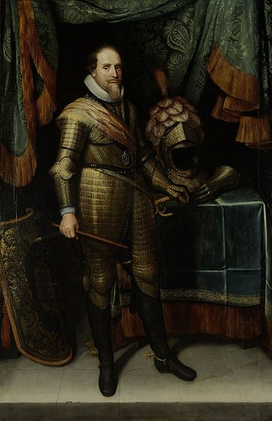
Dutch, Holland & The Netherlands
Holland also had an powerful admirality and stadtholder

