Slide 1
Somatic HyperMutation Aware Reverse Translator (SHMART)

Slide 2
Goals
Goal: To reverse translate an IgG sequence from amino acid to nucleotide in a codon aware way using alignment to germline AA V and J sequences enabling (a) germline codons for non-mutated positions (b) most probable codons according to AID mutation and substitution estimates ( c) randomly chosen codons for the parts of CDR3 that don’t align to V or J.
Limitations: There is no inference about V/J trimming in the CDR3, D encoded codons, or N nucleotide encoded codons. There is a risk of assuming a longer J contribution to the CDR3 than is actually there.
Considerations: It is recommended to pre-filter the input AA sequences using ANARCI to check for the presence of the expected CCW/F amino acids. This will avoid unnecessary computational resources and improve the performance of the RT script.
Potential updates: Currently, random codons are picked for the non V and J aligned parts of the CDR3. In theory, they could be chosen from a distribution of codon usage in the CDR3 built from actual data.

Slide 3
Overview of Script Usage
Run Anarci using the –IMGT option and the –csv output option. [ Information about ANARCI and software download is here: https://github.com/oxpig/ANARCI]
Parse the ANARCI results using parse.anarci.py. This function returns a CSV file that has a row for each input AA fasta sequence, the amino acid or gap character at the expected CC[WF] positions according to IMGT numbering, and a True/False column that is *True* if the CC[WF] requirements are met, and *False* if not. If less stringent requirements of the critical CC[WF] positions were desired, the output csv could be parsed for that.
Using the output from parse.anarci.py, the sequences from the input AA fasta file that satisfy the conditions can be extracted for the next step.

Slide 4
Overview of Script Usage [continued]
Call the Reverse Translate script with the filtered input sequences.
Use the sequences that are successfully reverse translated for further analysis.

Slide 5
Steps
1. Run Anarci (IMGT)
2. Use parse.anarci.py – To filter Functional sequences (invariant CCW/F)
usage: parse.anarci.py [-h] -a PATH_ANARCI -o OUT_FILE -c {heavy,light}
options:
-h, --help show this help message and exit
-a PATH_ANARCI, --path_anarci PATH_ANARCI
path to the input ANANRCI heavy chain csv file
-o OUT_FILE, --out_file OUT_FILE
name of the outfile
-c {heavy,light}, --chain {heavy,light}
the expected chain of the sequence
(Optional but Recommended)

Slide 6
Steps
1. Run Anarci (IMGT)
2. Use parse.anarci.py – To filter Functional sequences (invariant CCW/F)
usage: parse.anarci.py [-h] -a PATH_ANARCI -o OUT_FILE -c {heavy,light}
options:
-h, --help show this help message and exit
-a PATH_ANARCI, --path_anarci PATH_ANARCI
path to the input ANANRCI heavy chain csvfile
-o OUT_FILE, --out_file OUT_FILE
name of the outfile
-c {heavy,light}, --chain {heavy,light}
the expected chain of the sequence
3. Run SHMART.job script
a. SemiGlobal_aligner_and_Mutation_caller.py (V and J)
b. SHMART.R script
(Optional but Recommended)

Slide 7
Third step -
Usage - sbatch SHMART.job [OPTIONS]
Required Options:
-q <FILE> Path to the query amino acid FASTA
-t <TYPE> Chain type: "heavy" or "light"
-d <DIR> Directory containing reference files and scripts
-T <FILE> Output file for "True" translations (e.g. ReverseTranslated.True.txt)
-F <FILE> Output file for "False/Failed" translations (e.g. ReverseTranslated.FAILED.txt)
-A <FILE> Output FASTA of successfully translated sequences (e.g. ReverseTranslated.True.fasta)
-h Show this help message and exit
You can run 3a and 3b as a single job using the SHMART.job or use the individual commands on the next slides

Slide 8
3a. Semi-Global alignment and Mutation caller
usage: SemiGlobal_aligner_and_Mutation_caller.py [-h] --query QUERY --ref REF --output OUTPUT [--threads THREADS]
Align sequences and compute mutations (semi-global) in parallel.
options:
-h, --help show this help message and exit
--query QUERY Path to the query FASTA file
--ref REF Path to the reference AA FASTA file
--output OUTPUT Path for output
--threads THREADS Number of parallel worker processes

Slide 9
3b. SHMART.R
Usage: Rscript SHMART.R [MUTATION_CALLER_OUTPUT_VREGION] [MUTATION_CALLER_OUTPUT_JREGION] [POOLED_REFERENCE_NUC_FASTA] [QUERY_AA_FASTA] [POOLED_REFERENCE_AA_FASTA] [FIVEMER_SUB_CSV] [OUTPUT_TRUE_TRANSLATIONS] [OUTPUT_FALSE_TRANSLATIONS] [OUTPUT_FASTA]
Parameters:
MUTATION_CALLER_OUTPUT_VREGION: V region mutation caller output file
MUTATION_CALLER_OUTPUT_JREGION: J region mutation caller output file
POOLED_REFERENCE_NUC_FASTA: FASTA of pooled reference nucleotide sequences
QUERY_AA_FASTA: FASTA of query amino acid sequences
POOLED_REFERENCE_AA_FASTA: FASTA of pooled reference amino acid sequences
FIVEMER_SUB_CSV: CSV of five-mer substitution probabilities
OUTPUT_TRUE_TRANSLATIONS: Output file for valid reverse translations
OUTPUT_FALSE_TRANSLATIONS: Output file for invalid reverse translations
OUTPUT_FASTA: Output FASTA file

Slide 10
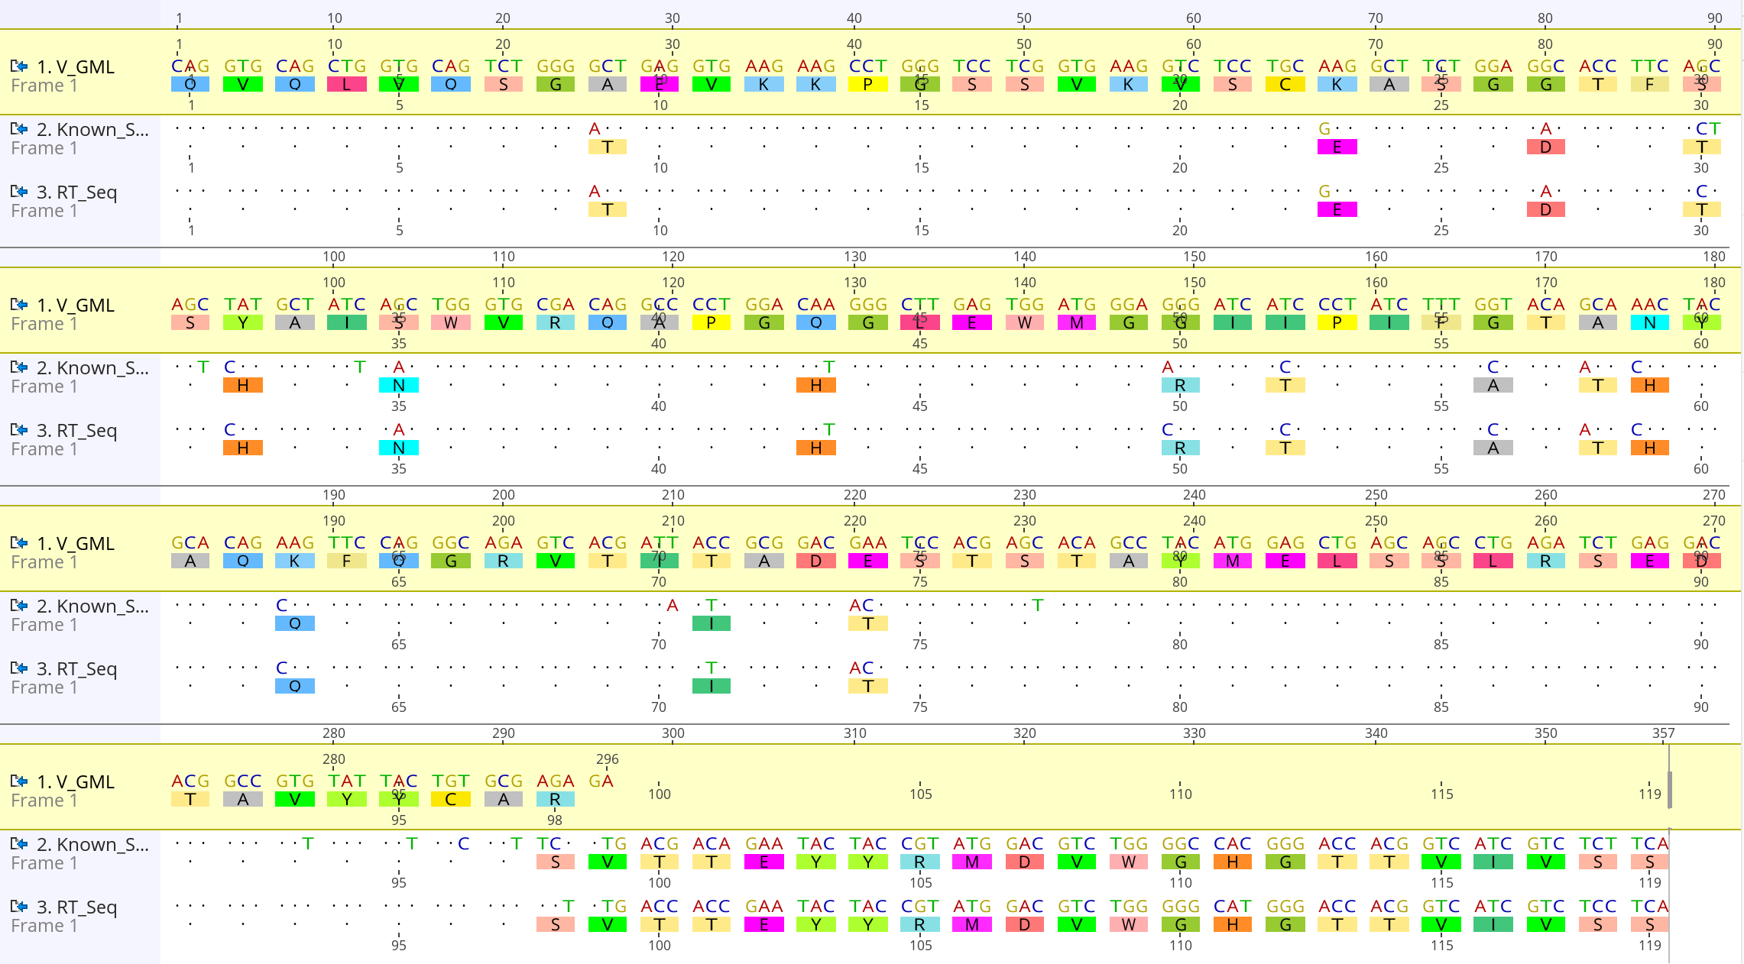
Seq 1 (GML): The reference (germline) nucleotide(IGHV1-69*01) sequence.
Seq 2 (Known): The known (input) nucleotide sequence. Seq 3 (RT): The reverse-translated sequence derived from the translating known sequence.
Mutations between GML and translated Known sequence –
A9T-K23E-G27D-S30T-Y32H-S35N-Q43H-G50R-I52T-G56A-A58T-N59H-K63Q-T71I-E74T-R98S
Crosscheck results - VRegion
When the amino acid matches between the GML and the known sequence, the reverse-translated codon is the same as the GML codon.
When there is an amino acid change, the RT script chooses a codon that requires the minimal number of nucleotide changes from the GML codon (i.e., minimal mutational path).
Verifying that the Known and RT rows have no unintended non-synonymous changes confirms that the reverse translation script is functioning correctly.

Slide 11
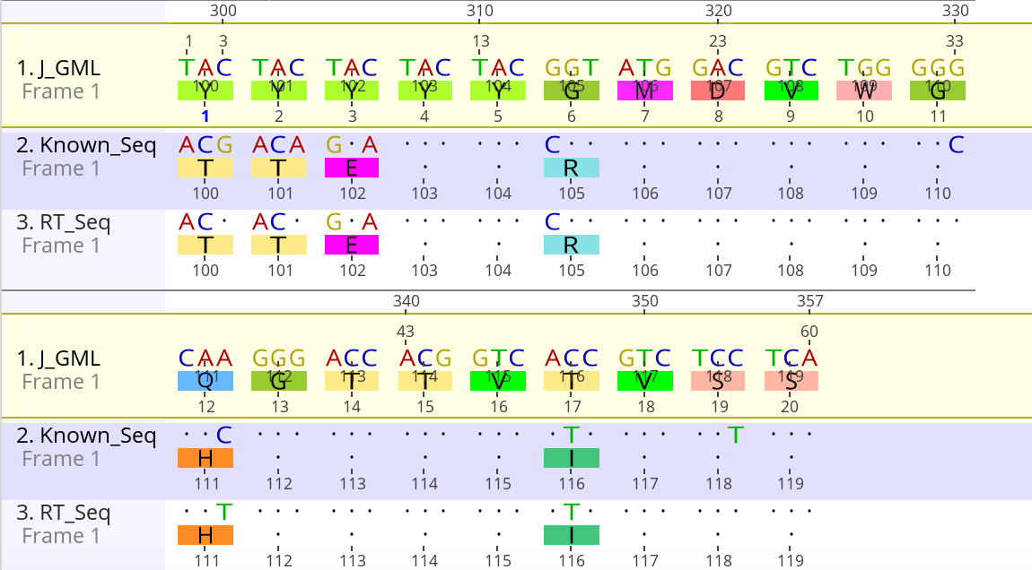
Crosscheck results - JRegion
Seq 1 (GML): The reference (germline) nucleotide(IGHJ6*01) sequence.
Seq 2 (Known): The known (input) nucleotide sequence.
Seq 3 (RT): The reverse-translated sequence derived from the translating known sequence.
Mutations between GML and translated Known sequence –
Y100T-Y101T-Y102E-G105R-Q111H-T116I
When the amino acid matches between the GML and the known sequence, the reverse-translated codon is the same as the GML codon.
When there is an amino acid change, the RT script chooses a codon that requires the minimal number of nucleotide changes from the GML codon (i.e., minimal mutational path).
Verifying that the Known and RT rows have no unintended non-synonymous changes confirms that the reverse translation script is functioning correctly.

Slide 12
NOTES

Slide 13
Reads and processes alignment results and FASTA sequences for both V and J regions.
Identify Mutations (semi-global alignment): Compare input sequence with a germline sequence to identify and analyze mutations.
For each position i, check if amino acids differ between input and germline sequence.
If different, analyze the mutation at that position.
Minimal Nucleotide Changes: Determine minimal nucleotide changes needed for mutations and calculate associated probabilities.
For each mutation, find the codons involved (both Input and germline).
Calculate minimal nucleotide changes required to transition to each possible codon. Select the codon with the least changes. Mutation: AAA (Lysine) -> ACA (Threonine)
Path 1: AAA -> ACA (1 change: A to C) ; Path 2: AAA -> ATA -> ACA
Generate Mutation Paths: Create all possible nucleotide change paths.
Create paths representing series of single nucleotide changes. For each differing position, generate paths considering one change at a time.
Select the path with minimal changes.

Slide 14
Probability Calculations In case of ties: Steps to Get Kmers Based on Change:
Identify Positions of Change: Determine positions in the nucleotide sequence where changes occurred.
Define Kmer Length: Typically includes the two bases before and after the position of change.
Sliding Window for Kmers: Extract kmers around each change position using a sliding window.
Extract Kmers: For each position of change, extract the substring corresponding to the kmer length. Look up the probability of this change in the context of the kmer from substitution/mutability data.
Total Probability for a Path:
Calculate total probability by multiplying individual probabilities of nucleotide changes.
Compare probabilities of different paths and select the highest.
Step Probability(P) = (Current Kmer mutability / Sum all Kmers mutability​) × mutability_current_nucleotide_change Total_Probability = P1 x P2 x …. x Pn

Slide 15
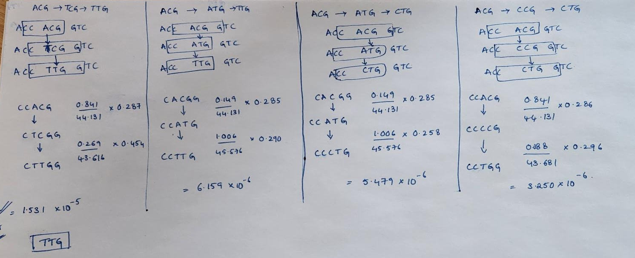
ACG (THR) -> TTG/CTG (LEU)

