Slide 1
GPP Exam: Zombie AI

Slide 2
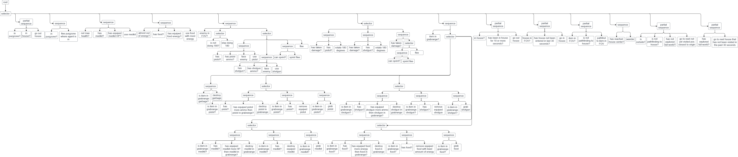
Decision Making

Slide 3
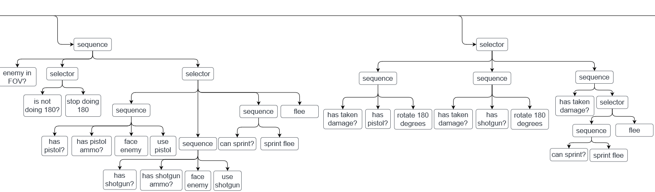
Enemy handling

Slide 4
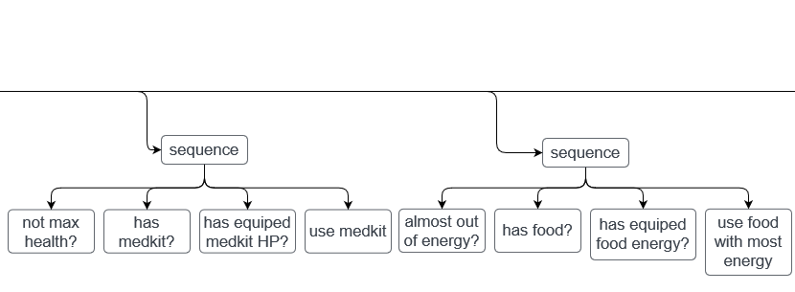
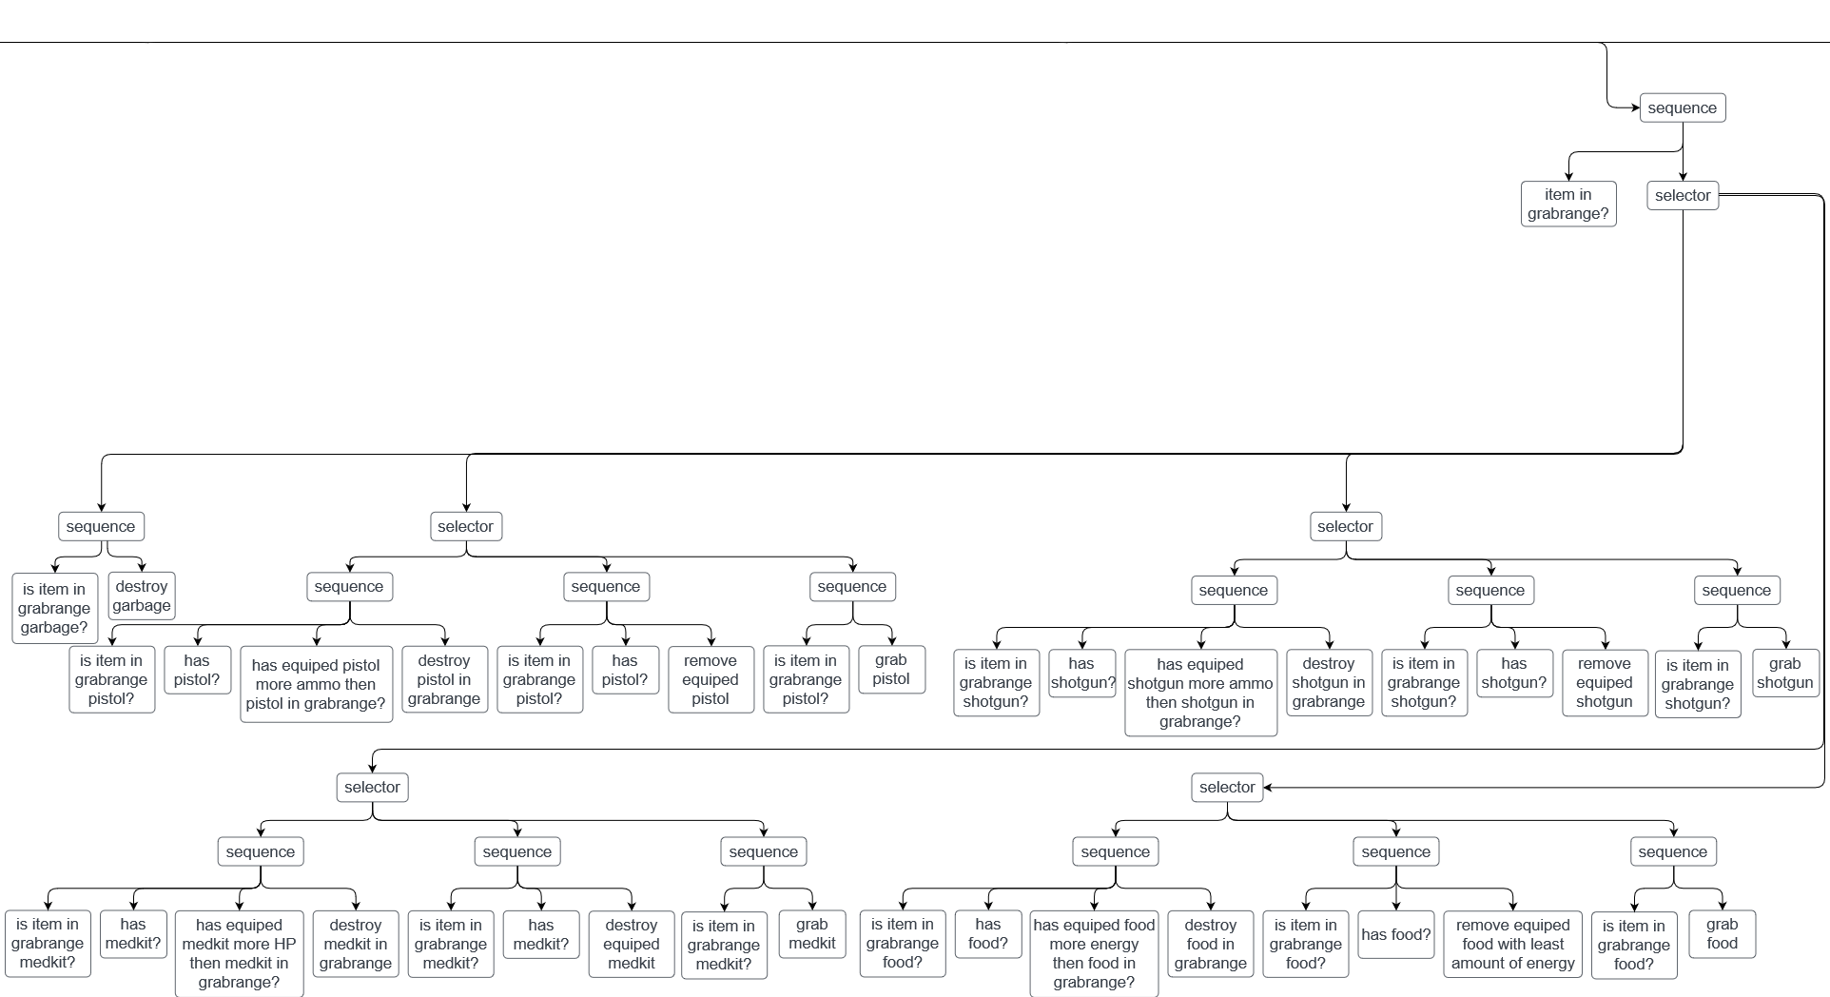
Inventory

Slide 5
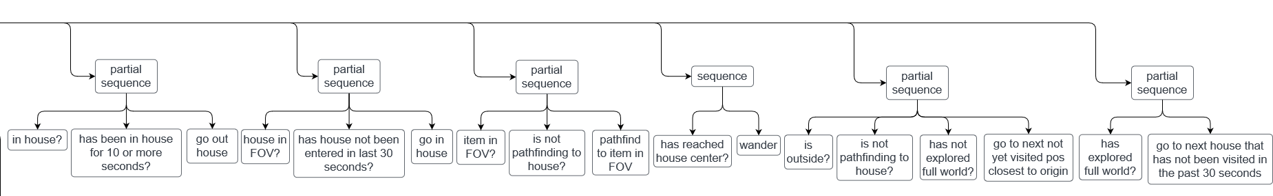
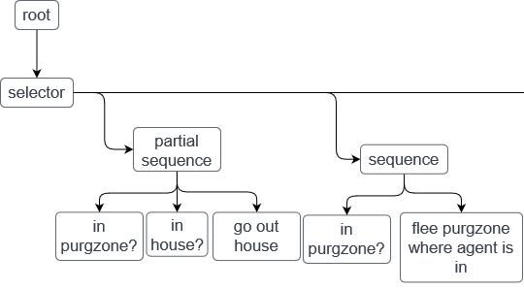
Movement & exploration
- no combined steering
5 behaviors:
Wander
Face
Seek
Flee
Sprint flee

Slide 6
High Score
Screen shot or list of highest scores

