Slide 1
GPP Exam: Zombie AI

Slide 2
Decision Making
Visualization of your decision making structure (readable!)

Slide 3
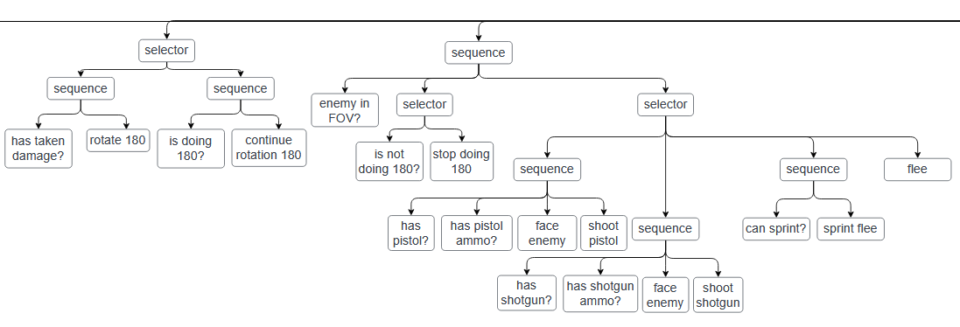
Enemy handling
How does your agent deal with enemies (aiming, shooting, item usage, avoidance, hiding, usage of sprint, …)?
USE IMAGES/GIFS

Slide 4
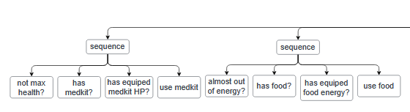
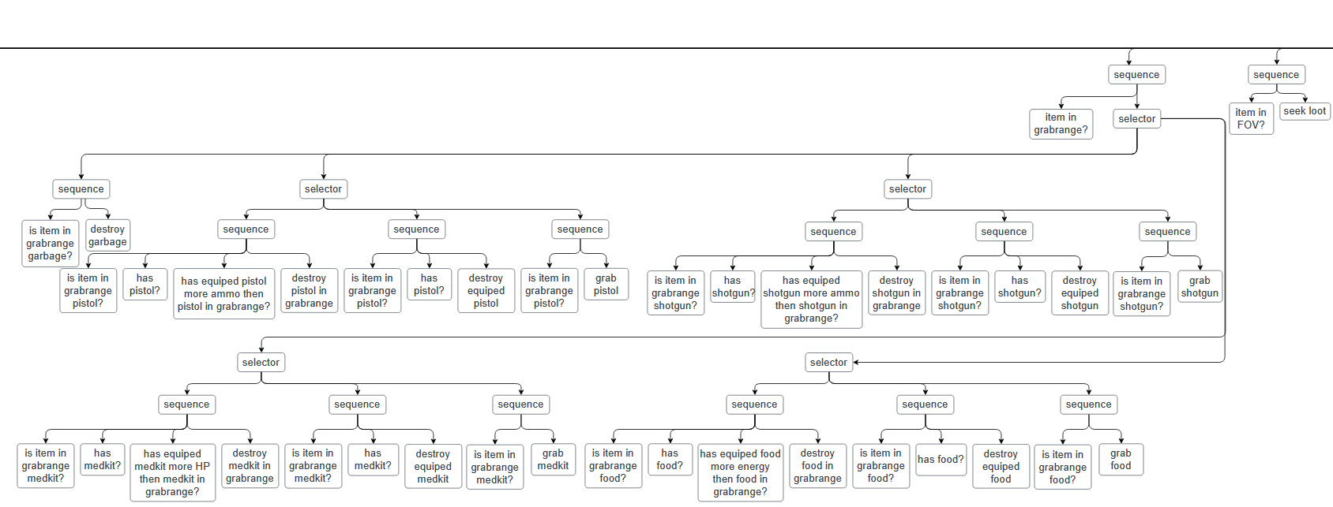
Inventory
How does your agent manage its inventory (inventory organization, item usage, picking up and remembering items,…)?

Slide 5
Movement & exploration
How does your agent explore the world ( how does it traverse the world, when and why does it visit houses, does it have a memory?)?
USE IMAGES/GIFS
How many steering behaviors does it use? Does it use blended steering?

Slide 6
High Score
Screen shot or list of highest scores

