Slide 1
Vybudovanie vzorového IoT riešenia
Projekt SOČ SPSE Pieštany

Slide 2
Zadanie

Slide 4
Úvod do IoT a IIoT

Slide 5
(Industry) IoT
Internet vecí (Industrial) Internet of Things (I)IoT) označuje prepojenie zariadení so zabudovanou internetovou konektivitou. Toto prepojenie prináša nové možnosti interakcií, ovládania, sledovania a zabezpečenie pokročilých služieb medzi jednotlivými systémami.
Príklad:

Slide 6
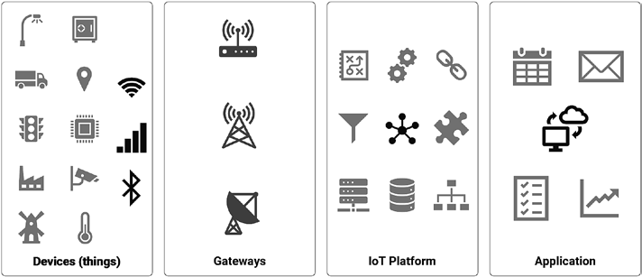
Vrstvy IoT riešenia
Sortiment senzorov
Zber dát:
Efektívne pripojenie
Správa a riadenie senzorov
Bezpečnosť
Spracovanie dát
Otvorenosť
Dostupnosť dát
Aplikácie: sluzby pre nastavovanie, spravu, prevadzku, podporu…
Perception layer | Transport layer | Processing layer | Application layer | Business layer

Slide 7
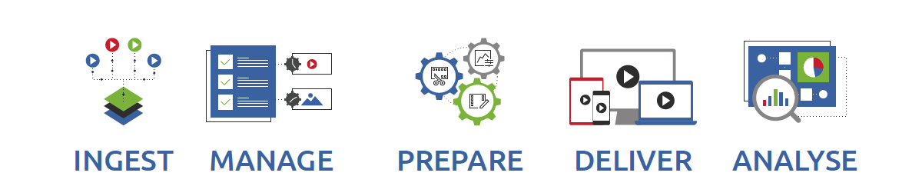
Procesy IoT riešenia
Proces | Obsah | System | Vrstvy
Ingest | Fyzicka realita + sensory -> Senzoricke data Lokalne (EDGE) spracovanie udajov na senzorickej jednotke Riadenie senzorov na zaklade parametrov, metadata Komunikacia v senzorickej sieti Citanie a ukladanie senzorickych dat | SJ_xxx: Senzoricke jednotky, moduly Sensory Spracovanie - firmware na senzorickych jednotkach Integracia na API RSSS | Perception layer | Transport layer
Manage | Registracia a riadenie senzorov Nastavovanie a riadenie senzorov: obsahu, parametrov Riadenie pristupovych prac ku jednotkam Dokumentacia senzorov | RSSS/ Riadiaci system senzorickej siete, moduly: Siet: koncentratory, GW Metadata a riadenie senzorickych jednotiek | Processing layer
Prepare | Prvotne spracovanie dat: normalizacia, augmentacia, cistenie, konsolidacia, apod Poskytovanie pripravenych dat pre konzumaciu | Ulozisko senzorickych dat a prevadzzkovych dat Spracovanie sensorickych dat, mikrosluzby az komplexne W/F Monitorig a riadenie systemu
Deliver | Aplikacie nad konzumovanymi datami Uzivatelske W/F Komunikacia | Biznis (koncove) APV: Bi, D/A, D/S, externe aplikacie Integracia ext. systemov na API RSSS | Application layer
Analyse | Biznis procesy nad konzumovanymi datami | Biznis procesy | Business l.
Notes:
Ingest
Vybudovanie senzorickej siete = Senzory + jednotky + konektivita
Ulozisko senzorickych dat a plnenie senzorickymi datami
Manage
Napojenie senzorov na IoT platformu, registracia senzorov a parametre
Prepare
Prevadzkove ulozisko, spracovanie a poskytovanie pre konzumentov
Uzivatelske spracovanie – standardne a specificke, referencne data, mikrosluzby, apod.
Deliver
Vytvorenie GUI, Bi, D/A, napojenie na biznis aplikacie
Analyse
Integracia do biznis procesov

Slide 8
IoT architektura a komponenty

Slide 9
Vrstvy IoT riešenia
The entire IoT system is managed by the business layer, including applications, business and business models, and user privacy [18].
The application layer is responsible for providing the user with specific application services. It defines different applications for the IoT, such as smart homes, smart cities, and intelligent health.
The processing layer is also referred to as the middleware layer. It can store, analyze, and process large quantities of transportation data. Also, it can manage and provide a variety of lower layers of services. It uses many technologies, such as databases, cloud computing, and big data processing modules.
The transport layer transfers sensor data from the perception layer to the processing layer and vice versa via networks such as Bluetooth, wireless, 3G, LAN,(Near Field Communications), NFC, and RFID.
The perception layer is the physical layer with environmental information sensors. In the environment, some physical parameters are sensed, or other intelligent objects are identified.
Network Layer
Notes:
Business layer
Application layer
Processing layer
Transport layer
Perception layer

Slide 10
Senzory
Príklady
Notes:
The perception layer is the physical layer with environmental information sensors. In the environment, some physical parameters are sensed, or other intelligent objects are identified.

Slide 11
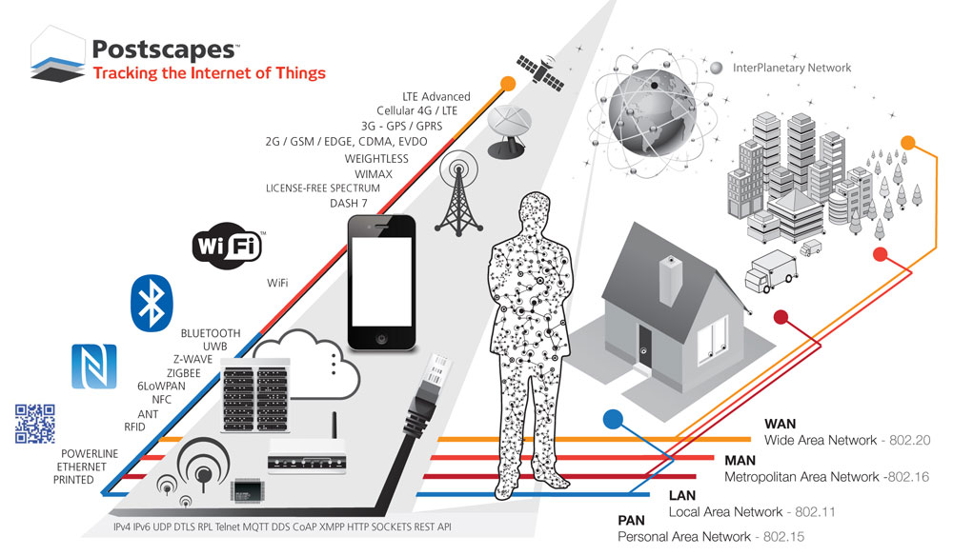
Transportná vrstva
Vybrane protokoly:
PAN: RFID, Bluetooth, Zigbee, UWB
LAN: WiFi
WAN: LoRaWAN, LTE/GSM, Nb-IoT
Notes:
The transport layer transfers sensor data from the perception layer to the processing layer and vice versa via networks such as Bluetooth, wireless, 3G, LAN,(Near Field Communications), NFC, and RFID.

Slide 12
Procesná vrstva
Potrebujeme spracovanie signal, sum
Data pre UI, notifikacie
Notes:
The processing layer is also referred to as the middleware layer. It can store, analyze, and process large quantities of transportation data. Also, it can manage and provide a variety of lower layers of services. It uses many technologies, such as databases, cloud computing, and big data processing modules.

Slide 13
Aplikačná vrstva
NodeRed
Notes:
The application layer is responsible for providing the user with specific application services. It defines different applications for the IoT, such as smart homes, smart cities, and intelligent health.

Slide 14
Biznis vrstva
Monitoring ovzdusia:
Sledovanie ovzdusia v sklenníku
Notifikácia
Monitoring stavu naplnenosti odpadových nádob:
Sledovanie stavu naplnenosti odpadových nádob
Časový priebeh napĺňania odpadových nádob
Notigfikácia
Notes:
The entire IoT system is managed by the business layer, including applications, business and business models, and user privacy [18].

Slide 15
Navrh technického riešenia zadania

Slide 16
Senzory
Senzor 1,2
Notes:
The perception layer is the physical layer with environmental information sensors. In the environment, some physical parameters are sensed, or other intelligent objects are identified.

Slide 17
Transportná vrstva
LoRa GW
Notes:
The transport layer transfers sensor data from the perception layer to the processing layer and vice versa via networks such as Bluetooth, wireless, 3G, LAN,(Near Field Communications), NFC, and RFID.

Slide 18
Procesná vrstva
LoRaWan
Notes:
The processing layer is also referred to as the middleware layer. It can store, analyze, and process large quantities of transportation data. Also, it can manage and provide a variety of lower layers of services. It uses many technologies, such as databases, cloud computing, and big data processing modules.

Slide 19
Aplikačná vrstva
NodeRed
Notes:
The application layer is responsible for providing the user with specific application services. It defines different applications for the IoT, such as smart homes, smart cities, and intelligent health.

Slide 20
Biznis vrstva
Monitoring ovzdusia:
Sledovanie ovzdusia v sklenníku
Notifikácia
Monitoring stavu naplnenosti odpadových nádob:
Sledovanie stavu naplnenosti odpadových nádob
Časový priebeh napĺňania odpadových nádob
Notigfikácia
Notes:
The entire IoT system is managed by the business layer, including applications, business and business models, and user privacy [18].

Slide 21
Návrh postupu

Slide 22
Postup budovania
Senzory simulacia
Fyzicke senzory
System
GW
Pripojenie sensory
TTN
UI
Dokumentacia
Notes:
Priority:
Time-series storage: dolezite v pripade narocnych streamov
Rules engine: v pripade potreby uzivatelskeho riadenia spracovania dat
REST APIs, microservices, Application and user management: individualny pristup pre jednotlive U/C, nasledne postupne budovanie generickej funkcnosti podla potreby
Ostatne su kriticke

Slide 23
Predpokladane zdroje
Senzory: 1,2
RPi
LoRa GW
Prístup TTN
Node-Red

Slide 24
Nasleduje implementácia

