Slide 1

Data Project 2 Worldwide Well-being
Youssef Sedra
Alexandra Biddiscombe
William Ambrosetti

Slide 2
Client Question
What influences the wellbeing of a country’s population?
What can each country improve to reach a better quality of life?
What would be the best country to move to, when ready to settle down and have children?

Slide 3
Data Source
What we chose, why, how, when, where, age
The datasets we chose represent data from the WHO, found on Kaggle at “World Health Statistics 2020|Complete|Geo-Analysis” (https://www.kaggle.com/datasets/utkarshxy/who-worldhealth-statistics-2020-complete).
The data we chose is separated into many different files, each of which only contains only one or two different features describing the state of the world, divided by country and by year. To use data like this, we need to determine which are the most relevant features for our research questions and how to evaluate them.
We took 22 of the 39 available (mostly based around medical idea)
(also used world happiness report (https://data.worldhappiness.report/table))

Slide 4
Dataset Exploration
No of features, amount of data
Years between 1962 and 2019
200 countries
= (2019 – 1962) * 200 = 11’400
22 features

Slide 5
Data Cleaning
Rows and features removed etc
Started by dividing features into outcome and explanatory features:
11 outcome features, 11 explanatory features
Removed years with too many missing values (everything before 2000)
Then, removed features with too many missing values (anything with 3000 or more NA)
What’s left: 4’020 rows, 16 columns (6 outcome, 10 explanatory)

Slide 6
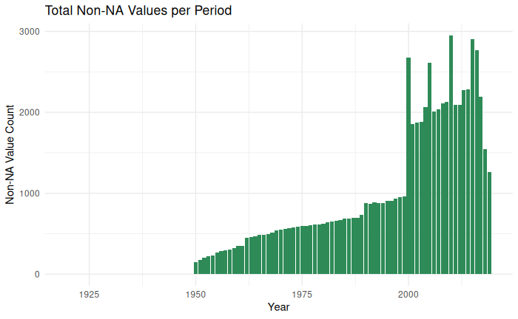

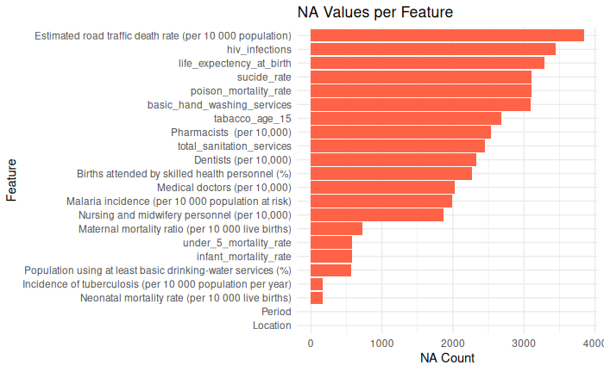

Slide 7
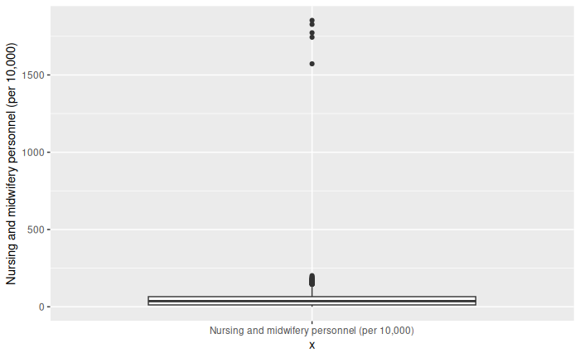
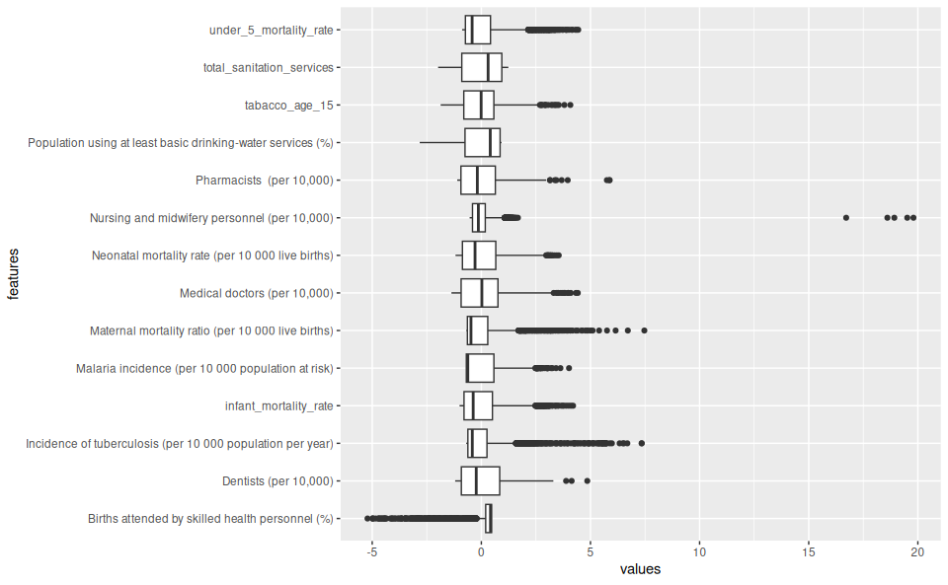
Anomaly Detection and Exploration

Slide 8
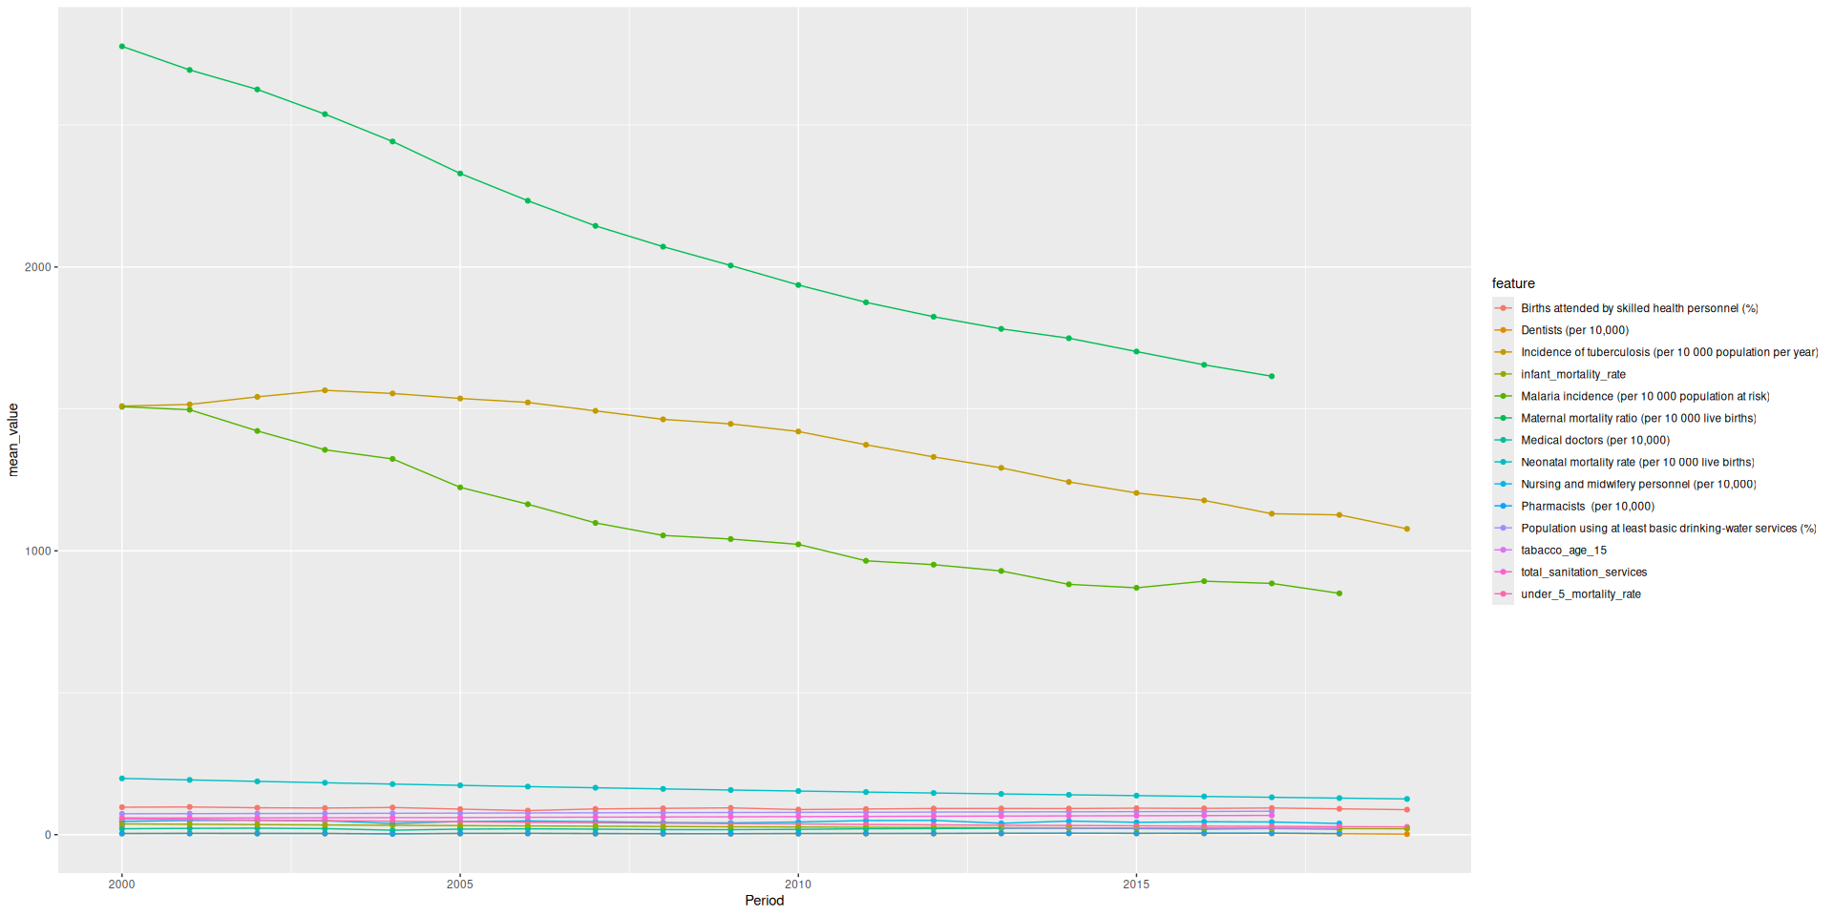
Exploratory Data Analysis

Slide 9
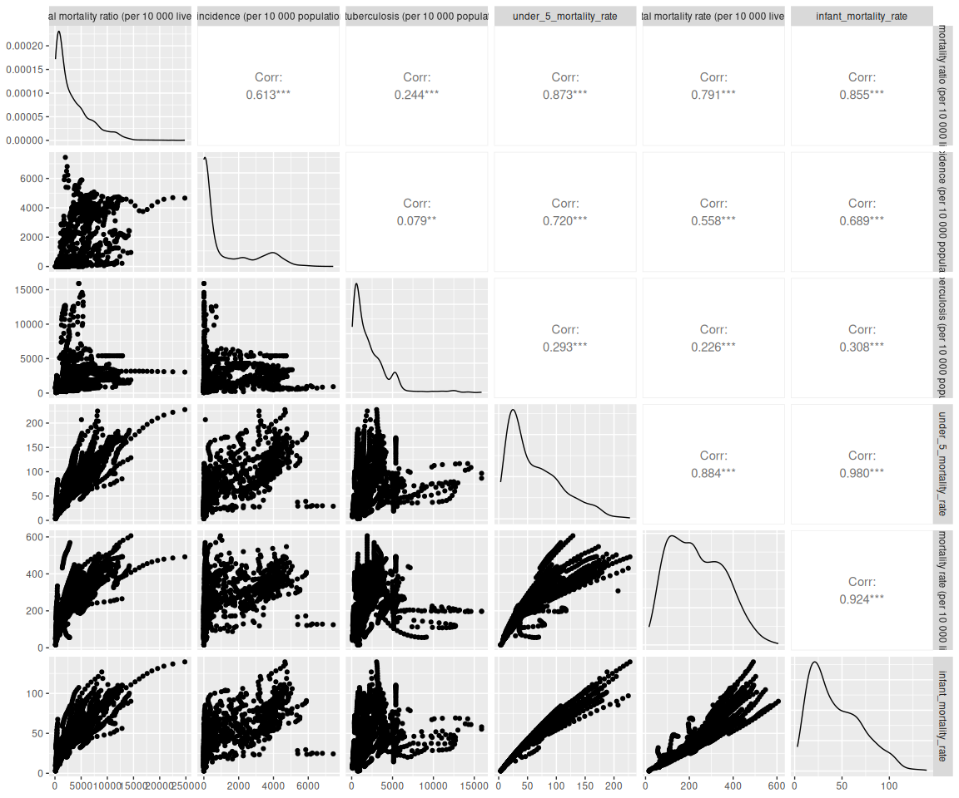
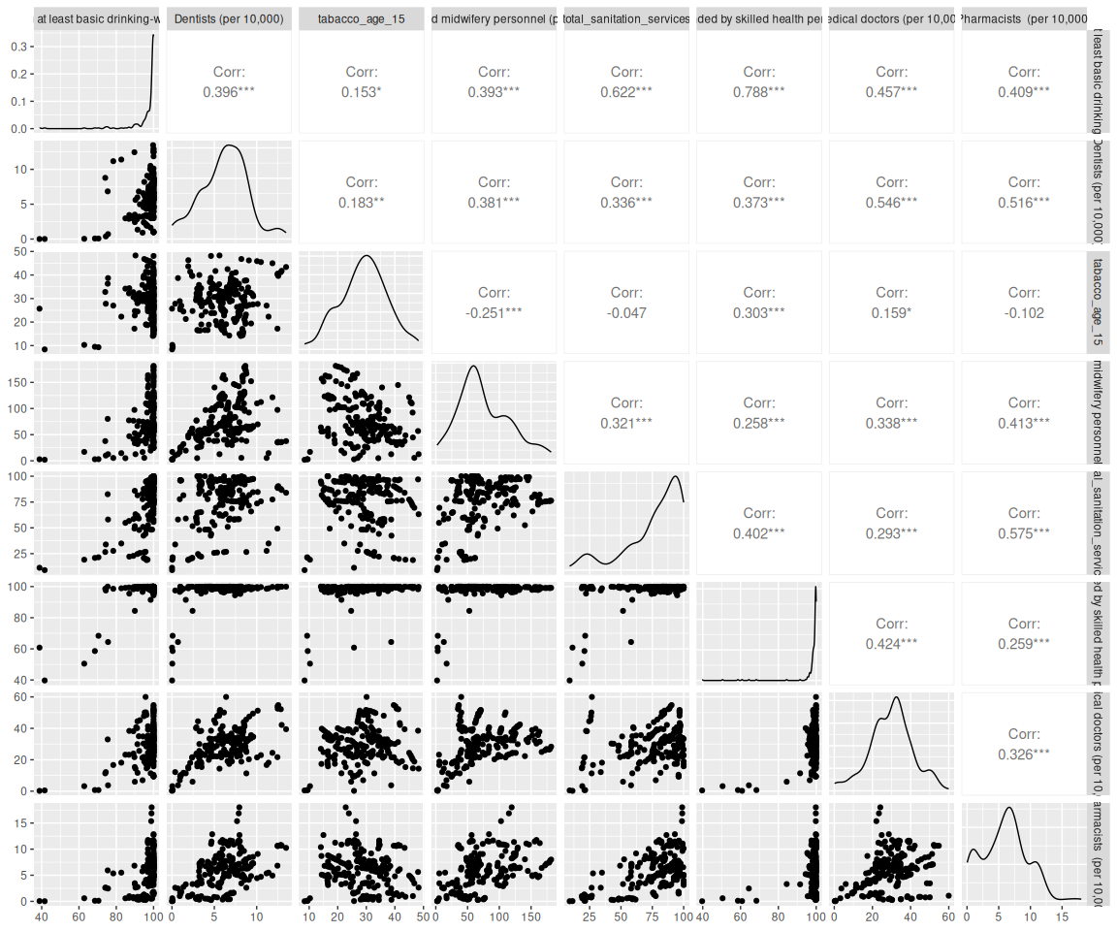
Correlation Analysis

Slide 10
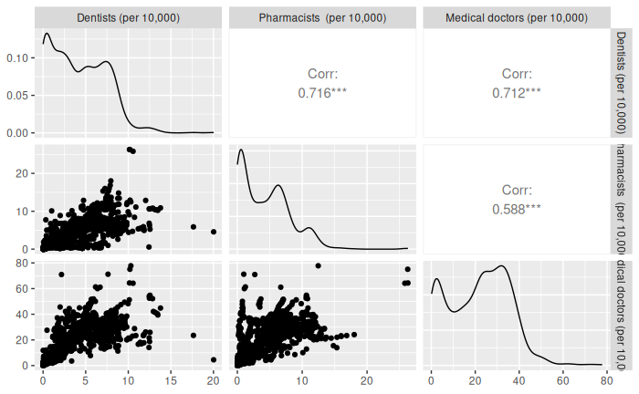
Choice of Features / Outcome
Maybe an animation that shows the whole plot and then zooms into the top
We found the best features to use for evaluations by looking at the top 10 happiest countries and using their feature values to judge the other countries. Infant mortality seems to be the most important
Included another plot to show that there are some countries above the “top 10” values
Also correlation between more features we expect to be similar

Slide 11
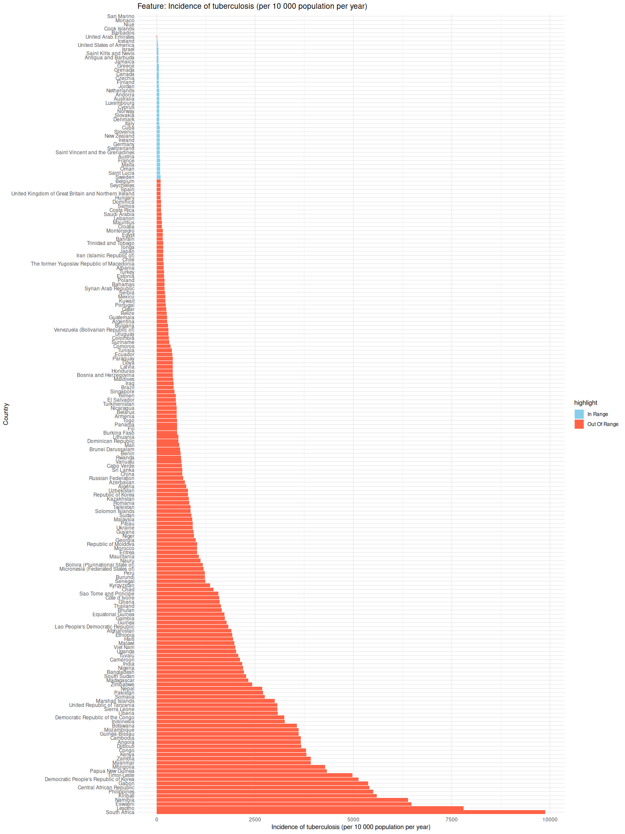
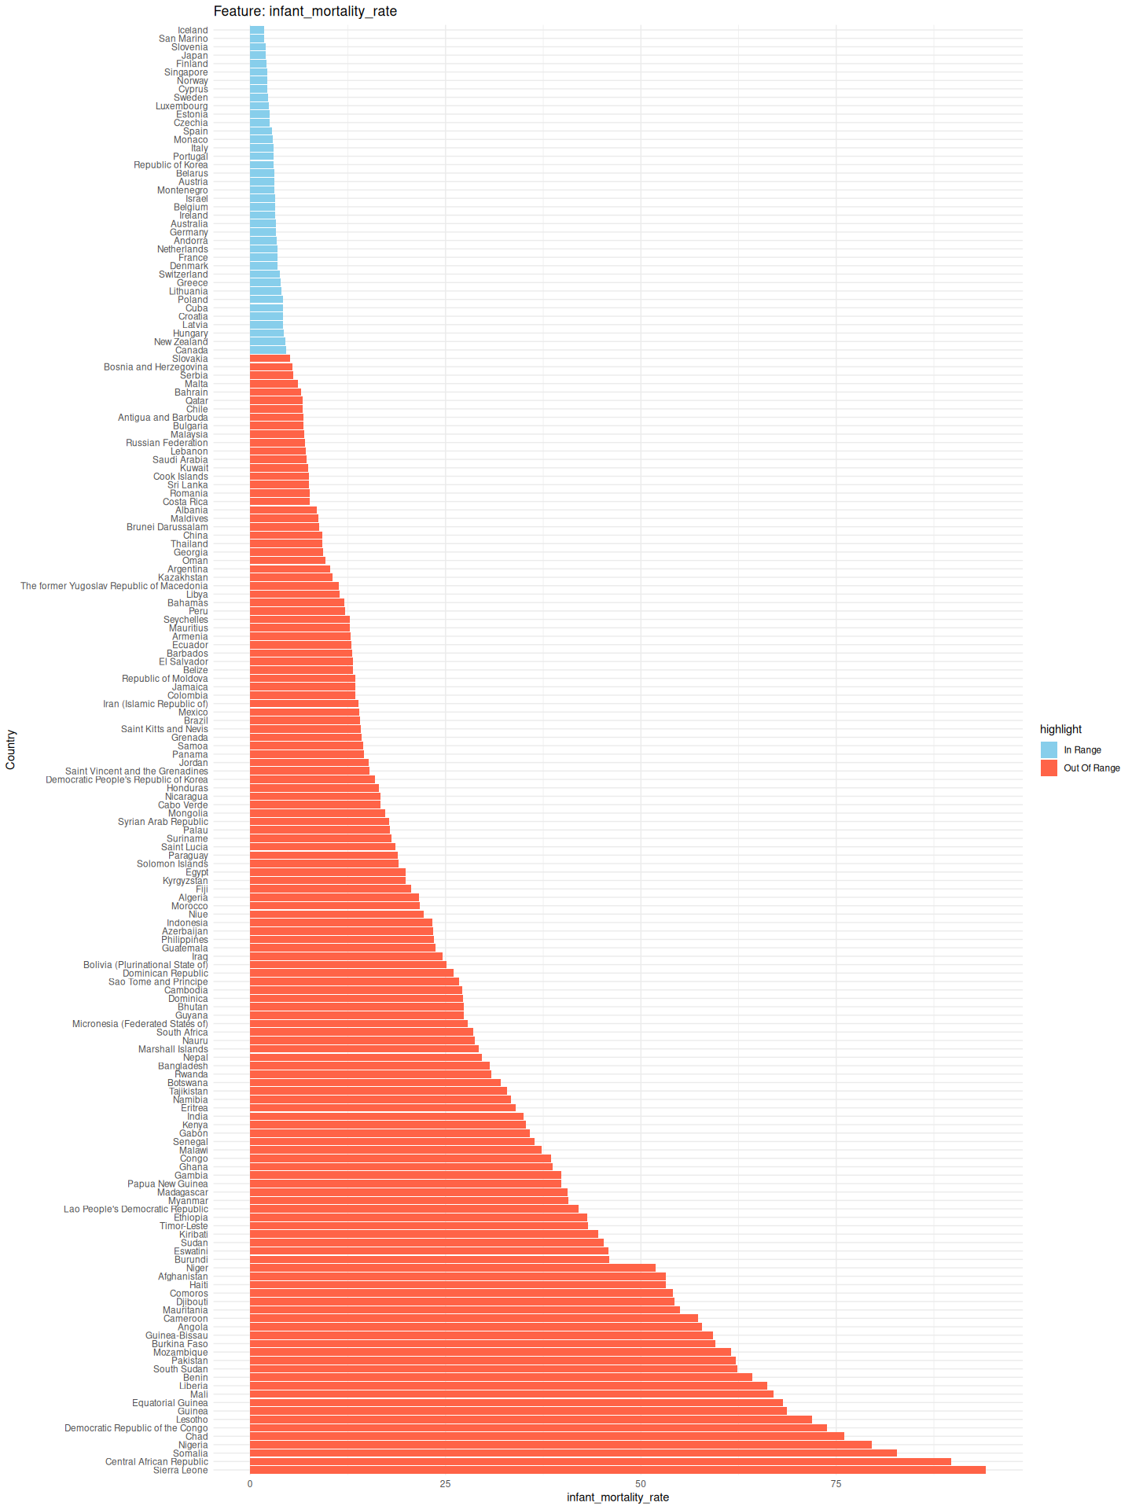

Slide 12
Model Training
Choice of models
For regression: predictint infant mortality, models: knn, lasso regression, linear regression, random forest, xgboost
For classification: tuberculosis classification, models: knn, random forest, lasso regression (binary), xgboost

Slide 13
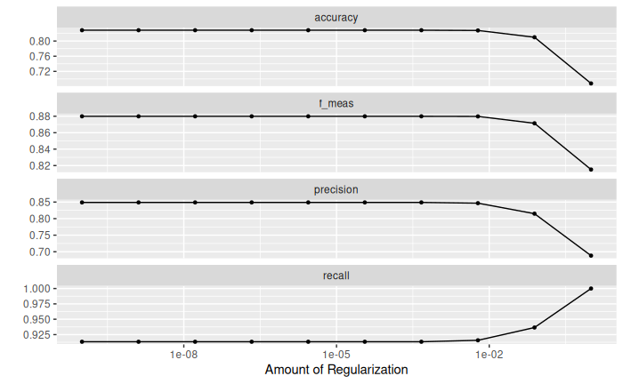
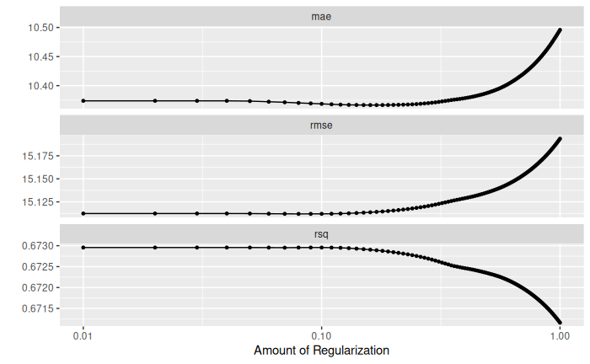
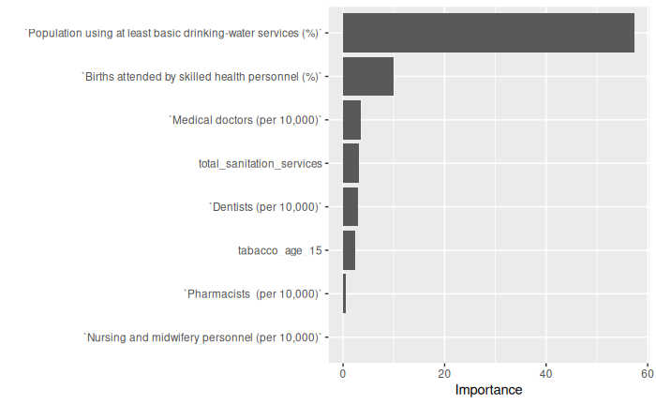
Linear regression model

Slide 14
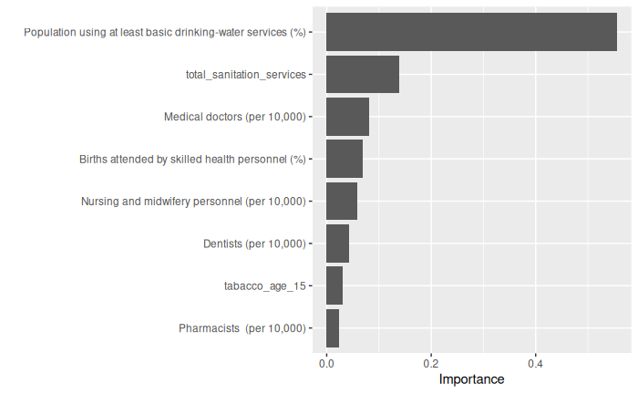
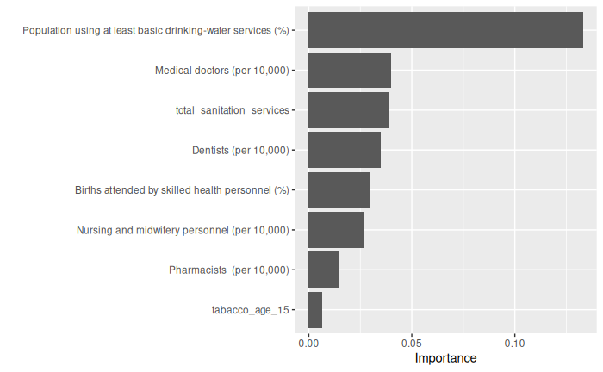
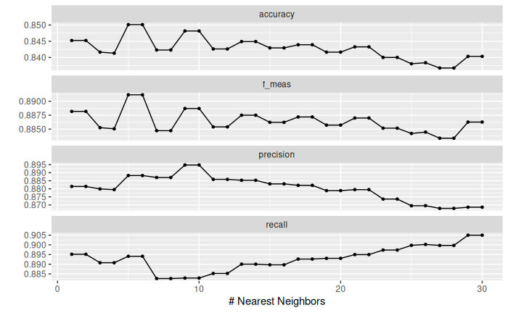
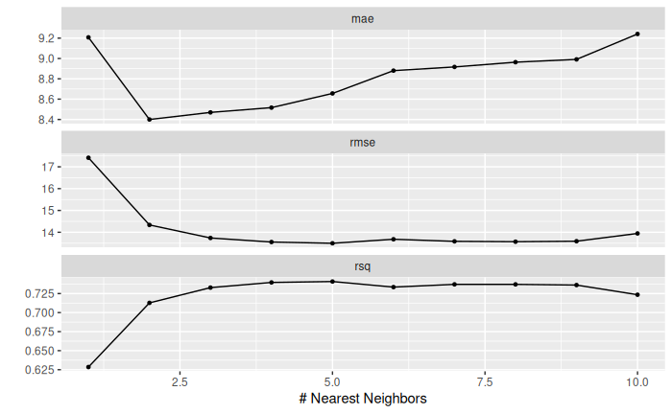
Classification images

Slide 15
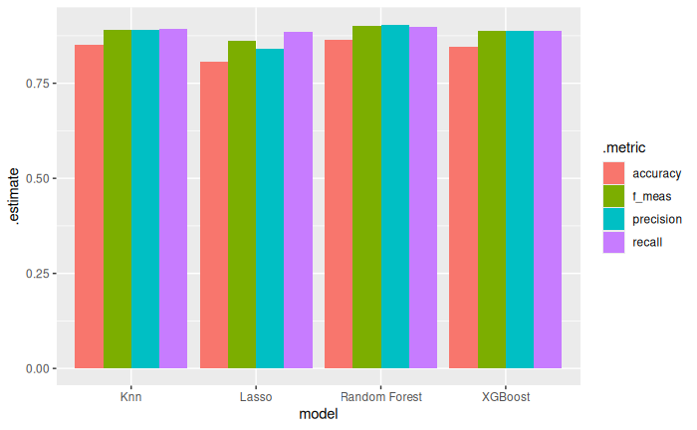
Models Comparison for TB

Slide 16
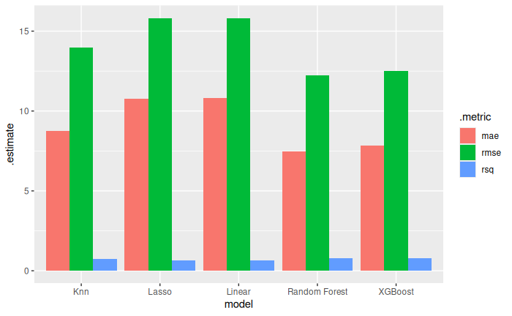
Models Comparison for IMR

Slide 17
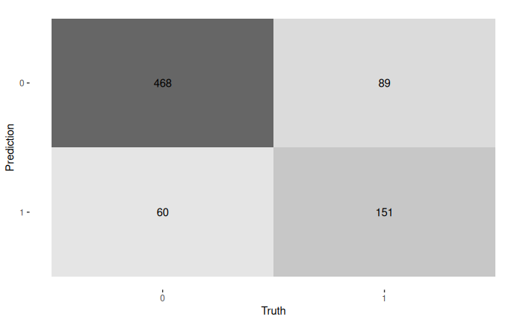
True Positives, False Positives and which we prioritize

Slide 18
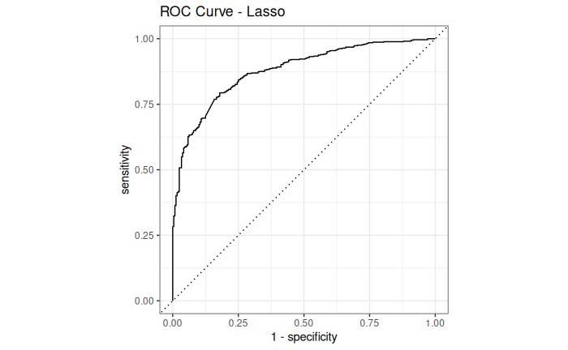
Model Accuracy

Slide 19
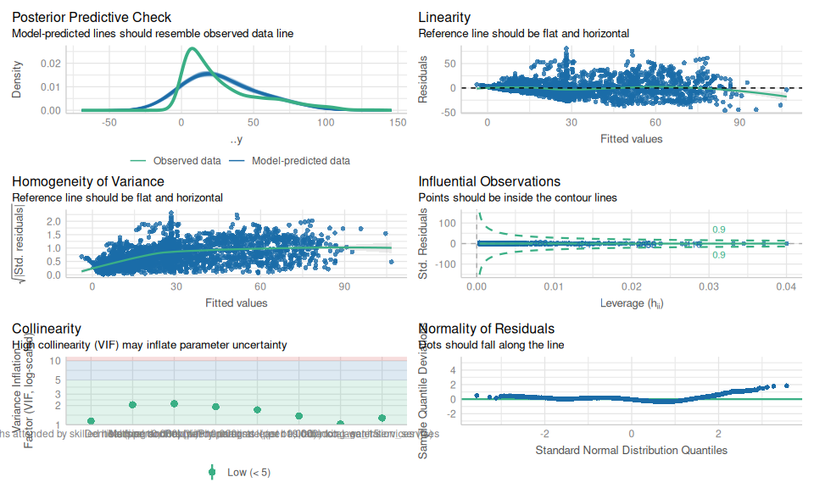
Check_Model()

Slide 20
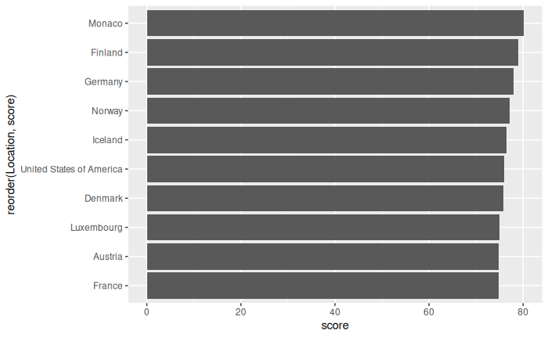
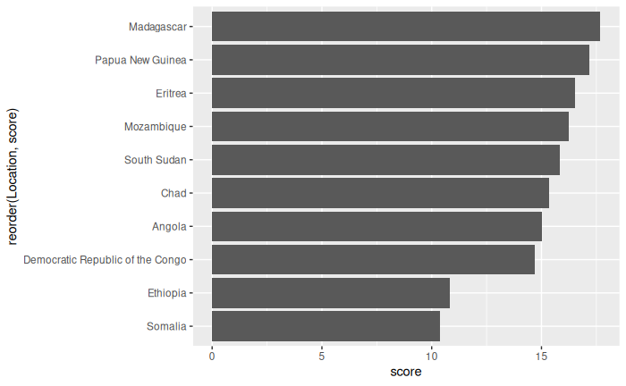
How to Answer Question
Feature weight etc

