Slide 1
Local Data Intro to Unionville Neighborhood- Intro Assets & Challenges Inventory
Will Finkelstein, MUP1
UP 494: Neighborhood Analysis
4 May, 2021

Slide 2
Points Today
Macon, Georgia Intro
Questions to Consider
Geographies of Comparison
Limitations
Findings
Analytical Solutions
Next Steps

Slide 3
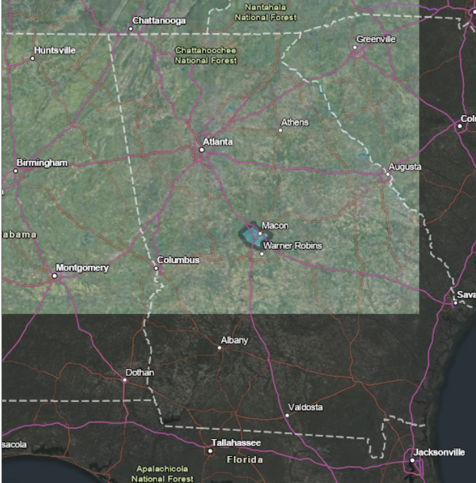
About Macon
Fourth Largest in Georgia (~150k)
Proud of Preservation/Southern Rock History
Consolidated in 2014 to Conserve Resources
hasn’t really panned out that way
Source: (ESRI, 2021)

Slide 4
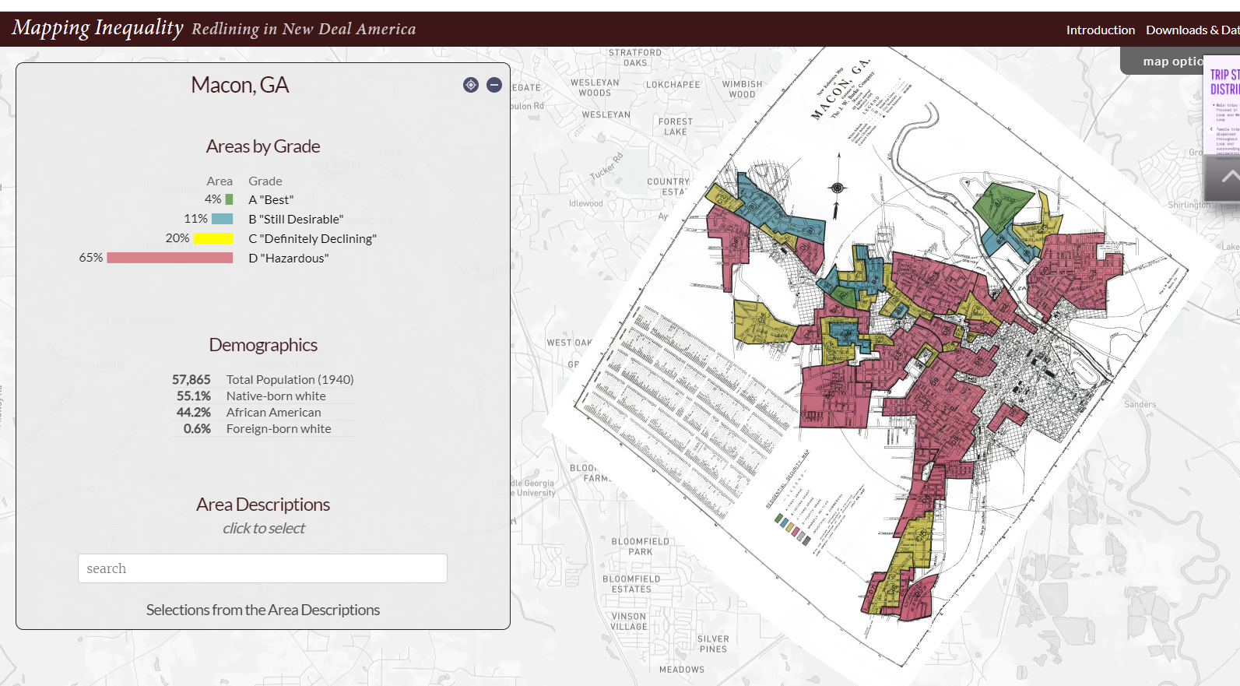
(Source: University of Richmond, 2021)

Slide 5
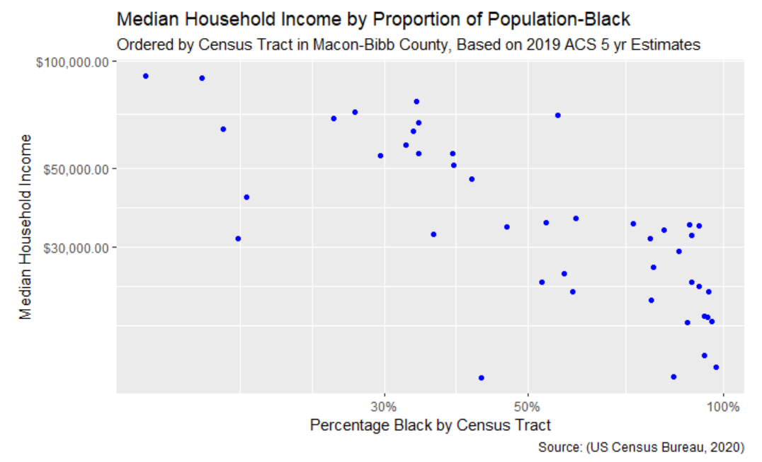
Follows Expectation?

Slide 6
Questions
Does there appear to be correlation between property neglect complaints and crime rates in three District 5 neighborhoods?
What do variables tell us about community health?

Slide 7
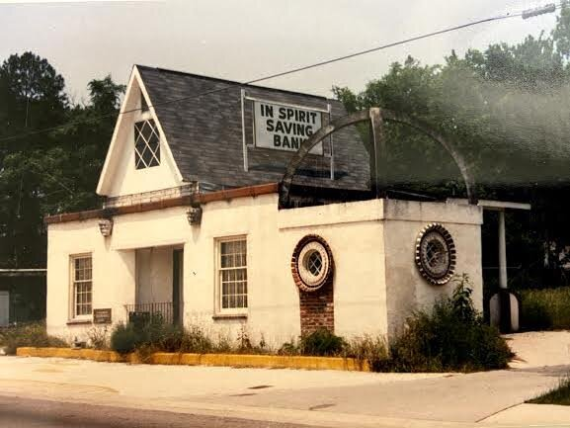
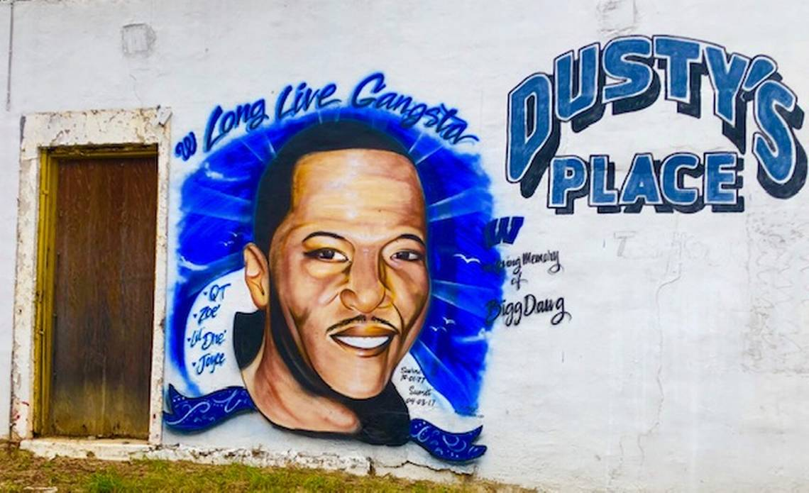
About Unionville
Source: (Vorhees, 2019)
Source: (Brown, 2021)

Slide 8
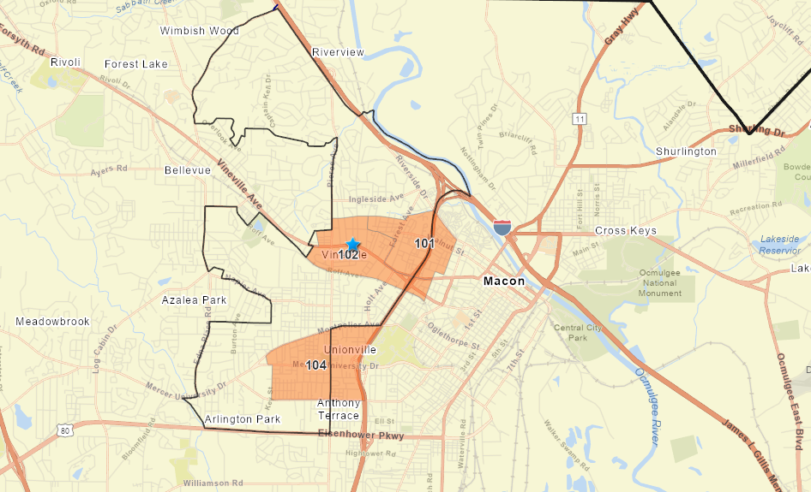
Comparison Tracts
Source: (ESRI, 2021; Atlanta Regional Commission, 2020; Nabhan, 2018)

Slide 9
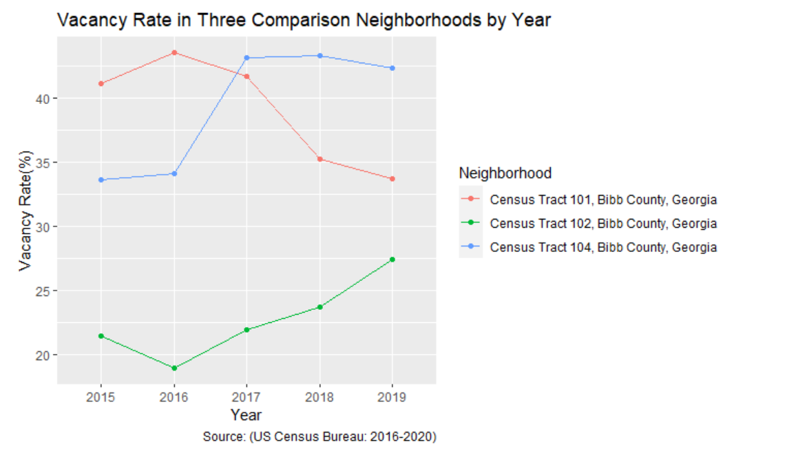
Vacancy (Best Relator to Blight)

Slide 10
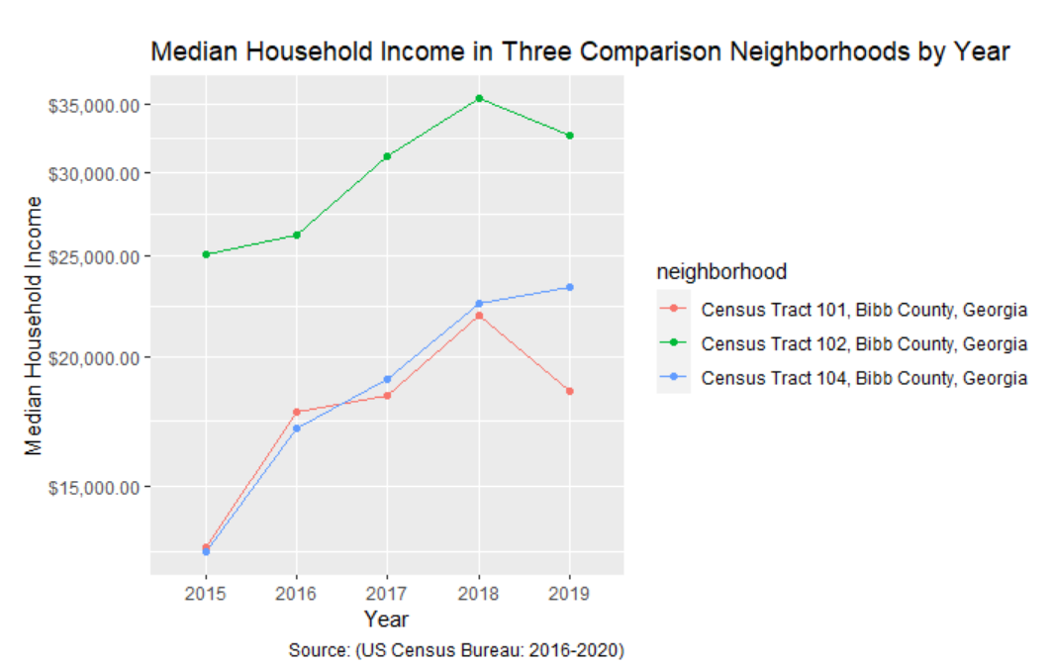
Area Median Income (Depends on Tenant)

Slide 11
Limitations
Resources of a Small Municipal Government- Data and Service
Unclear Boundaries
Stories Can’t Be Quantified

Slide 12
Crime
2/7 homicides in Unionville
Pleasant Hill had 4 arsons
Vineville mainly automobile robberies
Neighborhood | Events | Total In Region
U | 87 | 12.7%
PH | 69 | 10.1%
V | 48 | 7.0%
District 5 | 682 | 100%
Source: (Macon-Bibb County Sheriff’s Office, 2021)

Slide 13
See Click Fix
Subscription to Report Community Neglect/Nuisance
Narrowed Down to 17 Types of Events:
-Solid Waste- Dumping
Public Works- Roads, Sewers
Property Maintenance/Code Enforcement- Blight
Neighborhood | Number of Requests | Average Response Time | # Open | % Answered | Average (exc Open Cases
Unionville | 61 | 83.58 | 9 | 85.2% | 34.87
Pleasant Hill | 86 | 121.13 | 24 | 72.1% | 37.12
Vineville | 151 | 79.64 | 15 | 90.1% | 53.34
Source: (Macon-Bibb County Office of Communications, 2021)

